Slide 1

Consumer Staples
Sector Presentation
Anna Burns, Carter Evans, Arthur Ermakov, Zhao Chen

Slide 2
Sector Presentation Recap- Underweight
SIM Weight | S&P 500 Weight from SIM | +/-
7.14% | 4.85% | -1.12%
Conclusion: Given relative sector underperformance against the broader market of the S&P500, right now it is best to keep an underweighting in the consumer staples sector
Overweight:
Food and essentials retailing (Walmart, Kroger) due to strong market position and stable demand.
Select staples producers with pricing power and strong cash flow such as branded alcohol
Underweight:
Tobacco stocks given regulatory and structural challenges.
Household products and personal care where margin pressures are pronounced and consumer preferences shift

Slide 3
Consumer Staples - Valuation Analysis
Relative to SP500 | High | Low | Average | Current
P/E | 1.21 | 0.67 | 0.96 | 0.78
P/B | 1.99 | 1.23 | 1.58 | 1.24
P/S | 0.82 | 0.45 | 0.63 | 0.45
P/CF | 1.52 | 0.75 | 1.11 | 0.78
Cheap relative to SP500 on price, however in current bull market, consumer staples has weak growth and macro conditions favoring growth sectors like technology
P/S, P/B, and P/CF showed the investors have low confidence on its future

Slide 4
Consumer staples - valuation analysis
Company Comparison | P/E | P/B | P/S | P/CF
COST | 51.9230 | 14.2271 | 1.5101 | 22.3100
WMT | 42.3257 | 9.4742 | 1.2376 | 226.8000
KO | 23.5079 | 10.3049 | 6.2617 | 20.2730
PG | 21.5707 | 6.9631 | 4.2803 | 31.1675
KR | 14.7812 | 4.7650 | 0.3091 | 7.5010
These variations demonstrate how business concepts and growth prospects generate valuation disparities in the sector.
Significant premiums due to strong brand equity and defensive positioning

Slide 5
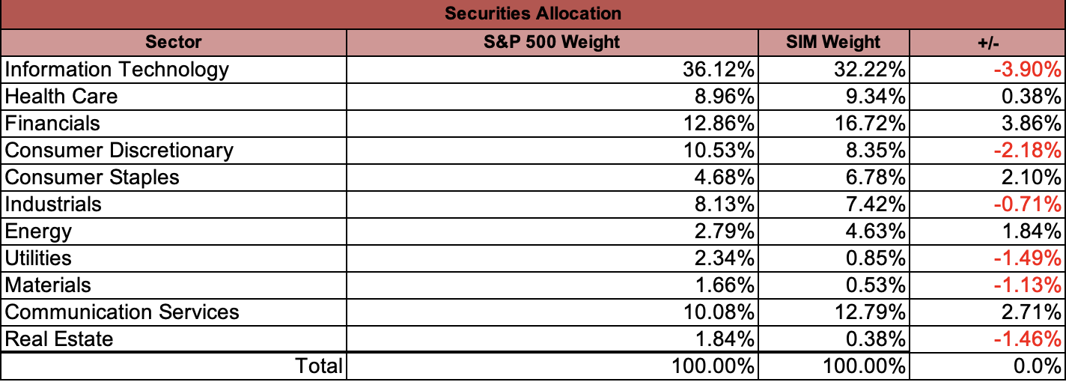
Current Portfolio- SIM allocation
SIM Weight | S&P 500 Weight | +/-
6.78% | 4.68% | 2.10%

Slide 6

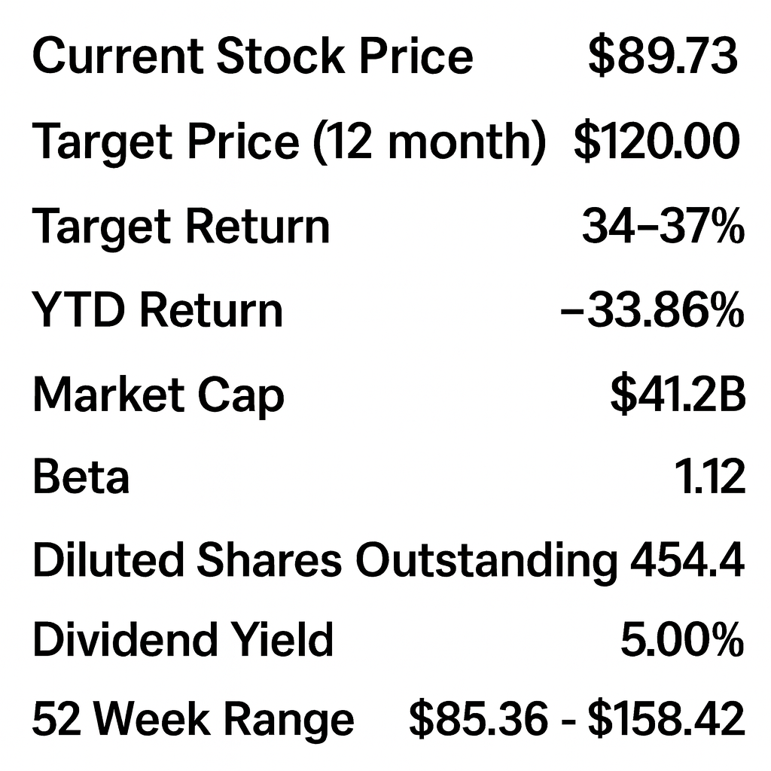
Target- Overview
Operates a nationwide network of discount retail stores offering apparel, home goods, groceries, beauty products, and household essentials
Serves customers across all 50 U.S. states with more than 1,950 stores and a strong digital/omnichannel presence
Headquartered in Minneapolis, Minnesota
Known for its affordable style, popular owned brands, customer-friendly shopping experience

Slide 7
Target- Business Analysis
Key Growth Drivers
Popular store brands like Good & Gather, Up & Up, and Cat & Jack attract loyal shoppers
Strong online and pickup options (Drive Up, Order Pickup, Ship) make shopping easy and fast
Stores across the entire country give Target a huge customer base
Grocery and essentials sales keep customers coming in even when the economy is slow
Updated store layouts and better supply systems help Target run more smoothly
Online sales continue to grow, adding more revenue
Reliable dividend payments make Target attractive to long-term investors
Reasons for Poor Stock Performance
High levels of theft have hurt profits
Customers are spending less on clothes and home items, which hurts key Target categories
Higher labor and product costs make it harder for Target to earn strong profits
Tough competition from Walmart, Amazon, and Costco puts pressure on prices
Economic uncertainty makes people more careful with their money
Investors are unsure because Target has had some uneven financial results
Past inventory problems still worry some investors

Slide 8
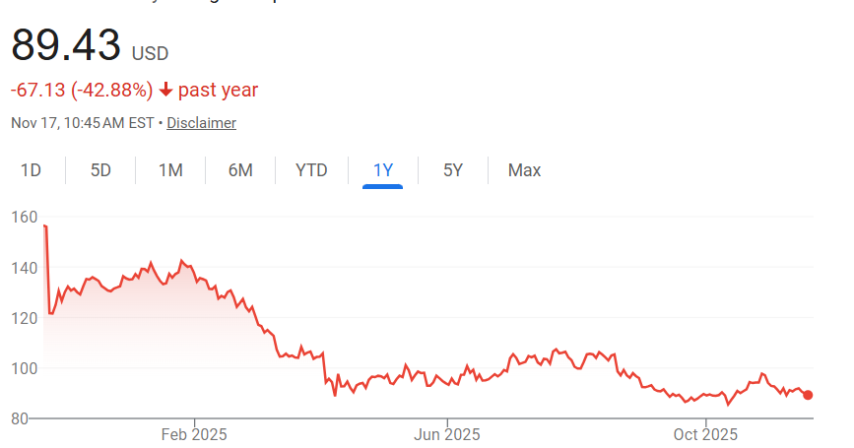
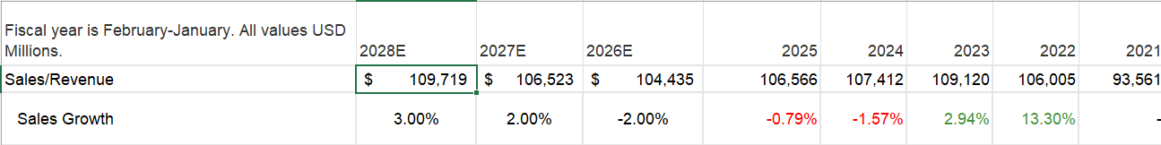
Target- Financial Analysis
Model sales growth rate 3.0%- Consensus believes lower growth
Actual Gross Profit has risen since 2023
Stock price dropped to under $100
EPS outlook decreases slightly
Uncertain outlook in future years

Slide 9
Target - Valuation Analysis
DCF-implied target price is ~$120, offering +34–37% upside from the current ~$89.73
8.0% WACC and 3.0% terminal FCF growth generate a total equity value consistent with long-term recovery expectations
Relative valuation suggests modest multiple expansion, supported by stable grocery/essentials demand and improving inventory discipline
Technical trend shows support in the high-$80s, indicating limited downside if consumer spending softens
Consensus analyst price target: ~$106.11, reflecting moderate confidence in earnings stabilization and long-term margin improvement

Slide 10
Target Recommendation - Hold
Positives
Strong private-label brands that drive loyal customers and higher margins
Reliable omnichannel services (Drive Up, Pickup, Ship) that keep traffic steady
Large essentials/grocery mix that provides stable, recession-proof demand
Risks
New CEO transition creates uncertainty around strategy and execution
Weak discretionary spending slows sales in apparel and home categories
Heavy competition from Walmart, Amazon, and Costco limits pricing power
Why It’s a HOLD
Target has solid long-term strengths, but near-term uncertainty especially around leadership changes and consumer spending keeps upside limited. It’s not weak enough to sell, but not strong enough to justify a buy right now.

Slide 11
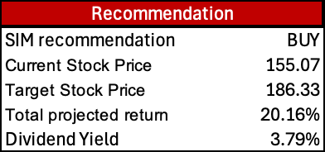
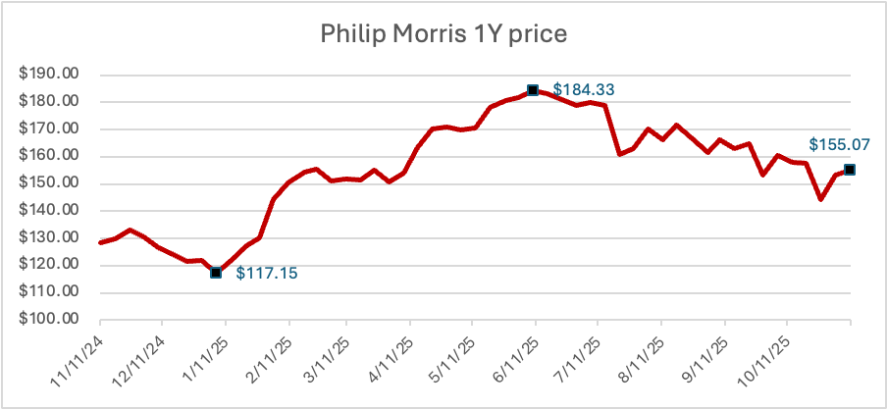
Philip morris- overview
Global tobacco & nicotine company
Sells Marlboro and other leading brands in 180+ countries
244B$ MCAP
Segments:
  Combustibles
  Smoke-free products
Rapidly shifting to smoke-free products (IQOS, ZYN, etc.)
~$38B in annual revenue

Slide 12

Philip morris- Business Analysis
Key drivers:
SFP market expansion (already 41% of revenue & >42% of gross profit)
Category leadership
  76% global share in heated tobacco
  38% in oral nicotine pouches
Brand strength & development
  Premium brands (Marlboro, IQOS, ZYN)
  $14B spent on R&D for new features
Reasons for price fluctuations:
Stock price up 28% YTD
Pullback from ATH:
  Q2 earnings less vs expected
  Q3 $100M spent on ZYN promotions
November bounce back:
  Split into U.S. and International units
  Reports to include Smoke-Free & Combustibles from Q1 2026

Slide 13
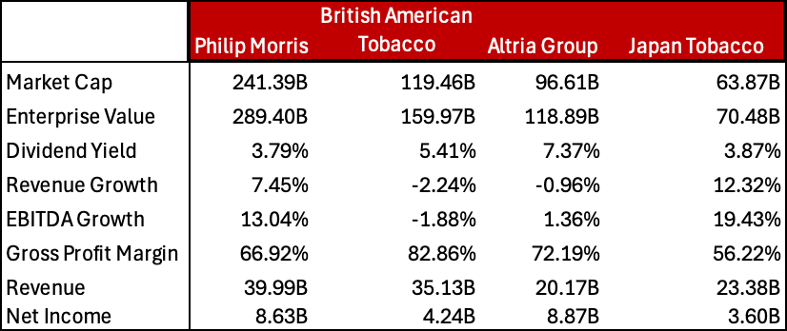
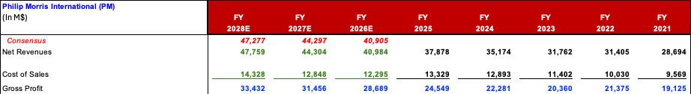
Philip morris- Financial Analysis
Revenue growth in high single digits
Gross Profit continuously rising
EPS projected to double in 3 years
Leader in revenue & mcap compared
to peers
Growth percentages are not industry's best not due to fundamentals but due to premium valuations & priority in reinvestments

Slide 14
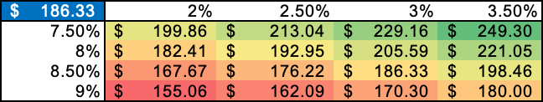
Philip morris - Valuation Analysis
Ticker | P/E | P/S | P/B | P/CF | EV/ EBITDA
PM | 24.25 | 6.48 | - | 24.33 | 18.01
Peers
BATS | 29.71 | 3.55 | 2.00 | 11.72 | 9.13
MO | 12.42 | 5.49 | - | 12.56 | 10.8
2914 | 43.78 | 2.56 | 2.09 | 15.81 | 17.47
ITC | 25.83 | 6.83 | 7.28 | 27.27 | 18.76
Average | 27.2 | 4.98 | 3.79 | 18.34 | 14.83
Median | 25.83 | 5.49 | 2.09 | 15.81 | 17.47
PM trades at premium in most of the multiples vs peers
DCF implies target price of $186.33 or +20.2% upside from the current ~155.07
Sensitivity analysis shows a neutral investment even in a bearish case
8.5% WACC and 3.0% terminal FCF growth in base case
Consensus analyst price target: $188.72, reflecting strong confidence in company leadership and long-term SFP expansion

Slide 15
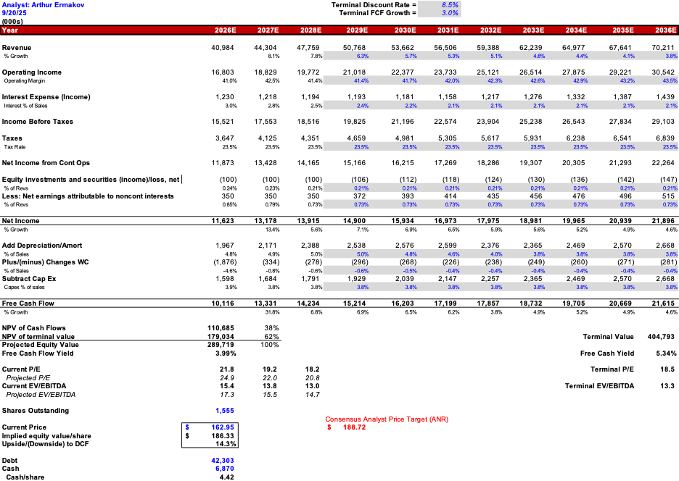
Phillip Morris DCF
WACC = 8.5%
Terminal FCF Growth = 3%

Slide 16
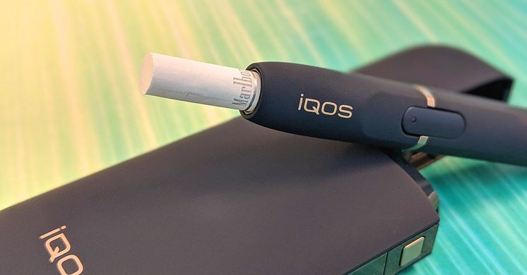
Philip morris Recommendation - BUY
Smoke-free product market expanding
PM is the leader in all of its categories
Sales growing high single digits
FDA approvals helping the company

Slide 17
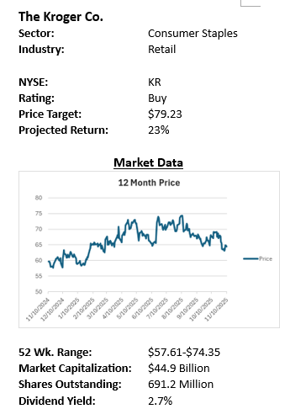
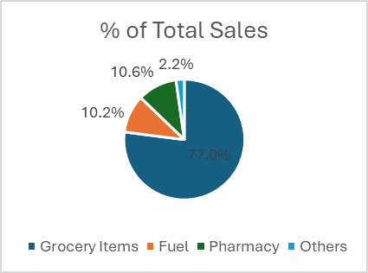
KROGER- OVERVIEW
Founded in 1883; headquartered in Cincinnati, Ohio
Target Price: $64.44
One of the largest grocery retailers in the U.S

Slide 18
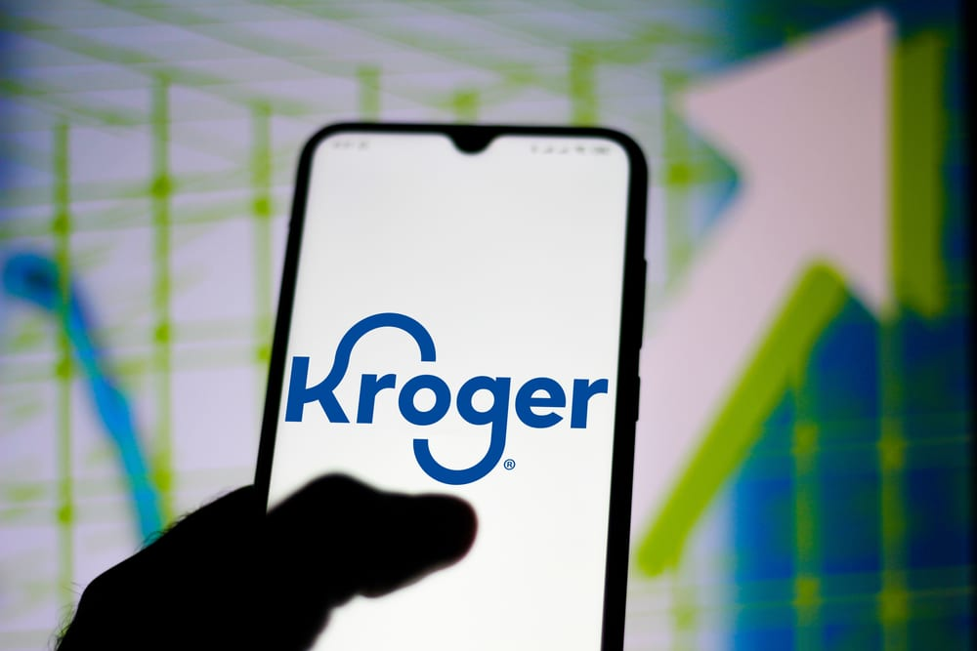
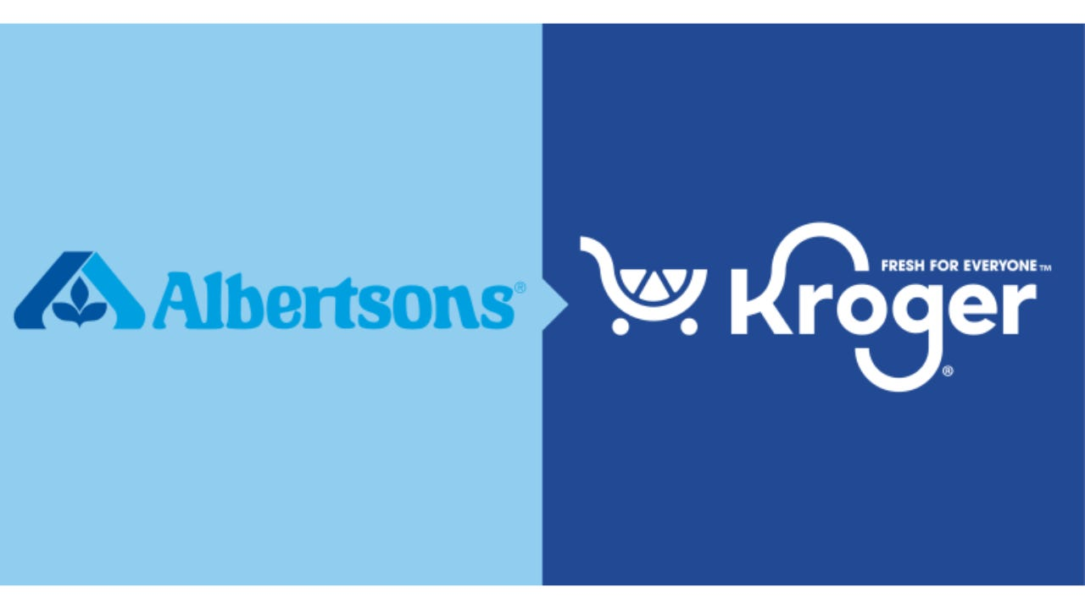
KROGER- Business Analysis
Growth Drivers
Undervalued vs peers with stable cash flows
Private-label + digital initiatives expand margins
Loyalty data enhances pricing & retention
Risks
Intense pricing competition limits margin expansion
Higher labor and operating costs pressure profitability
Kroger’s weaker performance is largely due to the blocked Albertsons merger, which removed expected cost synergies and created regulatory uncertainty

Slide 19
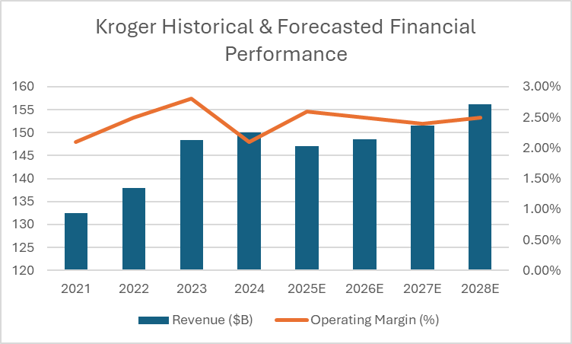
KROGER- Financial Analysis
Revenue remains stable with modest growth through 2028E, reflecting resilient demand in the grocery sector.
Operating margins hold around ~2.5%, showing solid cost discipline despite labor and logistics pressure
Ticker | P/E | P/S | P/B | P/CF
KR | 14.7812 | 0.3091 | 4.7650 | 7.5010
Average | 26.97 | 0.87 | 7.66 | 17.69
While the sector trades at elevated multiples, Kroger remains at a meaningful discount due to slower growth and margin pressure

Slide 20
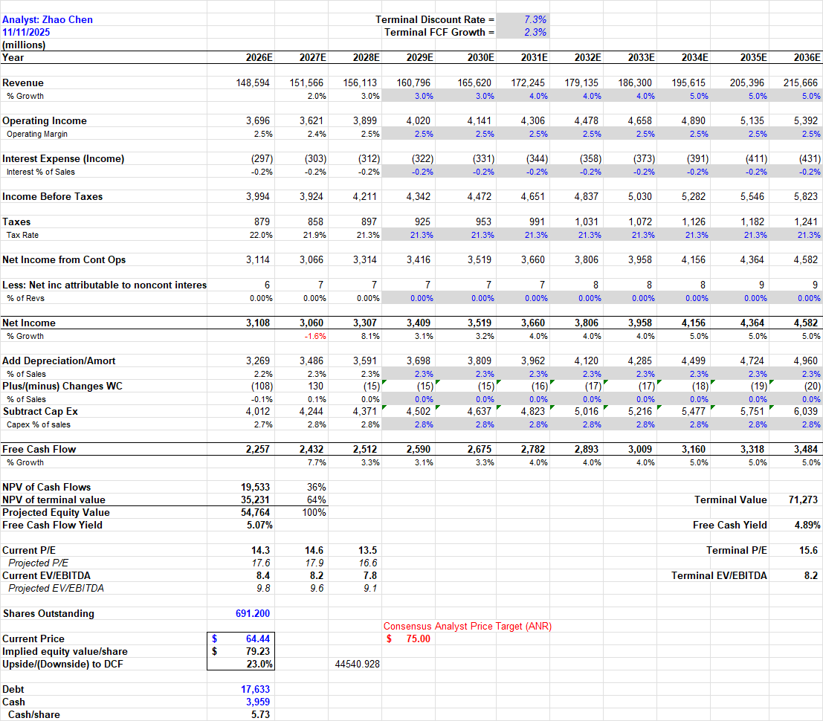
Kroger - Valuation Analysis
DCF-implied target price is $79.23, offering +23% upside from the current $64.44
7.3% WACC and 2.3% terminal FCF growth yield a total equity value of $54.8B
Relative valuation suggests future multiple expansion, supported by stable margins, strong cash flow, and below-market trading multiples
Technical trend shows steady long-term support around the low $60s, consistent with limited downside risk

Slide 21
Kroger Recommendation - Buy
Why Buy?
Meaningful valuation discount vs peers
Stable revenue and consistent 2.5% operating margin
Strong private-label margin expansion, digital growth, and loyalty data (84.51°) driving long-term cash flow
DCF-implied value of $79.23/share suggests attractive upside
Risks
Pricing pressure from Walmart, Costco, Target, and Aldi could limit margin expansion
labor and logistics cost inflation may weigh on earnings
Regulatory uncertainty following the blocked Albertsons merger removes expected synergies

Slide 22

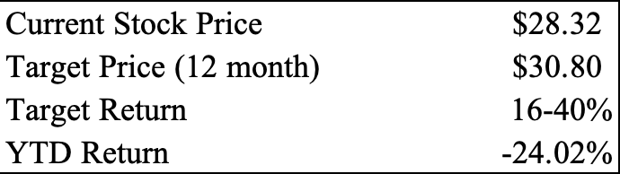
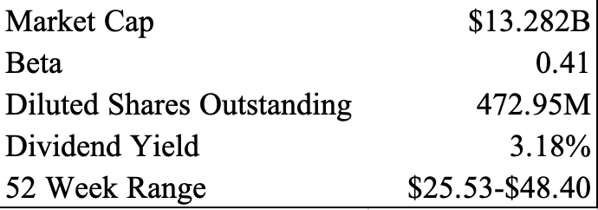
Brown-Forman Overview
Production and distribution of alcoholic beverages including whiskey, tequila, vodka, and wine
Sells products in over 165 countries and is the largest U.S. based spirits company by global sales
Headquartered in Louisville, Kentucky
Well-known brands include Jack Daniel's, Woodford Reserve, Old Forester, Herradura

Slide 23
Brown-Forman Business Analysis
Key Growth Drivers
Iconic brand portfolio gives consumer loyalty and pricing power
Organic sales growth in emerging markets (Brazil and Mexico)
Global expansion for Jack Daniel’s into markets such as India and Mexico
Ready-to Drink segment (Jack & Coke) caters to younger consumers
Extensive global distribution network to bring its premium spirits to consumers worldwide
Strong dividend history gives the stock investor appeal
Reasons for Poor Stock Performance
Tariff uncertainties and retaliatory tariffs from trading partners. (EU and Canada tariffs)
Slow consumer spending in premium category as the younger generation leans towards healthier trends
Cautious company guidance for fiscal 2026 adds to investor anxiety and downward pressure
Higher input costs and foreign exchange impacts pressured gross margins and operating income

Slide 24
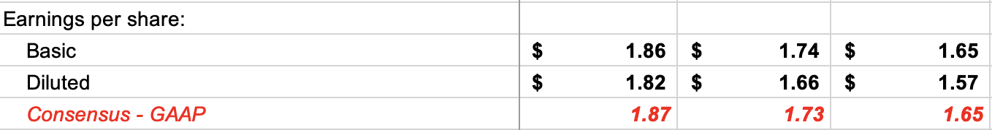
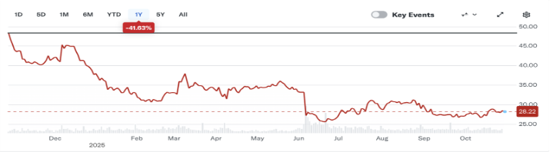
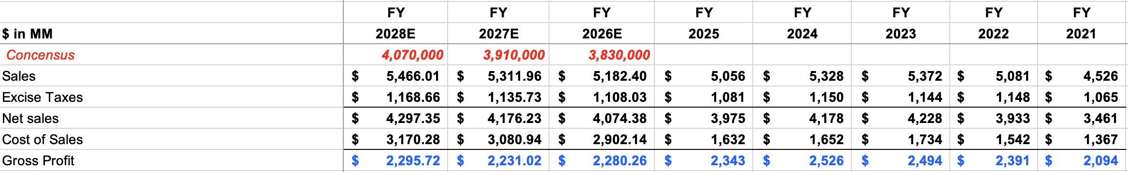
Brown-Forman Financial Analysis
Model sales growth rate 2.5%- Consensus believes lower growth
Actual Gross Profit declining since 2021
Stock price dropped to hovering $28
EPS outlook increases slightly
Uncertain outlook for the future

Slide 25
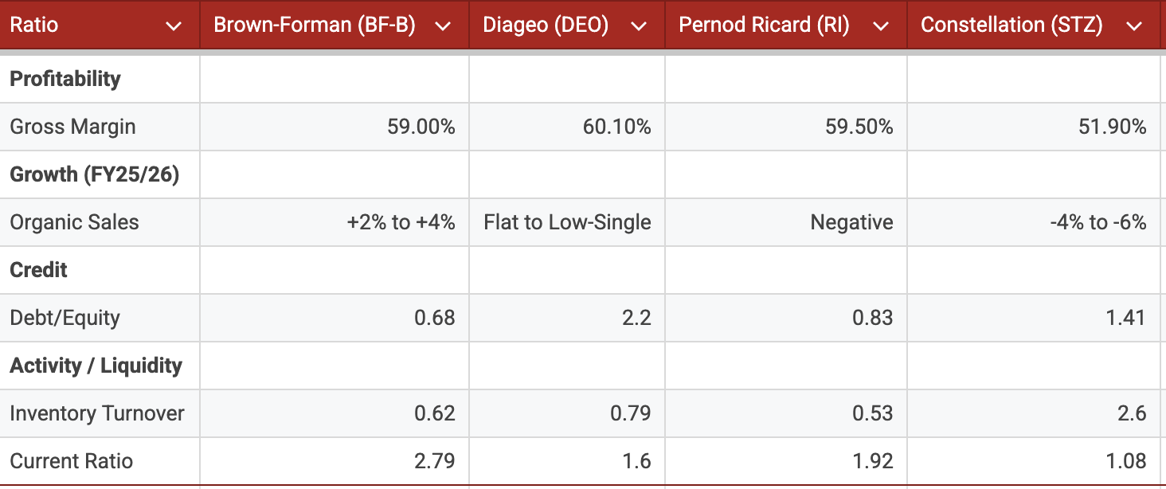
Brown-Forman Ratios

Slide 26
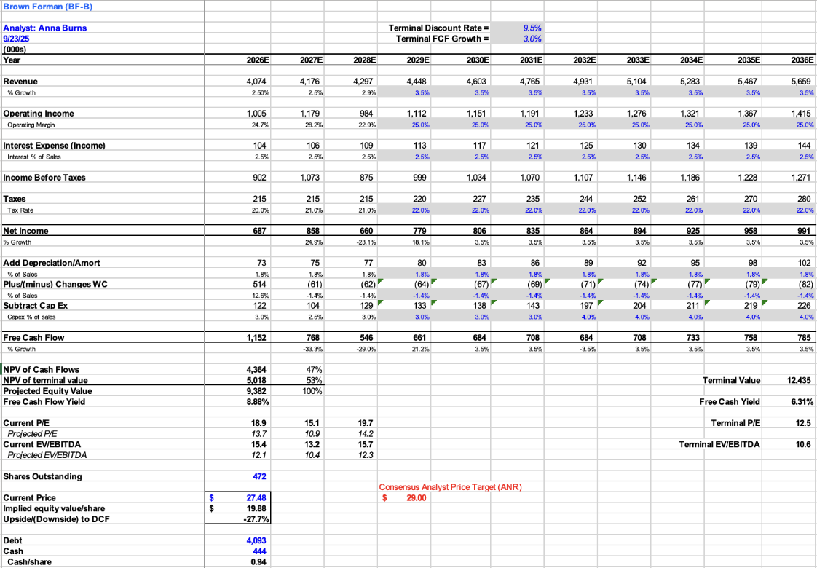

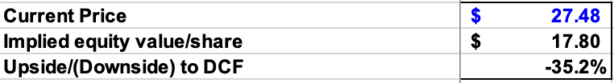
Discount Rate: 9.5% FCF: 3%
Discount Rate: 8.5% FCF: 4%
Discount Rate: 10% FCF: 2.5%

Slide 27
Brown-Forman Multiples & Target Price
Absolute Basis | High | Low | Average | Current
P/E | 44.4 | 14.25 | 31.69 | 15.75
P/B | 3.75 | 3.3 | 3.34 | 3.45
P/S | 3.87 | 3.38 | 3.49 | 3.56
P/EBITDA | 15.54 | 13.45 | 14.5 | 14.54
Absolute Valuation | Current Stock Price | Current Multiple | Your Target Multiple | Target/ Current | Target Price | Implied Return #
P/E | 28.65 | 16 | 17 | 1.06 | 30.36 | 1.06
P/B | 28.65 | 3.34 | 3.45 | 1.03 | 29.59 | 1.03
P/S | 28.65 | 3.56 | 3.2 | 0.89 | 25.6 | 0.89
P/EBITDA | 28.65 | 12.5 | 12.86 | 1.02 | 29.47 | 1.02

Slide 28
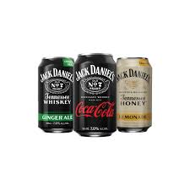

Brown Forman Recommendation- HOLD
WHY?
Consumers are pulling back on high-priced goods, and distributors are cutting back on inventory
New opportunities with RTD products and global expansion
Focused, premium strategy, but it will still be a challenging environment for at least the next 12-18 months
Undervalued
Optimistic future guidance, for now analysts remain uncertain
Execution of plan by Lawson Whiting

Slide 29
Final Recommendation
 | Current Price | Target Price | Expected Return | Recommendation | SIM Weight | Recommended Weighting
Kroger | $64.44 | $79.23 | 23% | Buy | 1.42% | 2.25%
Brown-Forman | $27.85 | $29-30 | 12% | Hold | 1.82% | 0.90%
Phillip Morris | $155.07 | $186.33 | 20.16% | Buy | 1.57% | 2.1%
Target | $89.43 | $120 | 34% | Hold | 0.92% | 0.92%

Slide 30
Questions?

