Slide 1

Consumer Staples
Sector Presentation
Anna Burns, Carter Evans, Arthur, Zhao Chen

Slide 2


Overview
What are consumer staples?
Everyday essentials people keep buying in any economy (food, beverages, household & personal care)
Non-cyclical businesses with demand that’s relatively insensitive to the economic cycle
Typically steadier earnings and lower volatility, often with consistent dividend payouts

Slide 3

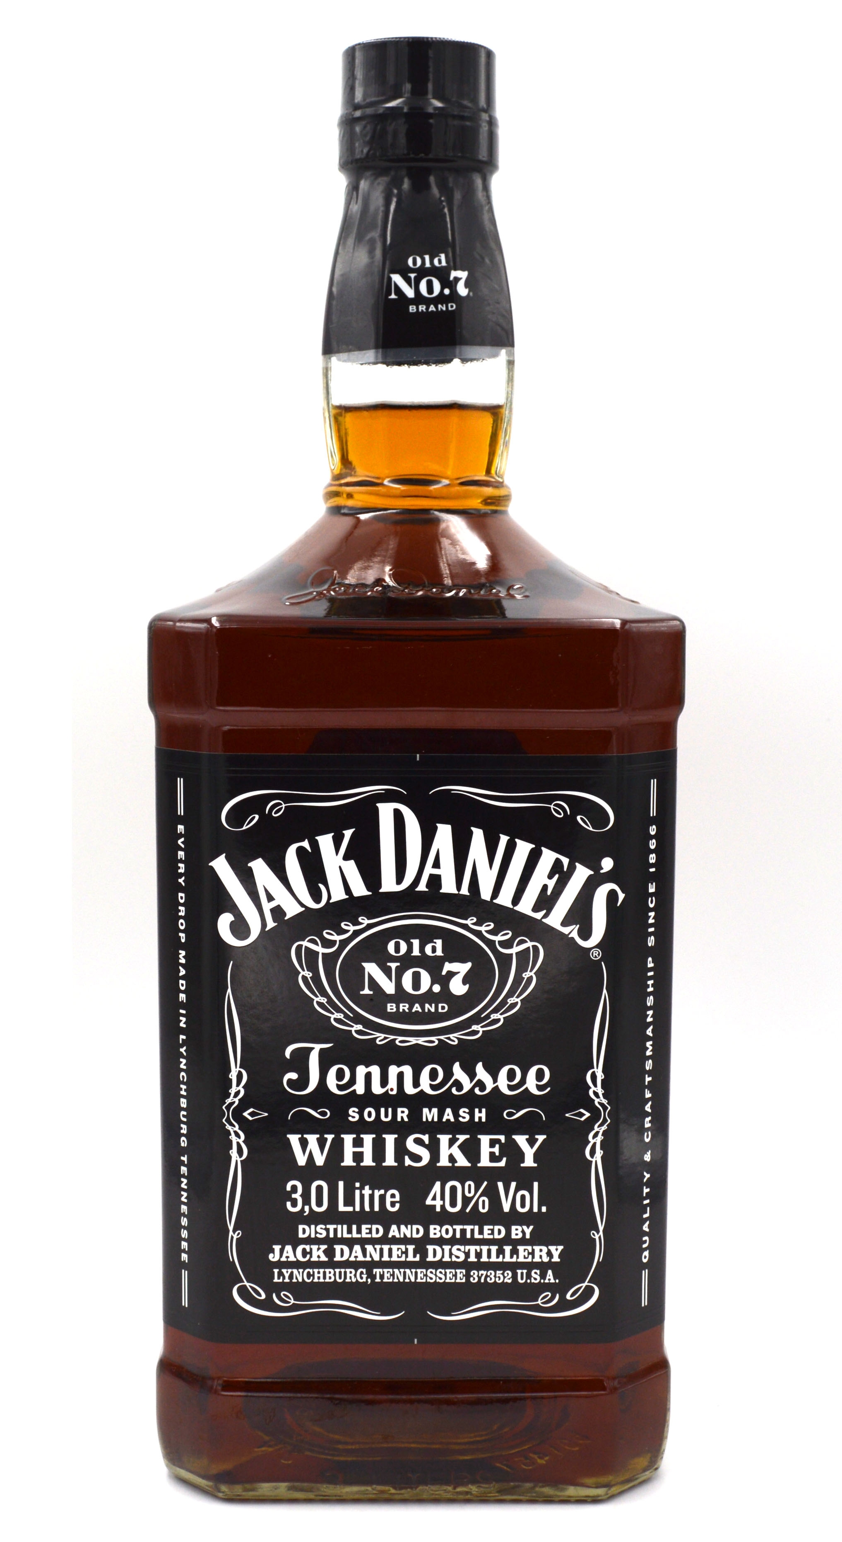



Overview
Number in S&P 500: 37
Total Market Cap: $3.3T
Percent of S&P 500: 4.98%
Average Market Cap: $89.61B
Average Dividend: 3.53%
Beverage
Pepsi
Coca-Cola
Brown Forman
Constellation Brands
Food
Tyson
Hershey
Smucker's
General Mills
Household
P&G
Target
Kroger
Dollar Tree
Personal
Altria
Kenvue
Phillip Morris
Estee Lauder
Source: Bloomberg

Slide 4
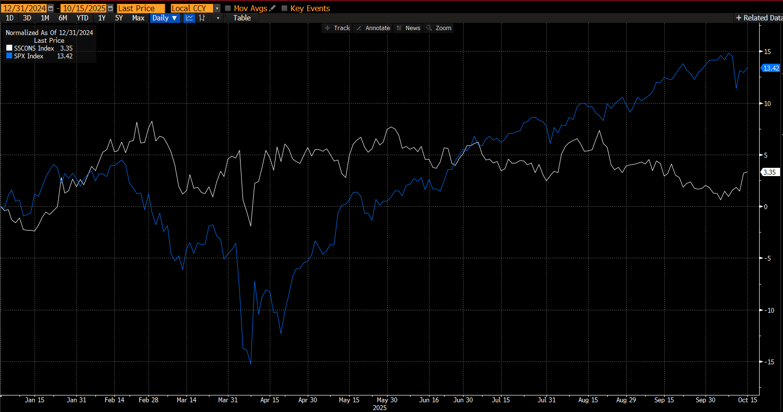
Year-to-Date performance
Source: Bloomberg

Slide 5
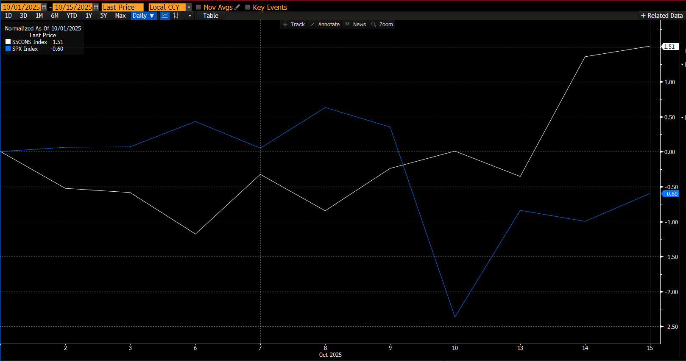
Quarter-to-Date performance
Source: Bloomberg

Slide 6

Demand Analysis
Mature sector with low single-digit organic growth
Economy influence:
  US: real wage growth, inflation, unemployment
  Foreign: EM growth
External factors:
  Regulation (taxes, FDA)
  Input Costs (packaging, energy)
Users are everyday househlolds

Slide 7
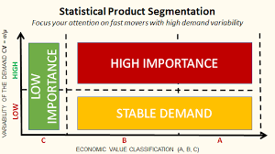
Profitability and Pricing (Market Dynamics)
Stable Demand: Essential goods lead to consistent, inelastic demand even in recessions.
Supply Factors: Costs tied to commodities and logistics can pressure margins.
Product Segmentation: Premium and niche brands earn higher margins; value brands compete on volume.
Notes:
https://www.investopedia.com/articles/fundamental-analysis/09/recession-proof-industries.asp?utm_source

Slide 8
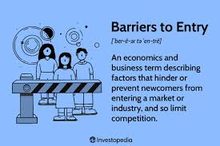
Profitability and Pricing (Industry Structure)
Concentration: Dominated by large global players (P&G, Nestlé, Unilever) with strong scale advantages.
Ease of Entry: High barriers from branding, distribution, and regulation; e-commerce slightly lowers entry costs.
Customer/Supplier Power: Retail giants hold strong leverage; suppliers have moderate power.

Slide 9
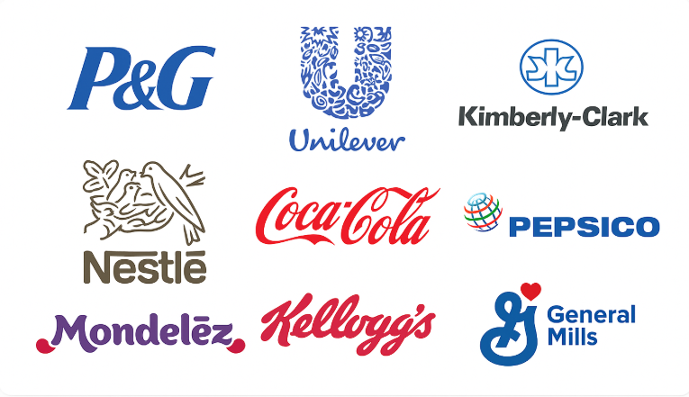
Profitability and Pricing (Competition & Profitability Drivers)
Competition: Intense brand rivalry and private-label pressure limit pricing power.
Substitution: Low for essentials but moderate within categories (e.g., soda, flavored water).
Profitability: High volumes and brand strength drive stable margins; innovation and premiumization boost returns.

Slide 10
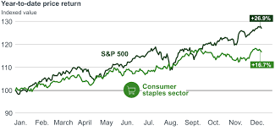
Economic Analysis
Low Economic Sensitivity: Demand remains steady across business cycles due to essential nature of products.
Weak Correlation: Consumer Staples show low correlation with GDP growth, inflation, and employment trends compared to cyclical sectors.
Regression Insight: Economic variables (like consumer income or inflation) have limited impact on sales staples are defensive stocks with stable earnings even in downturns.

Slide 11
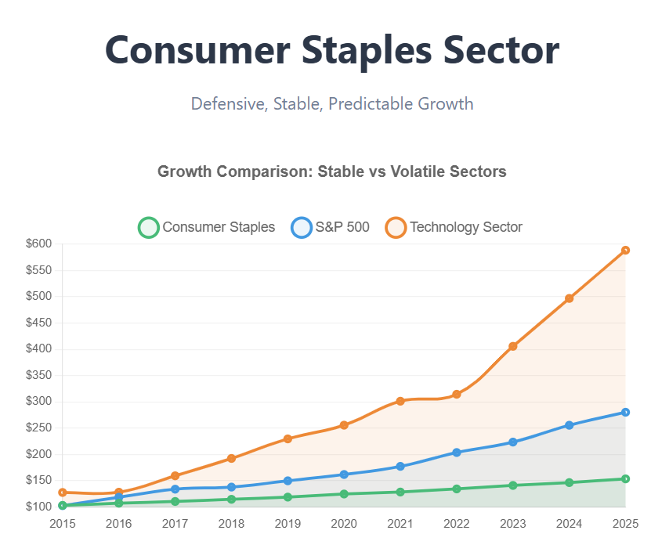
Financial Analysis: Growth & Profitability
Sales Growth: Historically steady at ~3–5% annually, slower than cyclical sectors but consistent.
Earnings Growth: Stable mid-single digits; driven by cost control and brand strength rather than volume expansion.
Margins:
Operating Margin: ~10–20%
Net Margin: ~8–15%
ROE: Typically 20%+ for leading firms like P&G or Nestlé.
Comparison to History: Margins have remained stable or slightly expanded post-pandemic due to pricing power and efficiency gains.

Slide 12
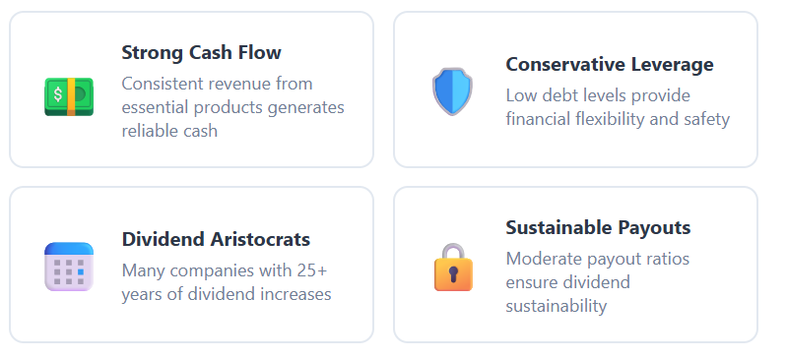
Financial Analysis: Cash Flow & Outlook
Cash Flow: Sector is a strong generator of free cash flow, enabling consistent dividends and buybacks.
R&D & CapEx: Low relative to sales (~2–3%) focus on brand innovation and sustainability.
Margin Trends: Expanding modestly vs. S&P 500, supported by cost efficiencies and premium product growth.
Financial Profile: High liquidity, low debt levels, and steady returns make it a defensive, income-generating sector.

Slide 13
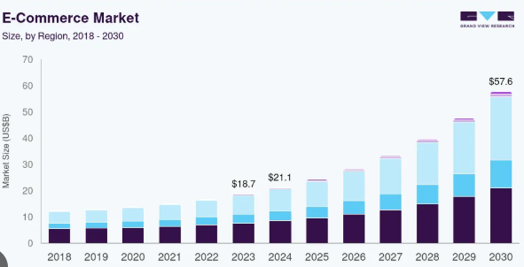
Consumer Staples Disruptions
Growth of e-commerce
  Gives small brands a place to compete
Focus on healthy alternatives
  Traditional items in the food and beverage segments are being replaced by new, healthier options
Technology innovations
  Major players moving away from product innovation to tech innovation
    Shelf stocking and sorting robots, shopper data, inventory tracking, etc.

Slide 14
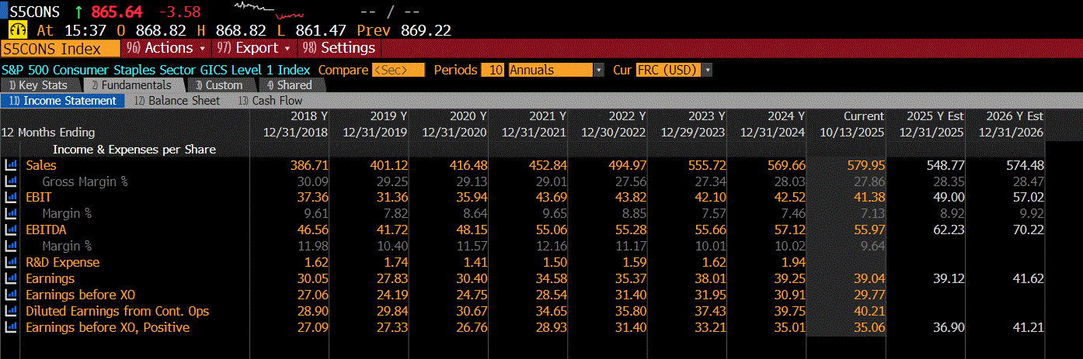
Financial Analysis: Sales & Earnings
Sales have increased to their highest in recent years for stability
Earnings decreased slightly in the last year
Sales are forecasted to decline possibly due to inflation and cost to the consumer
Source: Bloomberg

Slide 15
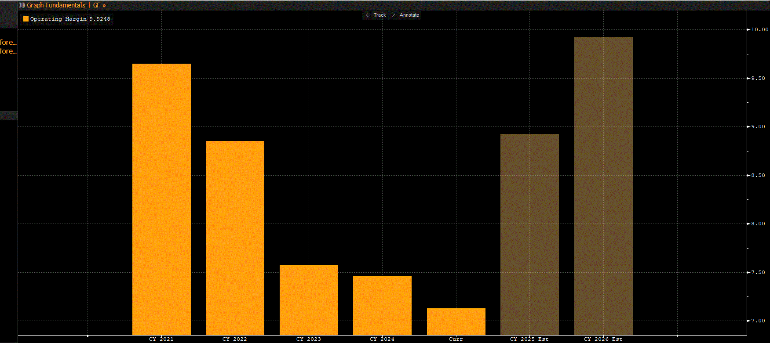
Financial Analysis: Operating Margin
Operating margins have decreased since 2021 due to input cost inflation
Remaining strong as of 2025 due to cost easing and innovation driven efficiencies
Source: Bloomberg

Slide 16
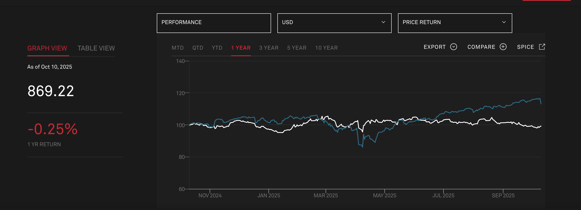
Financial Analysis: Peformance vs S&P 500
Consumer Staples has lagged recently among the S&P500 due to tech favoritism and elevated costs
Source: S&P Global

Slide 17
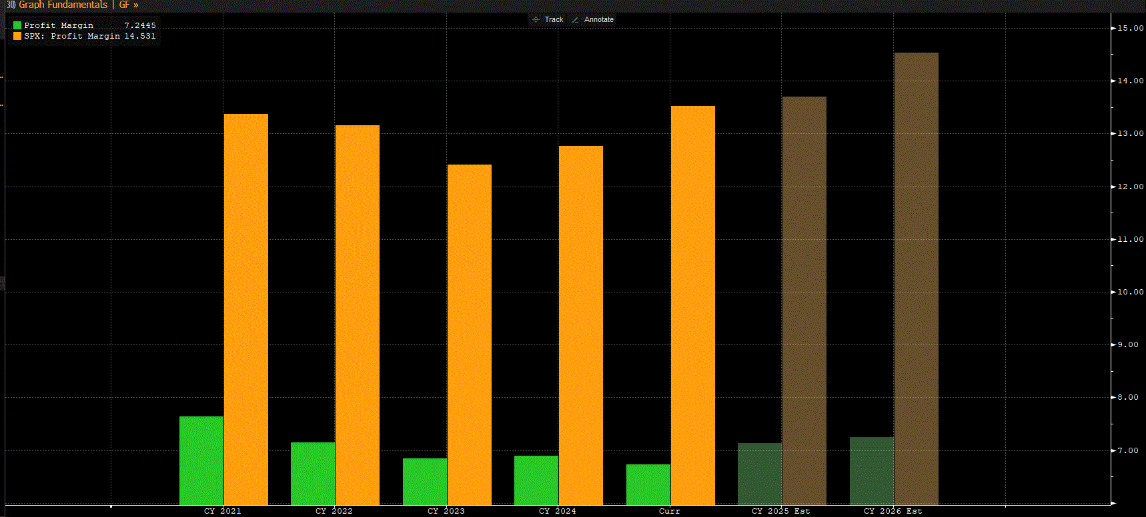
Financial Analysis: Profit Margin vs S&P 500
Consumer Staples profit margin 7.24
S&P500 profit margin 14.5
While S&P 500 margins are higher in stable times, consumer staples are more resilient during recessions
Higher fixed costs and tariff pressures
Source: Bloomberg

Slide 18
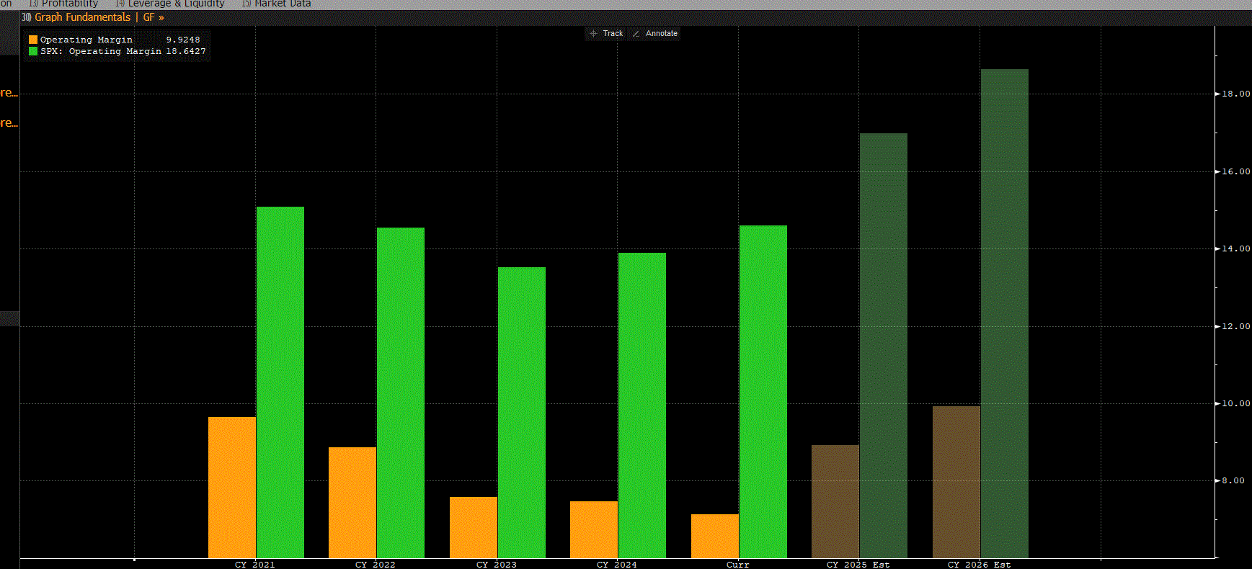
Financial Analysis: Operating Margin vs S&P 500
Consumer Staples operating margin 9.9
S&P500 Operating margin 18.6
Consumer behavior shows reduced demand for processed foods
Source: Bloomberg

Slide 19
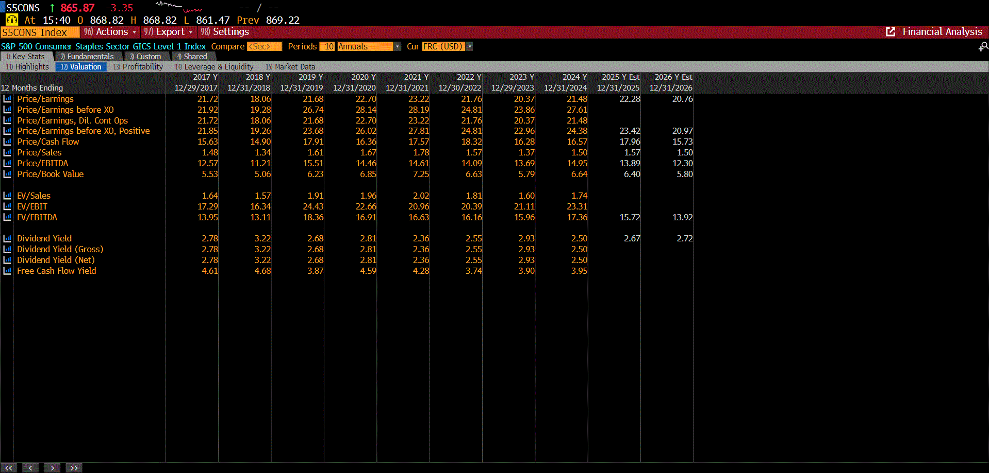
Financial Analysis: Price to Earnings
P/E ratio has been stable
Higher than what is expected
Explanations:
Suggests investors are optimistic and expecting higher future earnings growth than typical
Uncertain economic conditions, investors then move money into staples driving up the ratio
Source: Bloomberg

Slide 20
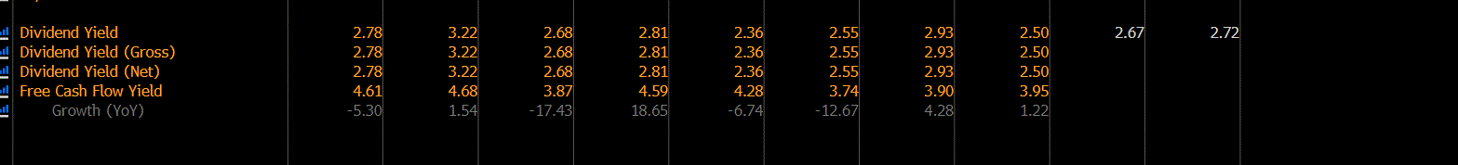
Financial Analysis: Cash Flows
Free cash flow yield shows:
  Efficient debt management
  Stable FCF generation
  Sufficient cash to support and grow dividends
  Investors may view sector as pricey but it is more stable and predictable
Source: Bloomberg

Slide 21
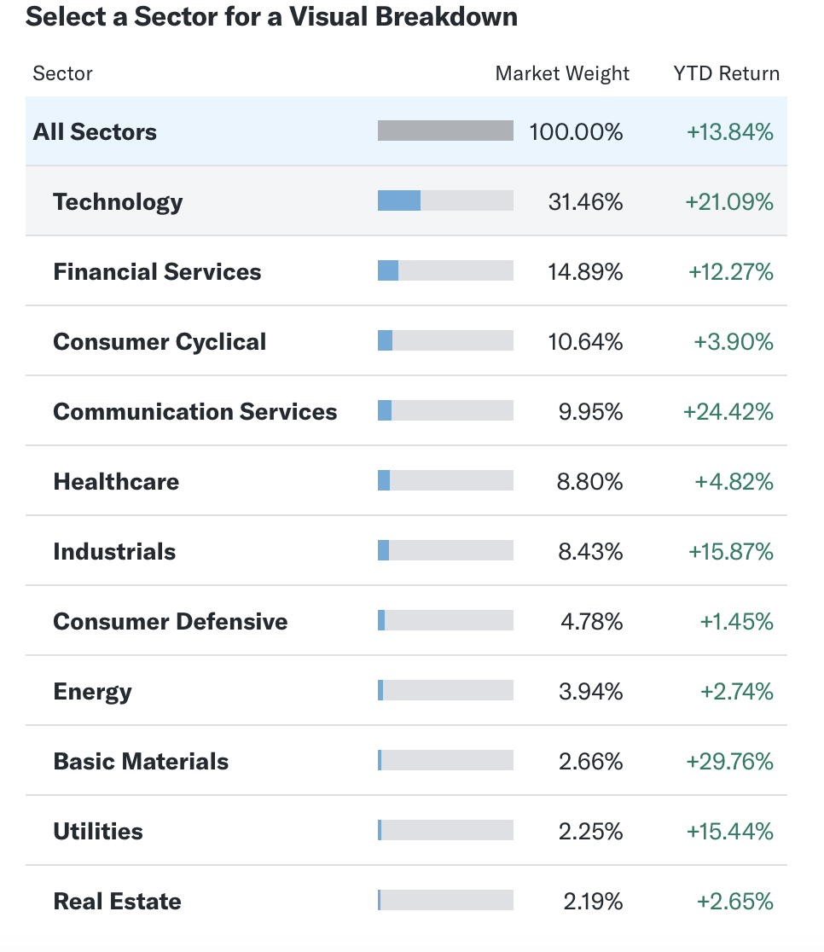
Financial Analysis: Peformance vs Sectors
Staples make up a lower percentage of the market weight
Return has been the lowest YTD 2025
Add for balance and moderate growth to protect in market downturns
Do not offer the explosive, high-reward growth potential of sectors like technology.
Source: Yahoo Finance

Slide 22
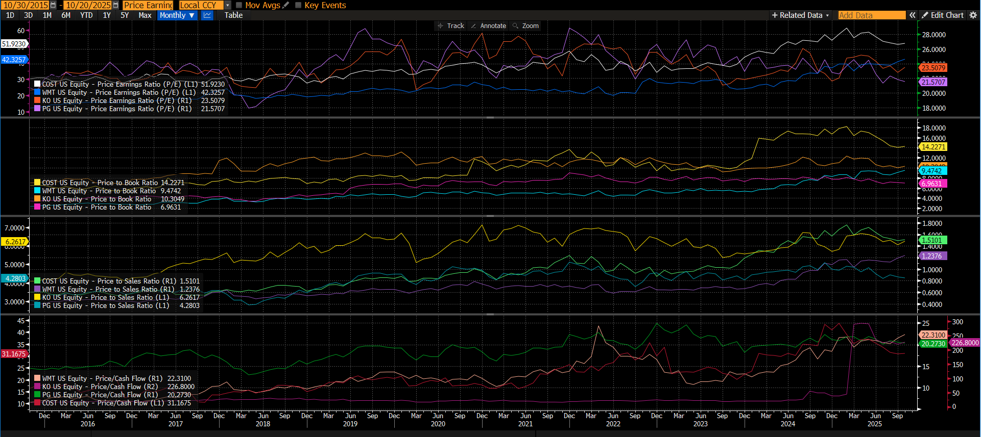
Valuation Analysis: Company Comparison
Companies in the Consumer Staples sector have substantial valuation differences.
Costco trades at a higher P/E and P/B ratios because to its efficient business strategy and robust cash flow, while Walmart and P&G have more stable valuations reflecting their mature market positions.
These variations demonstrate how business concepts and growth prospects generate valuation disparities in the sector.

Slide 23
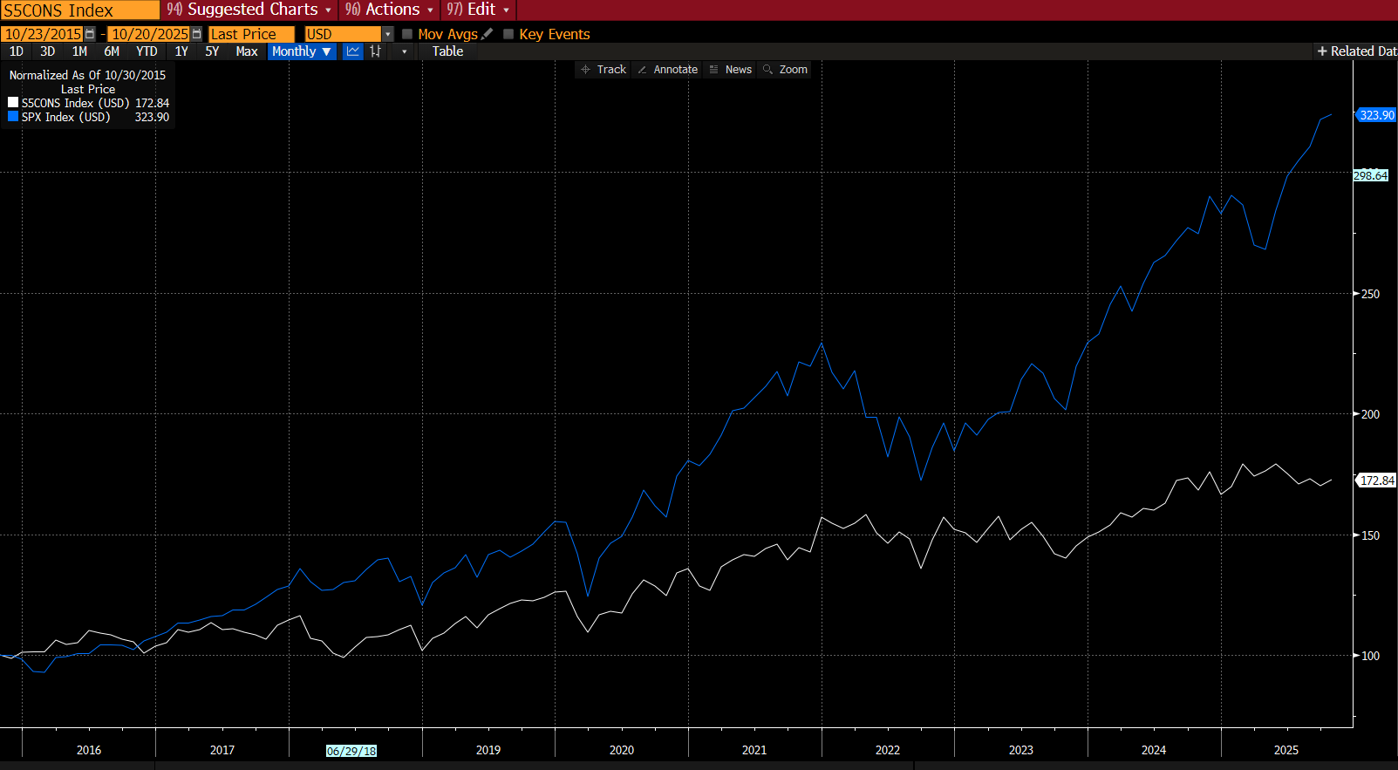
Valuation Analysis: Compared to the Market
With its defensive character and consistent cash flows, the sector is often underperformed than the S&P 500.
While market valuations fluctuate with economic cycles, Consumer Staples is more stable and provides downside protection.
Going forward, values are projected to remain stable or somewhat lower as investors shift their focus to growth industries.

Slide 24
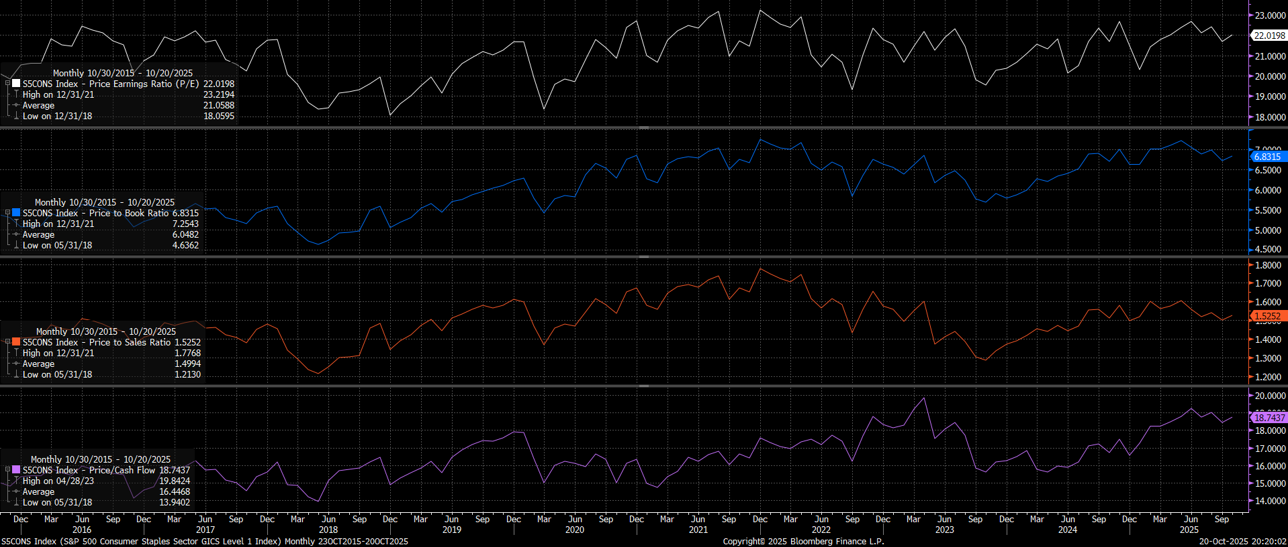
Valuation Analysis- Absolute
Consumer Staples valuations are slightly higher than historical averages.
While P/E and P/S remain stable, P/B and P/CF are relatively high, indicating that investors value the sector's consistent cash flows and defensive profitability in unpredictable environments.
Notes:
Due to the inflation issue, during the past three year, the cost of production goes up a lot, but the price of the product didn't change a lot. Even though the price of the product rise a little so that it makes customer won't buy it, which make the whole industry PE is lower than the average.

Slide 25
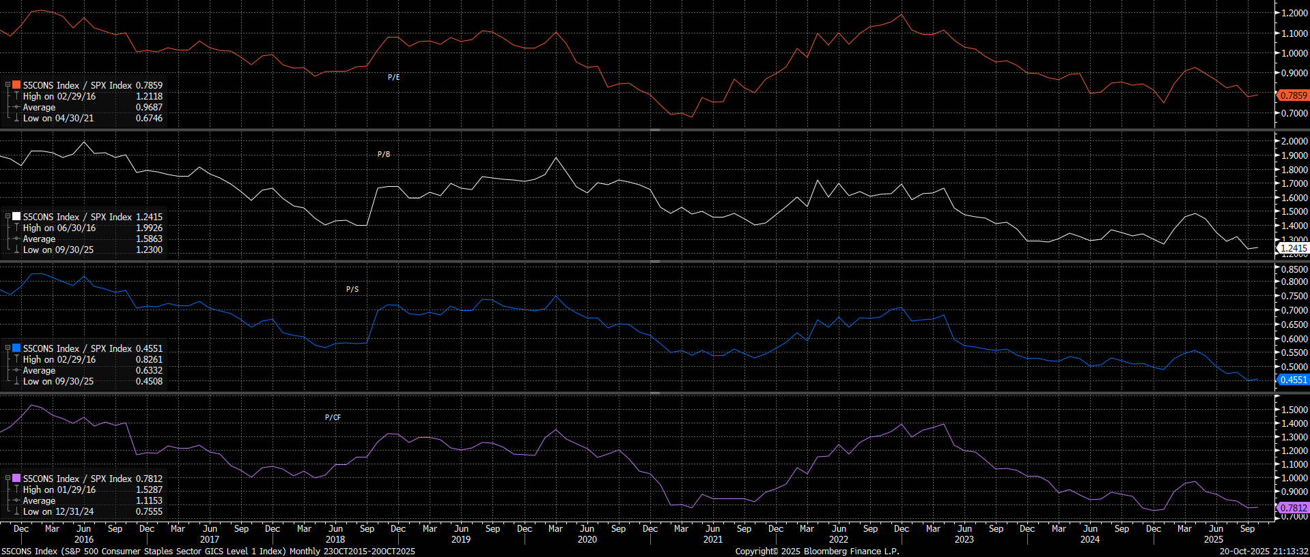
Valuation Analysis- Relative
The Consumer Staples sector has a lower valuation than the broader market.
Its P/E, P/B, P/S, and P/CF ratios are all lower than the S&P 500 average, indicating that the sector is undervalued and may have defensive upside potential if market volatility rises.

Slide 26
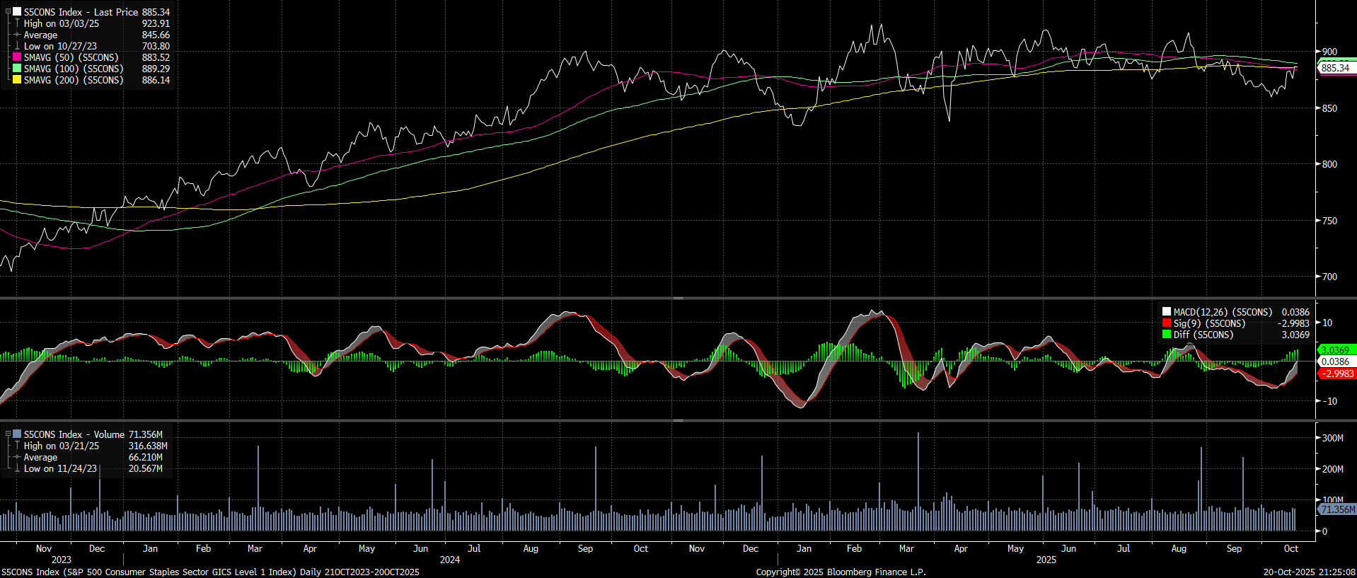
Valuation Analysis- Technical Analysis
Golden Cross End
Golden Cross
The MACD indicator has also shifted upward, indicating the rising momentum.
The 880-900 area provides short-term support, while around 920 may serve as the next resistance zone.
The previous uptrend is weakening. The market may enter a consolidation phase or even a mild correction rather than steady gains

Slide 27
Recommendations
SIM Weight | S&P 500 Weight from SIM | +/-
7.14% | 4.85% | -1.12%
Conclusion: Given relative sector underperformance against the broader market of the S&P500, right now it is best to keep an underweighting in the consumer staples sector
Positives:
Defensive characteristics provide protection in volatile or risk-off markets.
Income stability through dividend yields.
Exposure to essential consumer goods support steady returns.
Specific essentials holdings like Walmart and Kroger provide strong retail positions in staples.
Risks:
Underperformance in bull markets where tech and growth stocks lead.
Inflation and cost pressures may hurt margins and earnings.
Slow earnings growth may drag on relative portfolio performance.
Overweight might limit growth during economic expansions.

Slide 28
Industry Over/Under Recommendations
SIM Weight | S&P 500 Weight from SIM | +/-
7.14% | 4.85% | -1.12%
Conclusion: Given relative sector underperformance against the broader market of the S&P500, right now it is best to keep an underweighting in the consumer staples sector
Overweight:
Food and essentials retailing (Walmart, Kroger) due to strong market position and stable demand.
Select staples producers with pricing power and strong cash flow such as branded alcohol
Underweight:
Tobacco stocks given regulatory and structural challenges.
Household products and personal care where margin pressures are pronounced and consumer preferences shift rapidly.

