Slide 1
Consumer Discretionary Stock Recommendation
Presented by: Paige, Cameron, Natalie, and Shiqi

Slide 2
Sector Recommendation Recap
Underweight
Pause to rate cuts
Tariffs increasing inflation
Decrease in disposable income

Slide 3
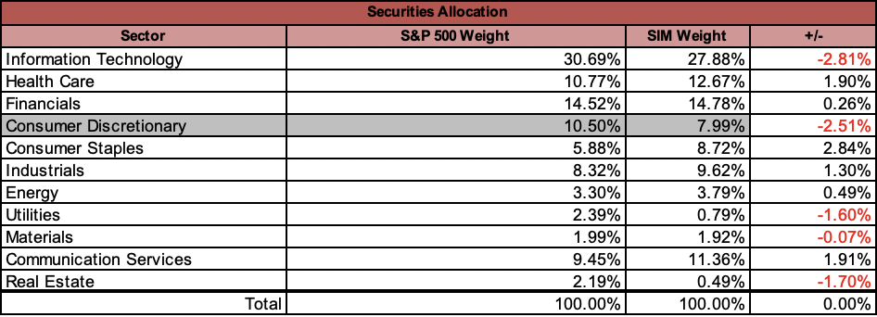
SIM Portfolio (as of Feb. 2025)
SIM weight of 7.99%, versus the S&P weight of 10.50%
Underweight –2.51%
Current Consumer Discretionary holdings in the SIM:
  Amazon (AMZN) (5.21%)
  Nike (NKE) (1.99%)
  Lennar Corp (LEN) (0.79%)

Slide 4

Current Price: $192.36
Target Price: $256.69​
Upside: 33.4%
Recommendation:
HOLD at 5.21%
Amazon Web Services (AWS): A cloud computing platform that allows Amazon to provide on-demand access to IT resources like storage, compute, and databases.
E-commerce: The rise of e-commerce has significantly boosted Amazon’s growth over the previous decade, allowing it to become a dominant player in the online retail market. Amazon accounts for almost 40% of e-commerce sales in the market today.
Extremely Strong Consumer Loyalty
Amazon Prime Membership: Free and quick shipping, among other services like streaming.
Ticker: AMZN
One Year Return: +5.13%
P/E: 37.65
Industry: E-commerce &
Cloud Computing
Market Cap: 2.02 Trillion
52 Week High/Low: $151.61-$242.52

Slide 5
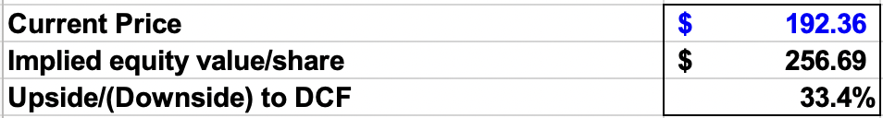
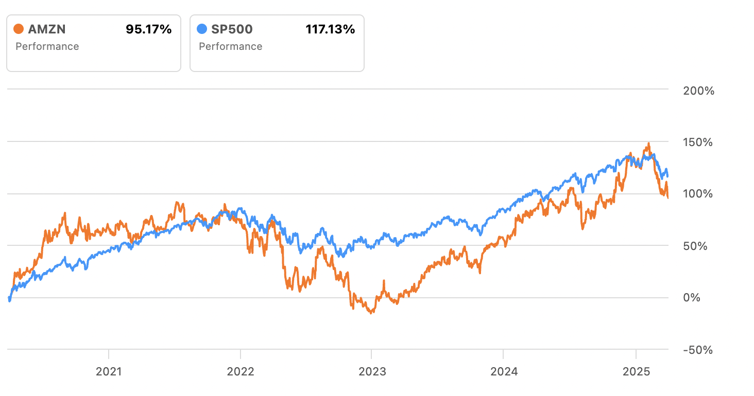
5 Year Return versus S&P500

Slide 6

NIKE
Recommendation: HOLD
Current Price: $64.67
Upside: 8.2%
Target Price: $70
1.99% of fund
-20% MTD
7 year low despite beating earnings on 3/20
Weak sales trends
Uncertainty surrounding turnaround plan & tariffs
Executives claim it may get worse before it gets better

Slide 7

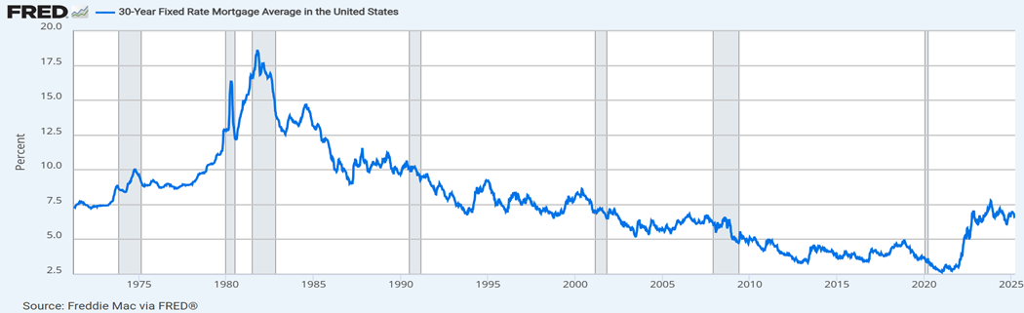
Recommendation: SELL
Current Price: $113
Target Price: $164
0.79% weight of SIM holdings
Description
Lennar is one of the largest homebuilders in the U.S., mainly focused on building affordable, entry-level homes for first-time buyers.
Investment Thesis
Q1 2025 gross margin: 18.7% (below 19% guidance)
Sales incentives rose to 13% of revenue
High mortgage rates
Stock underperformed in past 6 months
Market hasn’t responded positively to asset-light strategy after Millrose spinoff

Slide 8

Financial Analysis
SG&A slightly higher at 8.5%, net margin dropped to 10.2%
ROE around 15%，inventory improved but still high at ~$19B
Valuation low (P/E 8.37, DCF target $237/share but market not rewarding it yet

Slide 9
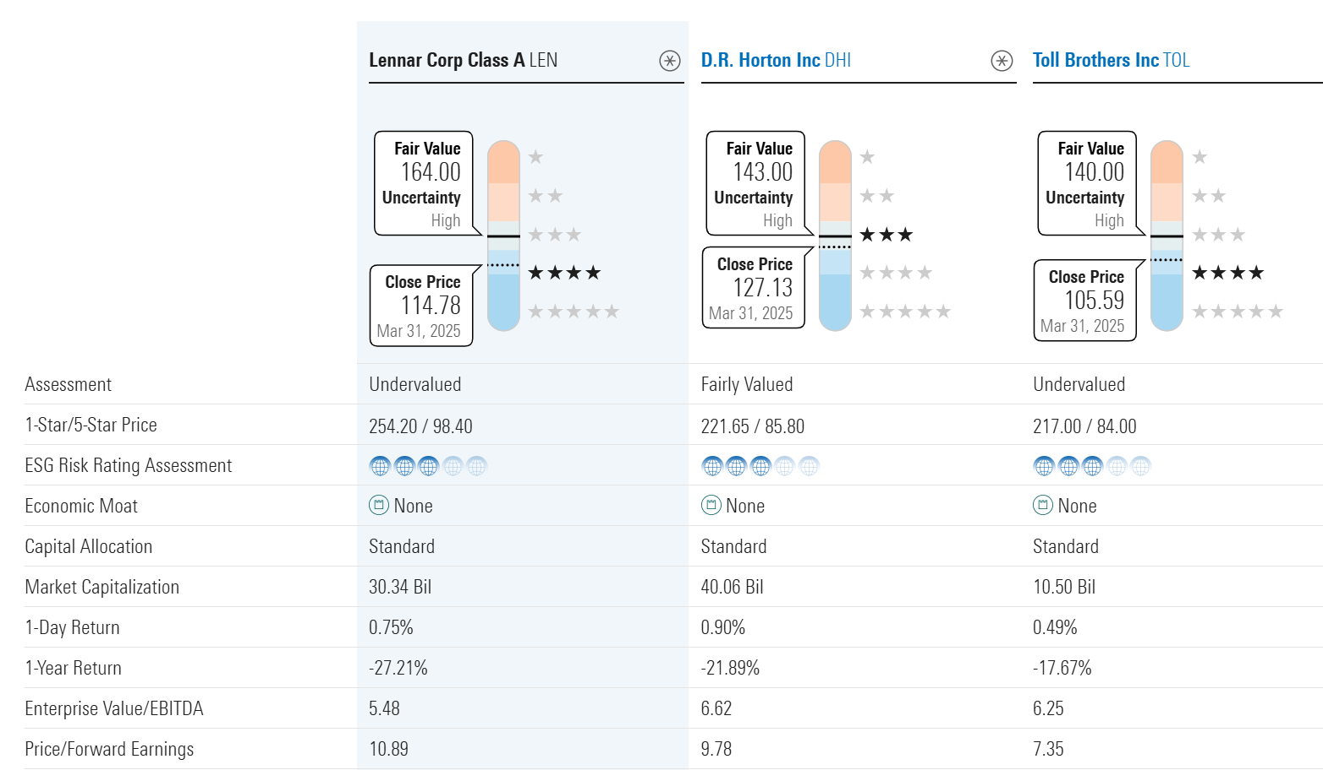
Lennar vs.
Peers (DHI, TOL)

Slide 10

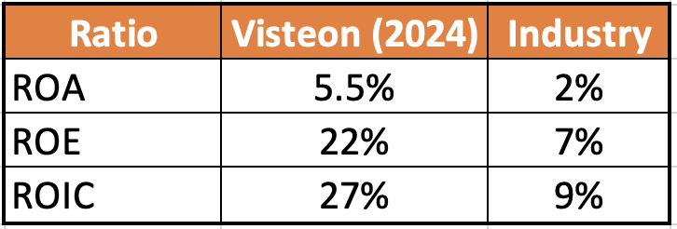
Recommendation: BUY
Current Price: $77
Target Price: $115
Upside: 49%
Description
Automotive technology company, that produces components for the next generation of vehicles
Investment Thesis
EV market will continue to benefit from government incentives
Secular theme: Consumers demand experience and customization of their automobiles
Strategic acquisitions
Increased product launches
Financial Analysis
Strong balance sheet: Cash/Debt ratio of 1.5
Deleveraging
Industry outperformance
Increased profitability

Slide 11
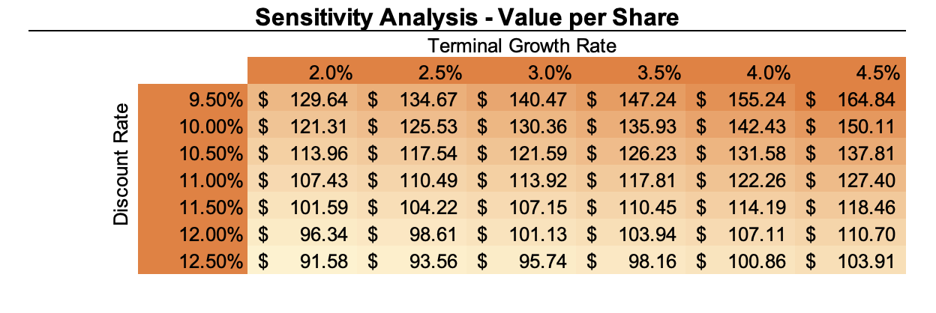
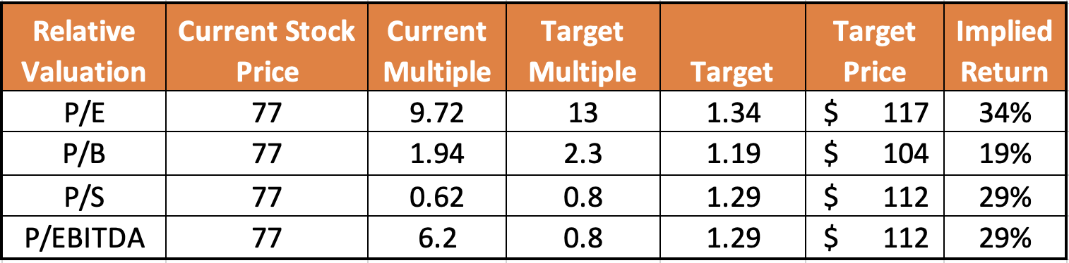
DCF Valuation:
Relative Valuation

Slide 12

Recommendation: BUY
Current Price: $4,587
Target Price: $5,350
Description
The world’s leading provider of online travel and related services.
  Operating well-known brands like Booking.com, Priceline, Agoda, Kayak, and OpenTable
Business Analysis
Key drivers:
  Resurgence in international travel
  Continuous implementation of AI
  Expansion of offerings
  Efficient business model
Financial Analysis
Generates revenue primarily through travel reservations, advertising, and commissions on bookings
2024 Financial Results
  Beat consensus on all measures other than EPS
    Strong revenue growth YoY of over 11%
    ROA: 18.2%
    ROC: 37.2%

Slide 13
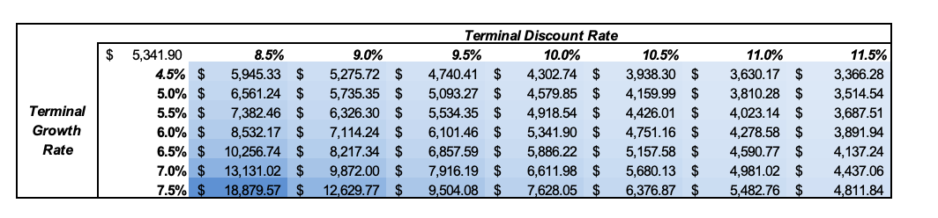
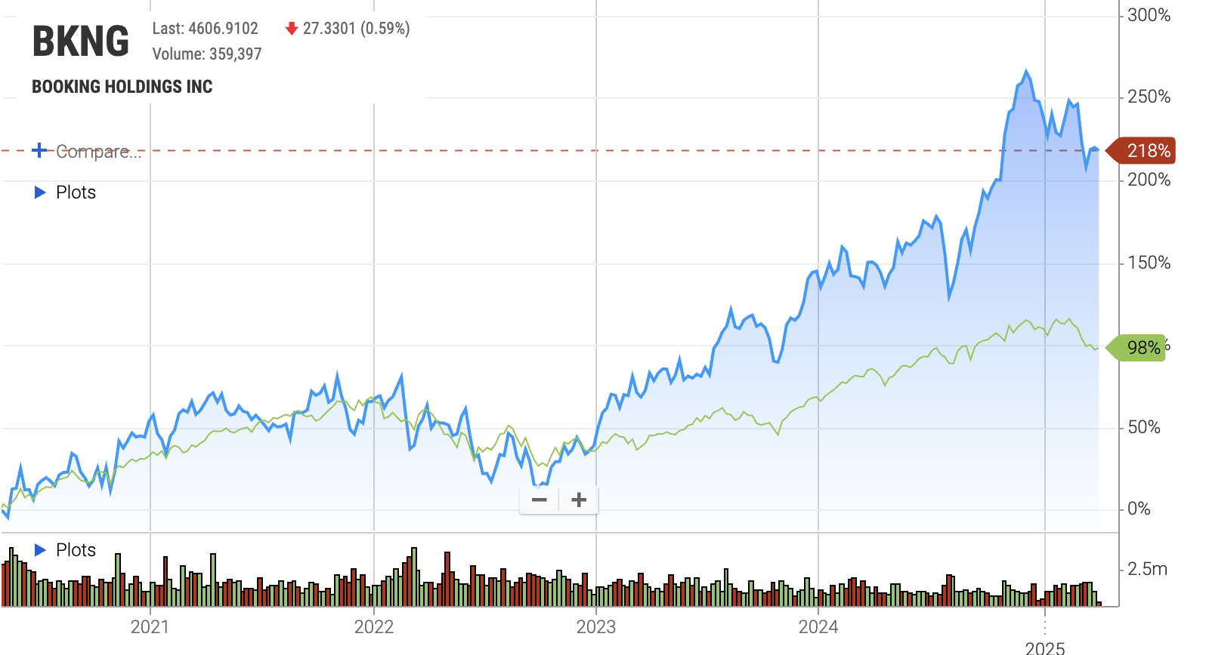
DCF Valuation
Relative Valuation

Slide 14
BKNG vs Peers
 | Booking | Expedia | Airbnb | TripAdvisor
Market Value | $152.26B | $21.29B | $74.51B | $40.83B
Revenue Growth YoY | 14.36% | 10.29% | 11.81% | 15.52%
Operating Margin | 31.83% | 12.20% | 15.01% | 27.87%
Basic EPS | 149.96 | 9.39 | 2.89 | 2.96
Price Performance (1 yr) | 31.1% | 24.3% | -26.6% | 34.2%
FCF | $7.89B | $2.33B | $4.52B | $70M
BKNG Financial Ratios
BKNG tends to have higher financial ratios compared to peers due to:
  Asset-light model
  Strong margins
  Global scale
  Capital efficiency

Slide 15
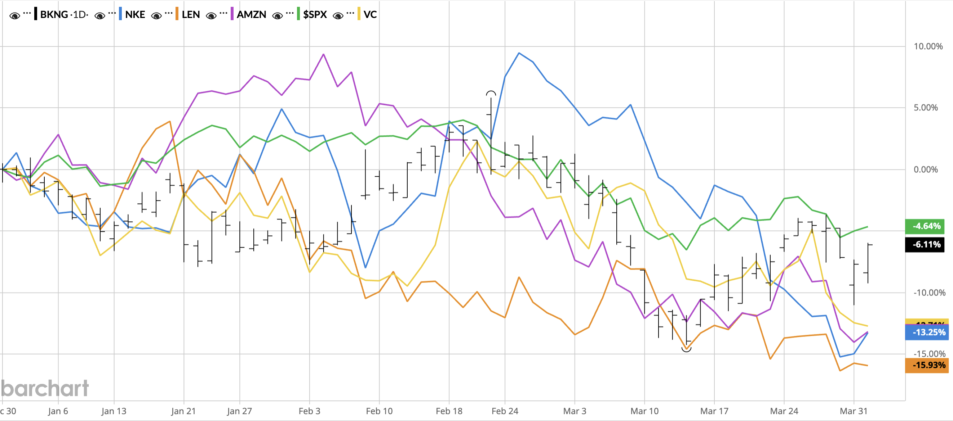
YTD Performance

Slide 16
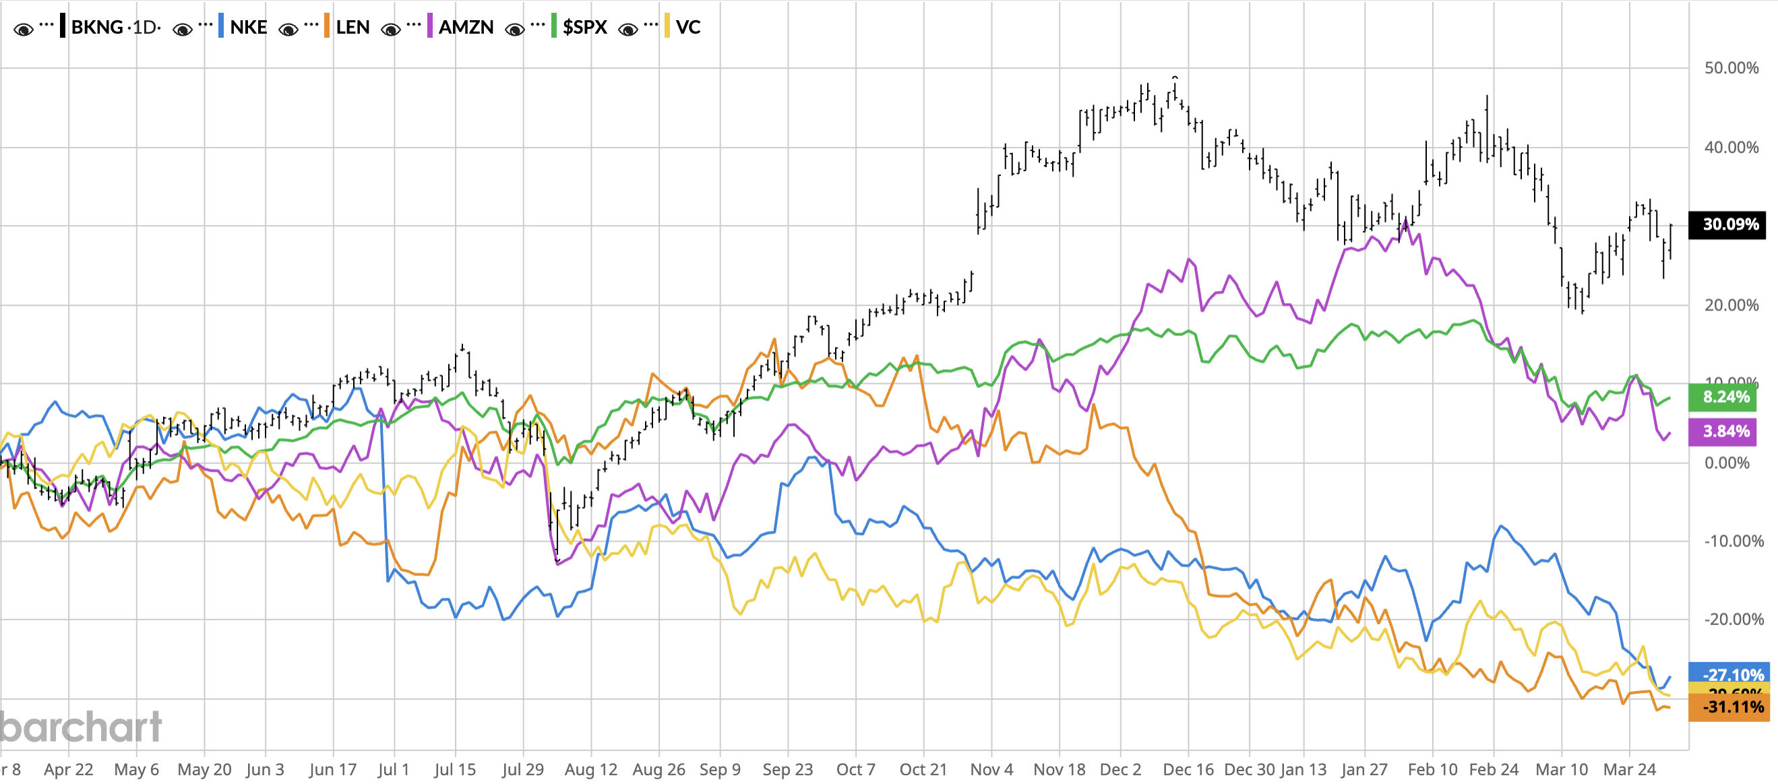
1-Year Performance

Slide 17
Final Recommendations
Stock | Recommendation | Current Price | Target Price | Current Weight | Projected Weight | Potential Upside
Nike | HOLD | $64.67 | $70 | 1.99% | 1.99% | 8.2%
Amazon | HOLD | $190 | $254 | 5.21% | 5.21% | 33.4%
Lennar | SELL (79 bps) | $113 | $164 | 0.79% | 0.0% | N/A
Visteon | BUY (50 bps) | $87 | $115 | 0% | 0.5% | 42.7%
Booking | BUY (50 bps) | $4,587 | $5,350 | 0% | 0.5% | 16.5%
Total |  |  |  | 7.99% | 8.2%

Slide 18
Appendix

Slide 19
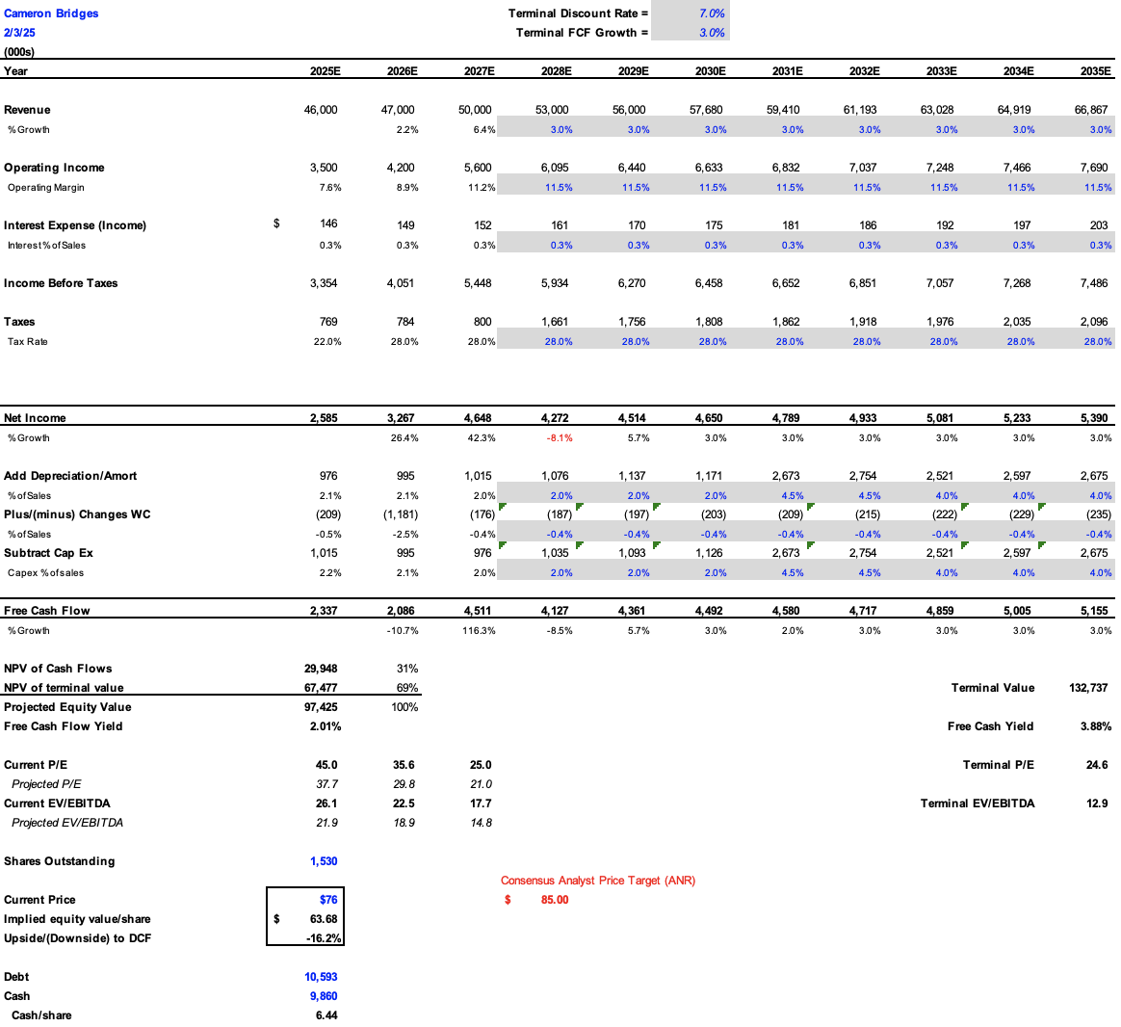
Nike DCF

Slide 20
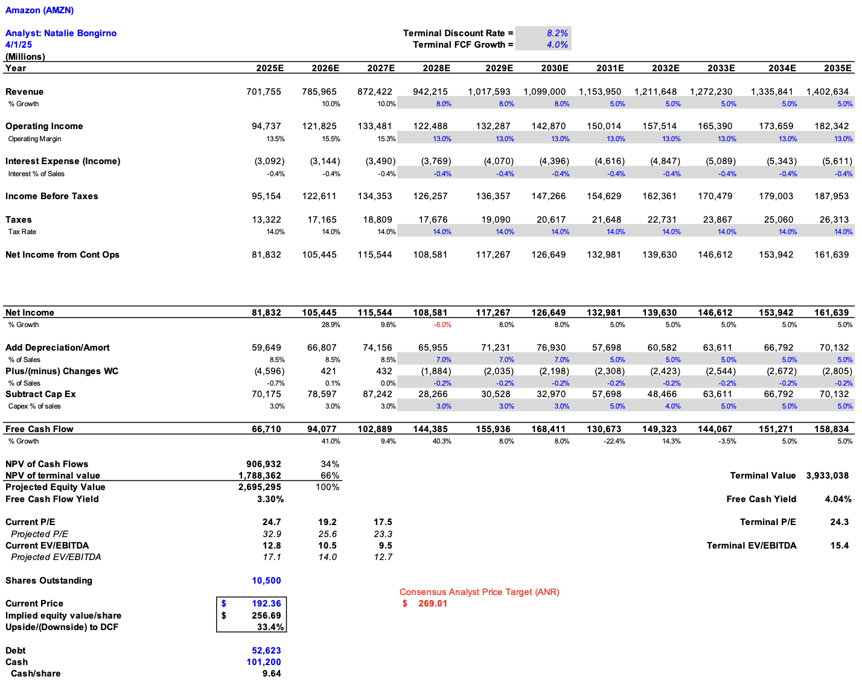
Amazon DCF

Slide 21
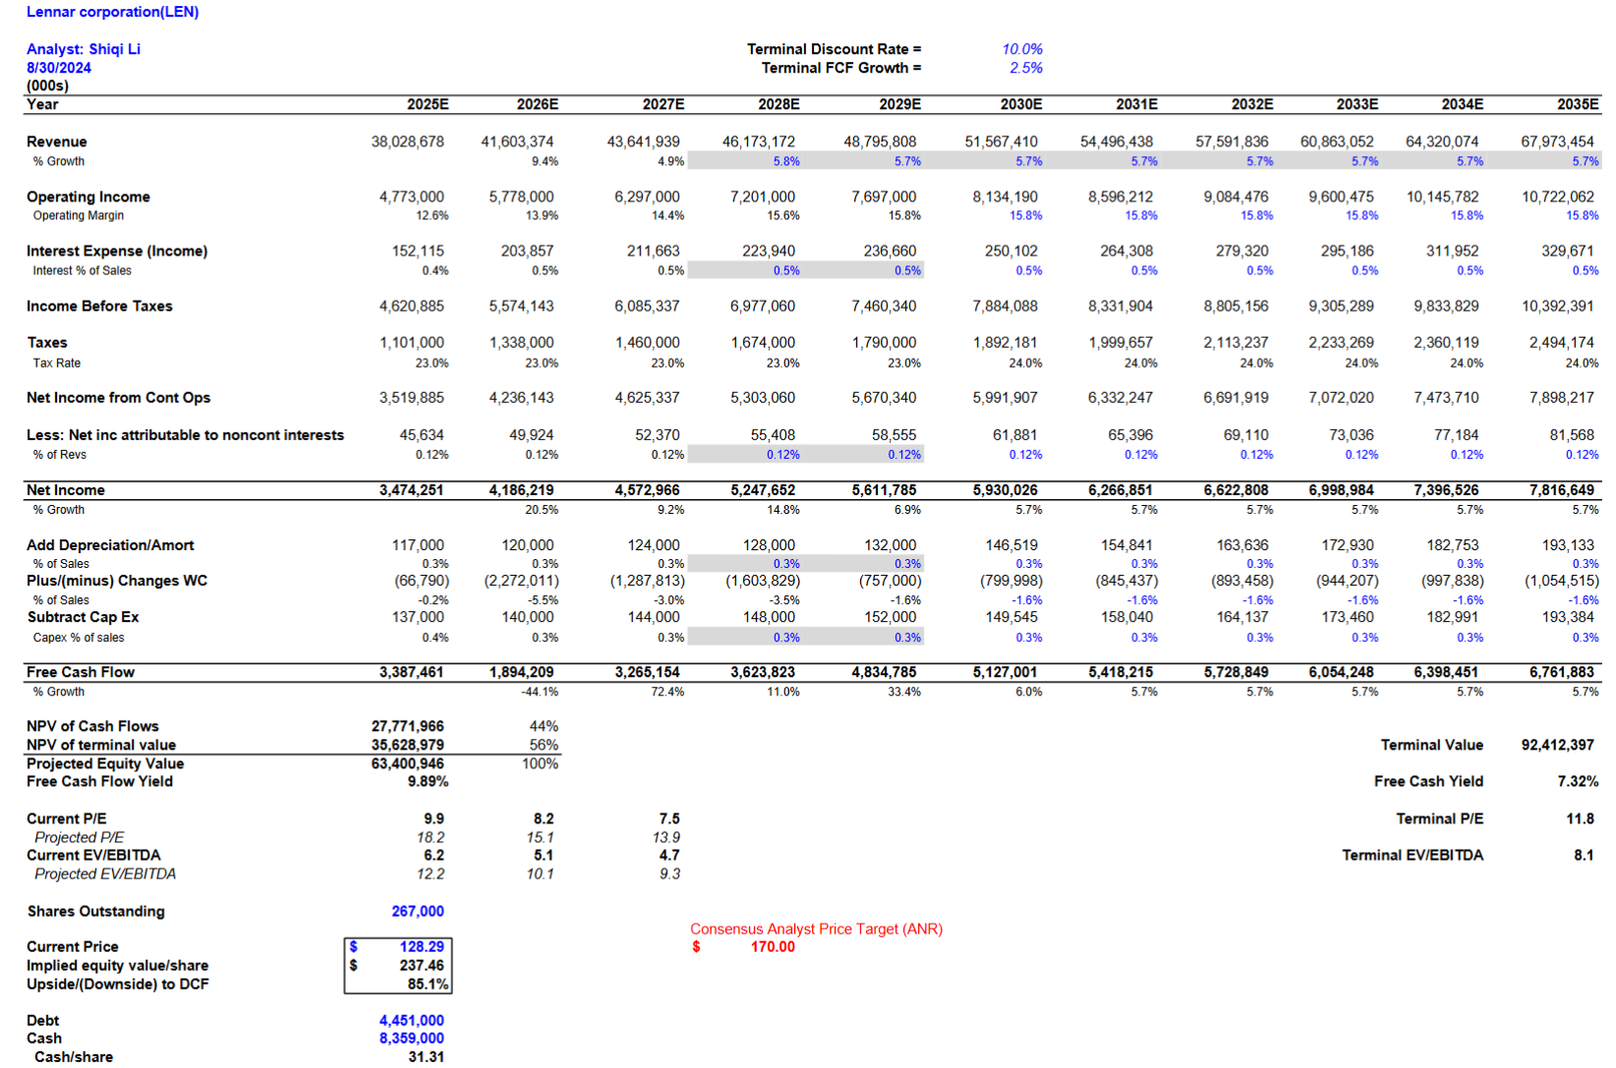
Lennar Corp. DCF

Slide 22
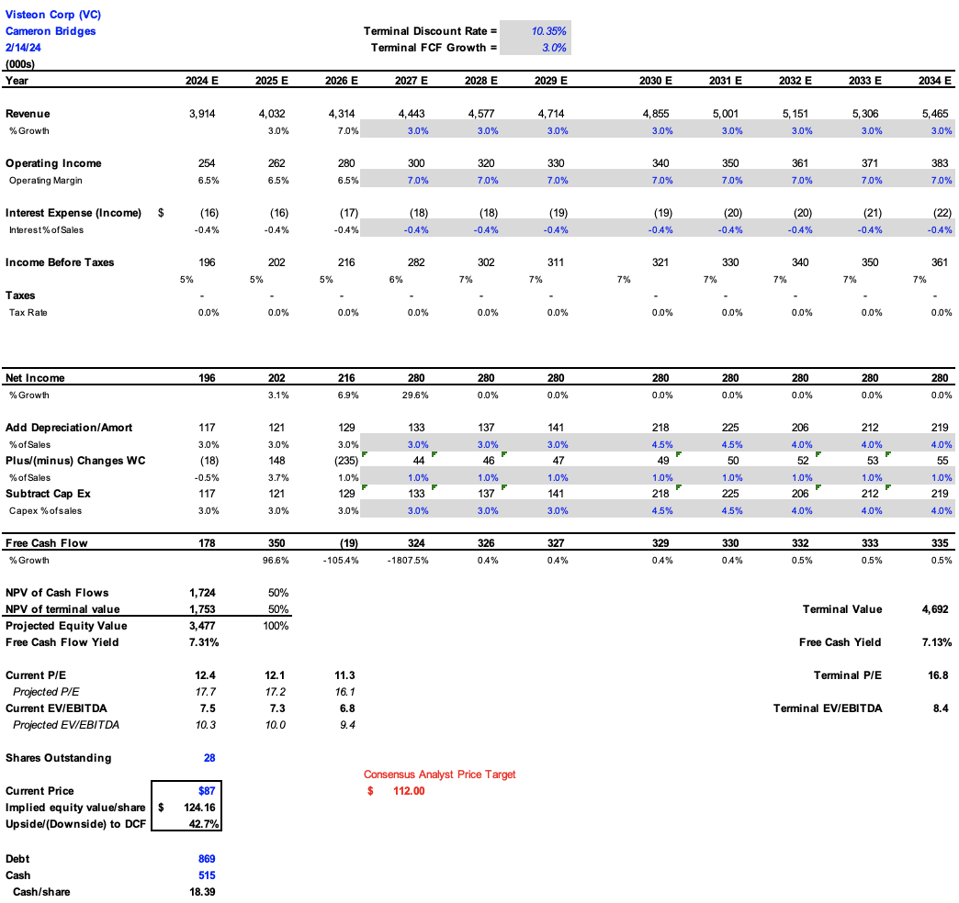
Visteon DCF

Slide 23
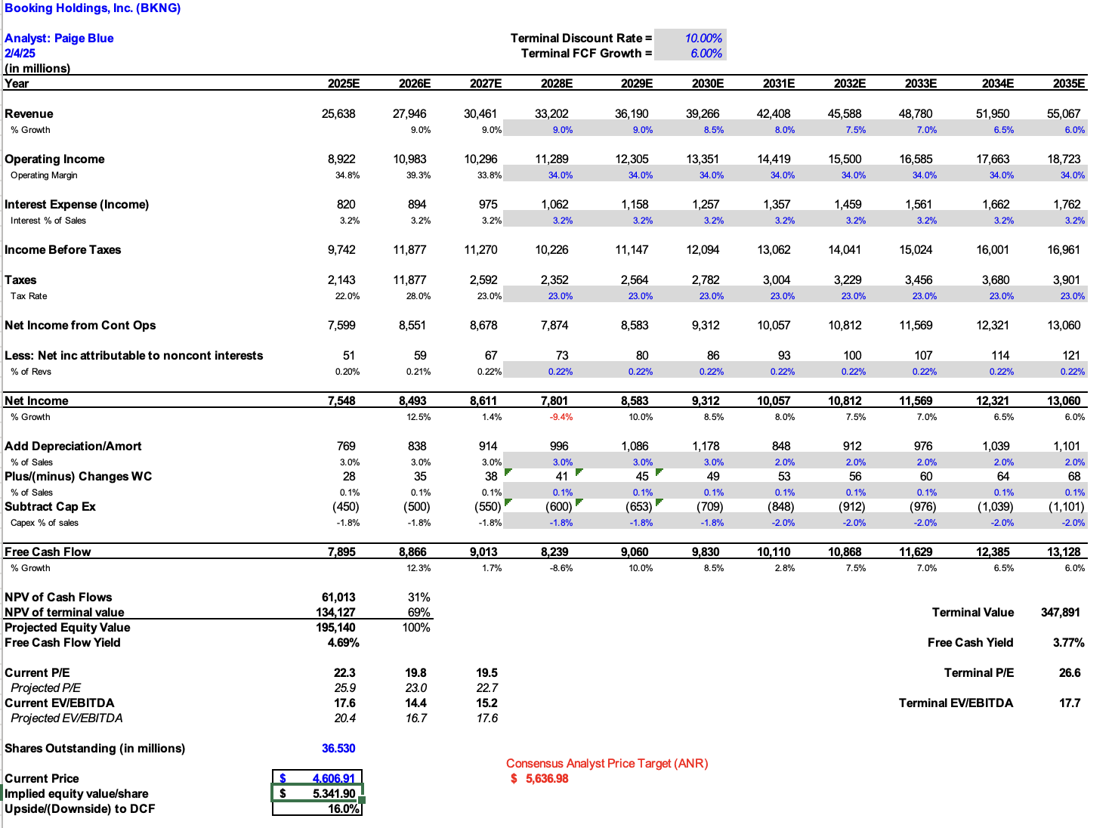
Booking Holdings DCF

