Slide 1
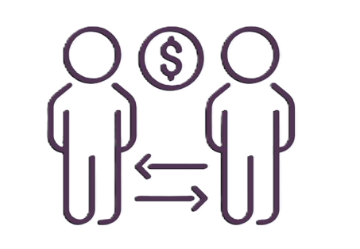
Consumer Discretionary
03/04/2025
Presented by: Cameron, Natalie, Paige, Shiqi

Slide 2




Sector Overview
$14.4 trillion in total market cap
Market Weight 10.53% of the S&P 500
Non-essential goods and services
Automobiles, Furniture and Appliances, Fast Food, Fashion
Year to date: -5.6%
2024 performance: 30.43%

Slide 3
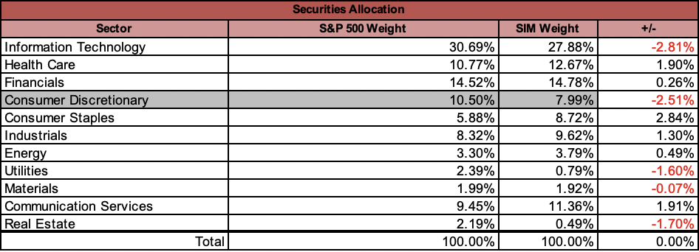
SIM Portfolio (as of Feb. 2025)
SIM weight of 7.99%, versus the S&P weight of 10.50%
Underweight –2.51%
Current Consumer Discretionary holdings in the SIM:
  Amazon (AMZN)
  Nike (NKE)
  Lennar Corp (LEN)

Slide 4
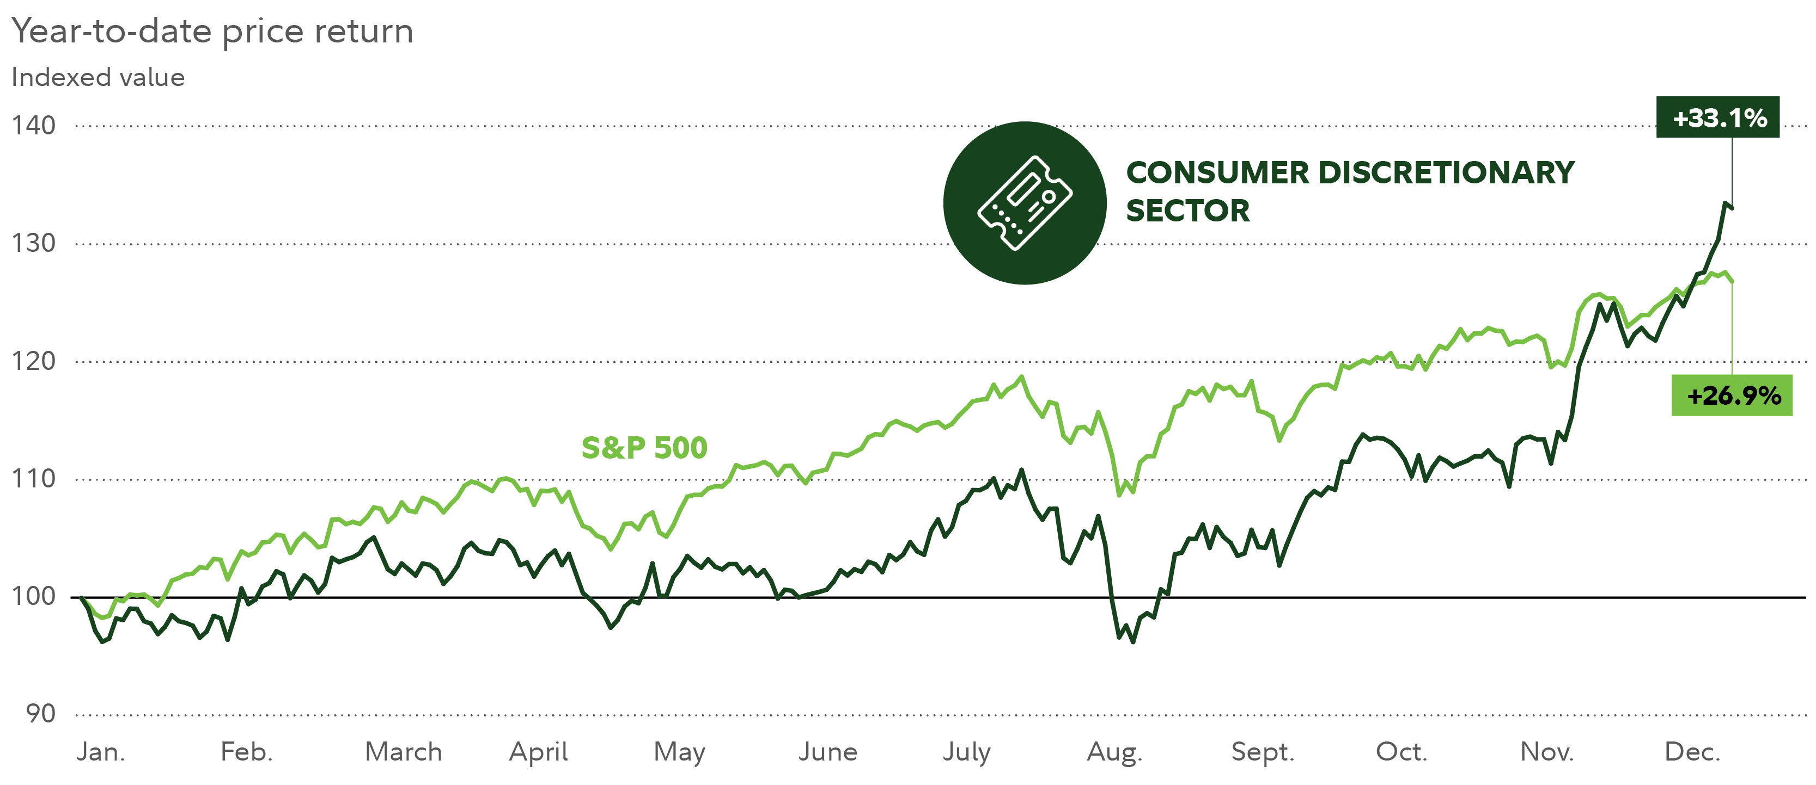
Business Analysis
In aggregate, the Consumer Discretionary sector delivered strong gains in 2024, by outperforming the S&P500 index with returns of +33.1%, compared to the index as a whole of +26.9%
Consumer Discretionary refers to non-essential goods and services that can be substitutes and replaced with cheaper goods and services during economic downturns.

Slide 5
Business Analysis
Sector performs well when consumer confidence is strong, extremely cyclical and dependent on the overall economic performance
Can be negatively affected by factors like higher interest rates, economic downturns, and possible implications of supply and demand of inputs and outputs through tariffs.

Slide 6
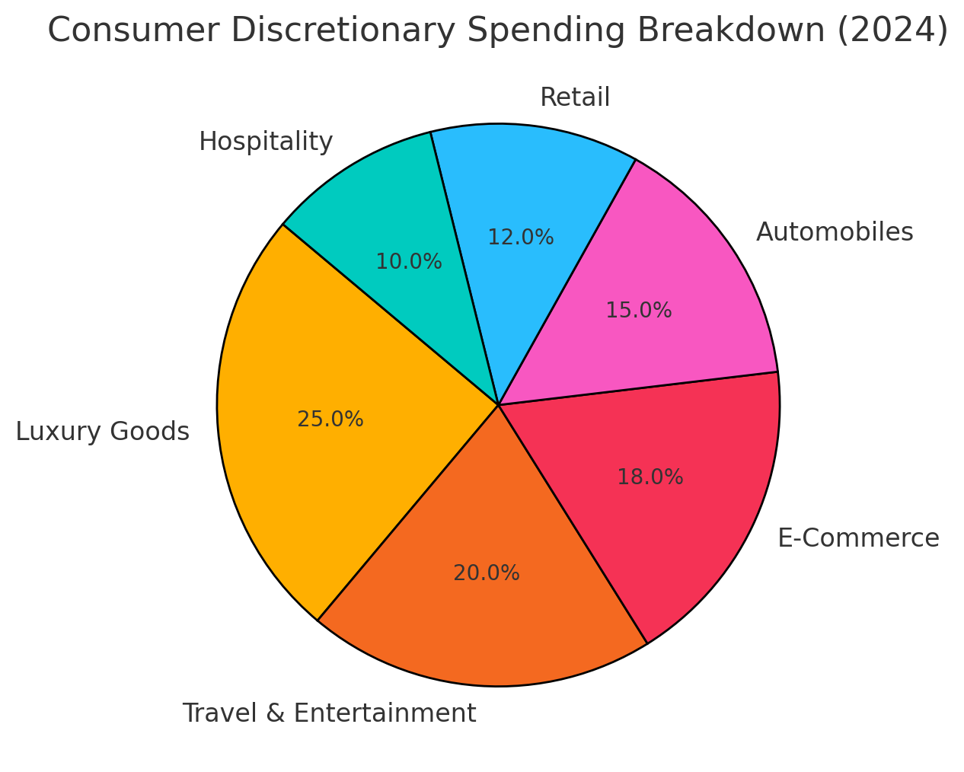
Business Analysis- Profitability and Pricing
Diverse product segmentation
  Mostly dominated by a few major players (Amazon, Tesla, Home Depot, McDonald's)
Competition: High
  Ex. Fast fashion vs luxury, streaming wars, goods vs experiences
Ease of entry: Average
  Despite high competition, e-commerce has made new entries easier
Bargaining power of buyers: High
  Customers have high bargaining power due to mass competition
Bargaining power of suppliers: Low
  High competition, many substitutes
Threat of substitutions: High

Slide 7
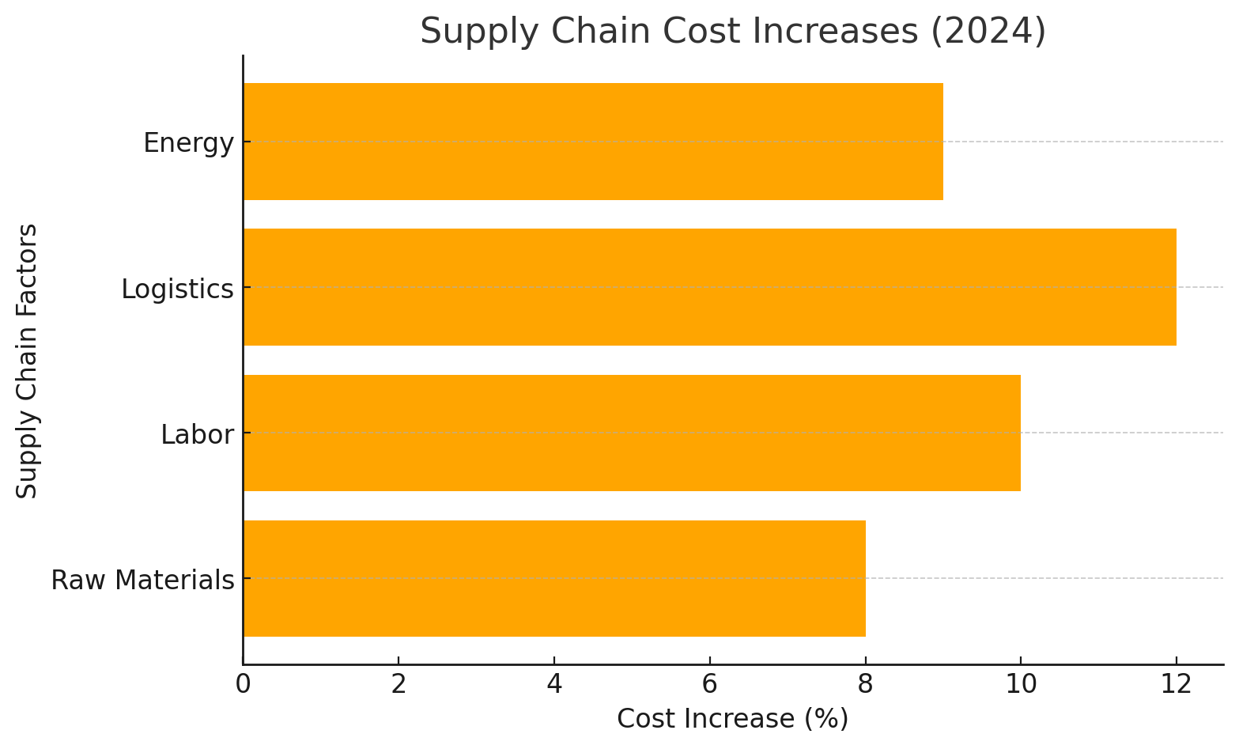
Business Analysis- Supply and Demand
New Capacity Limitations:
  Large companies optimizing omni channels
  Increasing productions to meet demand but faced with supply chain issues
  Labor shortages
Extremely cyclical
  Positive impact: lower inflation and interest rates, strong job market
  Negative impact: geopolitical tensions

Slide 8
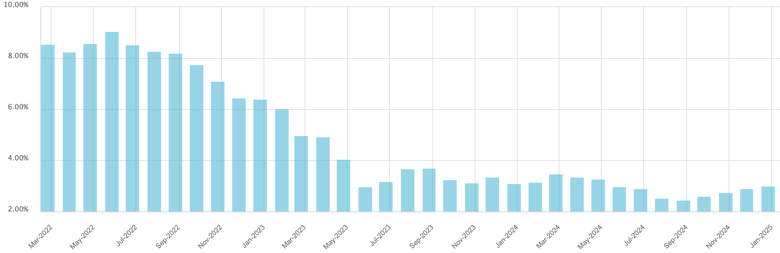
Economic Analysis
Inflation: 3%
Interest Rates
  Current Interest Rates: 4.33%
  Fed is anticipating one more cut in 2025
Unemployment is currently 4.13%
  2025 wage growth is estimated to be around 4%

Slide 9
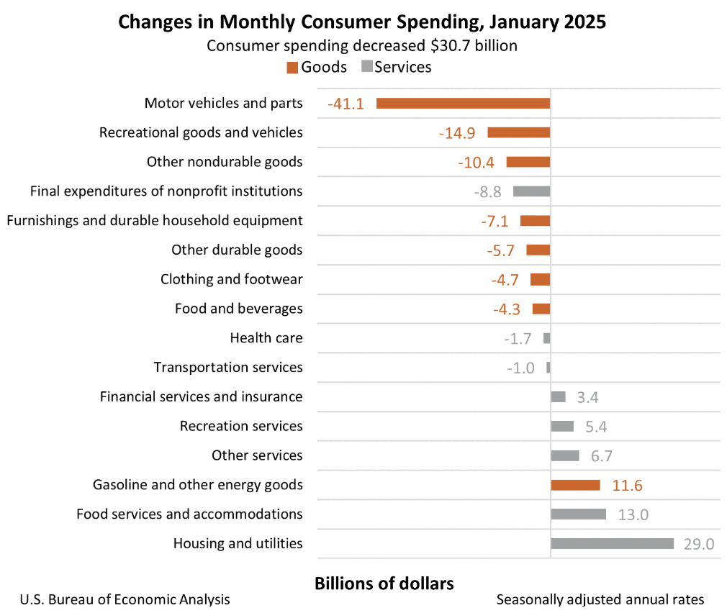
Economic Analysis (as of Jan 2025)
The consumer discretionary sector's likely performance can also be measured by the following indexes and data statistics:
  Consumer Price Index (CPI) - up +0.5% since Jan 2025
  Personal Consumption Expenditures (PCE) - decreased –0.2% in Jan
  Personal Savings Rate – 4.6%
  Unemployment Rate – 4.0%

Slide 10
Financial Analysis
Sales growth rate: 5.2% VS. 8.51%(2020-2023)
  Caused by inflation, competitive pressure
Earning growth rate 6.45% VS. 2.1%(2020-2023)
  More profit
R&D as a % of sales: 5.46%
  remains innovative
Margins: 35.33% VS. 32.23%(2020-2023) VS. 35.01%( S&P 500)
ROE: 33.02%
Can be both a net user of cash and a generator of free cash flow
  Consumer Goods & Services
  Growth- focused companies

Slide 11
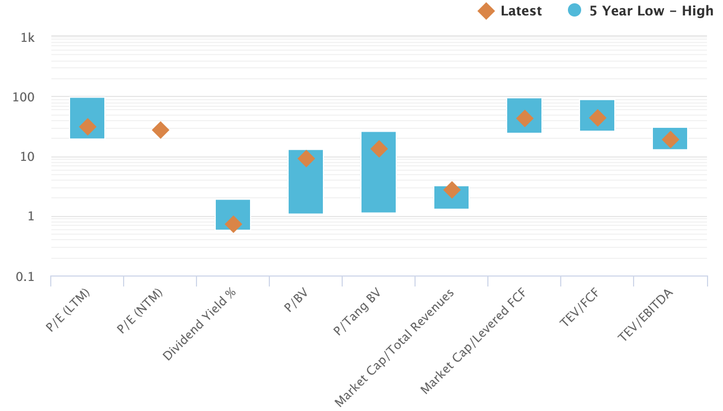
Valuation Analysis
P/E P/S P/B P/FCF VS S&P 500
  Sector: P/E: 29x P/S: 2.7x P/B: 9.4x P/FCF: 36.5x
  S&P 500: P/E: 27x P/S: 3.1x P/B: 5.2x P/FCF: 36x
Does valuation vary widely across sector?
  Yes; sector is very diverse by nature
  High multiples: luxury, e-commerce, fast-growing companies
  Low multiples: mature/cyclical businesses (ex. Automotive and home improvement)
Why did consumer discretionary have such a good 2024?
  Increased consumer spending, interest rate cuts, falling inflation
What will these valuations do going forward?
  Mean Reversion

Slide 12
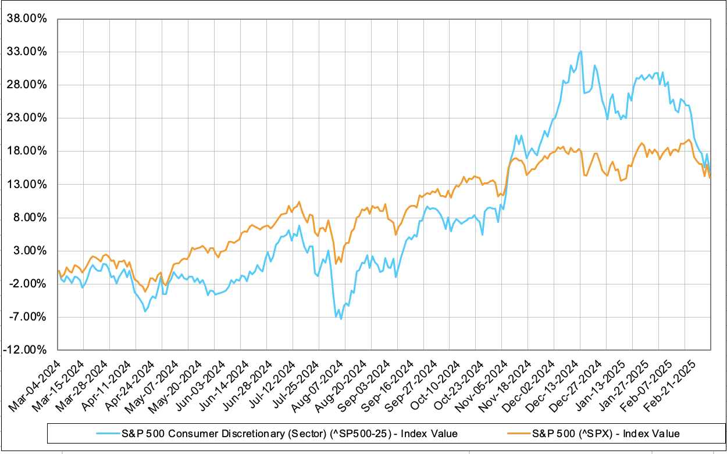
Recommendation
Remain Underweight
With strong 2024 outperformance the sector is due for a mean reversion
Trump administration policies driving up inflation with tariffs
Fed not cutting rates as much as anticipated

Slide 13
Q & A

