Slide 1

Stock Recommendation
Consumer Discretionary
By: Adriana Medley, Connor Michalski, Hrushi Muskula, Emanuel Ortega, Nathan Ost

Slide 2
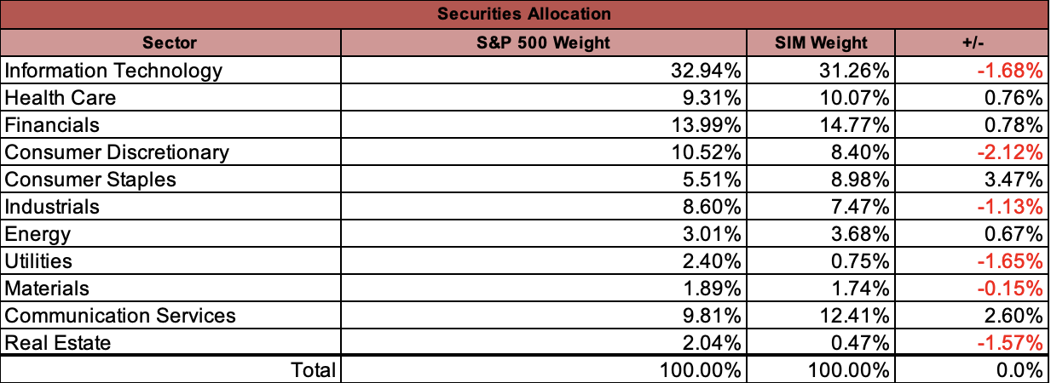
Sector Overview
10.52% S&P 500 weight / 8.40% SIM Weight
Recommendation: Increase position in sector
Stocks held:
  Amazon (AMZN)
  Booking Holdings (BKNG)
  Nike (NKE)
Businesses that sell non-essential goods and services (Luxury or "want" items)

Slide 3
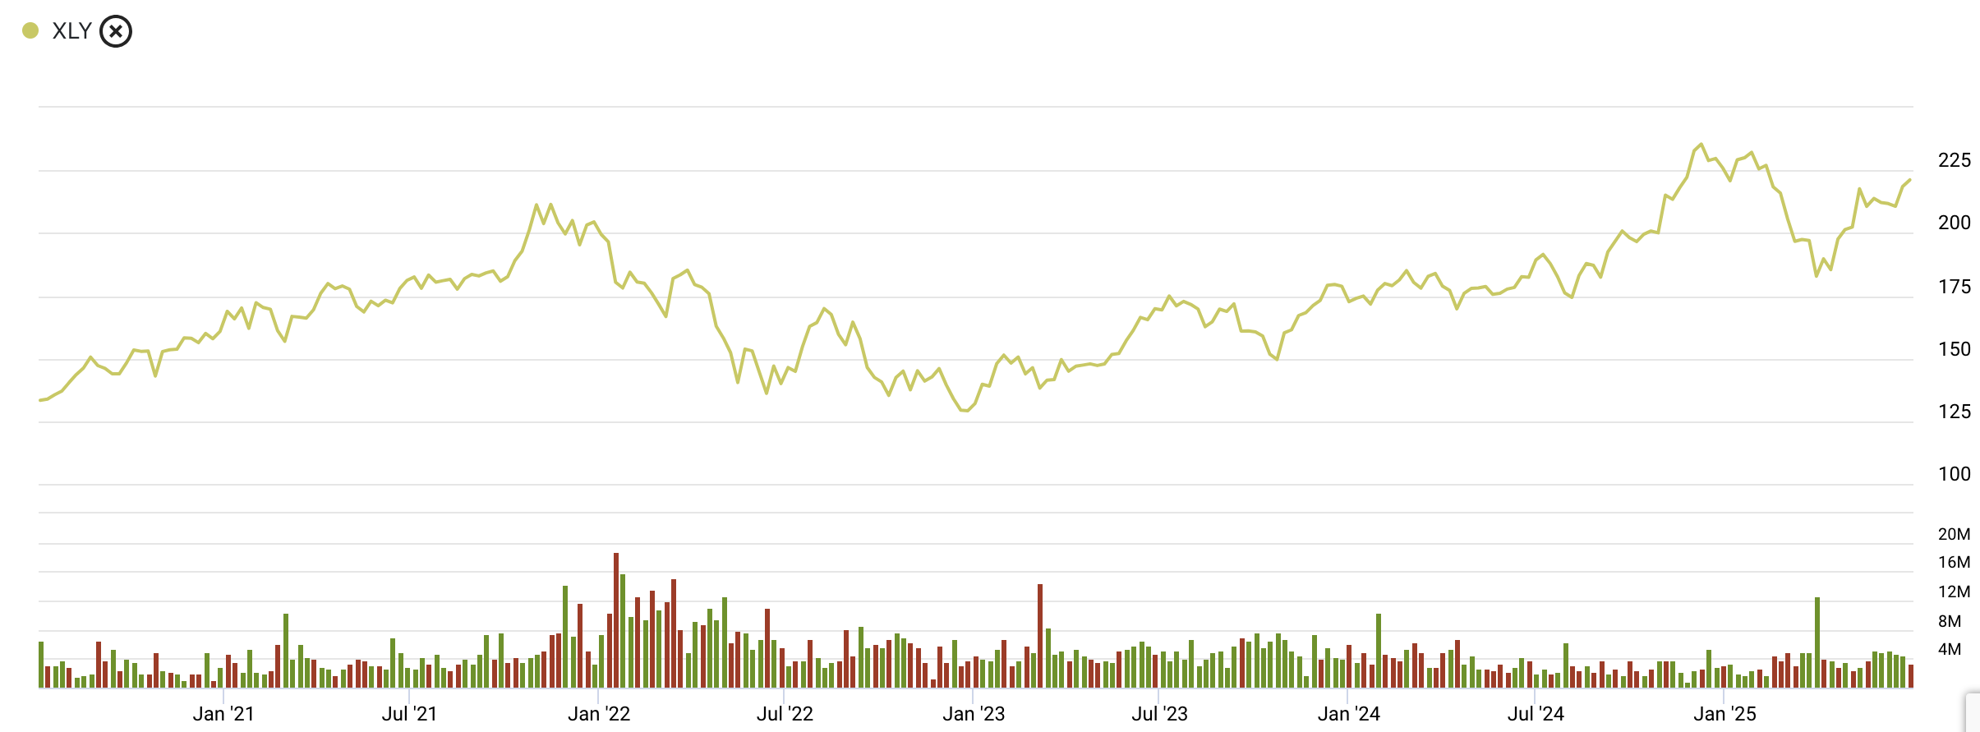
Sector Performance (5Y)
Current: $221.21
Range: $217.02 - $219.30
3

Slide 4
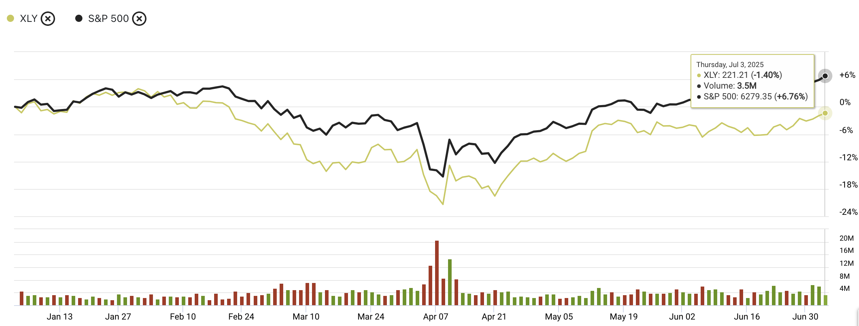
Sector Performance (YTD)
Slightly underweight in the SIM
Strong sector performance
  5Y: Up 69.51%
Sector is currently underperforming S&P 500 as of YTD
4

Slide 5

Business Analysis

Slide 6


Founded in 1994
Stock Price: $223.47 / Market Cap: $2.37T
Shares Outstanding: 10.62B
Leader in e-commerce and cloud computing (AWS)
Key Business Drivers:
  Consumer loyalty & Prime loyalty
  AWS
  Growing advertising segment
Outperforming Sector YTD
Risks:
  Regulatory scrutiny
  Risks of recession or higher interest rates could affect consumer disposable income
  Increasing competition
Leading premium athletic apparel brand focused on performance wear, lifestyle, and direct-to-consumer experiences
Stock Price: $323.00 / Market Cap: ~$41B
Shares Outstanding: 127M
Business Drivers:
  Strong Brand & Loyalty: High customer retention, expanding men’s & international segments
  Omni-Channel Strength: 45%+ of sales from e-commerce; fast-growing digital + store synergy
  Margin Power: Gross margin ~56%, premium pricing strategy
  Risks
  Competition: Nike, Adidas, Alo Yoga gaining share in lifestyle/athleisure
  Valuation Volatility: Trades at a premium (P/E ~17x) but well below historical average (42.53 10yr avg)
  Economic Sensitivity: Discretionary category vulnerable to consumer pullback
6

Slide 7

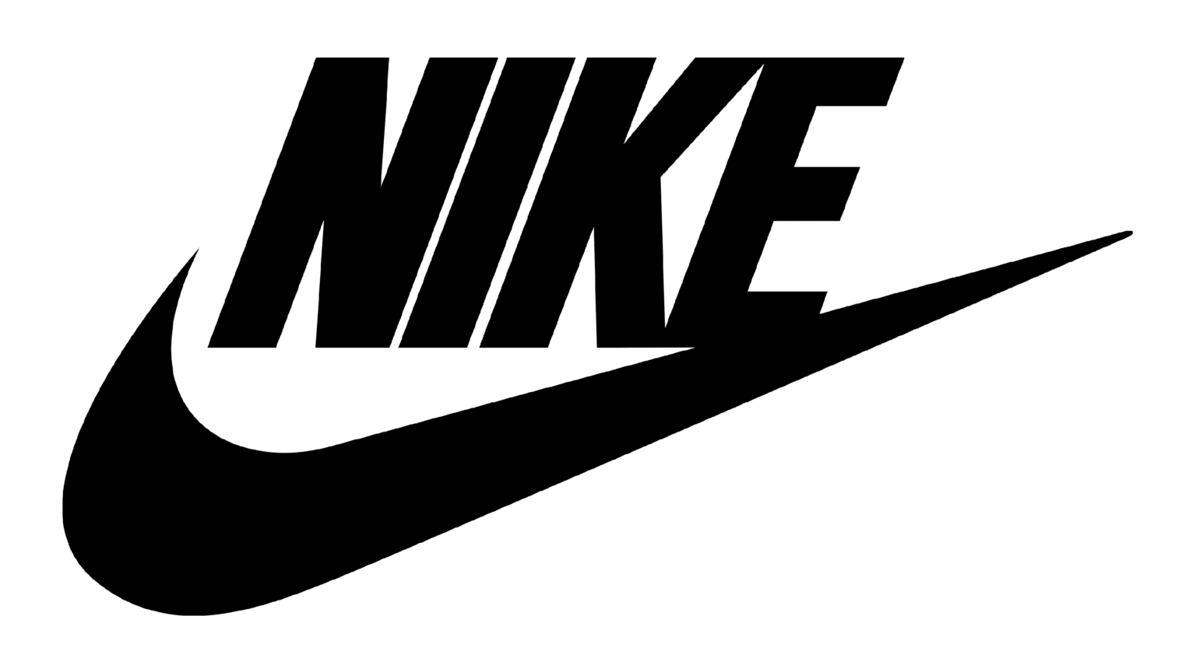
Lowe’s
Second largest home improvement retailer
Growing Pro business
Digital investments
Supply chain investments
Performance Drivers
  Housing market, Mortgage rates, and Inflation.
Risks
  Decreased consumer spending and elevated rates.
Headquartered in Beaverton, Oregon
Global athletic footwear, apparel, equipment, and accessory company
Stock Price: $73.89 / Market Cap (bn): $112.96
Shares Outstanding (bn): 1.18
Drivers:
  Customer loyalty & strong brand recognition
  Digital platforms & e-commerce
  Innovative product development & endorsements
Risks
  Intense competition
  Supply-chain issues & tariffs
  Economic downturn
7

Slide 8

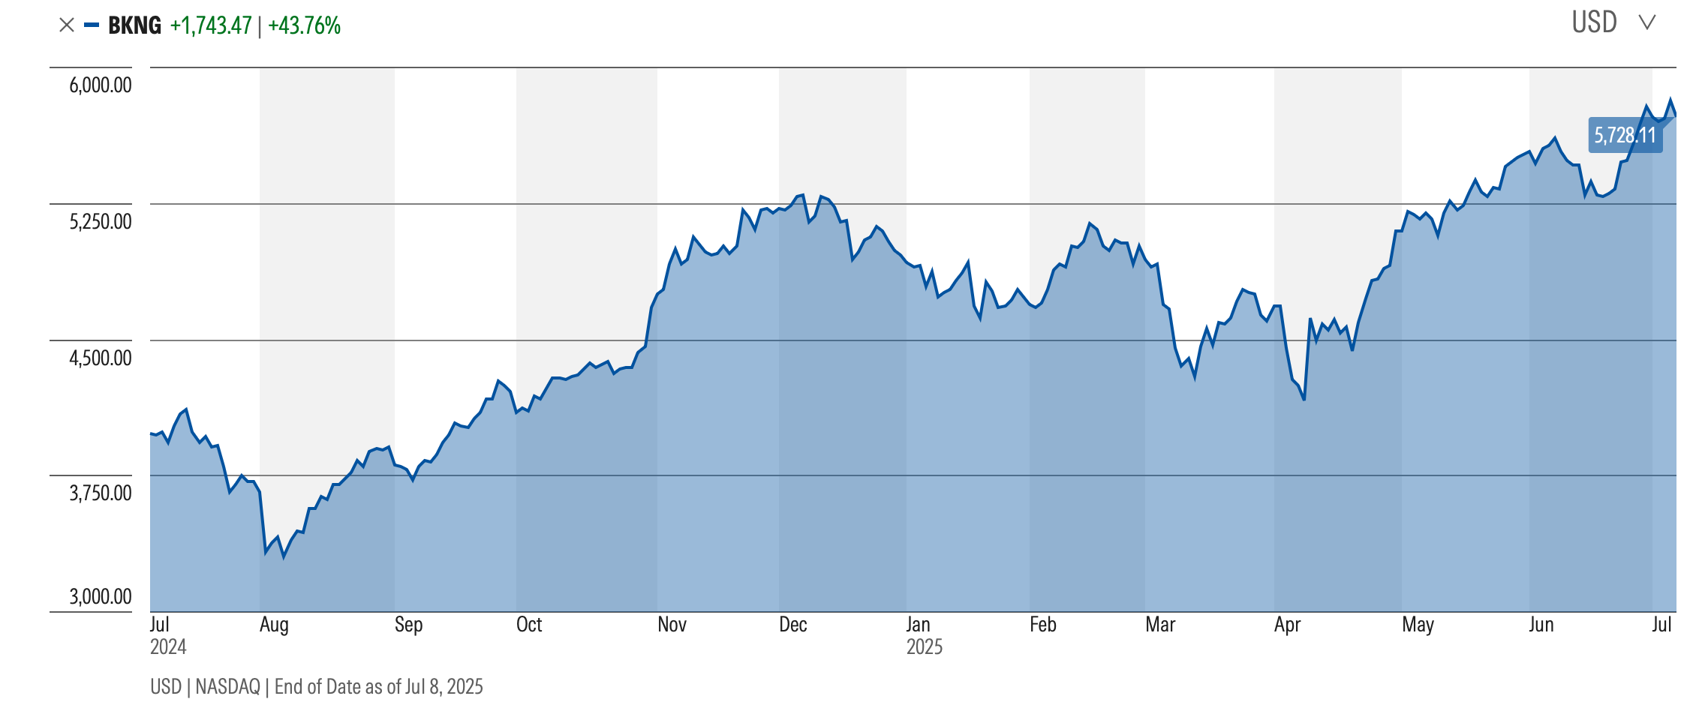
Currently up 43.76% over the past year
FY 2025 Revenue Estimate: $24.09B
P/E: 36.12 Above sector, below historical peak
Growth Drivers:
  Rebound in global travel demand
  Expansion into alternative accommodations and AI-driven personalization
  Continued margin strength from direct booking traffic and app growth
8

Slide 9

Financial Analysis

Slide 10
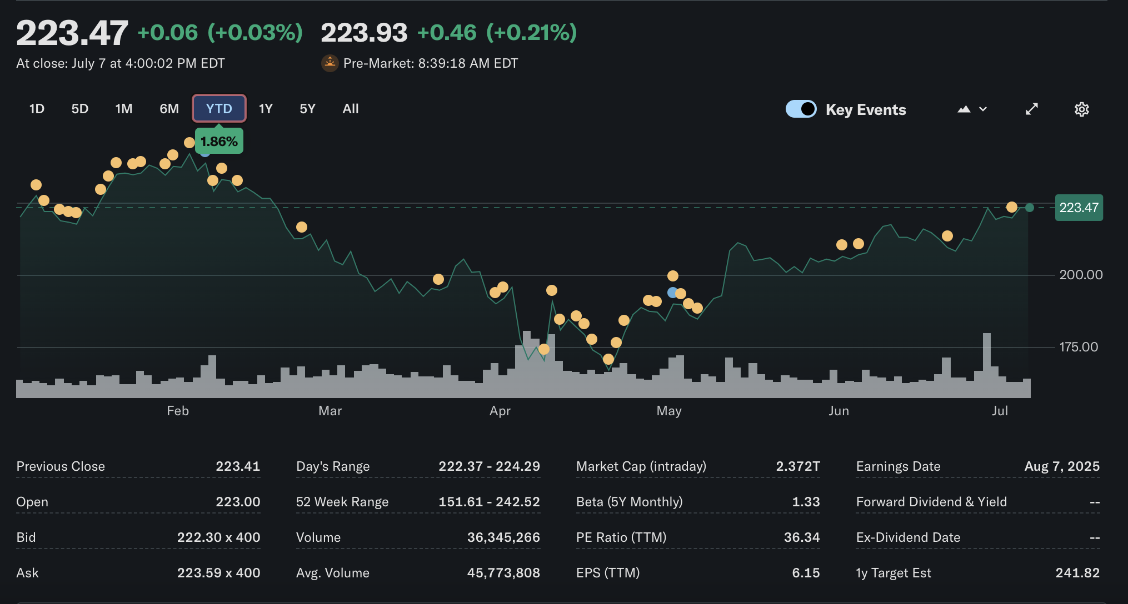
Amazon
Currently up 1.86% YTD
EPS: $6.21
P/E Ratio: 36.34 - slightly undervalued compared to the norm
Amazon ROE – 22% - above historical average
FY 2025 Revenue: $695.18B (10% increase)
Consensus Revenue Estimate 2026: $762.82B
Projected future growth due to investments I AI to drive AWS improvements, lower inflation, stable consumer spending
Well positioned for long term growth in the markets

Slide 11
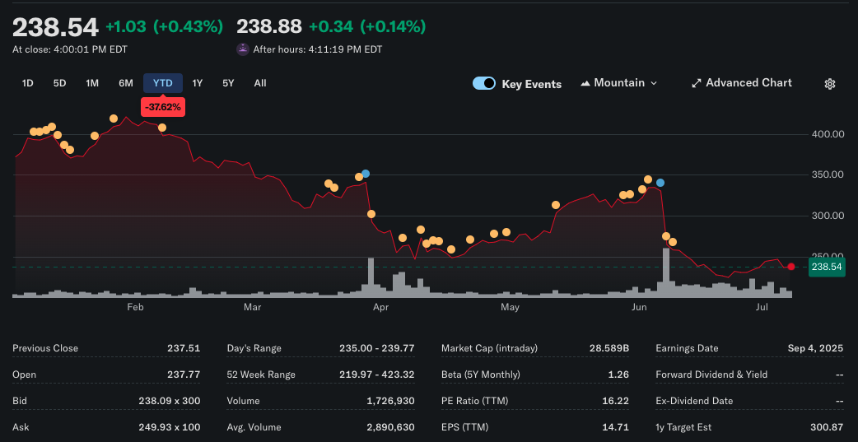
Lululemon
Currently down -37.62% YTD
EPS: 14.71
P/E Ratio: 16.22 – fairly valued vs. industry
ROE: 42% significantly above historical average
Fy 2025 Revenue: $11.3B (+10% YoY)
2026 Revenue Consensus: $12.0B
Pretty big pull back YTD; due to headwinds from tariffs, slowing U.S. demand, and margin concerns
But, long term growth still remains intact due to international expansion, brand strength & cash flow resilience

Slide 12
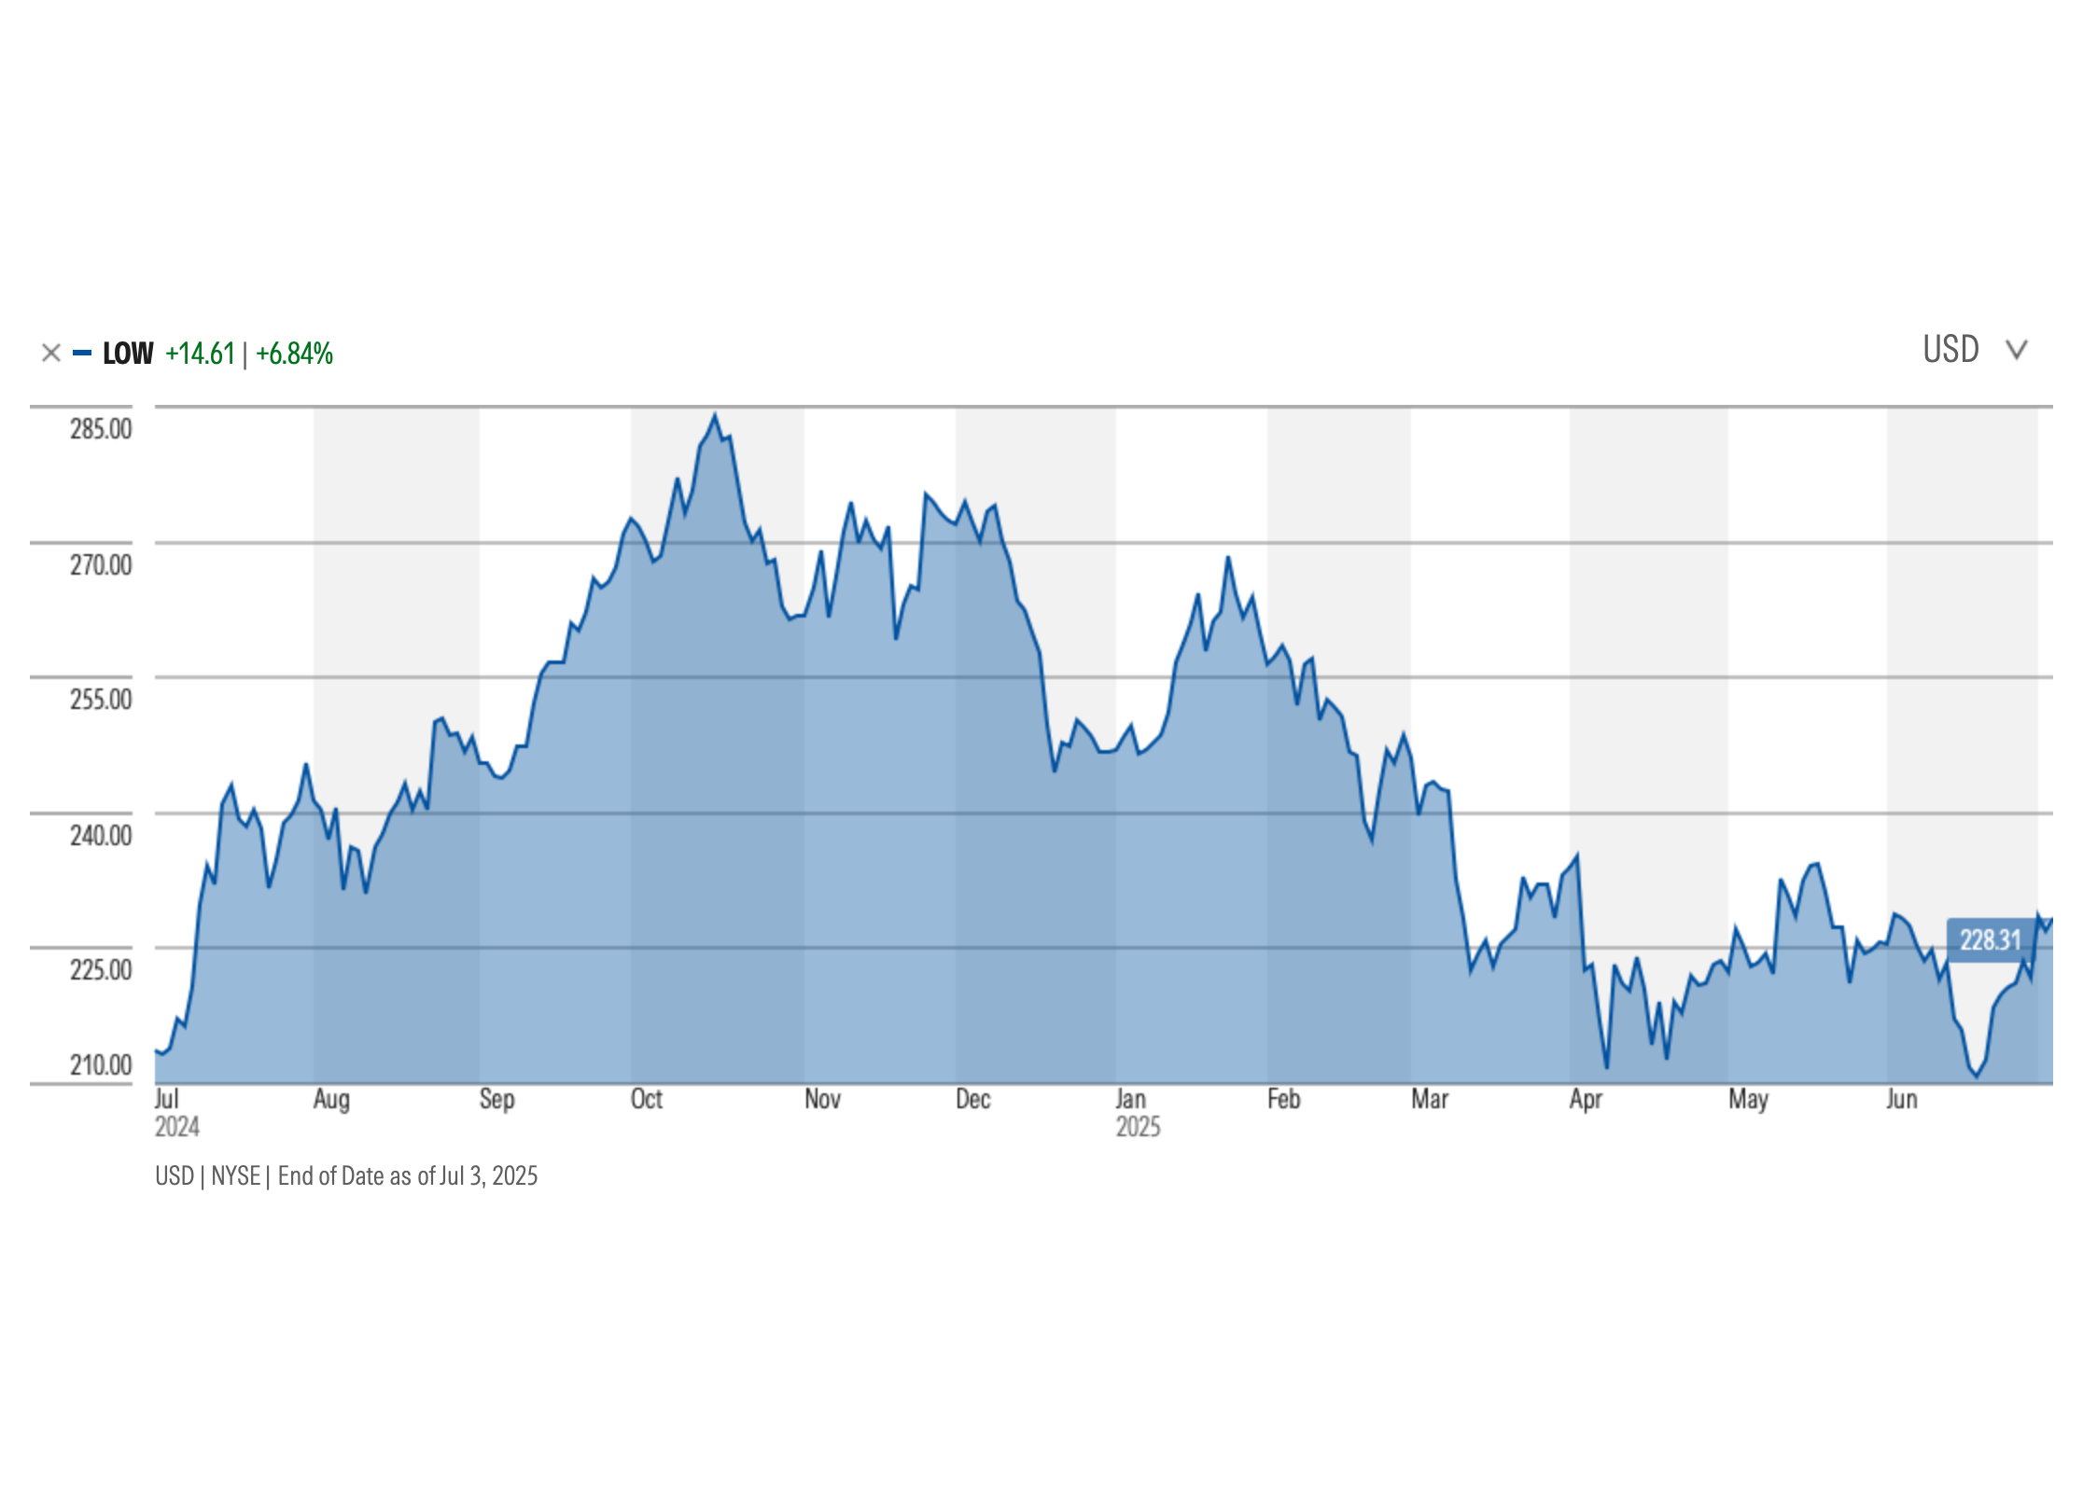
Lowe’s Companies Inc.
Currently up 6.84% over the past year
FY 2025 Revenue $83.67 B
P/E ratio 18.5 Slightly undervalued or fairly priced
Projected future growth due to rate cuts, better mortgage rates, increased housing market activity

Slide 13
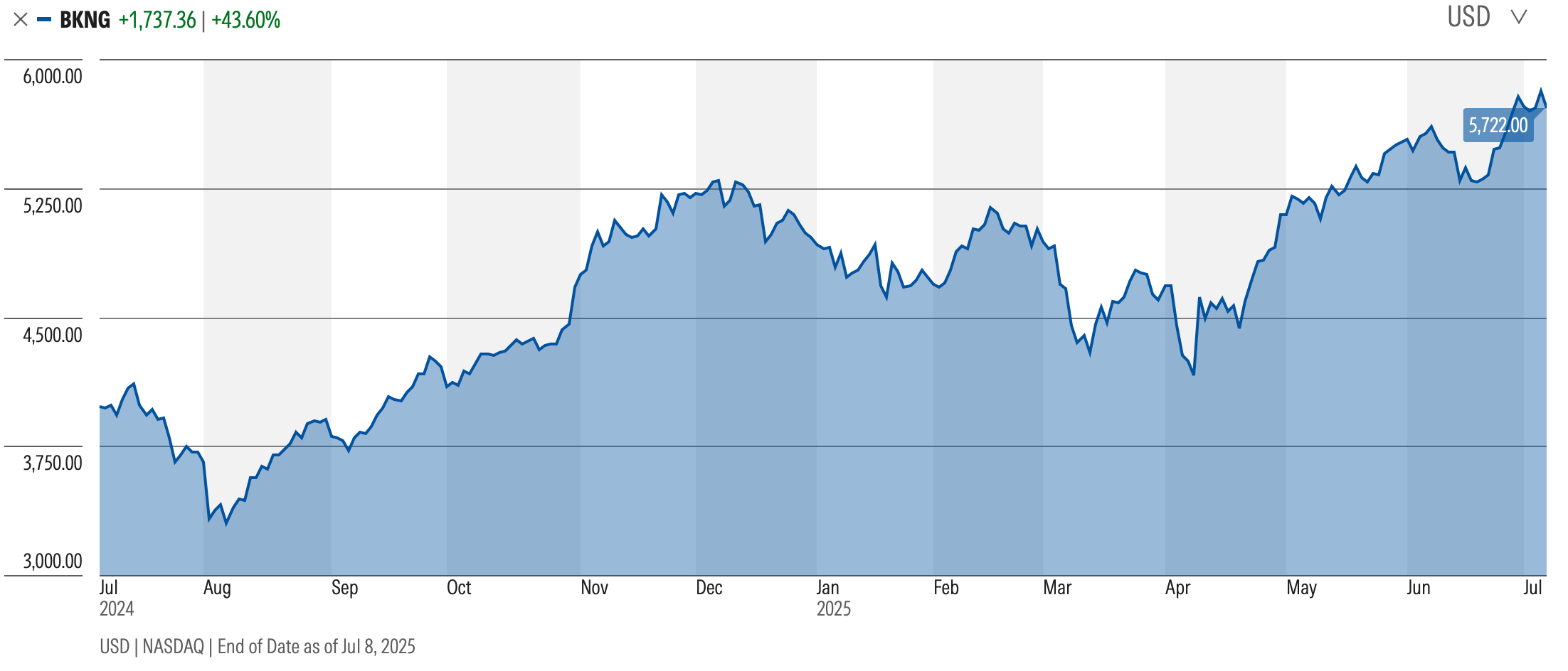
Booking Holdings
The stock is up 43.6% over the past year, showing strong momentum.
2025 revenue is expected to reach $25.92B, with 2026 estimates at $28.31B—about 9% growth year over year.
Booking trades at a premium, backed by strong travel demand, high margins, and exceptional returns.
13

Slide 14
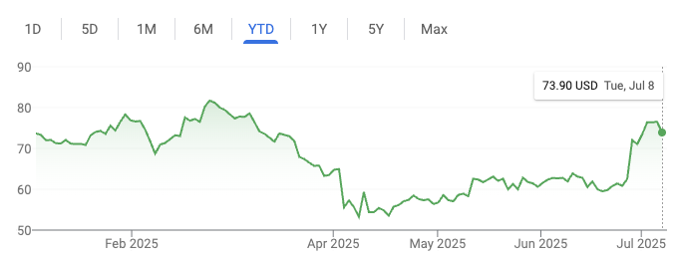
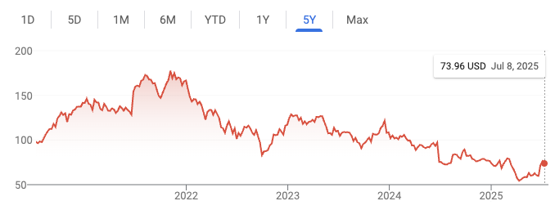
Nike
Currently up 0.42% YTD
EPS: $2.16
P/E Ratio: 34.25 - slightly undervalued compared to the norm
ROE – 23.29% - below historical average
2025 Revenue: $46.3B (~10% decline)
Modest upside with inventory reduction and increasing sales in China
Risks include macro uncertainties, potential slower rebuild in China, and extended discounting
Transitioning through a reset phase

Slide 15

Valuation

Slide 16
Target Price
Target Price
Potential Price Appreciation
Amazon : $241.82
Booking : $5626.94
Lowe’s: $264.48
Nike : $73.36
Lululemon: $298.77
$21.90 or 9.96% upside
$-95.06 or -1.66% downside
$33.08 or 14.29% upside
$.73 or 0.086% upside
$60.23 or 25% upside

Slide 17
Valuation v. Industry
P/E
P/S
EV/EBITDA Estimate
Booking: ~36.12x
Amazon: ~36.4x
Nike: ~35.3x
Consumer Discretionary Sector: ~30.6x
S&P 500: ~26.5x
All Stocks currently trade above the sector P/E
Booking: ~8.1x
Amazon: ~3.2x
Nike: ~3.8x
Consumer Discretionary: ~2.5x
S&P 500: ~3.2x
All three companies trade at a premium to both the sector and the S&P 500, reflecting brand strength and growth potential.
Booking: ~23.4x
Amazon: ~18.5x (blended across AWS and retail)
Nike: ~30.4x
Consumer Discretionary: ~19x
S&P 500: ~14.5x
Valuations are elevated but justified by higher margins and return on capital.

Slide 18
Future Valuation
Booking Holdings
Amazon
Nike
Forward P/E: ~27.7×
S&P 500 Forward P/E: ~22×
Trades at a premium to the S&P 500 and most travel peers (Expedia ~10×, Airbnb ~22×).
P/E Reflects strong profitability, high ROE, and post-pandemic travel momentum.
Valuation likely stays above market average, supported by their asset light model and consistent margin strength.
Forward P/E: ~34.6×
Premium driven by AWS, AI, and logistics improvements.
P/E has come down significantly from ~90× in 2021 to current ~30s.
Valuation likely to stay stable or slightly decline as profit margins expand.
Still viewed as a long-term compounder and a lasting premium is expected.
Forward P/E: ~43×
High multiple despite recent earnings decline and ~10% drop in revenue (FY2025).
Trades at a significant premium to sector peers (apparel/footwear ~15–16× forward).
Nike’s valuation is high given recent sales and earnings weakness.
If growth remains slow, the stock may lose some premium but could grow into its valuation over time.

Slide 19
Recommendation
Amazon
Catalysts: Strong AWS and AI-driven growth, and cost efficiencies improving margins.
Risk: Slower-than-expected AWS growth, regulatory headwinds.
Why Buy: AWS and AI-driven growth continue to drive profit expansion, cost efficiencies support margin upside. Amazon offers upside if growth stays on track, making it a strong addition.
Booking Holdings
Catalysts: High ROE, margin strength, continued travel demand
Risks: Macro headwinds, FX risk, competitive pressure
Why Hold: While Booking benefits from high ROE and travel sector recovery, its current valuation leaves limited upside unless demand picks up. Holding maintains exposure without overpaying for future growth.
Nike
Catalysts: Global brand strength, potential long-term recovery
Risks: Revenue decline, weak consumer demand, inventory buildup
Why Sell: With a ~10% revenue drop and lofty valuation, Nike’s price doesn’t align with its recent performance. The best course of action is to avoid potential decline.

Slide 20
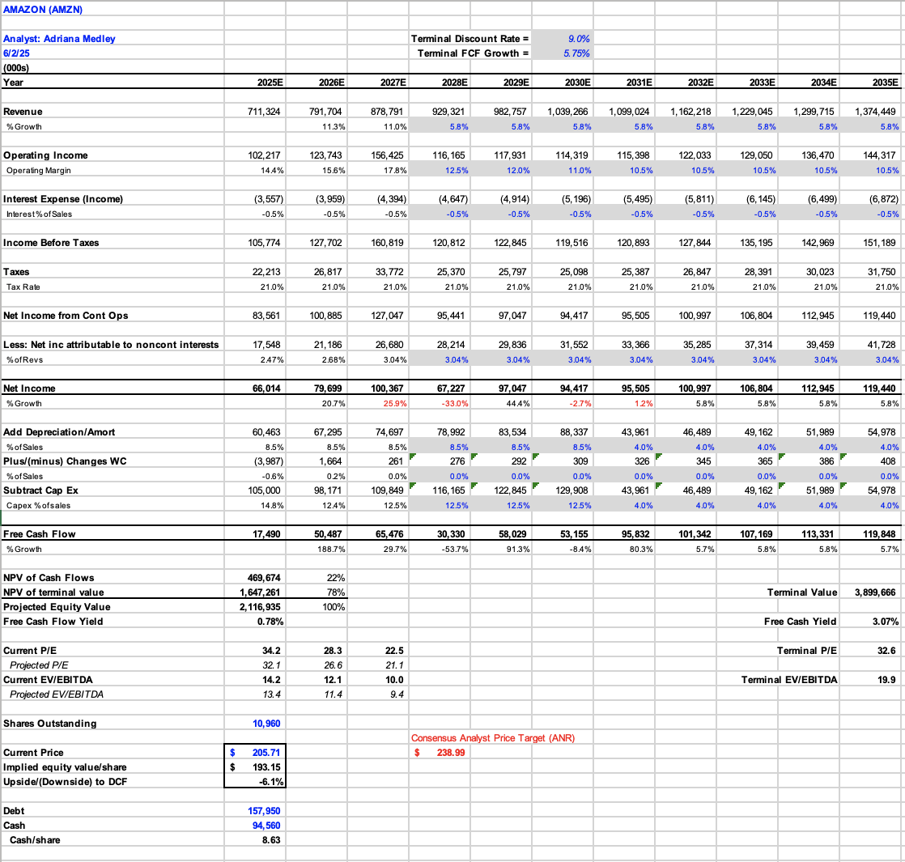
DCF Appendix

Slide 21
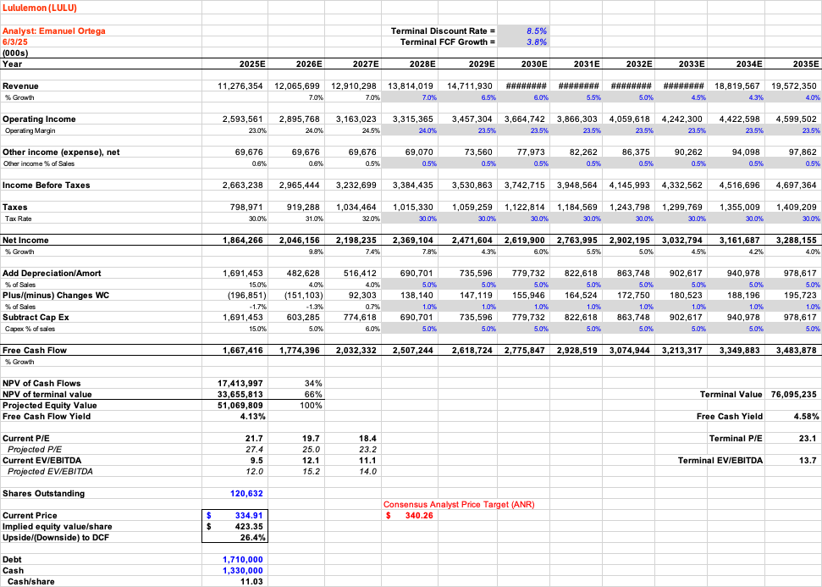
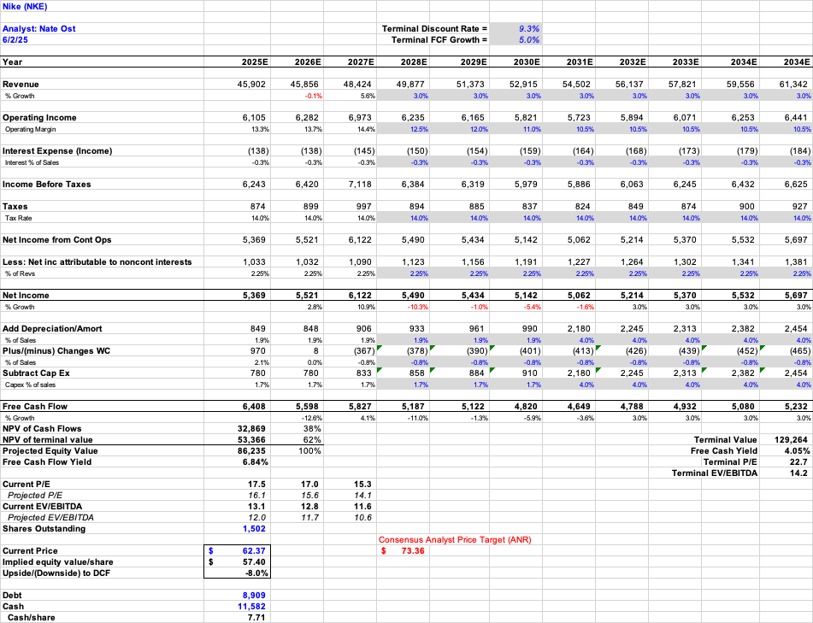
DCF Appendix

