Slide 1

Consumer
Discretionary
BUSFIN 4228
By: Adriana Medley, Connor Michalski, Hrushi Muskula, Emanuel Ortega & Nathan Ost

Slide 2

Agenda
Overview
Business Analysis
Economic Analysis
Financial Analysis
Valuation Analysis
Recommendations

Slide 3

Sector Overview
Consumer Discretionary: Businesses that sell non-essential goods & services. (Luxury or “Want” items)
Size of Sector: 10.47% against S&P 500
Industries:
  Household goods
  Automotive
  Travel & Leisure
  Luxury & Apparel
  Etc.
Largest Companies:
  Amazon (23.06%)
  Tesla (17.22%)
  Home Depot (6.57%)
  Booking Holdings (4.69%)
  McDonald's (4.11%)

Slide 4

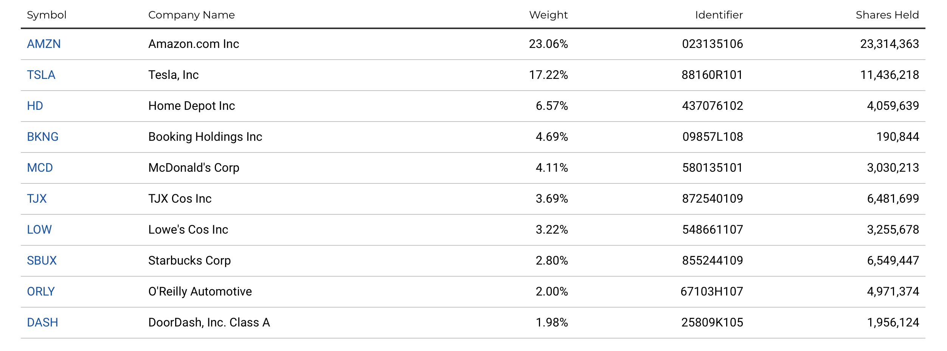
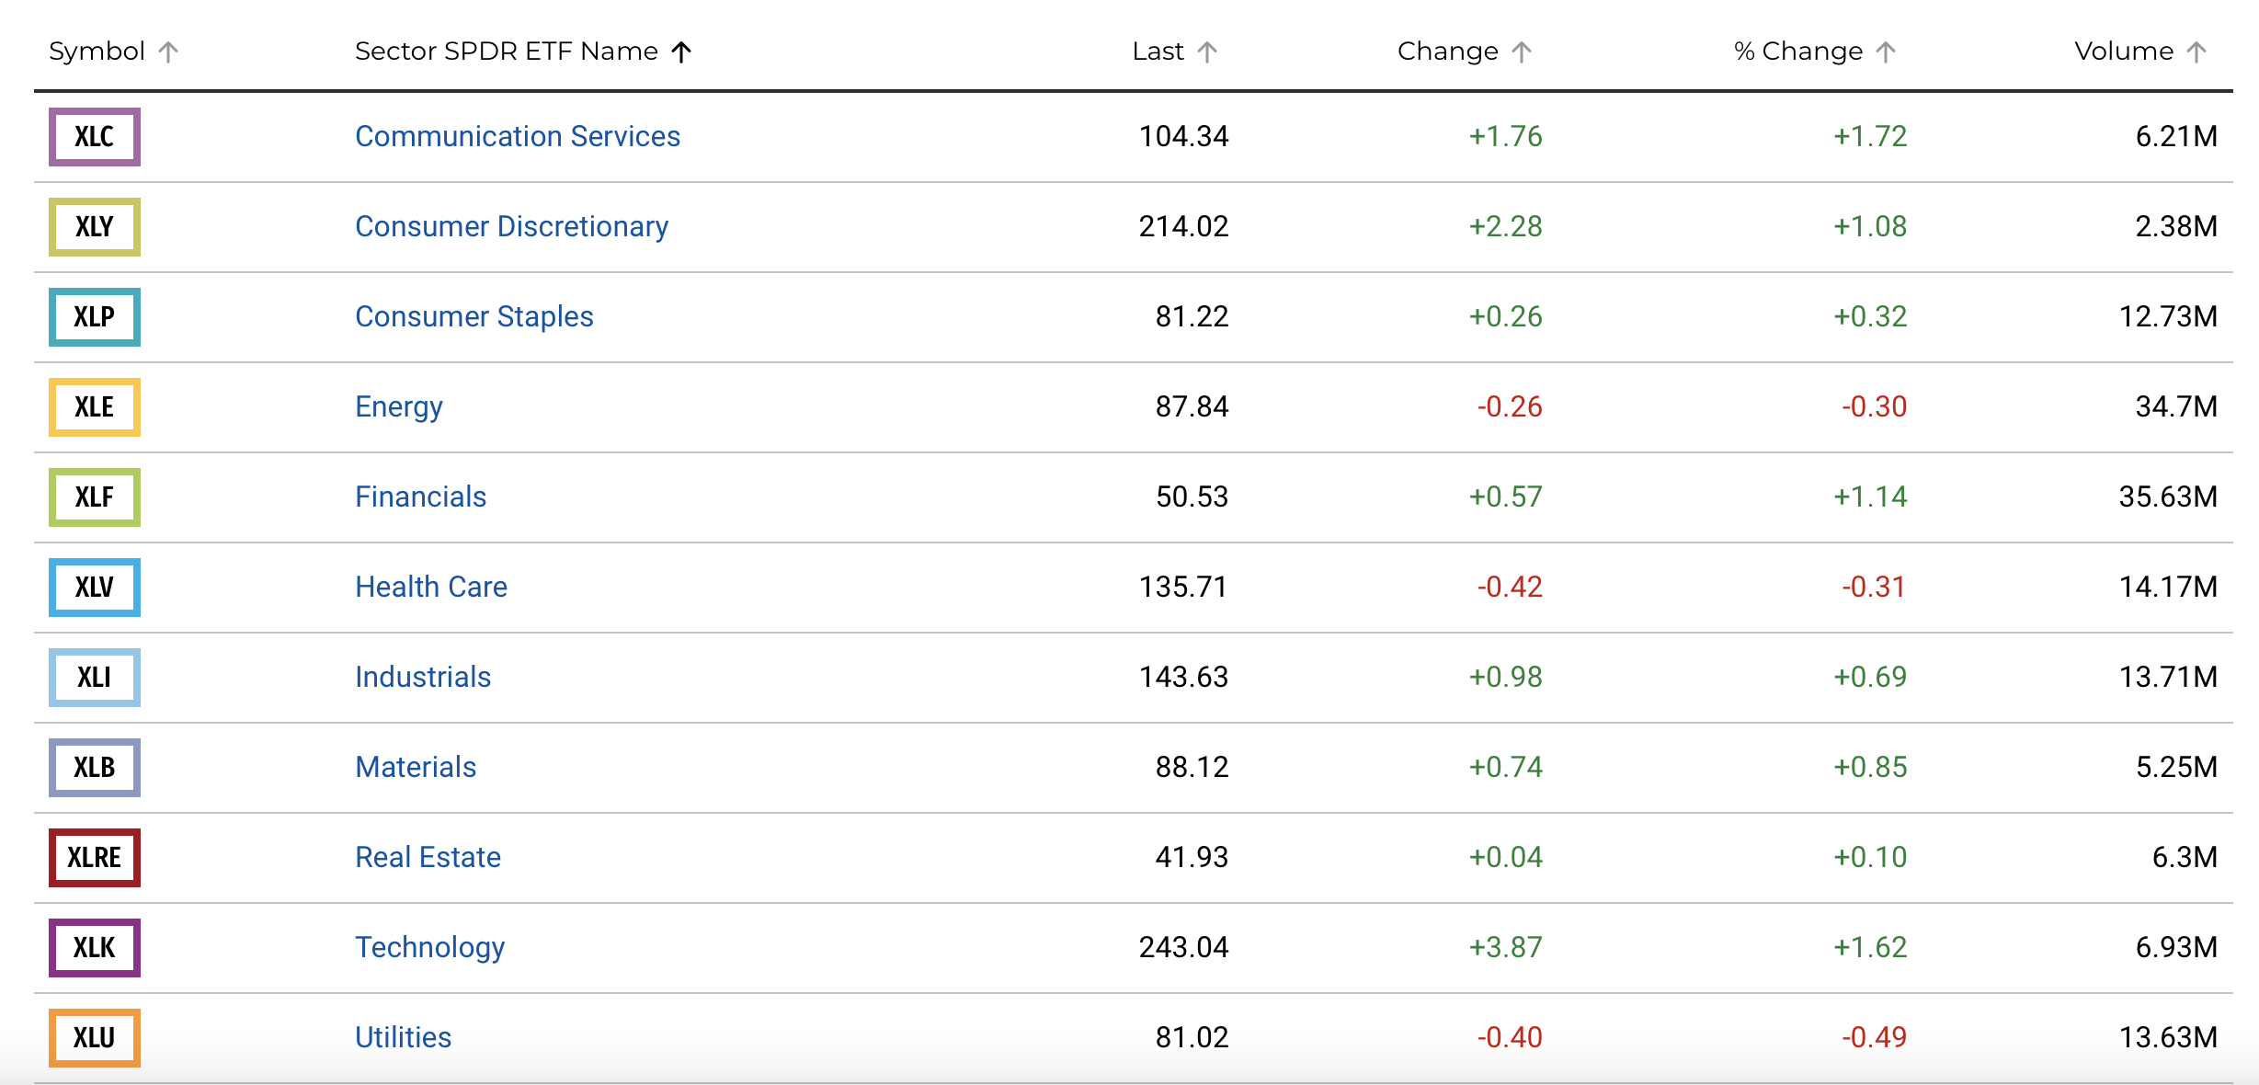

Slide 5
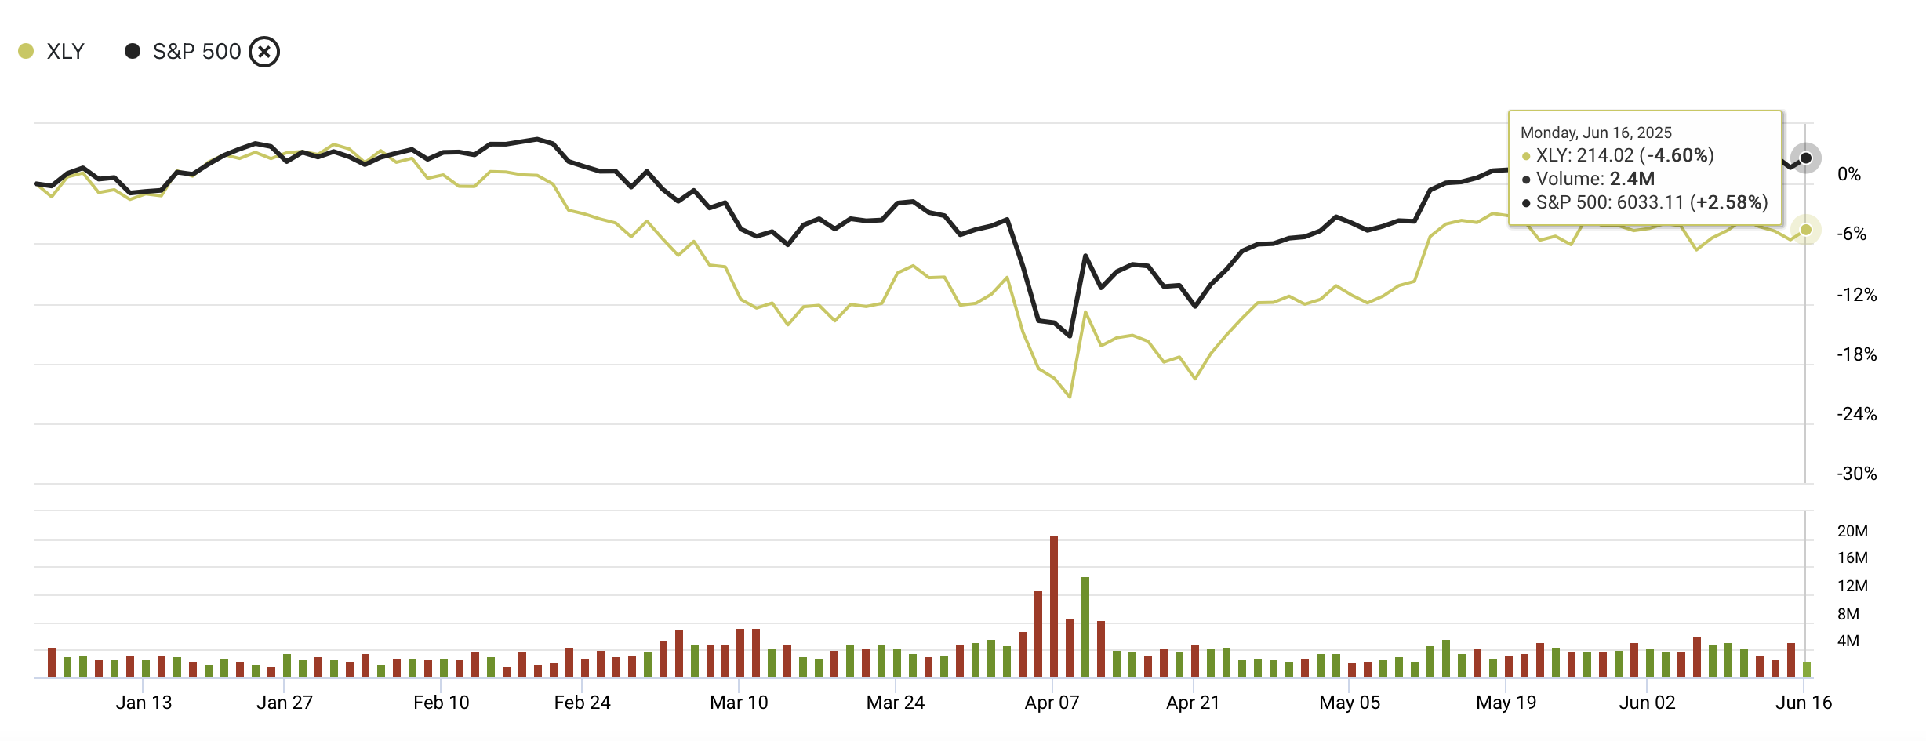
Year to Date Performance
XLY is down by around 4.60%
Underperforming the market by 7.18%

Slide 6
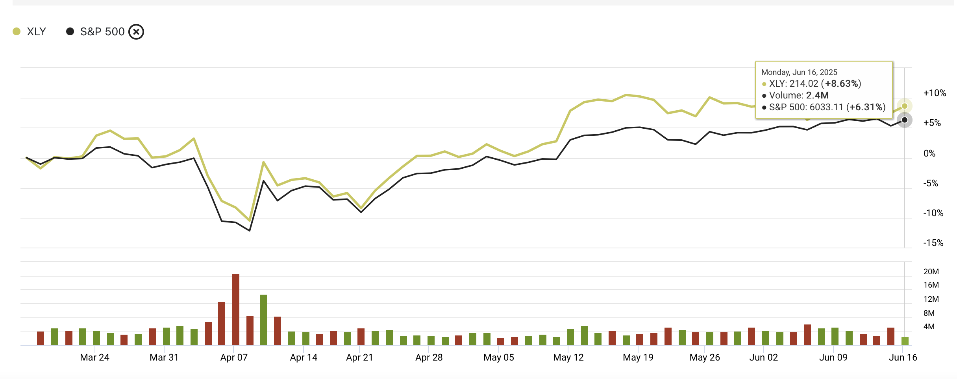
Quarter to Date Performance
XLY is up by around 8.63%
Overperforming the market by 2.32%

Slide 7
Business Analysis
Consumer Discretionary is a highly cyclical sector that is strongly correlated with strength of economy:
  Economic Conditions:
    US Economy (GDP rate, level of consumer confidence, unemployment rate)
    Global Economies (Market growth, trade policies/tariffs, exchange rates)
  External Factors: E-commerce growth, AI advancements, corporate sustainability initiatives
Current phases of the Life Cycle:
  Mature = Traditional retail and automotive (Slower growth due to market saturation, price competition and shifting consumer behavior)
  Growth = E-commerce, electric vehicles, streaming services (Expanding due to innovation, changing consumer preferences and strong demand for digital tools)

Slide 8
Business Analysis Cont'd
Porter's Five Forces Model (Analysis of the Competitive Environment)
Competitive Rivalry (High)
  Current intense competition with price wars in markets such as retail, auto, streaming
  This requires differentiation through branding, customer experience, and technology
Threat of New Entrants (Moderate)
  Currently still high capital requirements in automotive + EV markets
  E-commerce has significantly lowered entry barriers, especially for niche brands
Threat of Substitutes (High)
  Many alternatives are readily available (public transport vs cars, free content vs streaming)
  Consumer preferences are constantly shifting due to experiences, sustainability, product tech
Bargaining Power of Suppliers (Low)
  Most retailers and e-commerce stores dictate supplier's terms
  Only the automotive markets are struggling with supplier power due to supply chain issues
Bargaining Power of Buyers (High)
  Consumers are able to easily compare prices and reviews of products
  Switching brands is very easy in retail and streaming

Slide 9

Economic Analysis
Highly Cyclical Sector: Consumer Discretionary stocks tend to perform well in economic expansions and underperform during recessions, making them strongly tied to macroeconomic conditions.
Economic Sensitivity: These companies depend heavily on consumer confidence, disposable income, and employment levels, which are all cyclical indicators.
Interest Rate Sensitivity: Changes in interest rates directly affect consumer borrowing, which impacts demand in the sector. Regression analysis can quantify this impact over time.

Slide 10
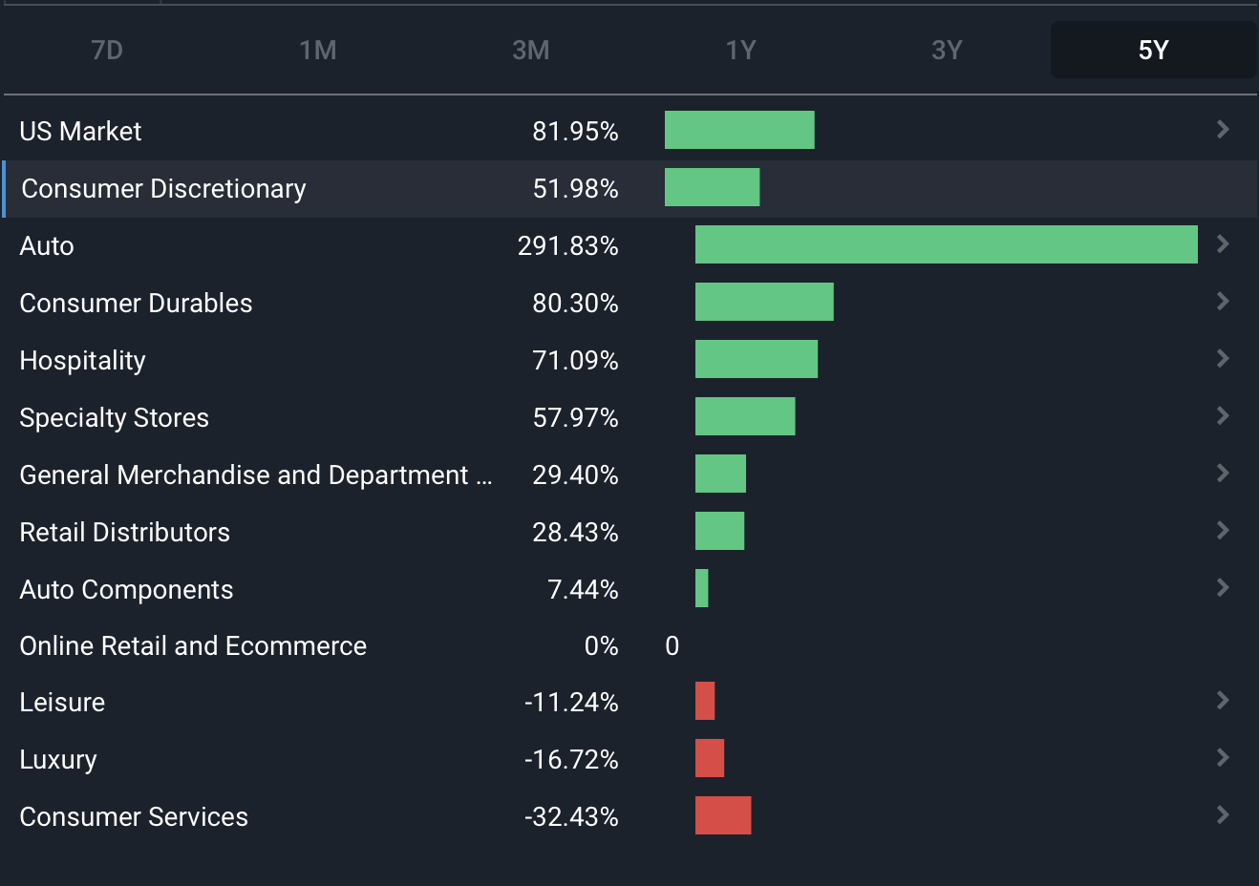
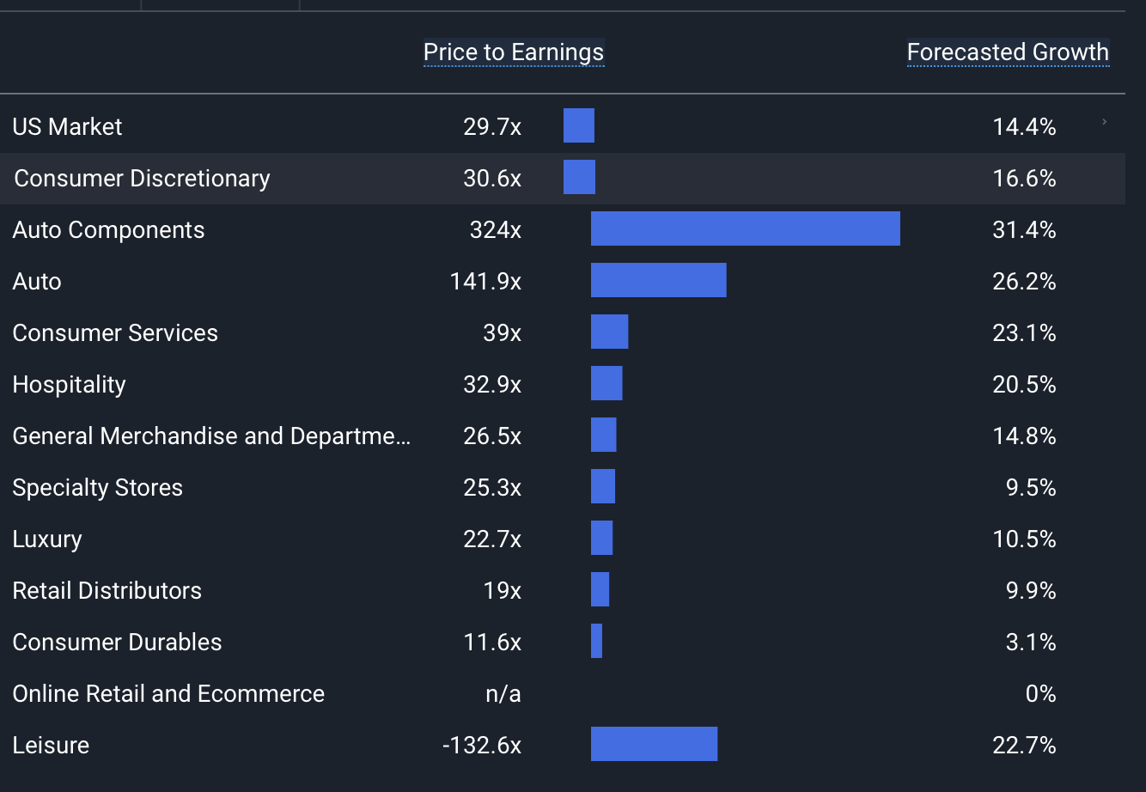
Returns
Financial Analysis
Valuation
https://simplywall.st/markets/us/consumer-discretionary

Slide 11
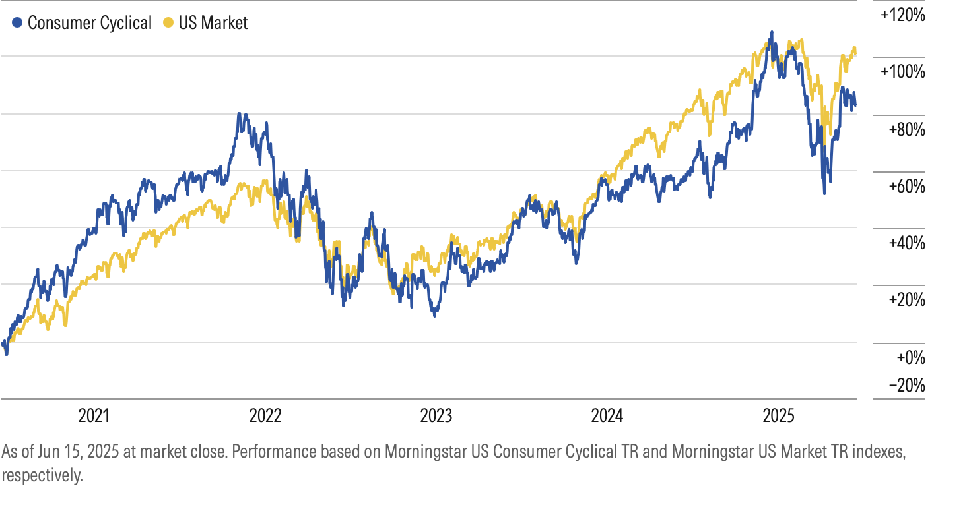
Performance vs Market

Slide 12
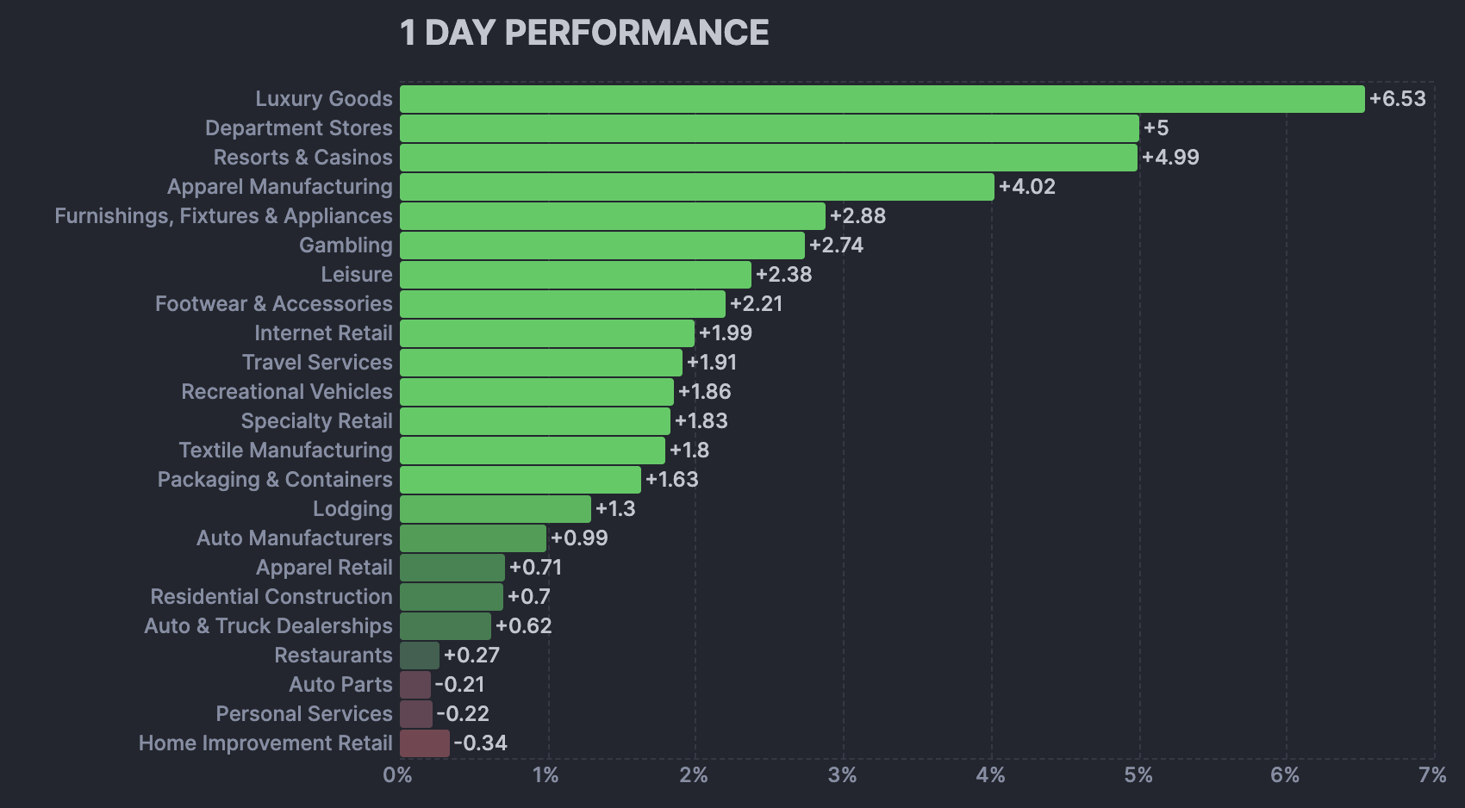
Valuation Analysis

Slide 13

Recommendations
Reasons to be Optimistic:
Sector benefits from AI-driven retail personalization and automation.
Strong wage growth supports higher-end discretionary purchases.
Resilient labor market and improving real income outlook.
Risks:
Inflation could continue to eat into margins & consumer spending (CPI last reported @ 3.8%)

Slide 14
Recommendations
Our Portfolio Weight: 8.20%
S&P 500 Sector Weight: 10.65%
Underweight by: 2.45%
We recommend increasing our exposure to the Consumer Discretionary sector to at least market weight or slightly above.
1. Attractive Sub-Sector Opportunities
High-growth names in e-commerce (Amazon, Etsy) and premium retail (Lululemon, Nike) continue to drive sector performance.
2. Strong Fundamentals
Sector ROE of 27.6% vs. 25.2% for S&P 500.
Valuation premium is justified by brand strength, pricing power, and digital strategy adoption.
3. Improving Macro Tailwinds
Real wage growth supports discretionary spending.
4. Underweight Creates Opportunity
Being underweight has limited upside capture in recent rallies.
Increasing weight better aligns with market trends and expected consumer resilience.

