Slide 1

Stock Recommendation
Consumer Discretionary

Slide 2




Team Overview
Adam Amara
Lukas Breunig
Vlad Bennett
Vu Bui
Consumer Discretionary Analyst
Consumer Discretionary Analyst
Consumer Discretionary Analyst
Consumer Discretionary Analyst

Slide 3



Consumer Discretionary Overview
Sector Recommendation
Overweight
  Sector is positioned for reacceleration due to expected continued rate cuts spurring economic activity​
  Structural themes within the industry such as digital retail & travel rebound support upside
Current Consumer Discretionary Holdings
As of October 2025
  Amazon
  Booking Holdings
  Nike Inc
Buy/Sell Recommendations
Sell Booking Holdings
Buy Amazon
Buy Lululemon
Buy Chipotle Mexican Grill

Slide 4
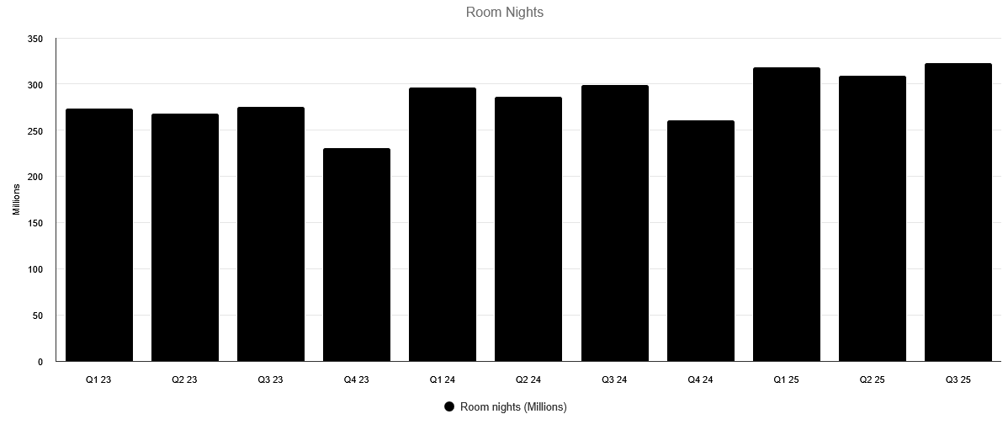
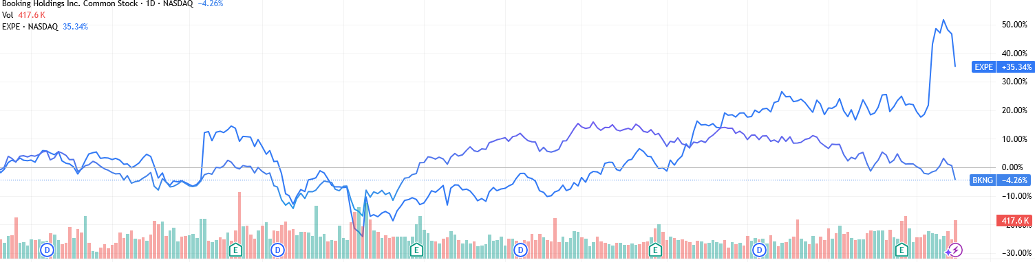
Business Analysis
The primary driver for Booking is commissions from bookings, which has begun to normalize post COVID.
Booking is trying to implement AI to reduce headcount and provide advisors.
A direct competitor of Booking is Expedia who has shown proof of margin expansion, dramatically boosting their stock price.
A recent sell-off of Booking stock is also due to the rise of Google Travel, which incorporates AI for bookings, and will eventually become a more direct competitor as an Online Travel Agency (OTA) since it will handle bookings instead of passing them off.
As of 11/17/2025
Notes:
Expedia has a bloated cost structure, and less efficient tech stack

Slide 5
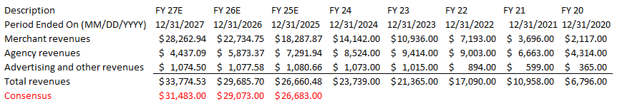
Financial Analysis
Revenue prediction is roughly the same as the consensus.
  Emphasis of Booking is to shift Agency to more profitable Merchant revenues.
Booking’s ROE is currently negative due to treasury stock, thus not meaningful.
Strong revenue growth of 12.96% compared to 3.21% for the sector.
Exceptional gross profit margin of 86.99% compared to 38.63% for the sector.
Notes:
Merchant is more profitable than agency

Slide 6
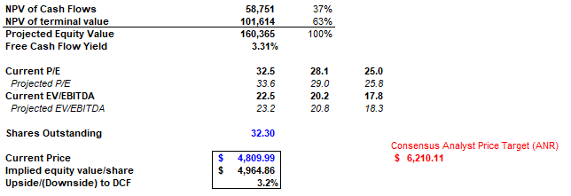
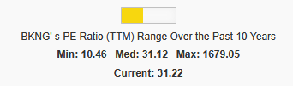
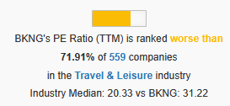

Valuation
Current stock price of $4,809 is only slightly lower than our price target of $4,964.
  This is primarily driven by our terminal discount rate (11%) and FCF growth rate (4%).
    Using the S&P 500 as an anchor we believe the terminal should be higher (Booking beta of 1.25), and a lower growth rate after normalization and heightened competition.
  We recognize that we have a strong divergence from consensus on outlook and risk. This is due to a split in assumed growth rates.
While Booking’s PE ratio is now closer to it’s median, it is still relatively high to compared to its industry and its sector.
Notes:
Non-GAAP removes anomalies

Slide 7
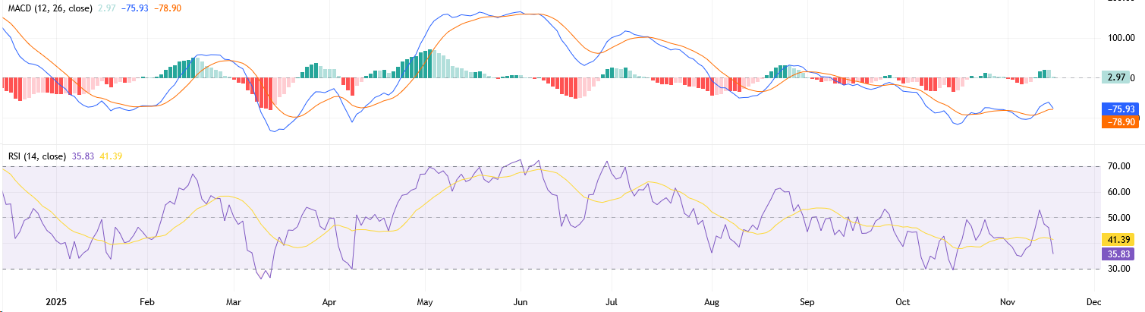
Technical Analysis
Reviewing the Moving Average Convergence Divergence (MACD), while both the signal line and MACD line is negative, the histogram is showing an upward purchase trend.
The Relative Strength Indictor (RSI), confirms a similar thesis, that the stock is nearly oversold. The price may rebound once it dips under 30.
Notes:
MACD line = 12-day EMA *MINUS* 26-day EMA (exponential moving average — weighs recent days heavier)
Signal line = 9-day EMA
Histogram = distance between lines
RSI line = avg gains / avg losses 14-day scale
RSI signal line = moving avg of RSI

Slide 8
Recommendation
Booking Holdings, while trading mostly flat for the past year, the stock has shown that the post-COVID growth in revenue has begun to slow down (-14% in past fiscal year). Despite a possible rebound in price, strong margins, and marginally beating expectations, their long-term prospects are not clear. We have a target price of $4,964.86, with an expected 3.2% return, and is currently 1% of the portfolio.
Baked into their current price is high expectations priced in for high growth, vague promises of AI cost savings that have not materialized, coupled with macro economic uncertainty of consumer bookings and poor performance, the rise of Google Travel could be detrimental to their market share. We believe that Booking is overvalued and will continue to fall under it meets support, therefore it would be most prudent to fully liquidate the position and invest in something more promising.

Slide 9




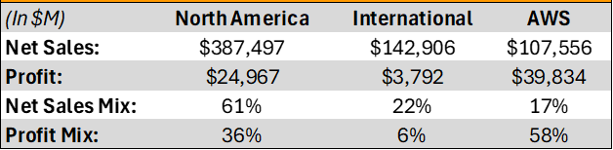


Business Analysis – Amazon
Amazon (AMZN)) is a leading global technology and retail company with operations in e-commerce, cloud computing, advertising, and digital streaming
Amazon is broken down through three primary segments: North America, International, and Amazon Web Services
Key Drivers
Accelerating profitability of high-margin segments
Investments in automation & increased efficiency across the e-commerce and logistics segments
Strong cross-segment integration across business

Slide 10
Financial Analysis – Amazon
Profitability and growth outlook remains stronger than the industry average, supported by margin expansion in AWS and advertising, while retail-driven volatility is keeping EPS less stable
Compared to its historical performance, Amazon is entering a more favorable environment, complementing its traditional retail and e-commerce business with high margin segments

Slide 11
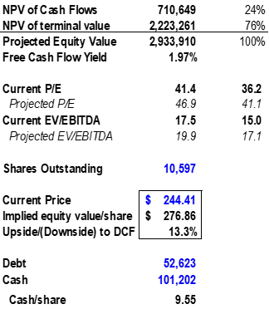
Valuation – Amazon
Based on the Discounted Cash Flow method, the derived target valuation for Amazon is $276.86 per share, a 13.3% upside compared to current price
Amazon’s valuation multiples have expanded over time as profitability and AWS scale have strengthened, and remain slightly above industry and broader market averages today
Going forward, modest multiple expansion is expected as mix shifts toward higher-margin cloud and advertising businesses, supporting the 13.3% DCF-implied upside while keeping valuation reasonable relative to sector peers and long-term trends.

Slide 12
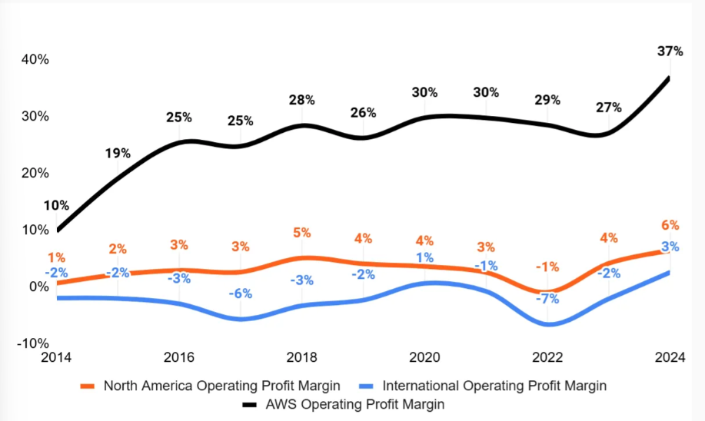
Recommendation
We recommend a BUY rating for Amazon (AMZN) with a price target of $276.86, implying +13.3% upside from the current share price of $244.41
Our valuation reflects Amazons market position in various sectors, their expanding margins and profitability, and the superior economies of scale due to operational scale
of the company
Despite inflationary pressure, Amazon has continuously expanded their net profit margins and we believe this trend will continue into the future

Slide 13

Business Analysis – Chipotle
Chipotle is a leader in the fast-casual restaurant market, selling customizable Mexican-inspired cuisine, including burritos, burrito bowls, quesadillas, tacos, and salads
Core customer base: younger generations (Millennials & Gen Z) & low- to middle-income consumers
Key Growth Drivers
U.S. Expansion: > 3,700 locations today, long-term goal of ~7,000 locations by the end of the decade
International Expansion: First Mexico location opening in 2026, large runway in Europe and Canada
Digital Ecosystem: 40M+ loyalty members, Chipotlane
Operational Efficiency & Automation: Autocado and Chippy systems
CMG Historic Performance
1M | 6M | YTD | 1Y | 3Y | 5Y
-26.91% | -41.11% | -50.45% | -49.59% | 3.61% | 19.38%
Pullback in visit frequency among price-sensitive younger and lower-income consumers
Macroeconomic Pressures: Persistent inflation and low consumer confidence

Slide 14
Financial Analysis – Chipotle
Chipotle consistently outperforms industry averages across all major financial metrics.
Financial strength supports the broader investment thesis of continued growth and recovery potential as macro headwinds ease.
High ROE and ROA demonstrate exceptional returns, particularly impressive given Chipotle carries little long-term debt, enhancing financial stability.
The company’s continued operational improvements and unit expansion plan suggest further upside to margins and cash generation.
 | 2020 | 2021 | 2022 | 2023 | 2024 | Industry Average
Revenue (Billion USD) | 5.985 | 7.547 | 8.635 | 9.872 | 11.314
Revenue Growth (YoY) | 7.10% | 26.10% | 14.40% | 14.30% | 14.60% | 6%
Operating Margin | 4.90% | 10.80% | 13.70% | 16.40% | 17.80% | 14%
Same-Store Sales Growth | 5.70% | 19.30% | 10.10% | 7.90% | 7.40% | 4.50%
Net Income Margin | 5.90% | 8.70% | 10.40% | 12.50% | 13.60% | 12.73%
ROE | 17.61% | 28.42% | 37.97% | 40.13% | 41.97% | 35%
ROA | 5.95% | 9.81% | 12.98% | 15.27% | 16.67% | 9%

Slide 15
Valuation – Chipotle
Recent contractions made Chipotle relatively cheap in terms of valuation multiples
Chipotle trades below peer averages on four out of five major valuation multiples, suggesting the stock is undervalued relative to competitors despite stronger fundamentals
Ticker | P/E | P/S | P/B | P/CF | EV/EBITDA
Chipotle (CMG) | 27.07 | 3.52 | 12.59 | 19.65 | 19.27
CAVA (CAVA) | 41.93 | 5.09 | 7.33 | 35.56 | 44.77
Yum! Brands (YUM) | 29.07 | 5.22 | 21.95 | 29.07 | 19.29
Shake Shack (SHAK) | 89.32 | 2.82 | 7.21 | 13.93 | 24.03
Sweetgreen (SG) | - | 0.99 | 1.74 | 18.30 | -
Average | 46.85 | 3.53 | 10.16 | 23.30 | 26.84
S&P 500 | 22.85 | 3.24 | 4.63 | 16.07 | 21.78
Chipotle’s multiples may expand moderately over time if margin expansion trends continue, driven by automation, digital mix, and scale efficiencies
DCF Model implies price target of $41.85, implying 36.9% upside

Slide 16
Recommendation
We recommend a BUY rating for Chipotle Mexican Grill (CMG) with a price target of $41.85, implying +36.85% upside from the current share price of $30.56
Our valuation is supported by a 10-year DCF using a 9.5% discount rate and 4.0% terminal free cash flow growth, reflecting Chipotle’s strong brand positioning, margin expansion potential, and minimal financial leverage
Chipotle’s long-term growth runway remains compelling, driven by aggressive U.S. expansion, early international market penetration, and automation initiatives (Autocado and Chippy) that support margin improvement and operating efficiency
Despite recent underperformance, largely due to traffic softness among younger and lower-income guests, Chipotle’s industry-leading unit economics, 40M+ loyalty members, and dominant digital ecosystem position it well to recover as macro conditions stabilize
As inflation moderates, consumer confidence stabilizes, and digital ordering continues to scale through Chipotlanes, Chipotle is positioned to return to dependable growth and sustain premium profitability over the coming years.

Slide 17
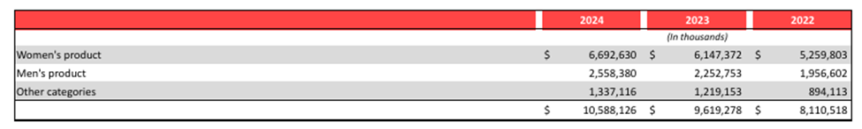
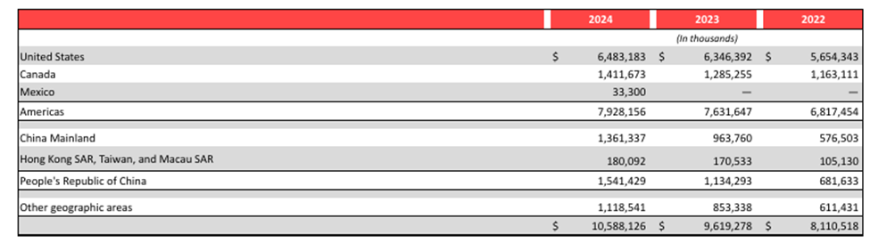
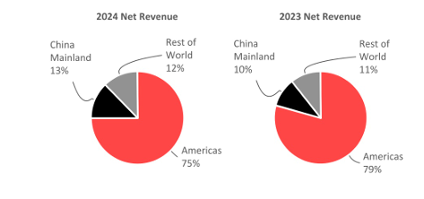
Business Analysis – Lululemon
Lululemon Athletica Inc (LULU) is a global leader in premium athletic apparel, footwear and accessories. The company’s brand is built on product innovation, performance fabrics, and a direct-to-consumer (D2C) model that emphasizes both customer engagement and community. Lululemon generates their revenue through both physical stores and digital platforms, generating roughly half of its revenue though its online channel.
Key Drivers
Penetration of international markets
Converting brand affinity into recurring customer engagement through a community

Slide 18
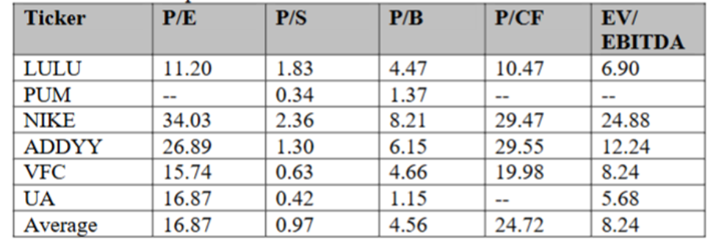
Financial Analysis – Lululemon

Slide 19
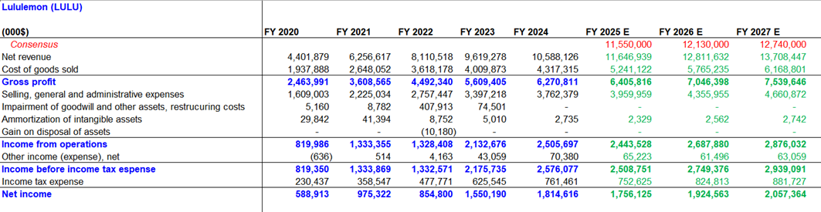
Financial Analysis – Lululemon

Slide 20
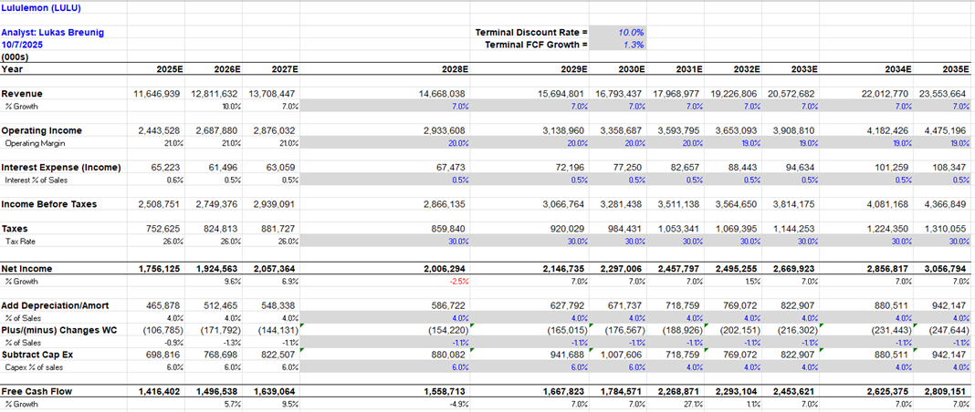
Financial Analysis – Lululemon

Slide 21
Recommendation
In conclusion, we recommend a BUY rating for Lululemon with a 12-month price target of $191 per share, representing approximately 12% upside from the current market price of $170. My valuation is supported using a 10% WACC and 1.25% terminal growth rate, which reflects a conservative long-term view of revenue expansion and margin stability.
Lululemon's growth opportunity remains supported by its expanding international footprint, category diversification, and industry leading profitability due to its ability to capture consumers and create a culture that promotes reinvesting in Lululemon’s products. Despite short-term macroeconomic and geopolitical headwinds, the company's brand strength, balance sheet flexibility, and loyal customer base provide competitive advantages that justify a premium multiple.
In my view the current market price underestimates Lululemon’s long-term earnings power and free cash flow generation potential. As macro conditions stabilize and AI-driven efficiency initiatives scale, Lululemon is well-positioned to resume double-digit EPS growth and sustain top-tier returns on invested capital.
LULU is currently not inside the portfolio, I am recommending a 100 bp purchase

Slide 22
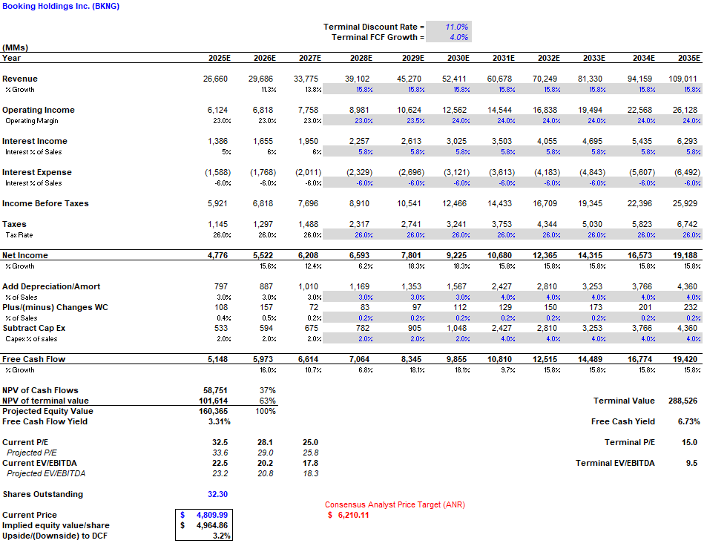
Booking Holdings DCF

Slide 23
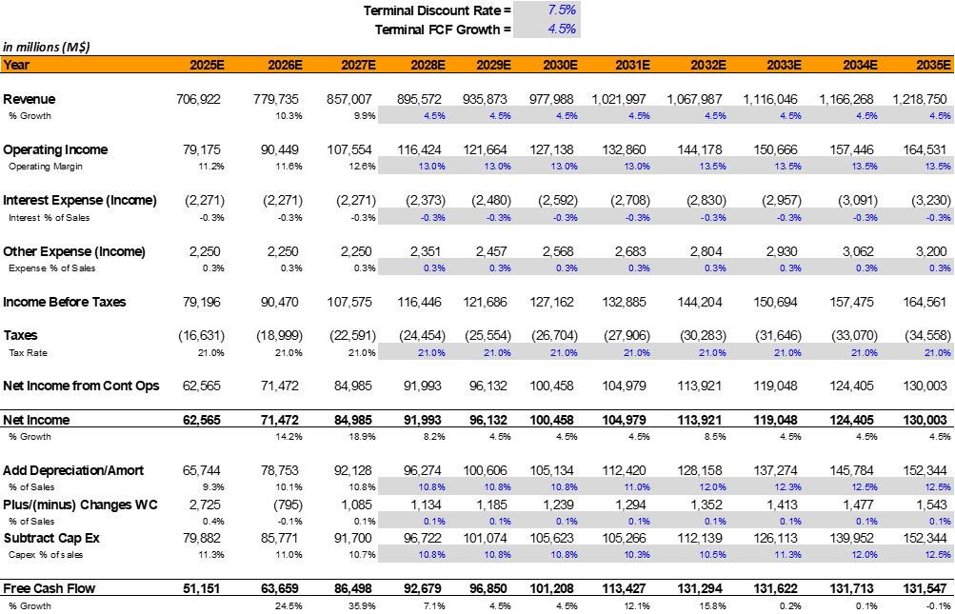
Amazon DCF

Slide 24
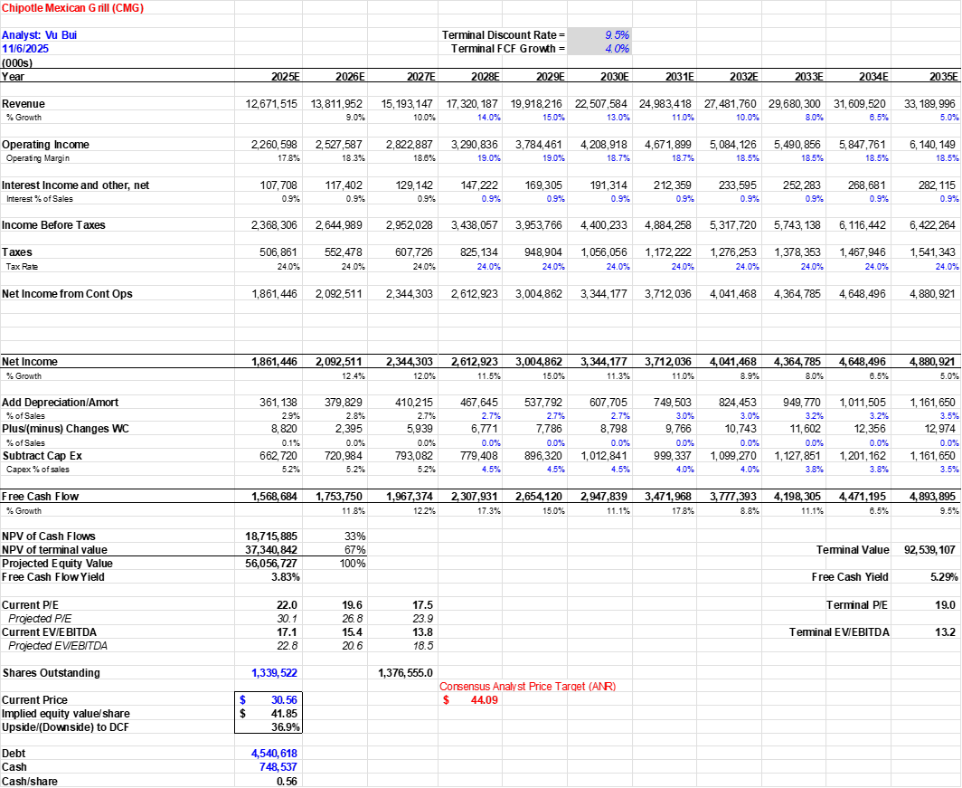
Chipotle DCF

Slide 25
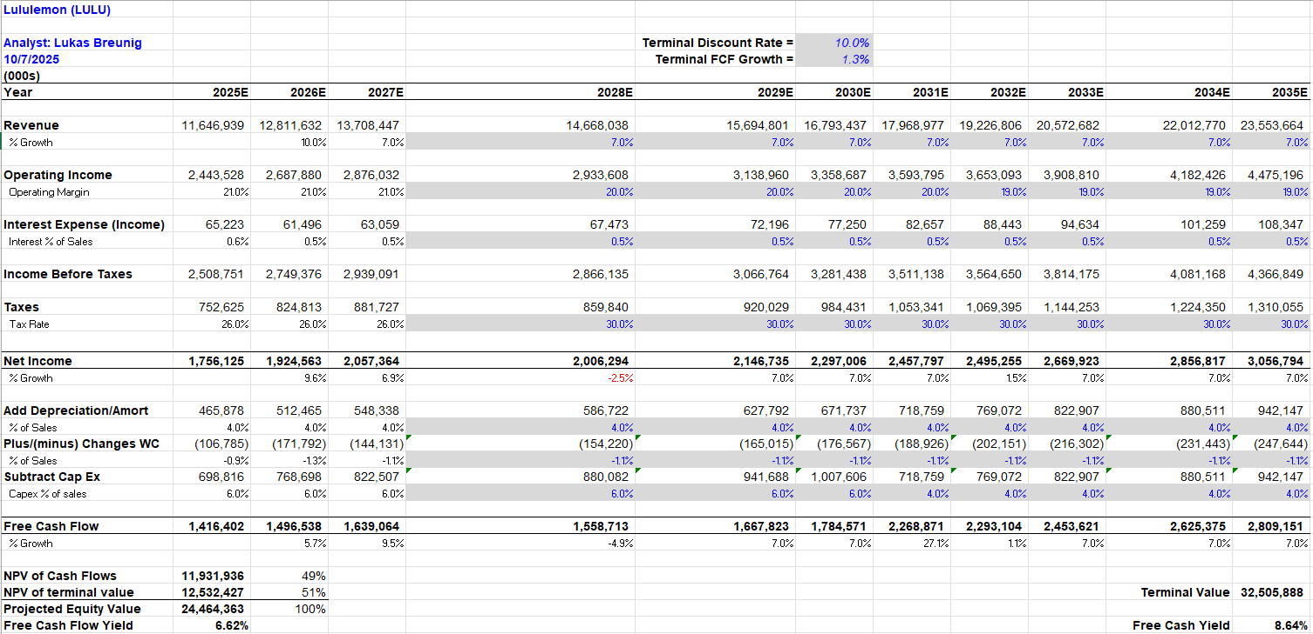
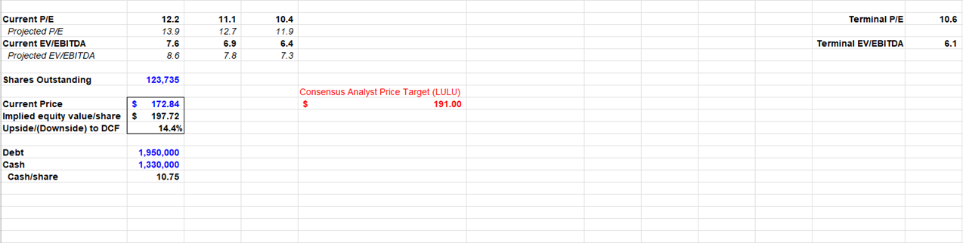
Lululemon DCF

Slide 26
References
https://finance.yahoo.com/quote/BKNG
https://ir.bookingholdings.com/
https://www.marketscreener.com/quote/stock/BOOKING-HOLDINGS-INC-41613106/finances/
https://www.tradingview.com/chart/s6OPN4Vx/?symbol=BKNG
https://finance.yahoo.com/quote/EXPE/
https://seekingalpha.com/symbol/BKNG
https://finance.yahoo.com/quote/CMG/
https://corporate.lululemon.com/investors/financial-information/sec-filings
https://research-morningstar-com.proxy.lib.ohio-state.edu/quotes/0P00009C0X

