Slide 1

Consumer Discretionary

Slide 2




Team Overview
Adam Amara
Lukas Breunig
Vlad Bennett
Vu Bui
Consumer Discretionary Analyst
Consumer Discretionary Analyst
Consumer Discretionary Analyst
Consumer Discretionary Analyst

Slide 3
Table of Contents
4
Sector Overview
5
Business Analysis
6
Economic Analysis
7
Financial Analysis
8
Valuation Analysis
9
Recommendation
Table of Contents

Slide 4





Sector Overview: Consumer Discretionary
Sector Size (% of S&P) & Performance
Various Industries
Specialty retail: auto parts, electronics, apparel, home improvement, online marketplaces
Consumer services: resorts, cruise lines, hotel booking, gyms, golf courses, theme parks
Media & Entertainment: film studios, streaming, music, video games
Automobiles: cars, trucks, motorcycles, equipment
Major Players
YTD Performance:
+2.34%
Quarter Performance:
+4.91%
Sector Overview

Slide 5
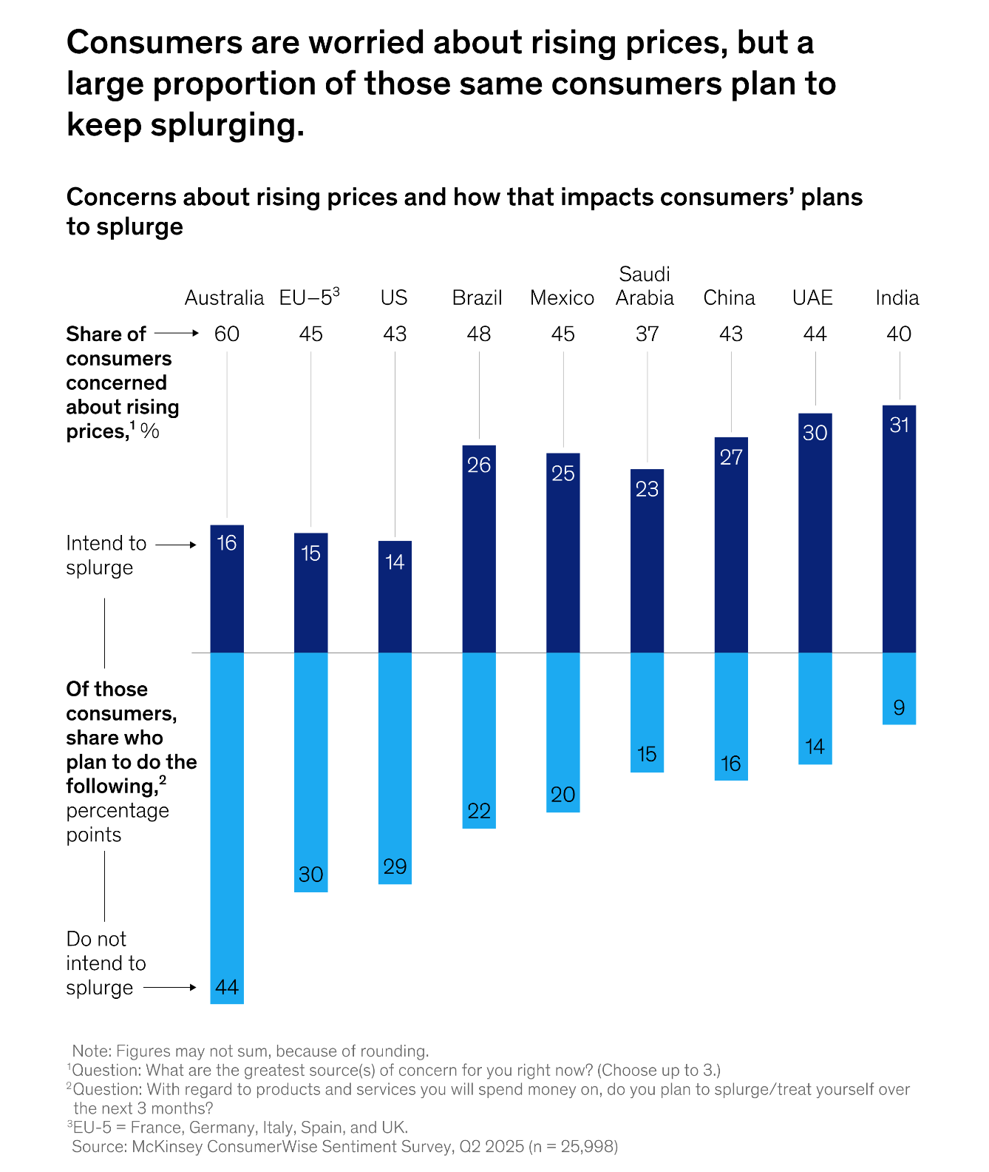
Business Analysis
Insights
Consumer Spending
Demand for consumer discretionary is mostly cyclical, mature, and driven primarily by the overall economy. The more discretionary income consumers have, the more they can spend on non-essential goods and services.
While most consumer spend remains in the US, emerging marketing continue to gain traction (Amazon vs Alibaba), despite being the most sensitive sector to tariffs.
Supply chains can be impacted by geopolitical threats as well as labor shortages.
Most automobile manufacturers are increasingly invested in the development of EVs, the US demand could lower after the EV credits expire in 2025.
The sector can be primarily broken into automobiles, travel, and retail stores. However, the sector is largely concentrated into many household names.
Manufacturing and physical stores remain capital-intensive, online only companies have lower barriers of entry.
Business Analysis

Slide 6
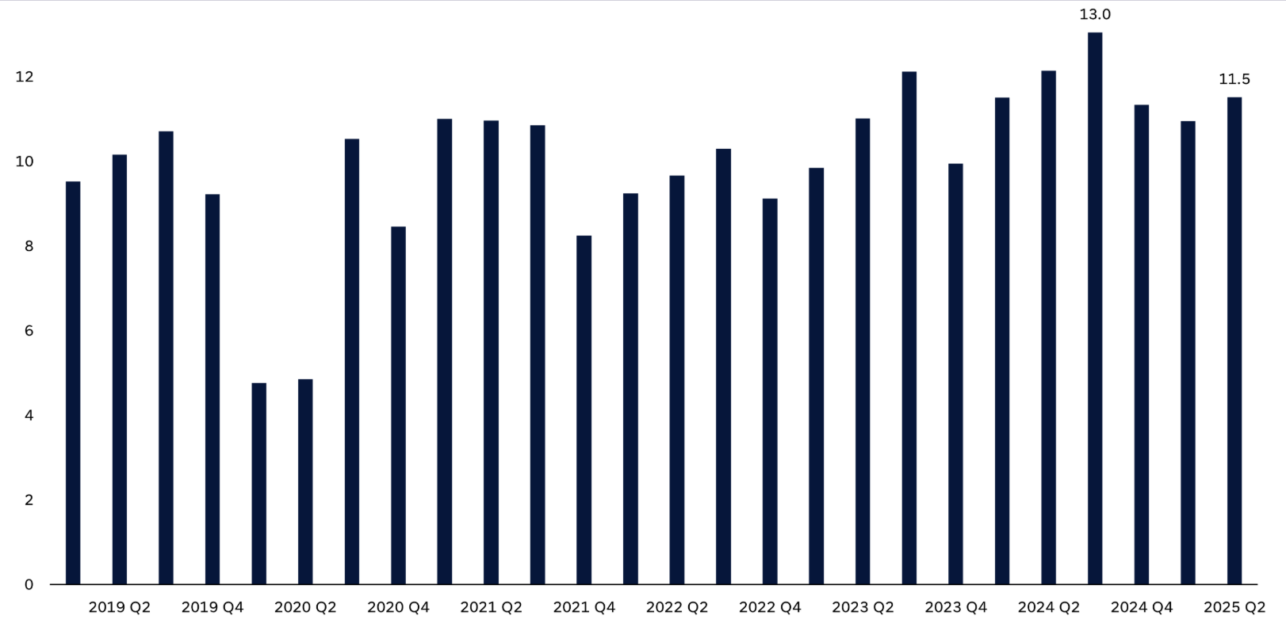
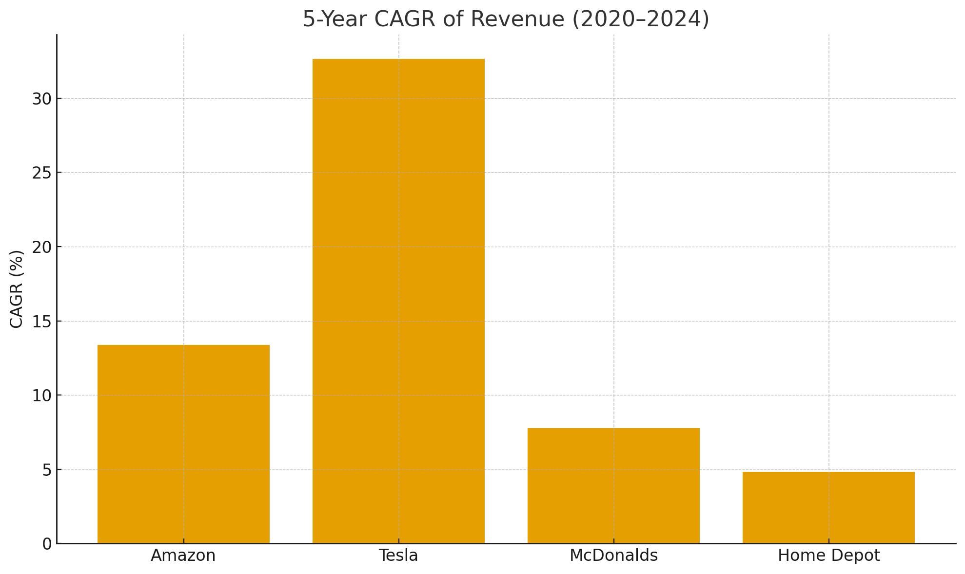
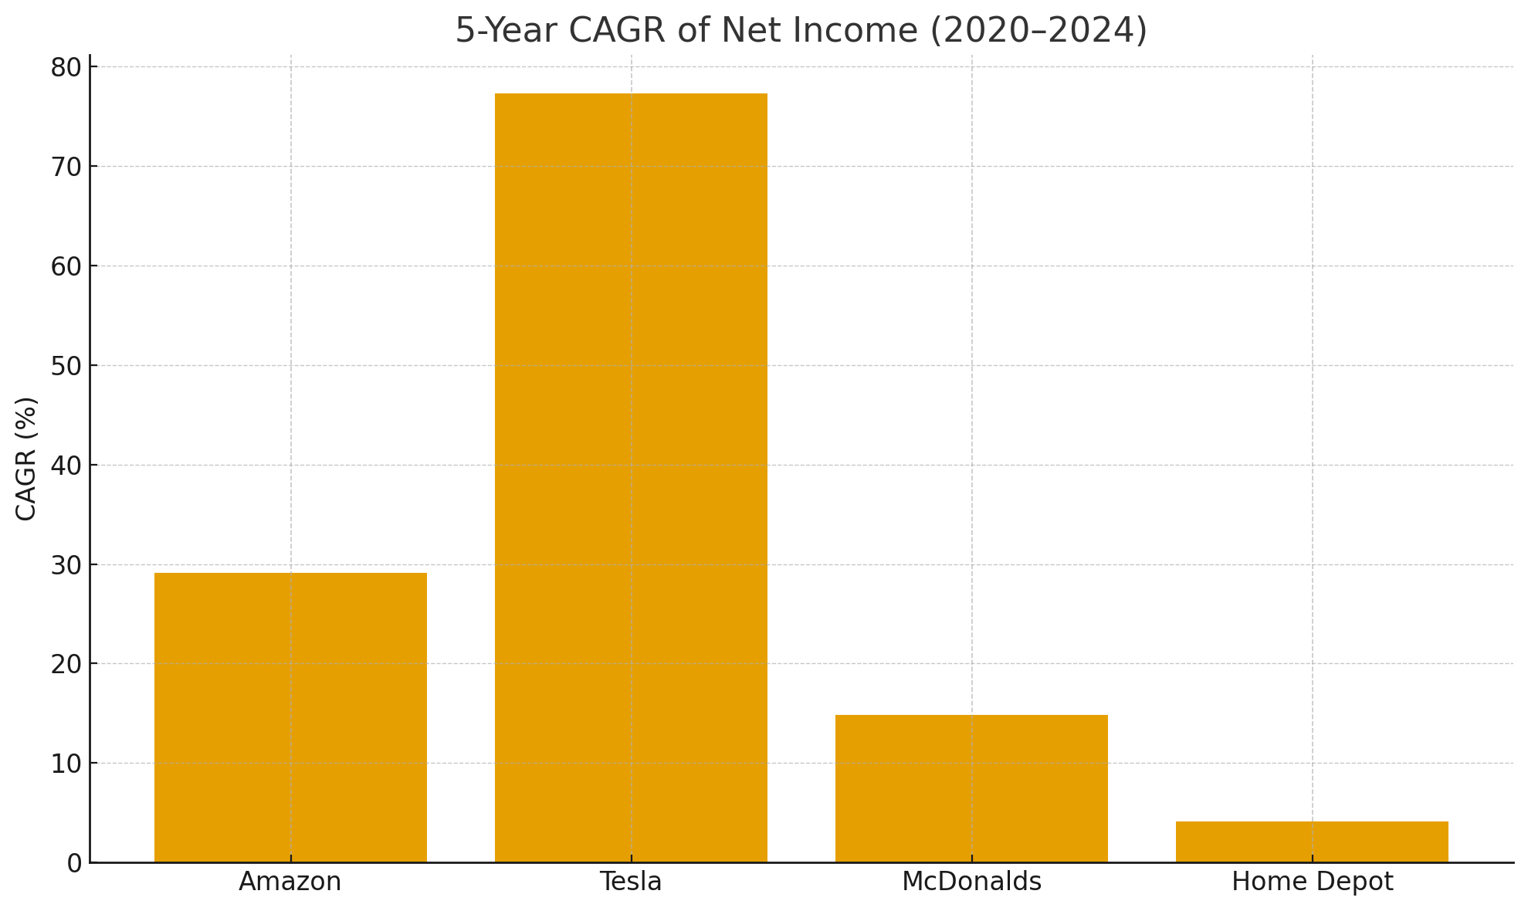
Financial Analysis
Sector Avg. Operating Margin
Major Players 5Y Revenue & Net Income CAGR
Financial Analysis

Slide 7
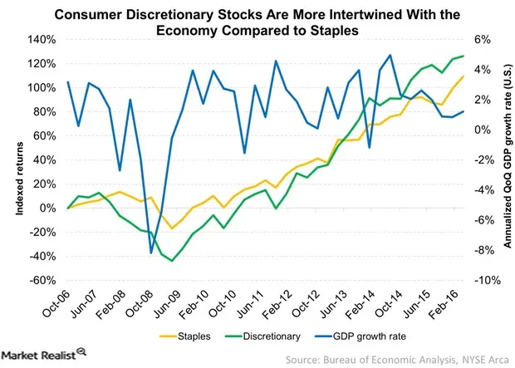
Economic Analysis
Key Economic Highlights
Economic Data Table
Metric | 2023 | 2024 | 2025E | Impact
U.S GDP Growth | 2.2% | 1.9% | 1.8% | Moderate demand growth
CPI YoY | 3.4% | 3.1% | 2.9% | Cooling price pressures
Fed Funds Rate | 5.25% | 4.75% | 3.75-4% | Credit cost easing
Consumer Confidence | 98 | 95 | 86 | Caution in spending
U.S Dollar Index | 105 | 103 | 98.8 | Boosts exporters
Sector closely linked to consumer sentiment and GDP growth; sensitive to economic cycles.
2025 U.S. GDP growth moderates to ~1.8%, with early-year volatility and mid-year rebound.
Inflation moderating, CPI at 2.9% YoY as of August; core inflation remains elevated near 3.1%.
Interest rates expected to ease from 4.25% to 3.75% by year-end, easing credit pressure.
Strong dollar weakness benefits international revenues and travel segments.
Economic Analysis

Slide 8
Valuation Analysis
Measurements
Measures | Consumer Discretionary | 2 Yr. Average | S&P 500
P/E | 29.40x | 33.10x | 22.86x
P/B | 9.20x | 11.40x | 4.60x
P/S | 2.80x | 2.60x | 3.21x
P/CF | 19.30x | 18.80x | 15.33x
Dividend Yield % | 0.89% | 0.85% | 1.32%
Sales Growth | 10.33% | 8.7% | 7.95%
Valuation across Industries:
Retail
E-commerce
Leisure
Services
Automobiles
Forecast & Analysis
Likely to remain flat or contract modestly as high rates persist and consumer spending normalizes.
If interest rates ease and inflation stabilizes, the sector could re-rate upward modestly, especially in retail and services.
Expected to maintain a small premium vs. the S&P 500 due to stronger structural growth and brand strength, but will not return to 2021 highs without a macro catalyst.
Valuation Analysis

Slide 9




Recommendation: Overweight
Investment Thesis
Key Drivers
Easing monetary policy expected to unlock demand for industries like auto and durable goods
E-commerce retail is accelerating
Companies are diversifying their products and business models
1. Sector is positioned for reacceleration due to expected continued rate cuts spurring economic activity
2. Structural themes within the industry such as digital retail & travel rebound support upside
Key Risks
Persistent inflation could pressure middle & lower income consumer budgets
Tariffs and supply chain issues remain a risk
Changing consumer preferences
3. Historically outperforms the S&P 500 during early easing cycles
4. Offers broad diversification across multiple sub-sectors of the industry
Recommendation

