Slide 1
Communication Services
Christopher Chin, Taylor Crouch, Jillian Davis, Jack Dawson
7/22/2025

Slide 2
Sector Overview
Communication Services: this sector is comprised of companies that offer communication services through fixed-line networks or wireless access and services.
Industries (market weight):
Internet content and information (64.22%)
Telecommunication services (15.42%)
Entertainment (14.72%)
Advertising agencies (2.87%)
Electronic gaming and multimedia (2.40%)
Broadcasting (0.19%)
Publishing (0.19%)
Market Cap: $6.65 Trillion

Slide 3

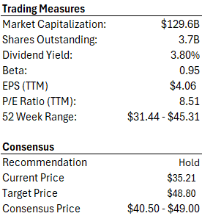




Comcast (CMCSA) – Overview
Firm Overview: American multinational media, telecommunications, and entertainment conglomerate.
Connectivity & Platforms
  Residential Connectivity & Platforms
  Business Services & Connectivity
Content & Experiences
  Media
  Studios
  Theme Parks
Risks:
  Broadband subscriber decline
  ARPU & pricing pressure
  Streaming and Versant spinoff uncertainty
Notes:
📡 Residential Connectivity & Platforms (Xfinity)
Provides broadband, voice, and mobile services to residential users.
Largest revenue driver (55% of total revenue).
Serves 31M domestic and 18M international customers.
Covers ~64M U.S. households with gig-capable service — largest among top 3 U.S. telecom providers.
Primary source of Comcast’s free cash flow.
🏢 Business Services Connectivity
Offers broadband, voice, and cybersecurity to SMBs.
Achieved 57% adjusted EBITDA margin in Q1 2025.
Reported 4% YoY revenue growth, showing stable enterprise demand.
🎢 Theme Parks
Operates Universal theme parks in the U.S., Japan, and China.
Opened Epic Universe (750-acre park) in Orlando in May 2025 — Comcast’s largest U.S. park investment.
Announced plans for Universal resorts in the U.K. and Europe — signaling strategic global expansion.
🎬 Studios
Includes Universal Pictures, DreamWorks Animation, Universal TV, and Focus Features.
Vertically integrated model enhances monetization across digital and theatrical platforms.
📺 Media (TV Networks & Peacock)
Encompasses domestic/international TV networks and the Peacock streaming service.
NBCUniversal cable networks to be spun off into Versant, focusing on legacy cable optimization.
Peacock remains the centerpiece of Comcast’s digital streaming growth strategy.

Slide 4
Comcast (CMCSA) – Analysis
Connectivity & Platforms:
Residential Connectivity & Platforms
  2024 Annual Revenue: $71.6B
  Q1 2025 YoY Revenue: -0.5%
  Wireless Growth: +323K wireless subscribers
  Segment Importance: Continues to be Comcast’s larges revenue and FCF contributor.
Business Services Connectivity
  2024 Annual Revenue: $9.7B
  Adjusted EBITDA margin: 57%
  Q1 2025 QoQ Revenue : +3.7%
  Segment Importance: Stable growth contributor, driven by small and medium business growth.
Content & Experiences:
Theme Parks
  2024 Annual Revenue: $8.6B
  Q1 2025 YoY Revenue: +0.8%
  Segment Importance: High-Margin, long term growth driver. Strong revenue outlook with May ‘25 Epic Universe launch.
Media & Studios
  2024 Annual Revenue: $39.2B
  Q1 2025 Peacock Revenue QoQ: +16%
  Q1 2025 Peacock Subscribers YoY: +20%
  Segment Importance: Stable top line growth contributor, strong outlook with streaming momentum and expanding content monetization.

Slide 5
Comcast (CMCSA) – Valuation
Comcast currently trades below historical average across all valuation metrics.
Intrinsic valuation $48.80 represents a 38.6% potential upside over its current price at $35.21.
Valuation Assumptions: An implied cost of capital of 10.5% and a 1.0% terminal growth rate were applied in the DCF analysis, reflecting heightened uncertainty stemming from Comcast’s elevated debt burden and its strategic shift away from core businesses toward growth initiatives such as Peacock, Xfinity Wireless, and theme park expansion.
Notes:
Comcast is currently trading below its historical average across all valuation metrics, this could coincide with risk in Comcasts ever so changing product/service offerings. The market could be more cautious due to concerns with competition, macro-economic pressures, and the ever so changing media/broadband landscape.
Comcast’s intrinsic value of $48.80 represents a Implied upside at roughly 38.6% and was calculated utilizing a conservative 10.5% discount rate and a 1.0% terminal growth rate, reflecting the elevated uncertainty tied to Comcast’s strategic pivot away from its core businesses toward emerging initiatives like Peacock, wireless, and theme parks.

Slide 6




Meta Platforms Inc. (META) - Overview
Firm Overview:
  Developing products to enable consumers to connect and share through social media apps, messaging systems, and virtual reality.
  Previously Facebook, Inc. until changing its name in 2021.
Segments:
  Family of Apps (FoA) - Facebook, Messenger, Instagram
  Reality Labs (RL) - Metaverse
Risks:
  Reality Labs and Metaverse
  AI and social media competition
  Data privacy and ad dependency
Trading Measures (07/20/2025)
Market Capitalization: |  |  | $1.771T
Shares Outstanding: |  |  | 2.52B
Dividend Yield: |  |  | 0.30%
Beta: |  |  | 1.27
EPS (TTM) |  |  | $25.61
P/E Ratio (TTM): |  |  | 27.54
52 Week Range: |  | $442.65-$747.90
Consensus
Recommendation |  |  | Buy
Current Price |  |  | $704.28
Target Price |  |  | $729.37
Consensus Price |  | $738.37

Slide 7
Meta Platforms Inc. (META) - Analysis
2024 Total Revenue: $164.5B
  Family of Apps: $162.35B
    98.7% of total
    Operating Income: +$69.4B
  Reality Labs: $2.15B
    1.3% of total
    Operating Income: -17.7B
2025 Q1 Total Rev: $164.5B
  Family of Apps: $41.90B
    YoY Change: +15.5%
    Operating Income: +$21.77B
  Reality Labs: $412M
    YoY Change: -6%
    Operating Income: -$4.21

Slide 8
Meta Platforms Inc. (META) - Valuation
Meta valuation has been slightly above average, reflecting an expansion in valuation. High P/E indicates confidence in continued growth in earnings for Meta's investors.
Currently levels are in a mid to upper historical range.
Absolute Basis | High | Low | Average | Current
P/E | 39.7 | 8.7 | 26.06 | 27.81
P/B | 9.72 | 2.49 | 7.6 | 9.72
P/S | 10.9 | 2.78 | 7.7 | 10.9
P/EBITDA | 25.09 | 5.63 | 16.3 | 19.8
Target Price Avg | $935 | $525 | $740 | $712.97

Slide 9

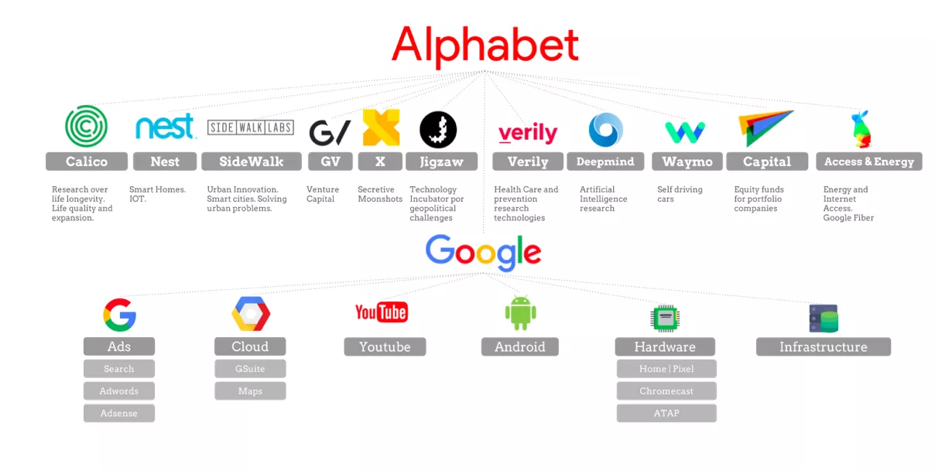
Alphabet Inc. (GOOGL) - Overview
Firm overview
  Collection of companies
  Products and services
    Gmail (email service), Android (mobile OS), YouTube (video-sharing platform), Google Maps (free mapping service), Google Chrome (website browser), etc.
  Worldwide
  Industries served
    Internet, computer software, consumer electronics, venture capital, healthcare
Risks
  Reliance on advertising revenue
  Competitors
    Microsoft, Amazon, Meta, Apple
  Artificial Intelligence
Trading Measures (7/21/25)
Market Capitalization: |  |  | $2.31T
Shares Outstanding: |  |  | 12.183B
Dividend Yield: |  |  | 0.47%
Beta: |  |  | 1.01
EPS (TTM) |  |  | $8.96
P/E Ratio (TTM): |  |  | 21.33
52 Week Range: |  | $142.66-$208.70
Consensus
Recommendation |  |  | Buy
Current Price |  |  | $191.15
Target Price |  |  | $201.41
Consensus Price |  | $204.33

Slide 10
Alphabet Inc. (GOOGL) - Analysis
2024
Total revenue = $350.018B
3 segments revenues:
Google Services: $203.93B
Google Cloud: $43.229B
Other Bets: $1.648B
Hedging gains $.211B
2025 Q1
Total revenue = $90.2M ($80.5M in 2024)
3 segments revenues:
Google Services: $77.3B ($70.4B 2024)
Google Cloud: $12.3B ($9.6B 2024)
Other Bets: $.450B ($.495B 2024)
Hedging gains $.260B ($.072B 2024)

Slide 11
Alphabet Inc. (GOOGL) - Valuation
Stock Valuation
Absolute Basis | High | Average | Low | Current
P/E | 66.05 | 28.55 | 16.23 | 20.63
P/B | 8.05 | 5.66 | 3.49 | 6.50
P/S | 8.10 | 5.70 | 4.38 | 7.02
EV/EBITDA | 23.39 | 16.39 | 12.23 | 16.3
Target Price Average | $250.00 | $203.00 | $160.00 | $204.33
Alphabet is below its average for P/E and EV/EBITDA, so it seems relatively undervalued
P/B and P/S ratios are higher than historical averages, suggesting investors are optimistic
Analysts believe its price will increase from its current price of $191.15, also suggesting undervaluation

Slide 12
Recommendation
Stock | Ticker | Current Price | Target Price | Expected Return | Recommendation | Sim Weight | Recommended Weight | (+/-) bps
Comcast | CMCSA | $35.21 | $48.80 | 38.6% | HOLD | 1.65% | 1.65% | -
Meta Platforms Inc. | META | $704.28 | $729.37 | 21.97% | BUY | 5.99% | 6.39% | +40
Alphabet Inc. | GOOGL | $191.15 | $201.41 | 5.37% | BUY | 4.77% | 4.87% | +10
Total |  |  |  |  |  | 12.41% | 12.91% | +50

Slide 13
Q&A, Thank you!

Slide 14
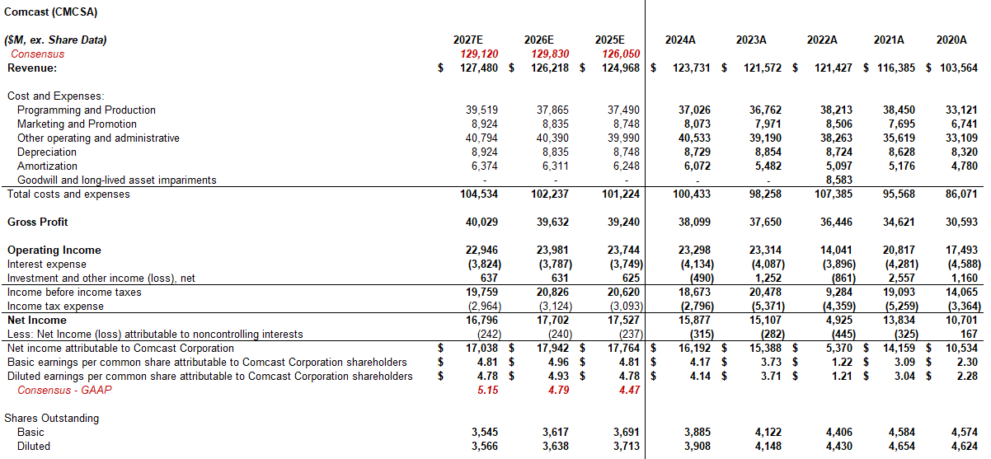
Comcast (CMCSA) – Appendix 1

Slide 15
Comcast (CMCSA) – Appendix 2

Slide 16
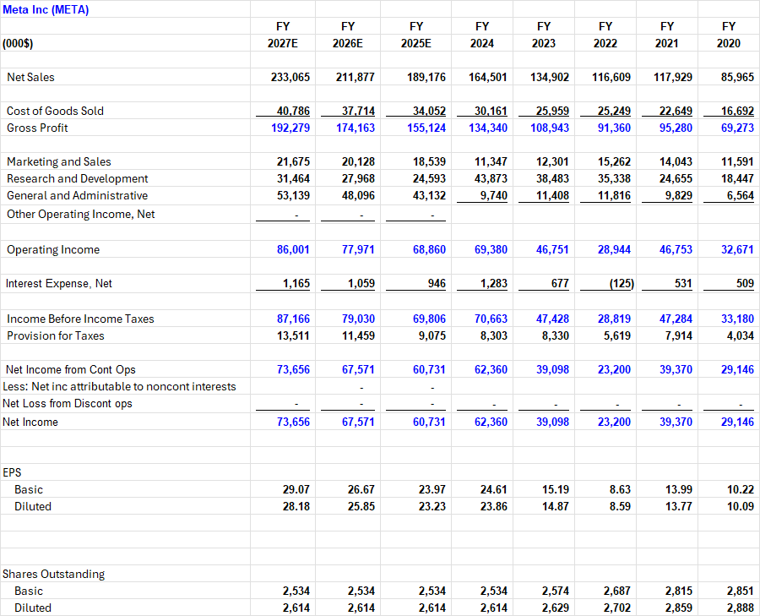
Meta Platforms Inc. (META) - Appendix

Slide 17
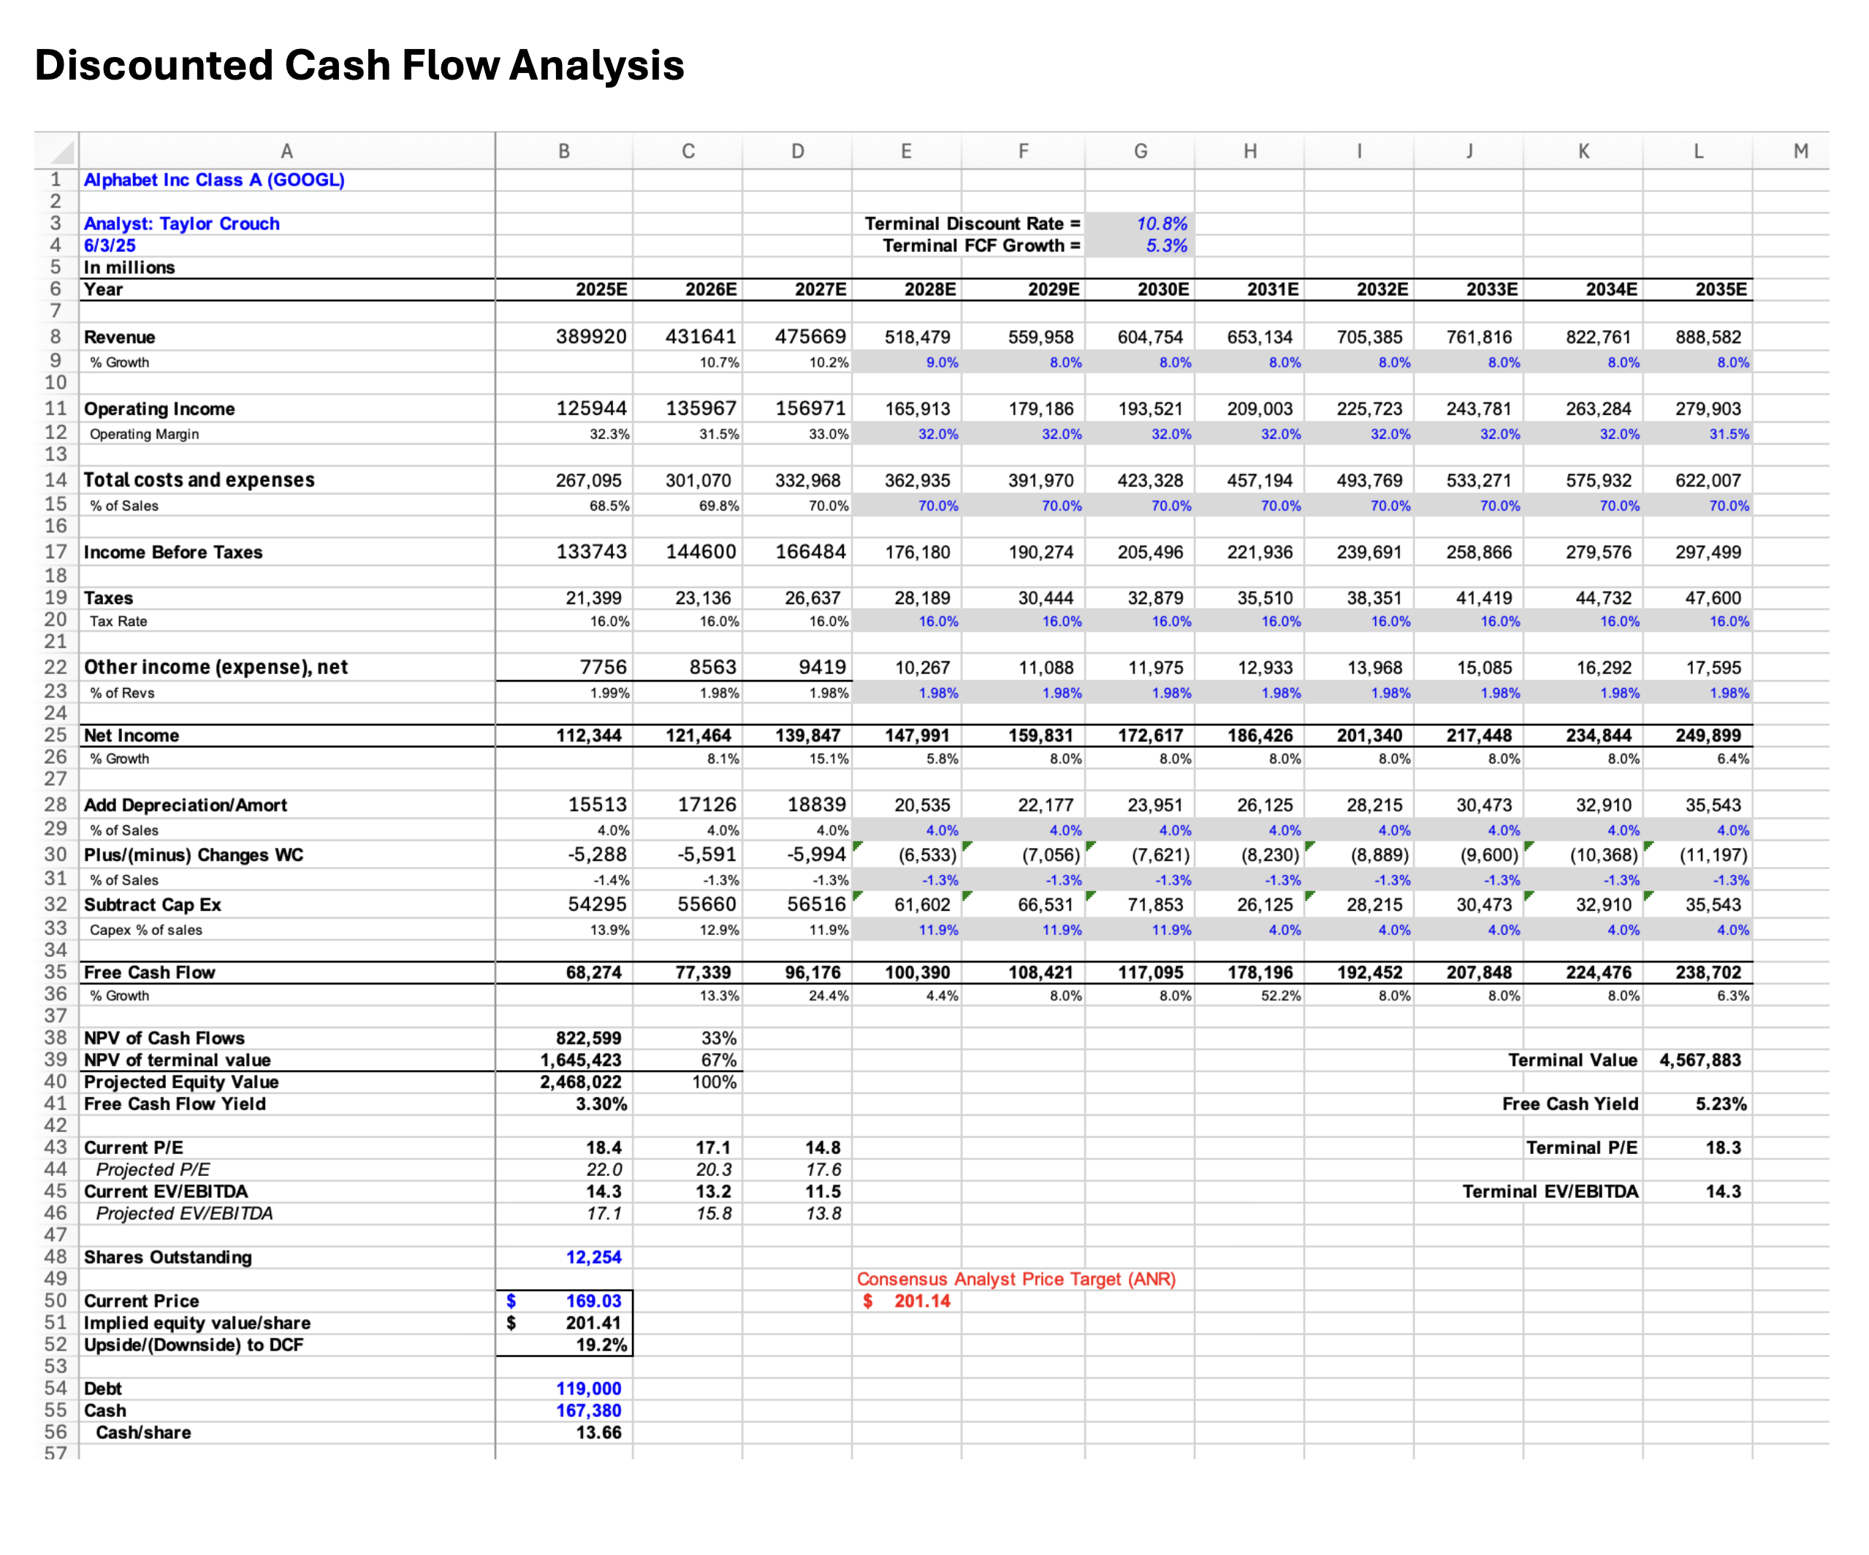
Alphabet Inc. Appendix

