Slide 1

Communication Services
Analysts: Jackson Pettit, Kaiden Roche, Cindy Pennella, Alex Peak

Slide 2


Communication Services Sector Recap
Established September 24th, 2018, replacing the Telecommunications Sector.
  Kept existing telecommunication companies (AT&T, Verizon)
  Added META and Alphabet from the information technology sector
A vast sector comprised of companies that provide information/entertainment through various media.
  Industries: Telecommunications, Internet Content & Information, Entertainment, etc.
Key Drivers: Increase in demand for cloud services and AI development, Rapid Deployment of 5G networks, Rise in data consumption largely driven by phone usage.
Company | Ticker | S&P Weighting | SIM Weighting | Rating
Meta Platforms | META | 2.45% | 4.46% | BUY
Verizon | VZ | .3% | 0.00% | HOLD
Alphabet | GOOGL | 5.74% | 7.09% | BUY
Comcast | CMCSA | .17% | 1.23% | HOLD
Sector | S&P 500 Weight | SIM Weight | +/-
Communication Services | 10.08% | 12.79% | 2.71%

Slide 3

Meta Platforms, Inc.
Overview
Description:
Meta Platforms, Inc. (META) is a global technology company that builds social media and communication tools used by billions worldwide. Founded in 2004 by Mark Zuckerberg and headquartered in Menlo Park, California, Meta’s mission is to “build the future of human connection.”
Trading Measures
Market Capitalization (INTRA) | 1.63 Trillion
Diluted Shares Outstanding | 2.61 Billion
Annual Dividend Yield | 0.25%
Industry | Interactive Media & Services
52 Week Range | $479.80-$796.25
Beta | 1.27
Risks:
Advertising Dependence & Economic Slowdown
  Digital advertising makes up 98% of total revenue. Any slowdown in global ad spending caused by weaker consumer demand/spending may have a direct impact on Meta’s revenue growth.
Competitive Pressure
  Competition from TikTok, YouTube, and other short-form content platforms continues to intensify.
Regulatory & Legal Risk
  Meta faces ongoing regulatory scrutiny across the United States and Europe regarding data privacy, user safety, and antitrust violations.

Slide 4
Business Analysis
2 Segments:
Family of Apps (FoA): Consists of Facebook, Instagram, Messenger, and WhatsApp.
  FoA accounted for 98.7% of Meta's total revenue in 2024 (162.3 billion).
Reality Labs (RL): focuses on Meta's virtual and augmented reality products, including Quest headsets and Ray-Ban smart glasses.
  RL accounted for 1.3% of Meta's total revenue in 2024 ($2.13 billion).
  Competitive Advantages
Network Effects & User Scale
  Meta's greatest strength is its massive global reach, with over 3.5 billion active users. This scale creates a powerful network effect that makes the platform more valuable for both users and advertisers.
Data & Artificial Intelligence Capabilities
  Meta's strength in digital advertising comes from its data-driven algorithms and advanced AI, which use massive amounts of user interaction data to optimize ad targeting. By matching the right ads to the right users, Meta boosts both advertiser conversion rates and user engagement.

Slide 5
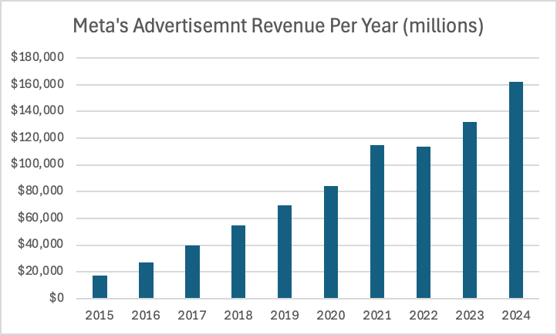
Financials
Meta Platforms (META)
(In Millions) | FY | FY | FY | FY | FY | FY | FY | FY
 | 2028E | 2027E | 2026E | 2025 | 2024 | 2023 | 2022 | 2021
Consensus | 255,000 | 240,000 | 220,000
Revenue | 252,070 | 237,802 | 218,568 | 195,150 | 164,501 | 134,902 | 116,609 | 117,929
% Growth | 6.0% | 8.8% | 12.0% | 18.6% | 21.9% | 15.7% | -1.1%
Total costs and expenses | 147,612 | 143,823 | 123,403 | 111,000 | 95,121 | 88,151 | 87,665 | 71,176
Income From Operations | 104,458 | 93,979 | 95,165 | 84,150 | 69,380 | 46,751 | 28,944 | 46,753
Provision for income taxes | 14,048 | 12,639 | 12,798 | 12,000 | 8,303 | 8,330 | 5,619 | 7,914
Net income | 91,976 | 82,750 | 83,794 | 73,650 | 62,360 | 39,098 | 23,200 | 39,370
Continued Growth
Revenue is expected to increase year over year due to:
  Continued growth across all of Meta's Platforms.
  Increase in ad placement.
Meta's long-term spending goal:
  Building AI data centers & computer infrastructure.
  Upgrading and scaling its core platforms.
  "Super intelligence/ advanced AI" build out.
Meta's CapEx Since 2020
Year | Amount (0000)
2020 | 15,115
2021 | 18,567
2022 | 31,431
2023 | 27,266
2024 | 39,230
2025 | ~72,000
2026E | 100,000
Low Macroeconomic Risk
Little direct exposure to interest rates.
Advertising demand is cynical.

Slide 6
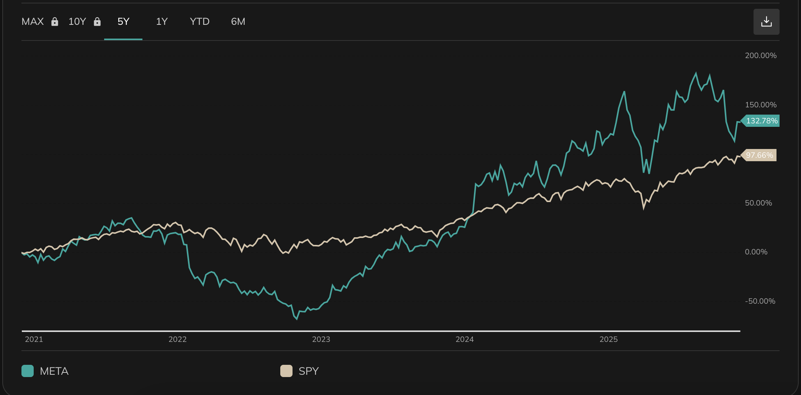

Slide 7
Valuation
DCF Summery
Terminal Discount Rate = | 9.25%
Terminal FCF Growth = | 5.50%
Current Price | $666.28
Implied equity value/share | $763.04
Upside/(Downside) to DCF | 14.52%
Terminal Discount & Growth Rate
Terminal Rates for the DCF were based on a conservative approach from prior year growth rates and the expected increase In future growth in ad revenue.
Absolute Basis | High | Low | Average | Current
P/E | 32.8934 | 10.6203 | 18.9697 | 27.24
P/B | 5.3542 | 1.6448 | 3.1545 | 5.2914
P/S | 3.2156 | 0.7196 | 1.8964 | 3.2156
P/EBITDA | 17.9704 | 4.2649 | 10.0623 | 15.489
Peer Comparison
Based on key valuation multiples, Meta trades below its main peers in nearly every category aside from P/E. Suggesting that Meta is undervalued from a competitor standpoint.
Ticker | P/E | P/S | P/B | P/CF | EV/ EBITDA
META | 27.24 | 3.21 | 5.29 | 18.8 | 15.4
Peer:
AMZN | 35.99 | 3.76 | 7.5 | 188.5 | 18
AAPL | 36.1 | 8.75 | 53.7 | 36.7 | 25.2
PINS | 9.4 | 4.6 | 4.8 | 15.95 | 84.8
GOOG | 27.51 | 7.7 | 7.8 | 42.1 | 19.7
Average | 26.5975 | 6.2025 | 18.45 | 70.8125 | 36.925

Slide 8
Business Overview
Firm Description:
  Verizon Communications Inc. is a leading provider in telecommunications, technology, information, streaming products and services to consumers, businesses, and government organizations.
Risks:
  Competition
  High debt
  Limited growth potential
Market Cap: | 171.482B
Diluted Shares Outstanding: | 4.22B
Annual Dividend Yield: | 6.80%
Industry: | Telecommunications Services
52-week range: | 37.59 - 47.36
Beta: | 0.32

Slide 9
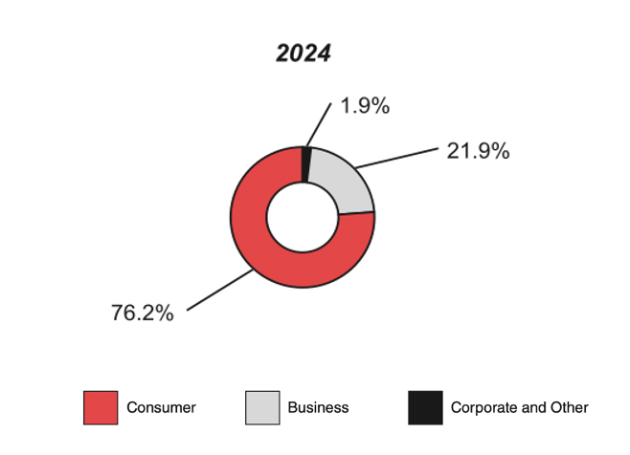
Business Analysis
Segmentation:
  Verizon Consumer Group:
  consumer-focused
  76.2% of 2024 revenue
  Verizon Business Group:
  Enterprise, government, business focused
  21.9% of 2024 revenue
Competitive Advantages:
  Rural Outreach
  Dependability
  Industry Presence
Revenues by Segment
https://www.verizon.com/about/sites/default/files/2024-Annual-Report-on-Form-10k.pdf

Slide 10
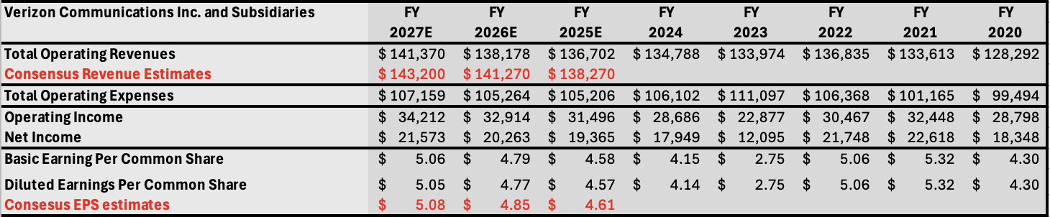
Business Financials
Key Financials:
2024 Revenue: $136.7 billion
2024 Net Income: $17.9 billion
2024 Debt: $153 billion
Takeaways:
Verizon exhibits slow but stable revenue growth
Estimates are slightly conservative to consensus for Revenue and EPS.

Slide 11
Business Valuation
Terminal Discount Rate | 9.8%
Terminal FCF Growth | 2.5%
DCF Valuation:
  Terminal Discount Rate of 9.8% because of Verizon’s high leverage, industry risk, and high interest rates
  Terminal FCF growth of 2.5% reflects steady mature growth
Multiples Valuation:
  Verizon trades at discount compared to peer multiples valuation, indicating an undervaluation relative to the sector
Current Price | $40.42
Implied equity value/share | $58.81
Upside/(Downside) to DCF | 45.5%
Ticker | P/E | P/S | P/B | P/CF | EV/ EBITDA
Verizon | 8.67 | 1.23 | 1.61 | 9.3 | 6.49
AT&T | 16.5 | 1.68 | 1.96 | 10.75 | 7.9
T-Mobile | 22.37 | 3.47 | 4.66 | 17.99 | 11.32
Average | 15.85 | 2.13 | 2.74 | 12.68 | 8.57

Slide 12

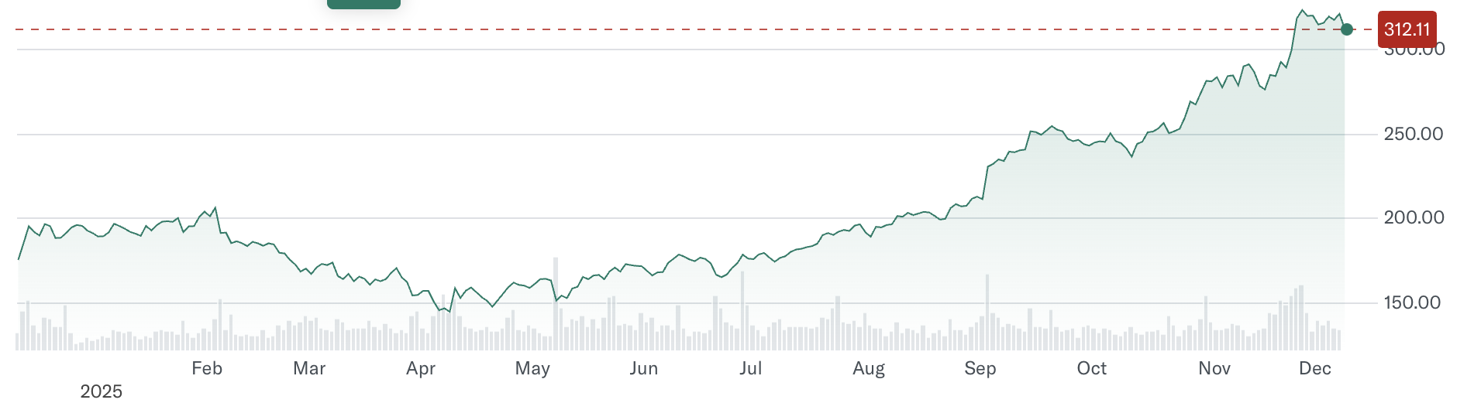
Business Overview
Firm Description
Alphabet Inc is the holding company of Google and through its subsidiaries, it provides web-based search, advertisements, maps, software applications, mobile operating systems, consumer content, enterprise solutions, commerce and hardware products. Initially went public in 2004 at a price of $85 per share in order to raise capital.
Risks
Elevated Capital Expenditures and AI payback
Regulatory and Antitrust pressures
Competition in Generative AI and cloud
Advertising Market Dependence
GOOGL Details
Industry | Internet Media and Services
Share Price (12/8) | 312.11
Market Cap | 3.36 trillion
Dividend Yield | 0.30%
52-Week Range | 140.53 - 328.83
P/E Ratio | 27.51

Slide 13
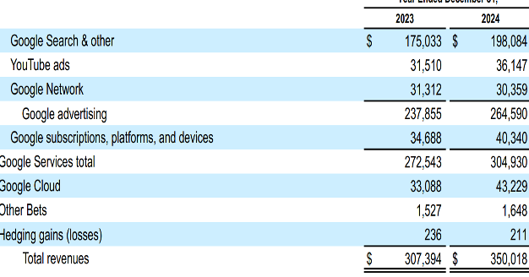
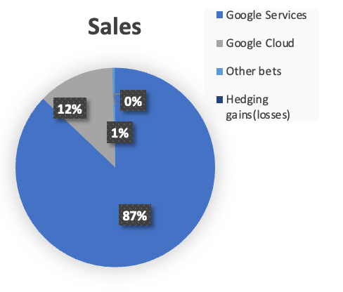
Business Analysis
Business segments
Google Services
  Google Maps, Google Play, Search, YouTube, YouTube TV, YouTube Music and Premium, NFL Sunday Ticket, Google One; the sale of apps and in-app purchases; and devices
Google cloud
  Google Workspace( Gmail, Google Drive, Calendar, Docs, and Meet)
Other bets
  initiatives beyond core business like Waymo, Verily, Google Fiber
Competitive advantage
Global Dominant in search and advertising engine
Massive data scale -> improve AI and personalization
YouTube platform reach -> #2 search engine

Slide 14
Business Financials
 | FY | FY | FY | FY | FY | FY | FY
 | 2027E | 2026E | 2025E | 2024 | 2023 | 2022 | 2021
Consensus | 426.35B | 379.34B | 335.32B
Revenues | $536,042 | $464,106 | $402,520 | $350,018 | $307,394 | $282,836 | $257,637
Total Costs and expenses | $351,108 | $305,846 | $266,468 | $237,628 | $223,101 | $207,994 | $178,923
Income from operations | $184,934 | $158,260 | $136,052 | $112,390 | $ 84,293 | $ 74,842 | $ 78,714
Income before income taxes | $196,727 | $168,006 | $144,907 | $119,815 | $ 85,717 | $ 71,328 | $ 90,734
Provision for income taxes | $ 33,050 | $ 27,889 | $ 24,503 | $ 19,697 | $ 11,922 | $ 11,356 | $ 14,701
Net Income | $163,677 | $140,117 | $120,403 | $100,118 | $ 73,795 | $ 59,972 | $ 76,033
EPS
Basic | $ 14.12 | $ 11.90 | $ 10.02 | $ 8.13 | $ 5.84 | $ 4.59 | $ 5.69
Diluted | $ 13.97 | $ 11.78 | $ 9.92 | $ 8.04 | $ 5.80 | $ 4.56 | $ 5.61
Consensus-GAAP | $ 12.09 | $ 10.66 | $ 9.93
Key financials (FY 2024) in Billions
Revenue: $350,018
Operating income: $112,390
Operating margin: 32.11%
Net income: $100,118
YoY increase in revenue -> +13.9
Highlights
Strong revenues and operational efficiency
Huge scale and diversification

Slide 15
Business Valuation
DCF Valuation
Reflects expectations for Alphabet’s long-term secular growth in AI, Cloud, and platform-based advertising
Appears undervalued relative to the market.
Multiple Valuations
Premium is justified by Alphabet’s strong operating margin
expansion (26.46% in 2022 → 32.11% in 2024), dominant global
scale, and accelerating growth in AI and Cloud.
Trades below Microsoft (36.4x) and Amazon
(36.3x) on P/E and EV/EBITDA, yet maintains superior
profitability and free cash flow generation.
Terminal Discount Rate | 9.5%
Terminal FCF Growth | 6.0%
Current Price (11/11) | $ 279.00
Implied equity value/share | $ 340.20
Upside/(Downside) to DCF | 21.9%
Ticker | P/E | P/S | P/B | P/CF | EV/ EBITDA
GOOGL | 28.09 | 7.87 | 7.99 | 21.88 | 14.51
ORCL | 53.84 | 11.48 | 32.99 | 76.91 | 32.42
META | 27.69 | 10.82 | 9.88 | 39.19 | 19.92
AMZN | 36.27 | 3.76 | 7.61 | 185.76 | 17.61
MSFT | 36.43 | 13.15 | 10.79 | 51.73 | 22.13
AAPL | 32.27 | 8.63 | 52.89 | 36.64 | 24.32
Average | 35.77 | 9.28 | 20.36 | 68.69 | 21.82

Slide 16

Business Overview
Firm Description
Comcast is one of the largest media and telecom companies. The firm operates across different lines of business including connectivity, media, content creation, and theme parks.
Founded in 1963, HQ’d in Philadelphia
60+ million customers
Risks
Intensifying broadband competition
Media & streaming profitability
Refinancing headwinds
CMCSA Details
Industry | Telecom Services
Share Price (12/5) | $27.31
Market Cap | 100.834 B
Dividend Yield | 4.83%
52-Week Range | $25.75 – $43.30
P/E Ratio | 4.54

Slide 17
Business Analysis
Business Segments:
Residential Connectivity & Platforms (Xfinity)
  Broadband, wireless & video
Business Services Connectivity
  Broadband & networking
Media
  NBC, Telemundo, cable networks & Peacock
Studios
  Universal Pictures & DreamWorks
Theme Parks
Competitive Advantages
Scaled broadband infrastructure
Vertical integration
Strong, predictable cash flow generation

Slide 18
Financials
Key Financials (FY 2024)
Revenue: $123,731B
EBITDA: $38.1B
Debt: $99.1B
Hold a large, but manageable debt balance
Staggered maturity & low coupon
CMCSA | FY27E | FY26E | FY25E | FY24 | FY23 | FY22
Revenue | $127.477 | $126.215 | $124.350 | $123.731 | $121.572 | $121.427
Consensus | $126.855 | $127.468 | $123.268
Net Income | $16.884 | $16.227 | $15.739 | $16.193 | $15.389 | $5.370
EPS | $4.76 | $4.46 | $4.15 | $4.14 | $3.71 | $1.21
Consensus | $4.91 | $4.52 | $4.31
18.33% 19.18% 11.56% 17.89% 16.89%
FY24 FY23 FY22 FY21 FY20

Slide 19


Valuation
Relative Valuation
  Trades at a discount
  Current valuation is overly compressed
DCF Valuation
  Significant discount to intrinsic value
  More conservative modeling still produces > 20% margin of safety upside
Ticker | P/E | P/B | P/S | EV/EBITDA
CMCSA | 4.54 | 1.03 | 0.83 | 3.99
CHTR | 5.69 | 1.73 | 0.53 | 5.79
VZ | 8.67 | 1.61 | 1.23 | 6.49
DIS | 15.37 | 1.71 | 2.02 | 11.87
Comm Services Average | 13.25 | 1.95 | 1.16 | 7.18

Slide 20
Recommendation
HOLD
Despite DCF implied upside
Bad performance YTD
  Don’t want to “double down” on a loser
Allow room in portfolio for better investments
Still produces great cash flow for portfolio with high dividend yield
Carhart 4 Factor Model – Stocks that underperform for a period tend to outperform the next period

Slide 21


Recommendation
Ticker | Current SIM Weighting | S&P Weighting | Current Price | Target Price Upside/Downside | Rating | Recommended Weightings change (bps)
META | 4.46% | 2.45% | $666.28 | $763.04 (+14.52%) | BUY | + 30 bps (.3%)
GOOGL | 7.09% | 2.47% | $312.11 | $340.20 (+9.00%) | BUY | + 25 bps (0.25)
VZ | 0.00% | .3% | $40.42 | $58.81 (45.5%) | HOLD | -
CMCSA | 1.19% | 0.16% | $27.31 | $58.66 (114.8%) | HOLD | -
Company | Catalysts | Risk(s)
Meta Platforms, Inc. | Continued growth in users and advancements in AI. | Increase in competition, Regulatory & Legal Risk.
Alphabet Inc. | Acceleration in Google Cloud Profitability, AI integration, Youtube growth | Regulatory & Antitrust Pressure, Digital Advertising Cyclicality
Verizon Communications Inc. | 5G expansion, further acquisition and build-out deals | Competition, limited growth potential
Comcast Corporation | Broadband ARPU growth, stabilization of subscribers | Intensifying broadband competition

Slide 22
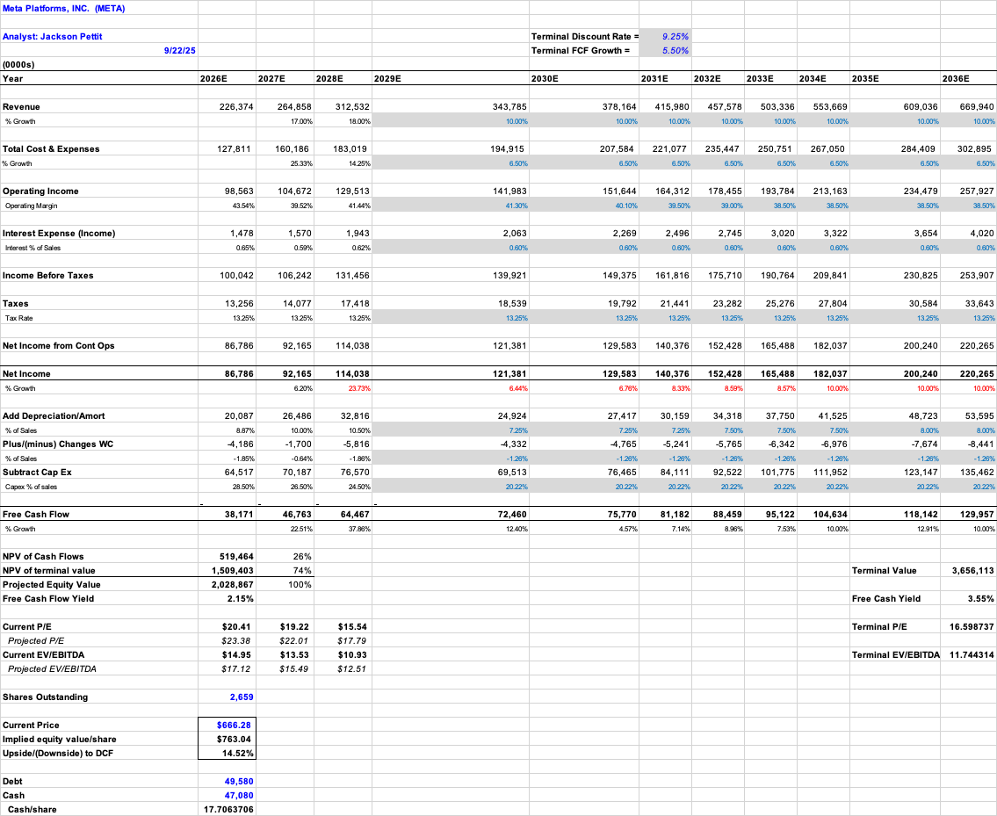
Appendix

Slide 23
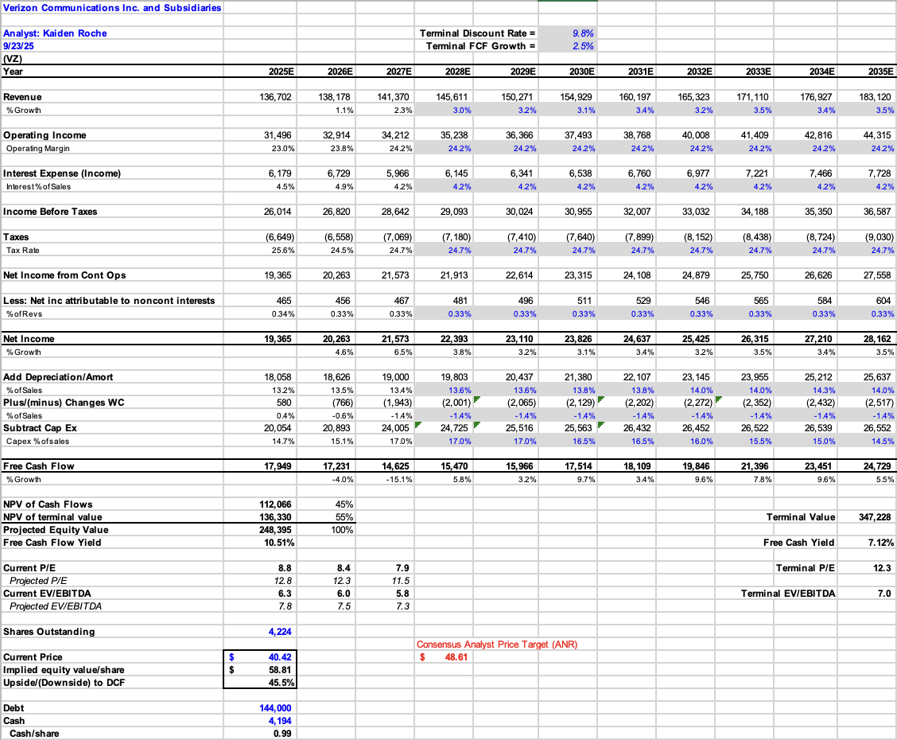
Appendix

Slide 24
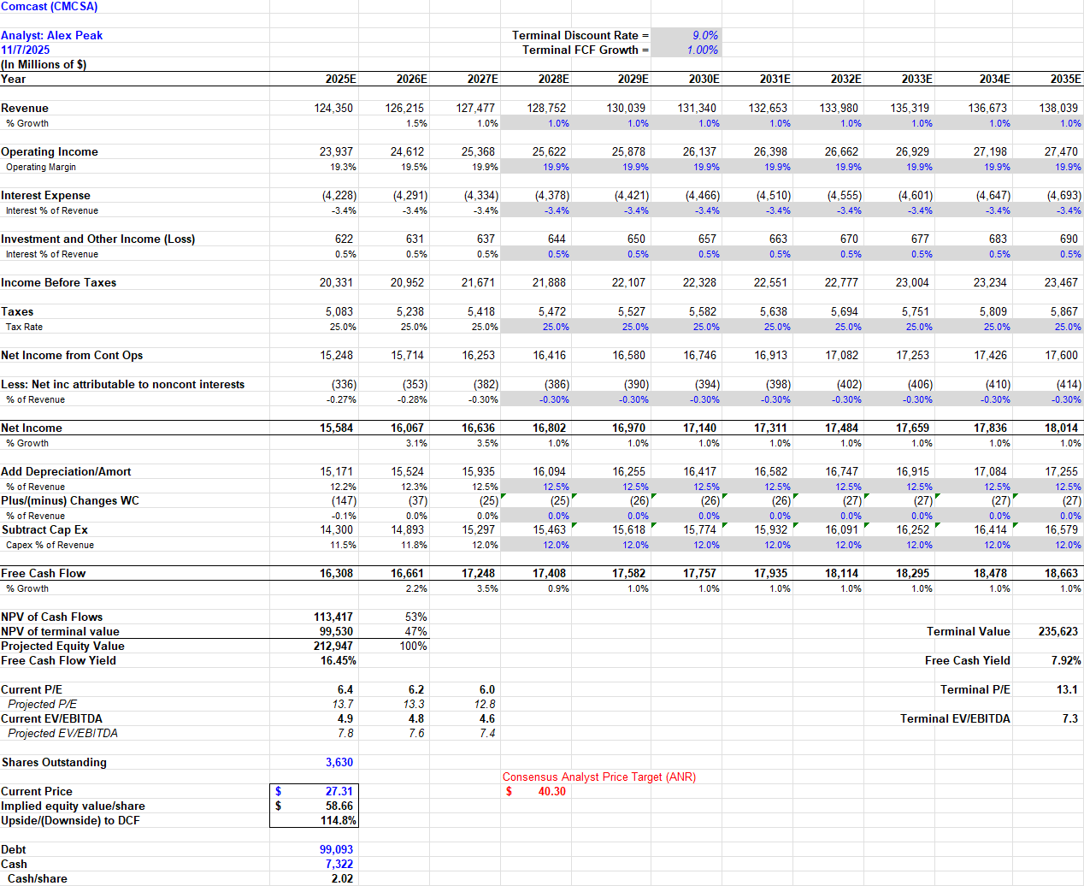
Appendix

Slide 25
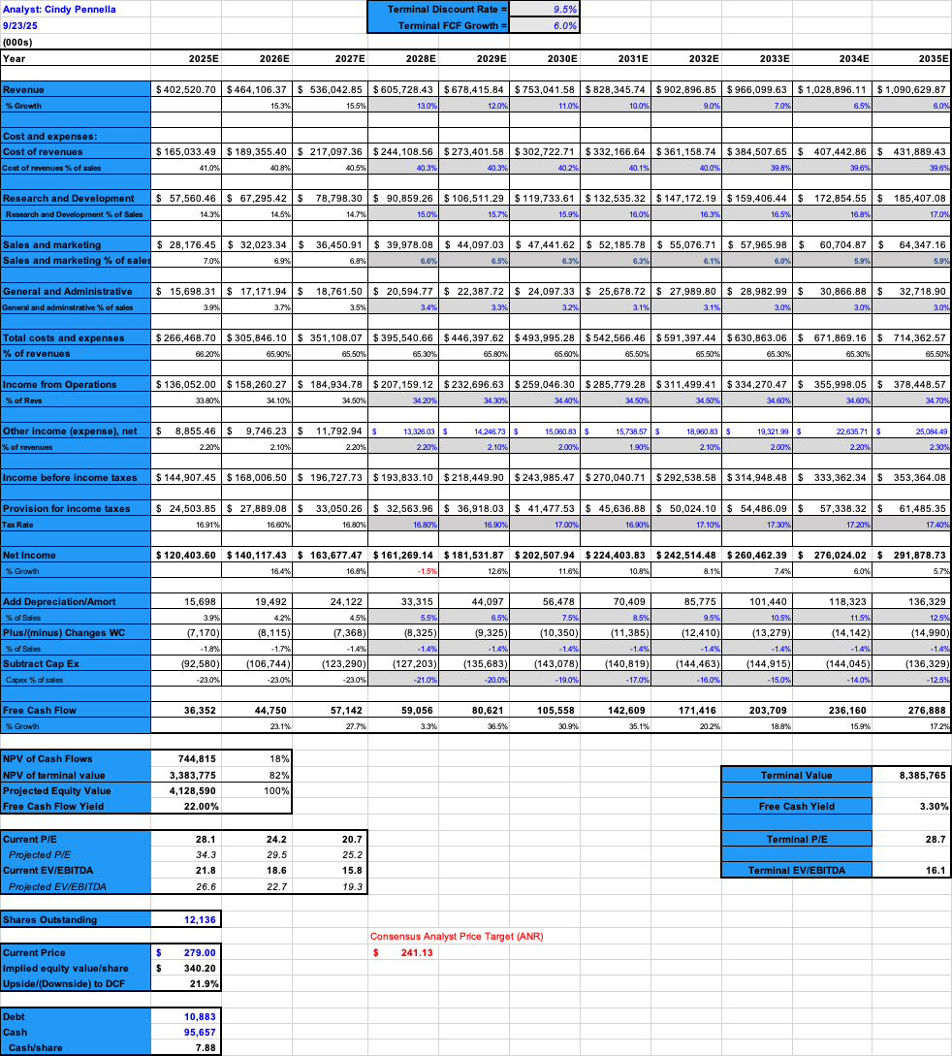
Appendix

