Slide 1

Communication Services
Kaiden Roche, Jack Pettit, Alex Peak, Cindy Pennella

Slide 2




Communications Services Overview
Extremely broad sector comprised of companies that provide information/entertainment through various media.
Industries: Telecommunications, Internet Content & Information, Entertainment, etc.
Key Drivers: Increase demand for cloud service/AI, Rapid Deployment of 5Gnetwork, Rise in data consumption largely driven by phone usage.
Established September 24th, 2018, replacing the Telecommunications Sector.
Kept existing telecommunication companies (AT&T, Verizon)
Added META and Alphabet from the information technology sector

Slide 3
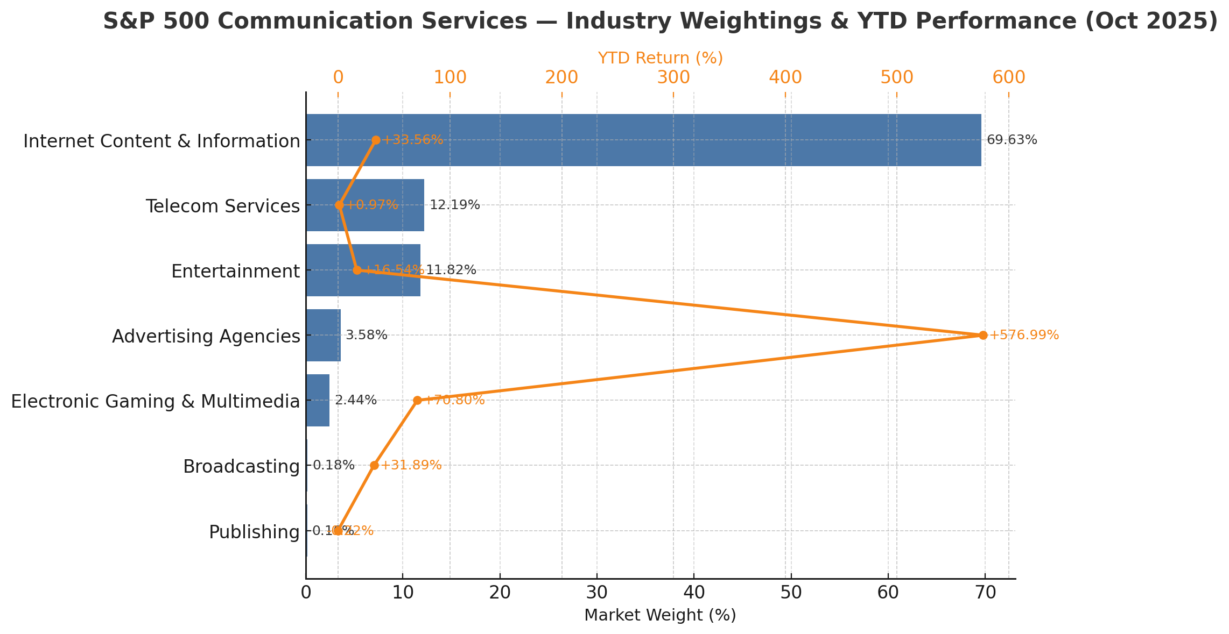
% Industry Weighting With YTD Performance
Yahoo Finance – Communication Service
Yahoo Finance – Communication Service

Slide 4
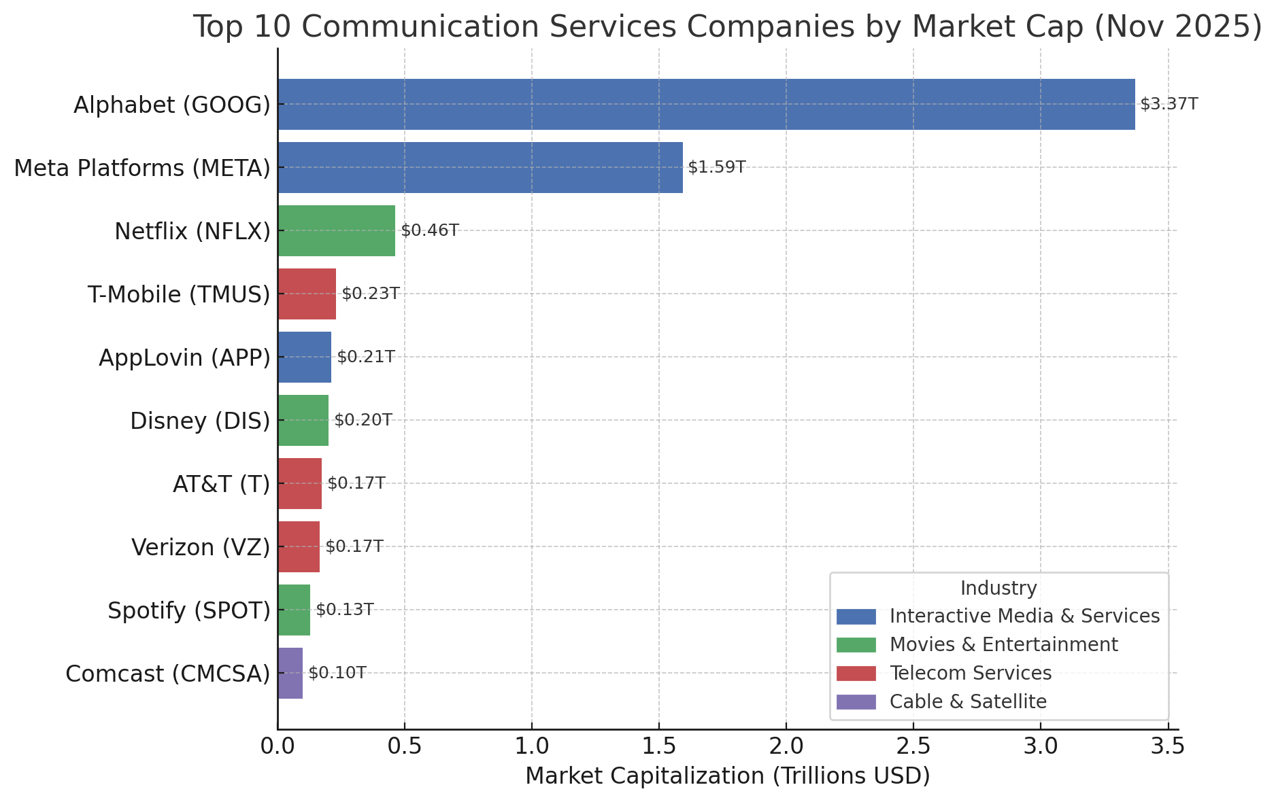
10 of the Largest Companies in the Communication Services
The Communication service sector has 27 total holdings with a Combined market cap of ~8.43trillion (~10.5%) as of 10/29/25 of the S&P). Revenue ~ 2Trillion. P/E~27.43
  In 2018, Alphabet Inc. (Google) and Meta Platforms were reclassified to Communication Services.
    In 2025, Alphabet and Meta make up roughly 1/3 of the entire sector. Alphabet makes up 4.69% of the S&P while Meta makes up 2.76%.

Slide 5
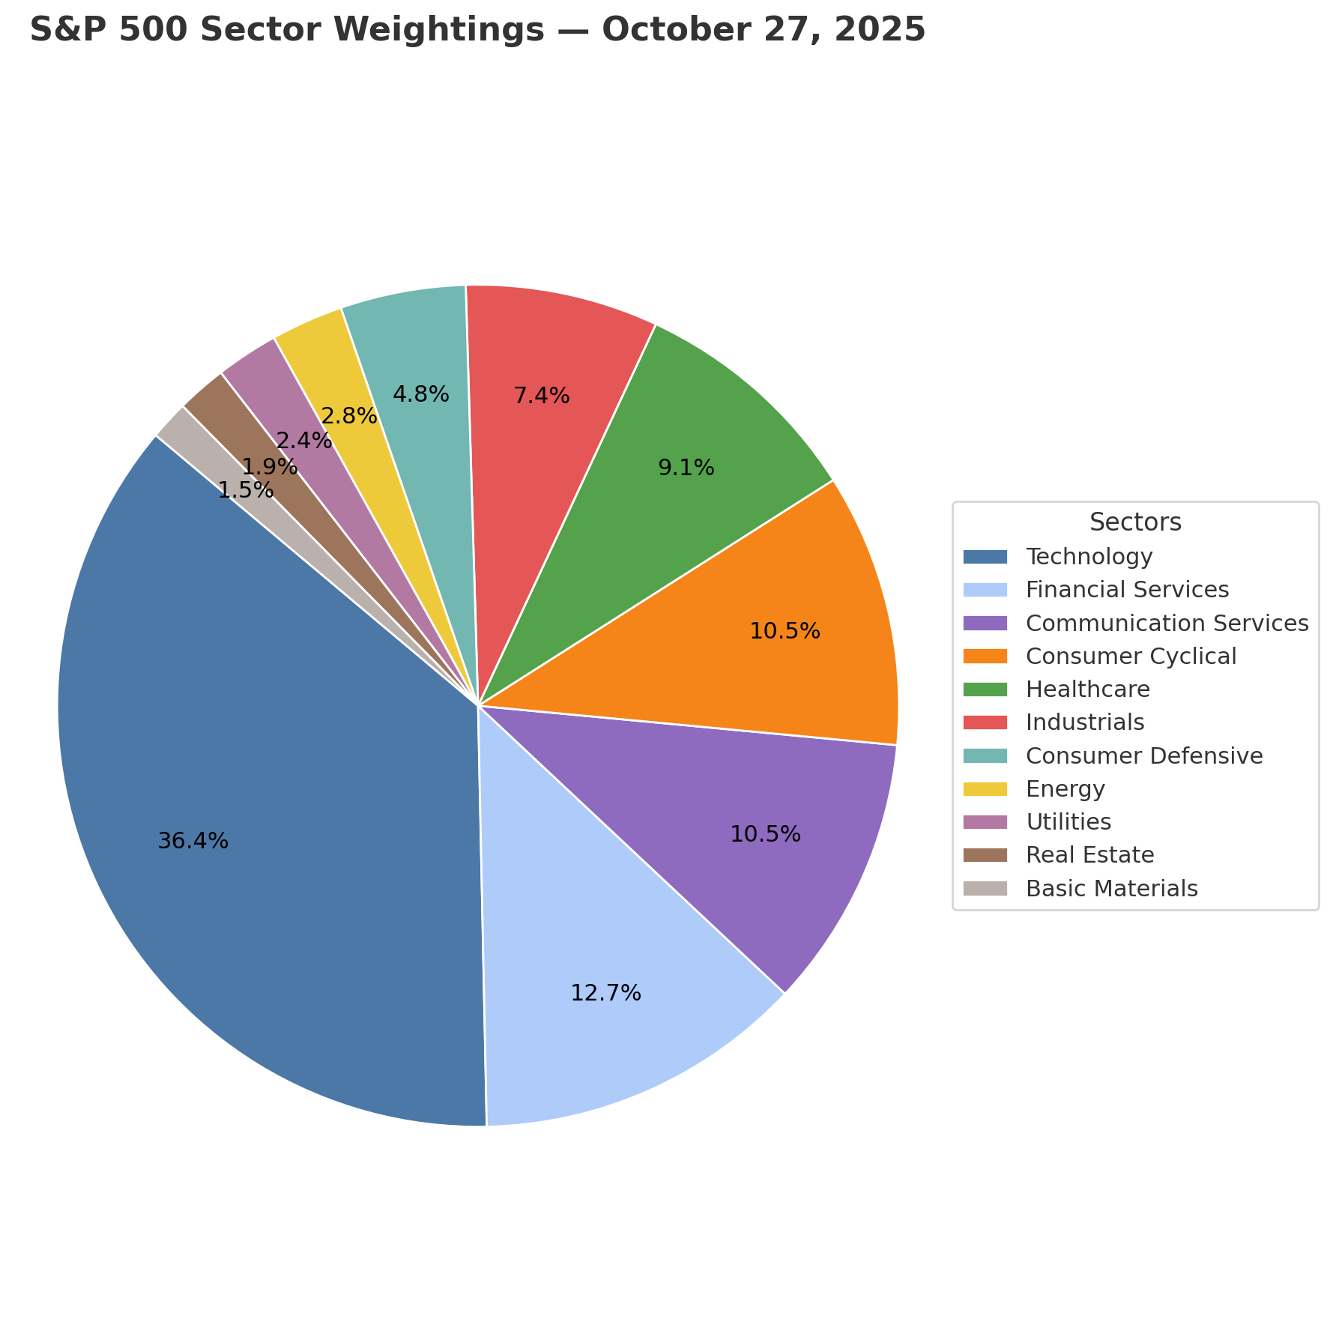
% S&P Holding
    The communication service sector makes up 10.5% of the S&P weightings as of 10/27/25.
    The communication services sector is up 30.54% YTD, while SPY as a whole is only up 16.9% YTD.

Slide 6
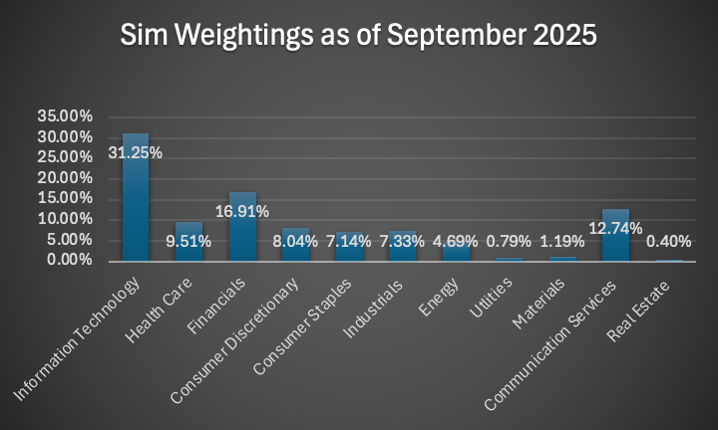
SIM Weighting

Slide 7


Business Analysis

Slide 8
Business Cycle
Historically defensive, but now more cyclical due to growing market share of Internet Content & Information and Entertainment companies within the sector
Telecom Services | Entertainment | Internet Content & Information
Verizon. AT&T, T-Mobile Defensive Mature stage Slightly cyclical due to Infrastructure investments tied to economy | Netflix, Disney, Warner Bros Highly cyclical Mature stage Mostly subscription based Discretionary spending News outlets display defensive characteristics | Alphabet, Meta, Spotify Moderately cyclical Mature stage Advertising based revenues

Slide 9
Supply Analysis
 | Telecom Services | Entertainment | Internet Content & Information
Capacity Additions | Infrastructure investment (5g towers, fiber optic expansion) Company acquisition & mergers | Content creation and licensing Streaming service investments | Cloud computing capacity Algorithm and platform development

Slide 10
Porter’s 5 forces
Porters 5 Forces | Strength | Reasoning
Ease of Entry | Low | High upfront capital investment High concentration in top companies
Bargaining Power of Suppliers | Moderate | Few Suppliers Mature Market
Bargaining Power of Buyers | High | Low Switching Costs Easy to Switch Price Transparency
Threat of Substitutes | High | Alternative Options Rapid Tech Innovation
Industry Rivalry | High | Competitive Pricing Concetrated Market Share

Slide 11

Economic Analysis

Slide 12
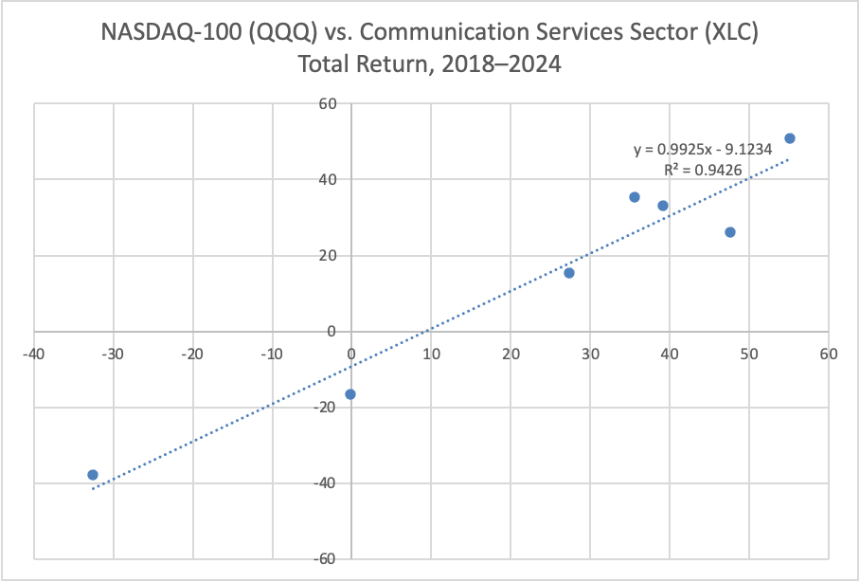
The regression analysis shows a strong positive relationship (R² = 0.94) between the NASDAQ-100 (QQQ) and Communication Services total returns from 2018 to 2024.
This indicates that the sector’s performance is largely driven by growth-oriented technology trends and the market movements of major constituents such as Meta and Alphabet.

Slide 13

Financial Analysis

Slide 14
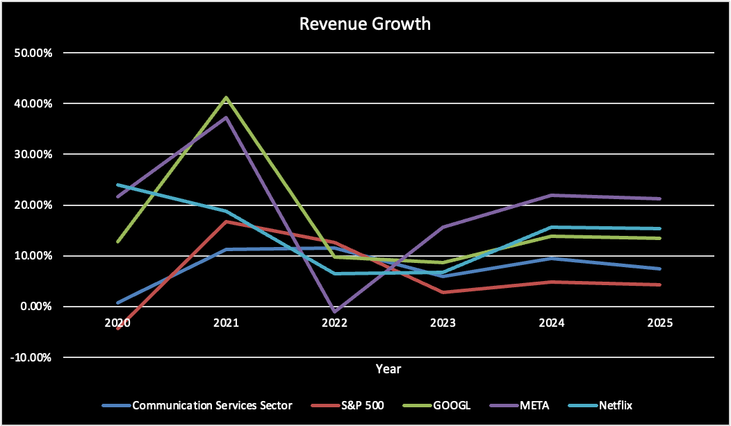
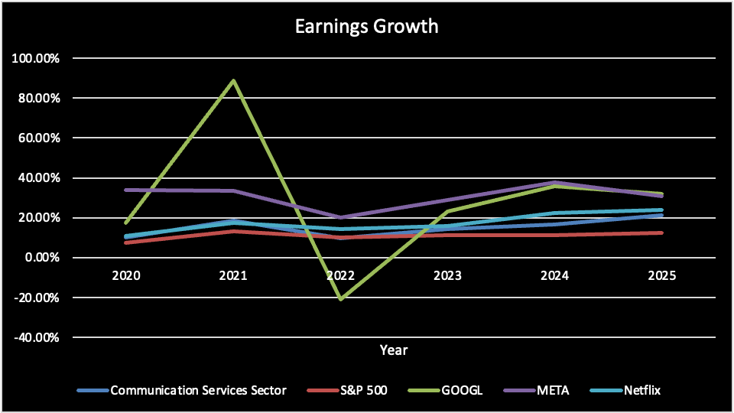


Communication Services sector outperformed the S&P 500 in both revenue and earnings growth
2021: post pandemic boom -> digital transformation
2022: market correction back to normal levels -> inflation, higher interest rates, less streaming/engagement
Source: NetAdvantage

Slide 15
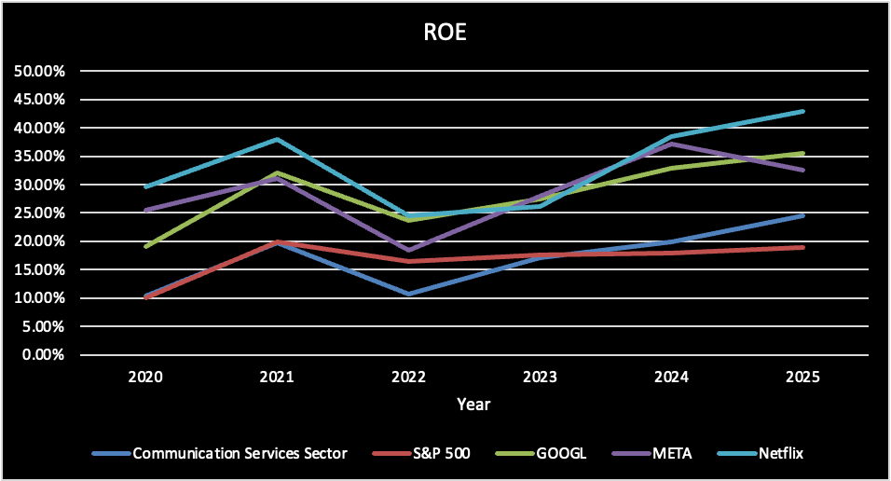
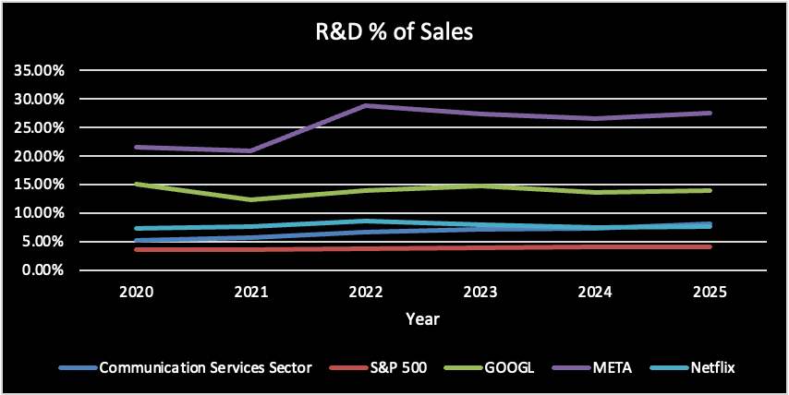
Trend: Margins and profitability are expanding, meaning these firms are generating more return from their shareholders’ capital.
The sector average (around 7–9%) indicates strong focus on digital innovation.
Source: NetAdvantage

Slide 16
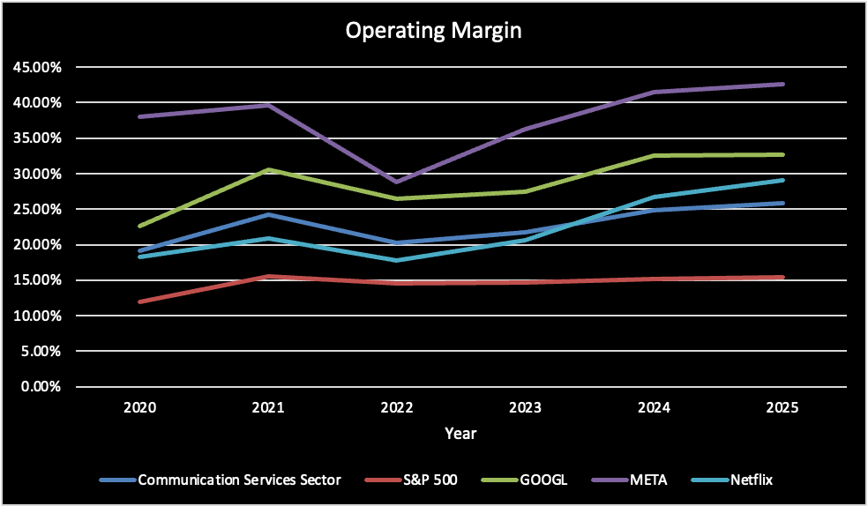
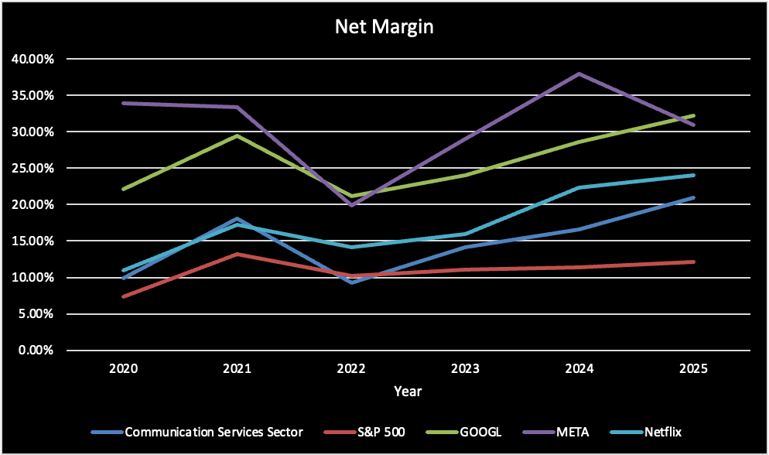
Margins are expanding sector-wide, while S&P 500 margins are relatively flat.
These firms are net generators of free cash flow, not users of cash — they have low leverage and strong recurring revenue streams
Compared to the S&P 500, the Communication Services sector generates higher profitability and cash flow per dollar of sales.
Source: NetAdvantage

Slide 17

Valuation Analysis

Slide 18
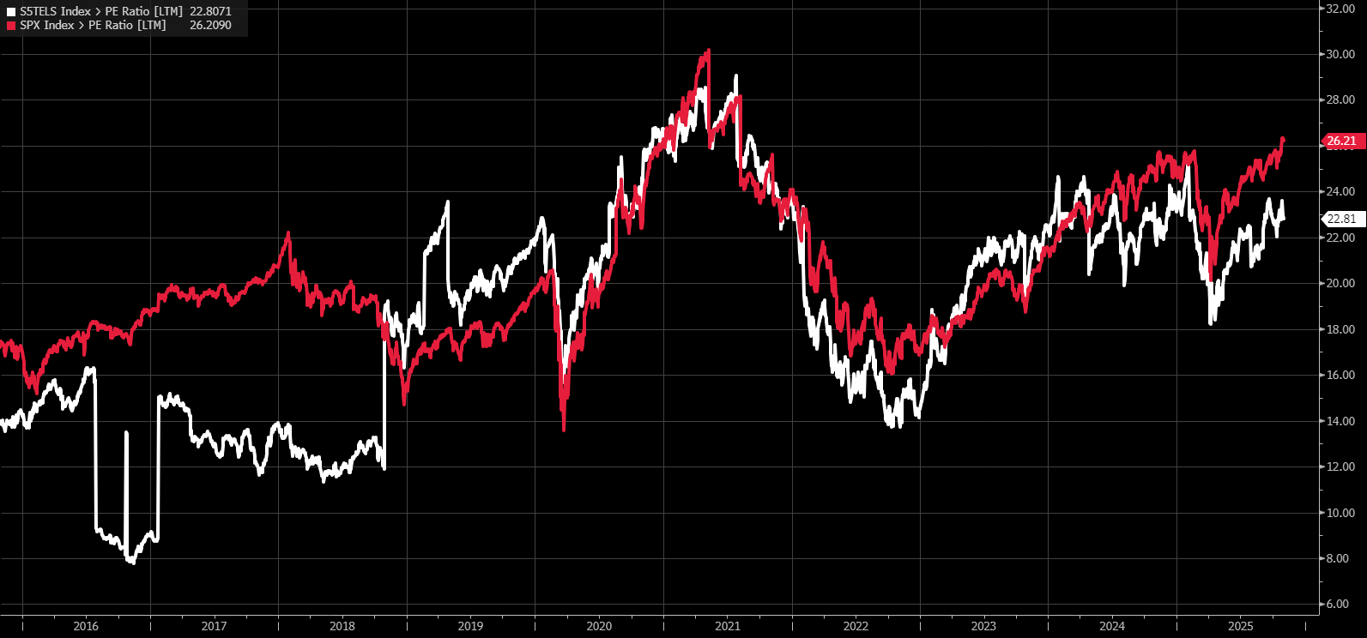
P/E – Comm Services Sector vs S&P 500

Slide 19
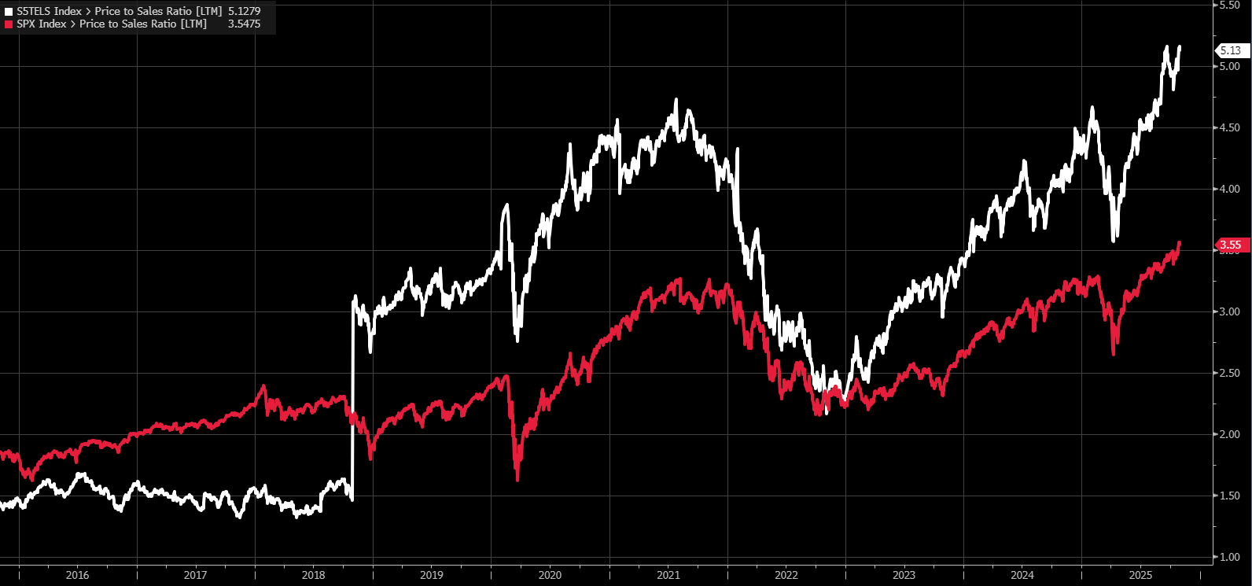
P/S – Comm Services Sector vs S&P 500

Slide 20
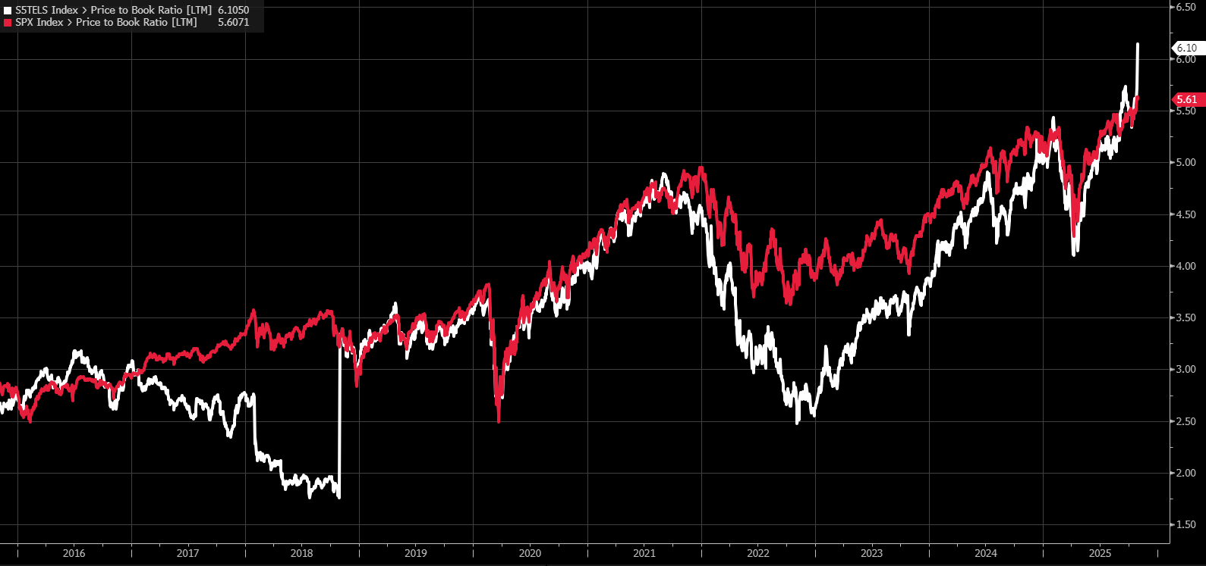
P/B – Comm Services Sector vs S&P 500

Slide 21
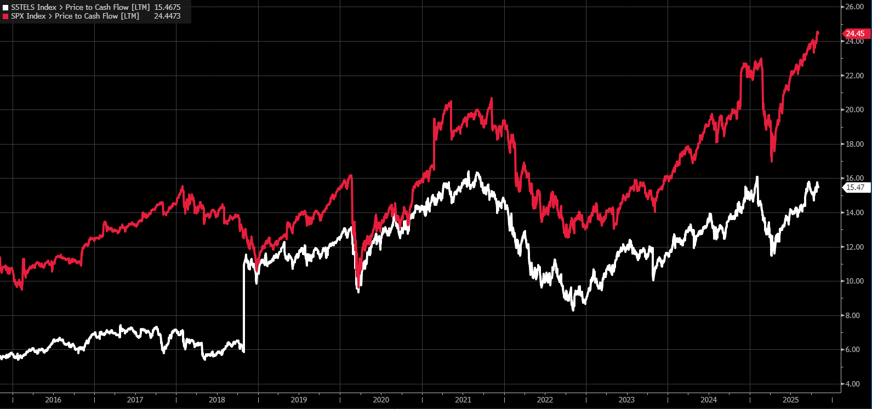
P/CF – Comm Services Sector vs S&P 500

Slide 22
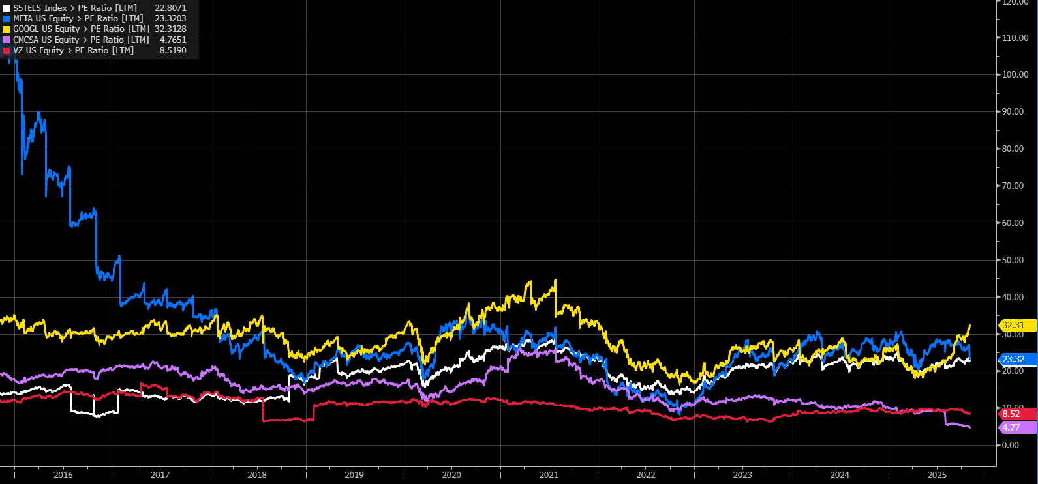
P/E Among Stocks in Comm Services Sector

Slide 23
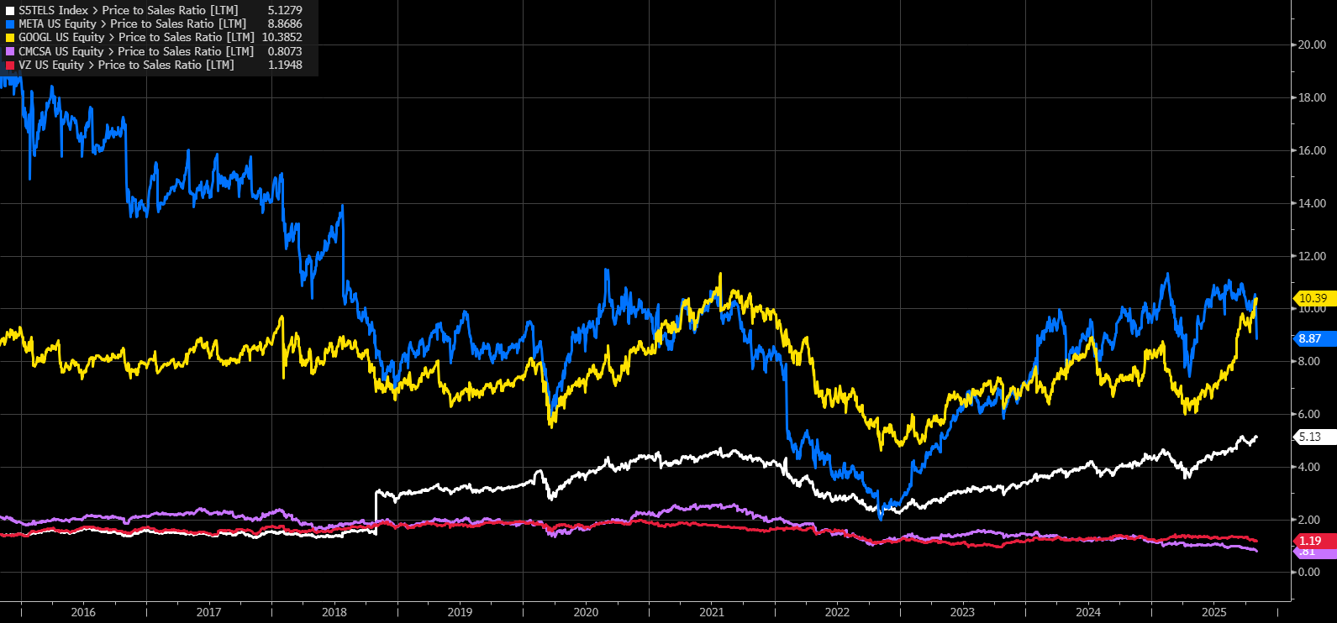
P/S Among Stocks in Comm Services Sector

Slide 24
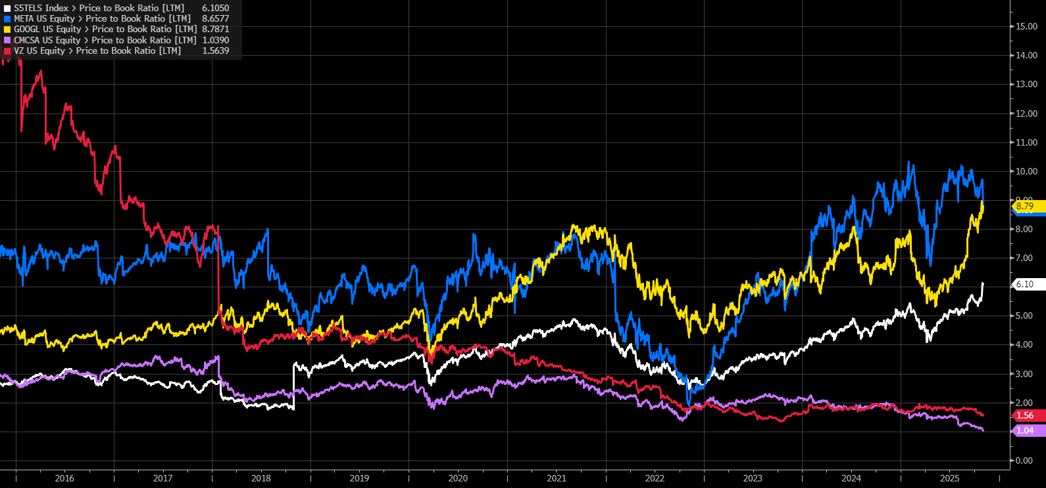
P/B Among Stocks in Comm Services Sector

Slide 25
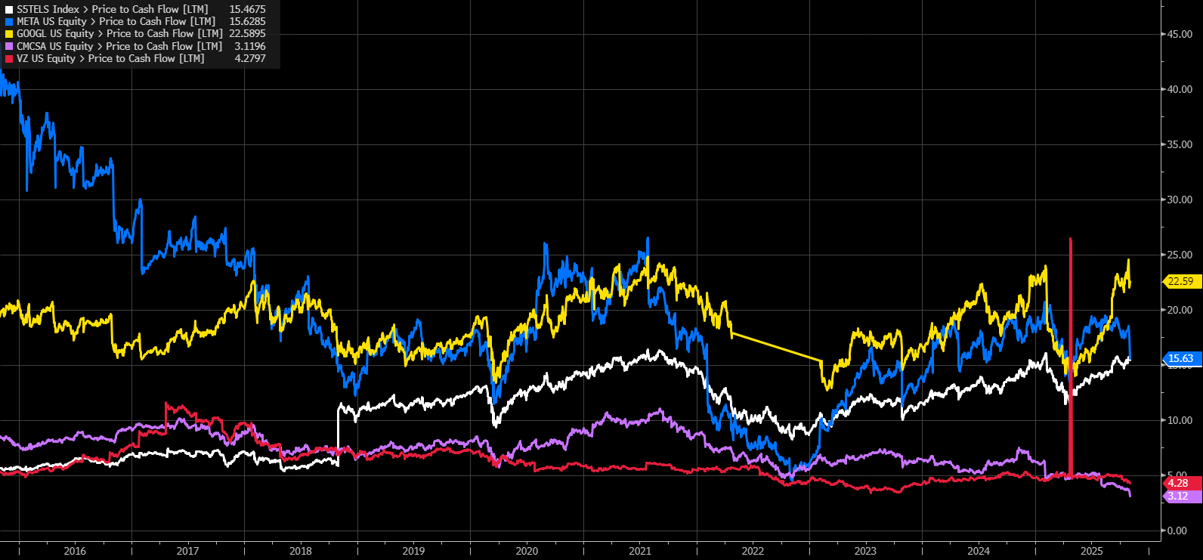
P/CF Among Stocks in Comm Services Sector

Slide 26
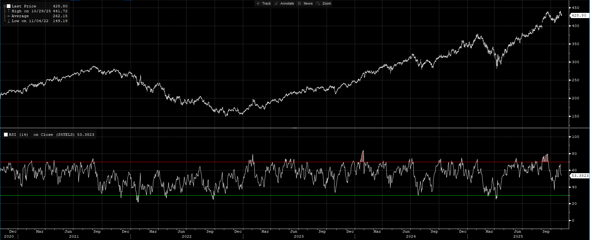
Technical Analysis – RSI

Slide 27
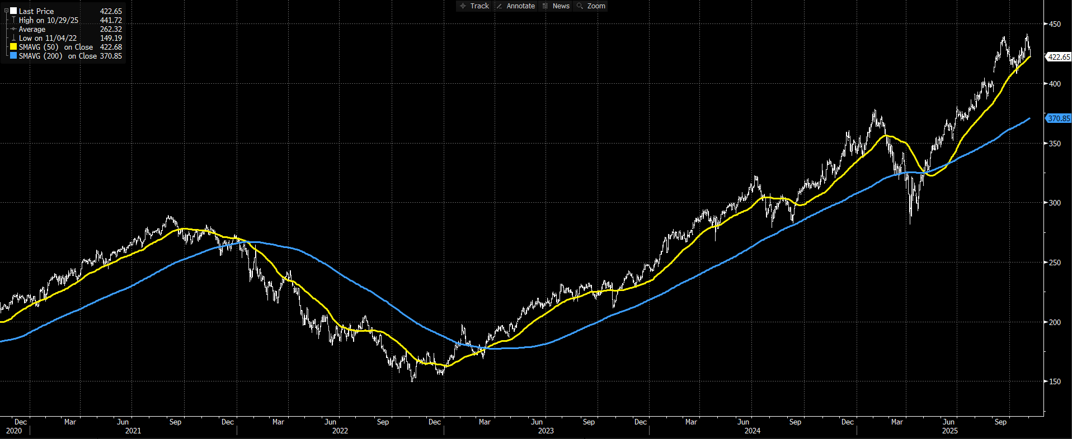
Technical Analysis – Moving Averages

Slide 28
Valuation Takeaways
Valuations vs SPX
  P/E: Roughly in-line
  P/S: Expensive
  P/B: Roughly in-line
  P/CF: Cheap
Divergence Between Industries
  Media & Internet (META & GOOGL): Premium Valuations
  Telecom (CMCSA & VZ): Discounted Valuations
Outlook
  Valuation expansion for high-growth firms
    Increasing margins & innovation
  Valuation contraction for mature firms
    Slow top-line growth

Slide 29
Slight Overweight Recommendation
Reasoning:
The Communication Sector has outperformed every sector in the SPY YTD. Largely driven by digital ad recovery, AI integration, and streaming profitability improvements.
Sector leaders like Google, Meta, and Netflix each exhibit strong free cash flow, expanding margins, and most importantly, disciplined cost control.
Long-term drivers, including 5G adoption, mobile content consumption, and AI integration, enhance the long-term outlook of communication services.
Risks:
Regulatory scrutiny on privacy, AI, and antitrust could pressure overall sector performance.
High concentration in mega-caps (META, GOOGL) creates a performance dependency.
Industries:
Overweight: Internet Content & Information, Entertainment/Streaming, Advertising Agencies
Underweight: Telecommunications Services

Slide 30
Q & A

