Slide 1

Communication Services
Analysts: Juliana Metz, Cai Marquez, Ruohan Ma, Jonny Musial

Slide 2
Sector Overview
Comprised of companies that create, distribute, or facilitate communication and content globally. Industries include telecommunications, internet services, broadcasting, and content creation. Key drivers are technological innovation, consumer demand for connectivity and digital content, and subscriber growth. The sector plays a vital role in connecting people and businesses worldwide.
Key Attributes:
  Industries: Telecommunications, internet services, streaming platforms, broadcasting.
  Market Size: Estimated at $4.050 trillion.
  Key Drivers: Technological innovation, consumer demand, subscriber growth.
  Dividends: Vary widely among companies.
  Role: Crucial in connecting individuals and enterprises globally.

Slide 3
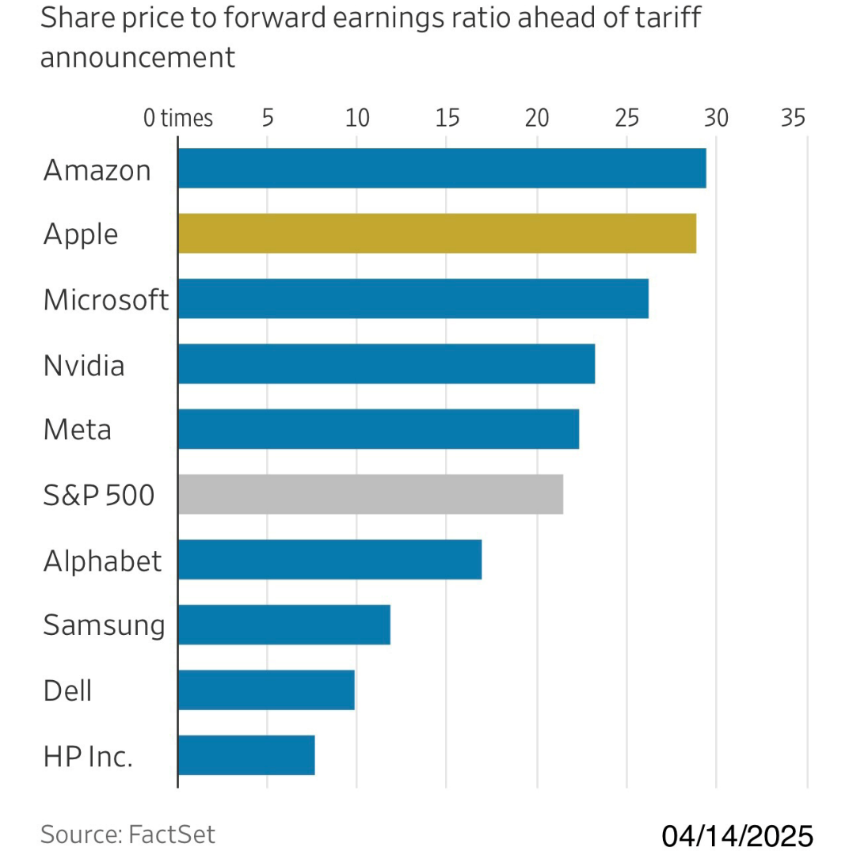
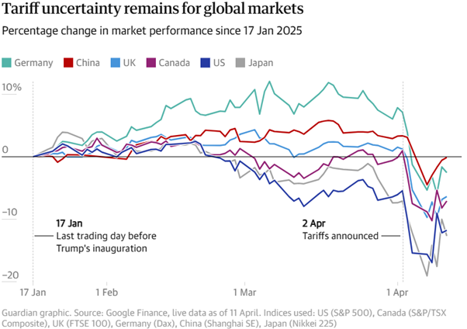
Macroeconomic Environment
Notes:
The Chinese commerce ministry announced on Friday it was raising the 84% tariffs on all US imports to 125% in retaliation of Trump’s consecutive duties on Chinese imports, totaling 145%. Due to the forex market de-dollarizing, the US current account deficit is narrowing and investor sentiment is deteriorating. As such, inflation is expected to soar to 6.7% in the following 12-months. Consequently, companies—with less intellectual property than labor intensity—are facing more tariff exposure. These multinational corporations (MNCs), switching costs to diversify manufacturing, will have profit margins contracted. So, we’re recommending investment in companies that are being victimized by the rising VIX index.

Slide 4

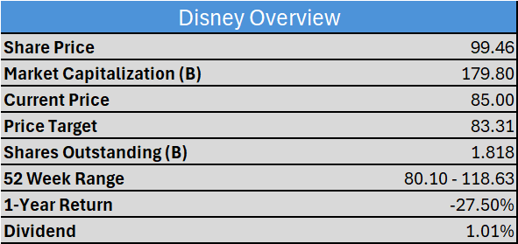
Overview
Description:
Disney is a global entertainment and media enterprise. The business operates through three main segments: Entertainment, Sports, and Experiences. The main value of Disney lies in its intellectual property as they have claims of popular franchises such as Mickey Mouse, Marvel, Star Wars and many others.
Risks:
Consumer Spending: Due to their positioning as an entertainment company, Disney is reliant on consumer spending. This reliance on consumer spending could prove detrimental as the economic outlook is very uncertain
Pricing Power: Disney's business model centers around their ability to put a premium on their products and services. Disney has recently utilized price hikes: $8 - $10/month for a Disney+/Hulu subscription, approximately 30% increase in Disneyland vacation over the last 5 years ($3230-$4266).

Slide 5
Business Analysis
Business Segments
Entertainment:
Consists mainly of their traditional television network, and their direct-to-consumer streaming services such as Disney+ and Hulu.
Sports:
Disney Owns a large stake of ESPN, thus having access to its streaming and distribution. Disney has streaming rights over basketball (NBA), football (NFL), soccer, and other sports.
Experiences:
This portion of the business consists of their in-person experiences, which is made up of their resorts/theme parks and cruises. Disney currently has 12 theme
parks. These parks are in the following locations: California, Florida, Tokyo, Paris, Hong Kong, Shanghai.
Growth Drivers
Entertainment:
Pricing increases are being to grow revenues and margins within this segment. Disney must balance these increases while avoiding subscriber losses.
Sports:
Pricing increases are also being used while simultaneously trying to get more viewership on their recent ESPN app.
Experiences:
Disney is expanding its cruise fleet with over 60 billion dollars in investment over the next 10 years to increase their fleet size. They currently have six ships and are planning to have seven more created. As previously mentioned, they also are utilizing price hikes within their resorts/theme-parks to grow revenues/op margins.

Slide 6
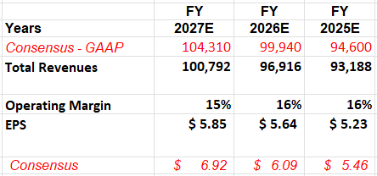
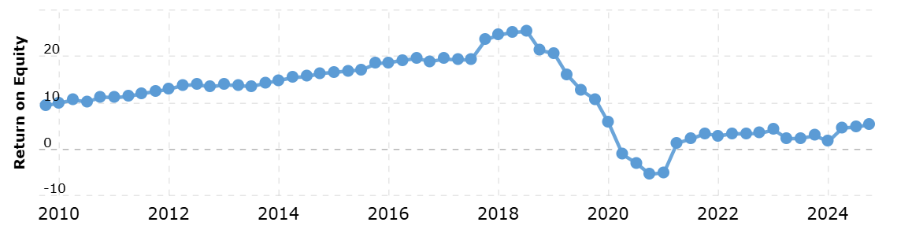
Financial Analysis
Historical ROE
Source: Macrotrends

Slide 7
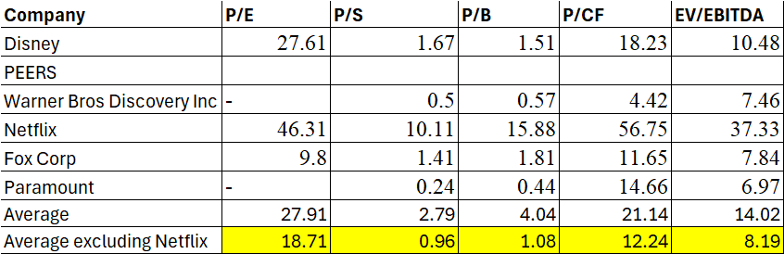
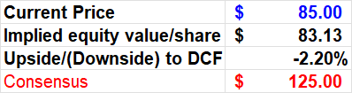

Valuation
DCF Assumptions:
The model assumes lower revenue due to a difficult macroeconomic environment. These revenues are expected to be lower specifically because of two factors: consumer spending & pricing. Disney issued significant forward-looking guidance regarding operating incomes of their different sectors, so a large operating margin increase was assumed as a conservative approach. Based off the model we recommend a SELL.

Slide 8
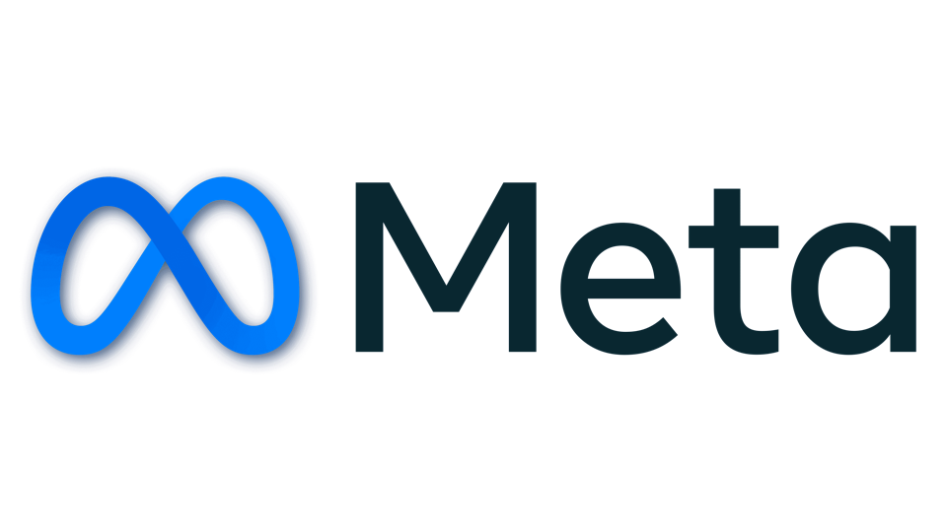
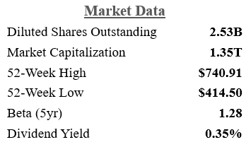
Overview Of Meta
Company Description
Meta Platforms, Inc. (META) is the world’s leading social media company with two business segments. At the core of revenue generation, META’s Family of Apps (FoA)—Facebook, Instagram, Messenger, WhatsApp, and Threads—are platforms, whereby marketers purchase advertisements. This segment is responsible for bringing communities together, keeping relationships in touch, and serving consumer touchpoints. Reality Labs (RL) delivers data, software, and hardware products by researching Mixed Reality (MR), Virtual Reality (VR), and Augmented Reality (AR). Stewardship is critical for META, especially in Artificial Intelligence (AI) investments.
Risks
If META is forced to divest Instagram and WhatsApp.
Following TikTok’s 75-day extension, it will either divest in the U.S. or face a ban. Regardless, META’s top line already benefits.
On a global basis, the following remain concerns: regulation, macroeconomic conditions, secular themes, integrity of ESG, and simply the execution of innovating AI as the pioneer.
Philosophy
The strategic vision of Meta Platforms—to efficiently integrate its FoA and RL—will come to fruition alongside bullish technological advancements in MR, VR, AR, and AI. If this technology crosses the chasm via the Internet of Things (IoT), developing monetization opportunities, META’s mission will have attained first mover advantages through the prioritization of ESG.
Notes:
The FTA
Europe’s potential to implement digital tariffs, Meta’s short-term revenues would become materially pressured, and we’d project 15% reduction in our target price. Even if this were to occur, Meta would still be undervalued as the US operations of TikTok remain uncertain, raking in additional revenue.

Slide 9
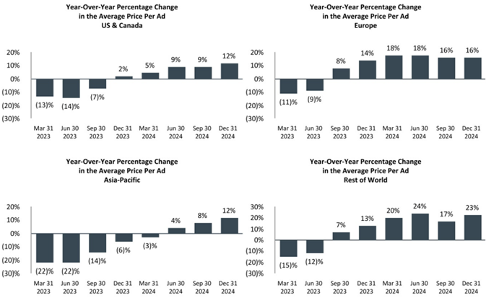
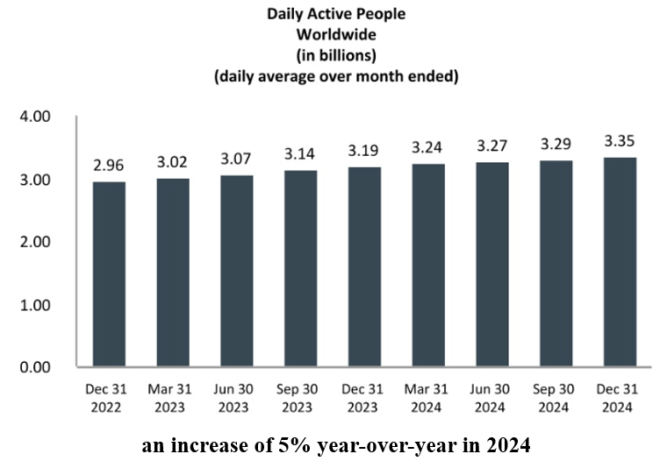
Business Analysis
Notes:
Meta’s network effect is illustrated through a 3-year trailing growth from 2.96-3.35 billion DAP on a FoA. With a premier reputation, Meta protects the intangible assets of RL with a wide economic moat.
The average price per advertisement is calculated as total advertising revenue divided by the number of ads delivered.
In Q4, the average price per ad increased 14%. Pricing growth benefited from increased demand from advertisers, in part driven by improved ad performance and anticipation for Llama 4, an open AI model.
In 2024, revenue increased by 18% in United States & Canada, 26% in Europe, 22% in Asia-Pacific, and 31% in Rest of World, in each case relative to 2023.

Slide 10
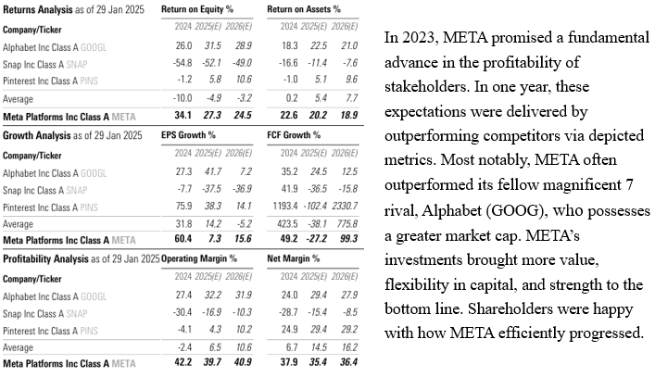

Financial Analysis
Notes:
At the end of 2024, the EBIDTA margin of Meta experienced a three-year trailing growth of 19.35%. In February of 2025, Meta increased its dividend by 5%; this was a month after announcing an expected $20 billion increase in capex YOY. With a forward P/E of about 22, getting basically 44% of its revenues in the US is favorable. Due to the fear in markets, Meta’s overselling is result of recessive noise, so it is recommended that we capitalize on this volatility. Additionally, hardware became reprieved from US tariffs, positioning the bottom line of META even higher. To manage the risk of absolute economic exposure, META has enhanced governance. Being the final mag 7 company to turn red this year, META’s substantial change in working capital has been strategic. Following operating expenses and depreciation, employee compensation is expected to be the second-largest investment of 2025; this includes technical talent in the priority areas of infrastructure, monetization, RL, generative AI, as well as regulation and compliance. Therefore, the price of META is low, all while key personnel additions expand opportunities

Slide 11
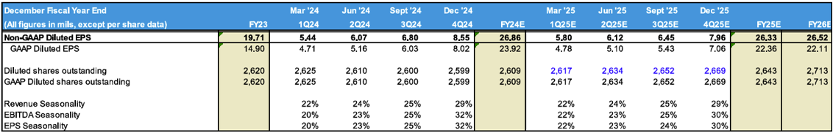
Valuation
Thesis
Amid META’s oversell, it is recommended to BUY META at the current price of $530.29. Selling at the target price of $749.69 will return 41.4%. This valuation is attributable to the qualitative impact of ESG management on market sentiment and quantitative analyses of adjusted EPS forecasts and a DCF model.
Notes:
META’s forward PE is $4 below the operational bottom line, adjusting eps at $26.33 for 2025.
Moreover, the forward PE is less than the GAAP eps for 2024.
With robust financials at the end of Q4, META emphasized expectations for continued growth in revenues and RL investments. As such, the terminal FCF growth of 5.25% indicates trust in META’s family of data to innovate technology sustainably. In reducing economic uncertainty by leveraging ESG initiatives, the paramount demand for AI justifies the value delivered at a terminal discount rate of 8.7%.
At an oversold price of $530.29, we recommend to buy Meta, targeting a return of 41.4%.

Slide 12

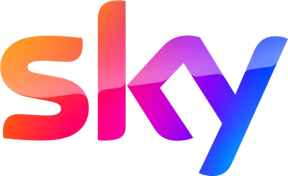

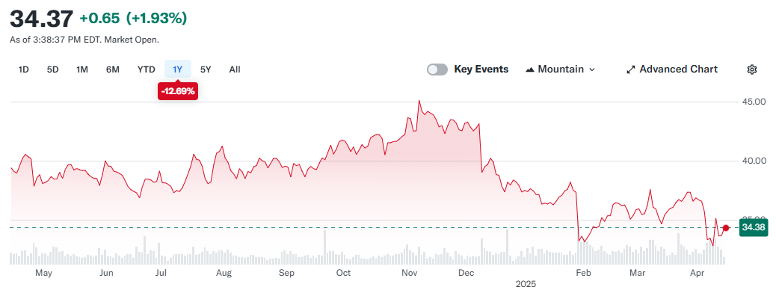
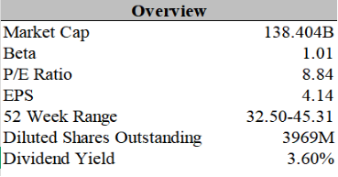




Overview
Description
Comcast is a global media and technology conglomerate with two core business segments: Connectivity & Platforms and Content & Experiences. The company provides broadband, wireless, video, voice, and home security services primarily under the Xfinity and Comcast Business brands. It owns NBCUniversal, which includes a wide portfolio of television networks, film studios, and theme parks.
10.8
Risks
Continued decline in video subscribers due to industry-wide cord-cutting
Intense competition in broadband and streaming markets from AT&T, Verizon, Netflix, and Disney+
Regulatory risks in media and telecommunications

Slide 13
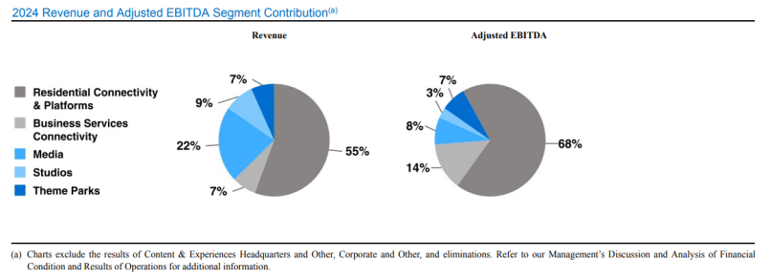
Business Analysis
Residential Connectivity & Platforms
  Broadband, Wireless, Video,
Advertising, Other
Business Services Connectivity
Media: Broadcast Networks, Streaming Platforms
Studios: Comcast Film Studios, Comcast TV Studios
Theme Parks: Orlando, Hollywood, Japan, Beijing
Key Drivers
Broadband Growth: Comcast leads the U.S. broadband market with over 26% share.
Wireless Expansion: Xfinity Mobile is rapidly growing, supported by bundling and new prepaid brand "NOW".
Streaming Strategy: Peacock reached 36M paid subscribers (+46% YoY revenue growth in 2024).
Theme Parks
Spin-Off Strategy: Comcast plans to spin off non-core domestic cable networks by end of 2025 to focus capital on growth segments.

Slide 14
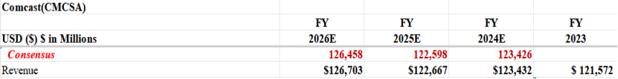
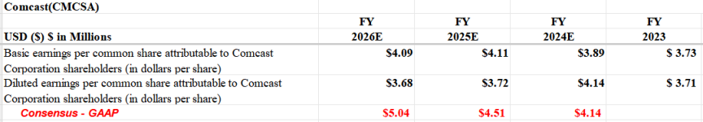
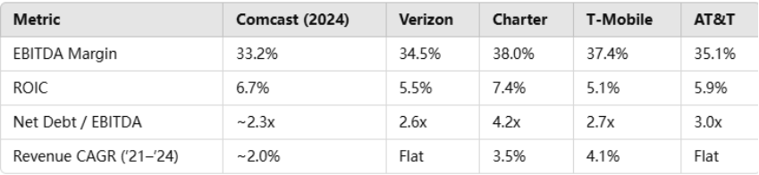
Financial Analysis
Financial Ratios and Comparisons

Slide 15
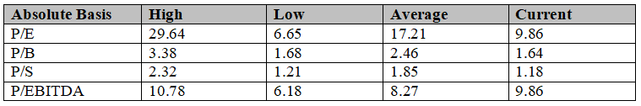

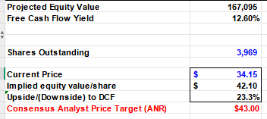
Valuation

Slide 16

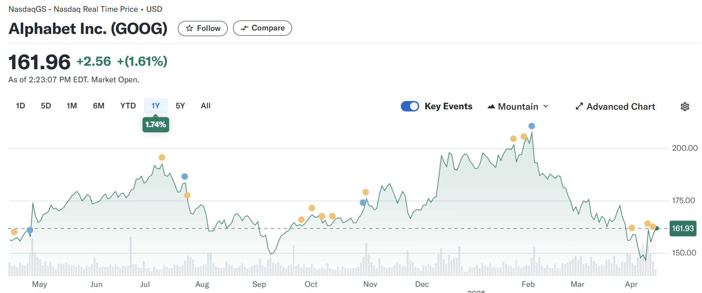
Alphabet Inc, Class A
Overview:
General Data (As of 4/8/25)
Alphabet Inc. (Google's parent company) is a global technology conglomerate specializing in internet services, software, consumer electronics, and innovative ventures like AI and autonomous vehicles. In 2024, Alphabet reported $350 billion in revenue and $100 billion in net income, with Google Services contributing 92.4% of total revenue. Key businesses include Google Search, YouTube, Android, Google Cloud, and experimental projects under "Other Bets" like Waymo and Verily.
Risks:
Regulatory Scrutiny: Alphabet faces antitrust investigations and privacy-related challenges globally, which could impact its advertising dominance.
Competition: Intense rivalry from Microsoft (Azure), Amazon (AWS), and Meta in AI, cloud computing, and digital advertising markets.
Revenue Dependence: Over-reliance on advertising (80.5% of revenue) makes Alphabet vulnerable to shifts in ad spending and adoption of ad-blocking software.
Market Volatility: Recent stock declines reflect investor concerns over missed earnings expectations and high capital expenditures on AI infrastructure
Sector | COMM SRVCS
Industry | Internet Content and Info
Price | $161.96
Beta | 1.03
Market Cap | $1.796T
Dil. Shares Outs. | 13.31B

Slide 17
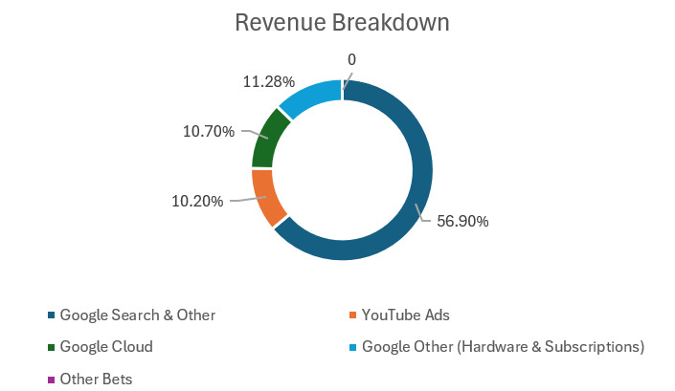
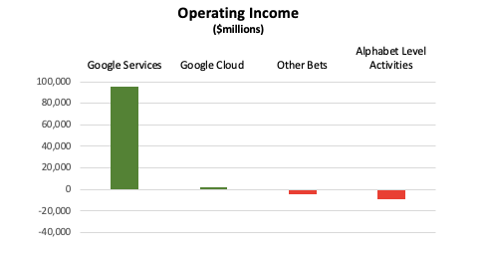
Business Analysis
Three Business Segments Google Cloud
The second-largest segment focuses on enterprise solutions:
Google Cloud Platform (GCP): Provides infrastructure-as-a-service (IaaS) and platform-as-a-service (PaaS) offerings.
Google Workspace: A suite of productivity tools competing with Microsoft Office 365.
In 2024, this segment generated $31.3 billion in revenue (12% of total revenue) and turned profitable with over $4 billion in operating income
Google Services
This is Google's largest and most profitable segment, contributing approximately 87% of Alphabet's total revenue in 2024:
Advertising, Platforms & Applications, Hardware and Subscriptions
Other Bets
- Waymo: Autonomous vehicles.
- Verily: Life sciences.
- DeepMind: Artificial intelligence research.
Despite generating $1.2 billion in revenue in 2024, this segment recorded an operating loss of $3.3 billion due to its high-risk, long-term projects

Slide 18
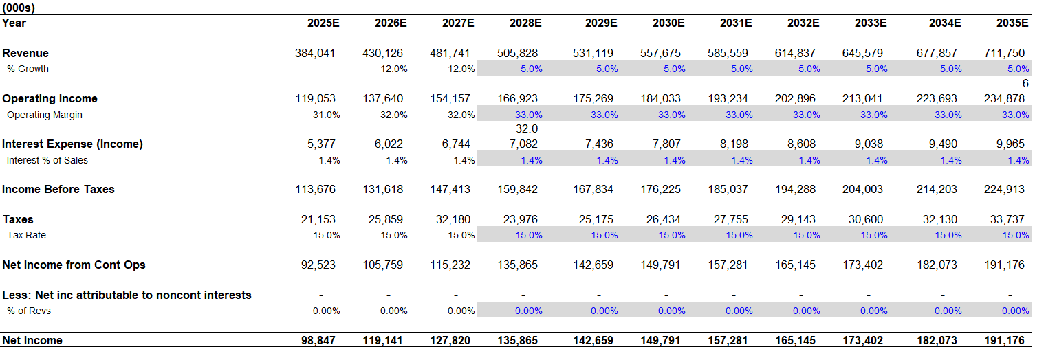
Financial Analysis
Metric | Google (2024) | Microsoft (2024) | Amazon (2024) | Meta Platforms (2024)
EBITDA Margin | 33.5% | 48.0% | 16.0% | 42.0%
ROIC | 15.0% | 30.0% | 12.0% | 21.0%
Net Debt / EBITDA | Negative (Net Cash) | 1.5x | 2.0x | Negative (Net Cash)
Revenue CAGR ('21-'24) | 9.3% | 13.0% | 11.0% | 7.8%
Notes:
Positives for Google:
1. Strong Cash Position
2. Steady Revenue Growth
3. Competitive ROIC
Negatives for Google
1. Slower Growth vs. Key Competitors

Slide 19
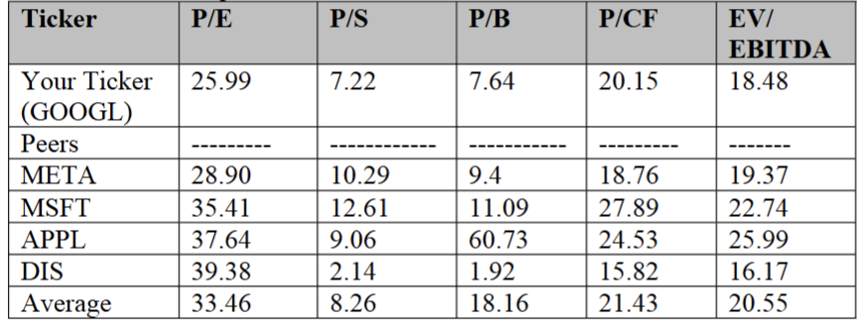

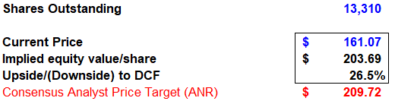
Valuation
Thesis
It is recommended to BUY GOOGL at the current price of $161.07. The upside being 26.5% and the implied value per share of $203.69. This valuation is attributable to Google Cloud being a major profit generator, AI advancements, and a significant stock buyback program in early 2025.

Slide 20

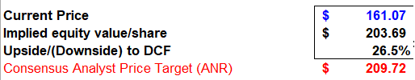
Recommendation
Ticker | Current weighting | SGP weighting | Upside / (downside) | Recommended change | Recommended weighting
DIS | 2.66% | 0.35% | -2.2% | -2.66% | 0%
META | 2.68% | 2.62% | 41.4% | +1.33% | 4.01%
CMCSA | 1.87% | 0.36% | 23.2% | - | 1.87%
GOOGL | 3.65% | 2.02% | 26.5% | +1.33% | 4.98%
DIS
CMCSA
META
GOOGL

Slide 21
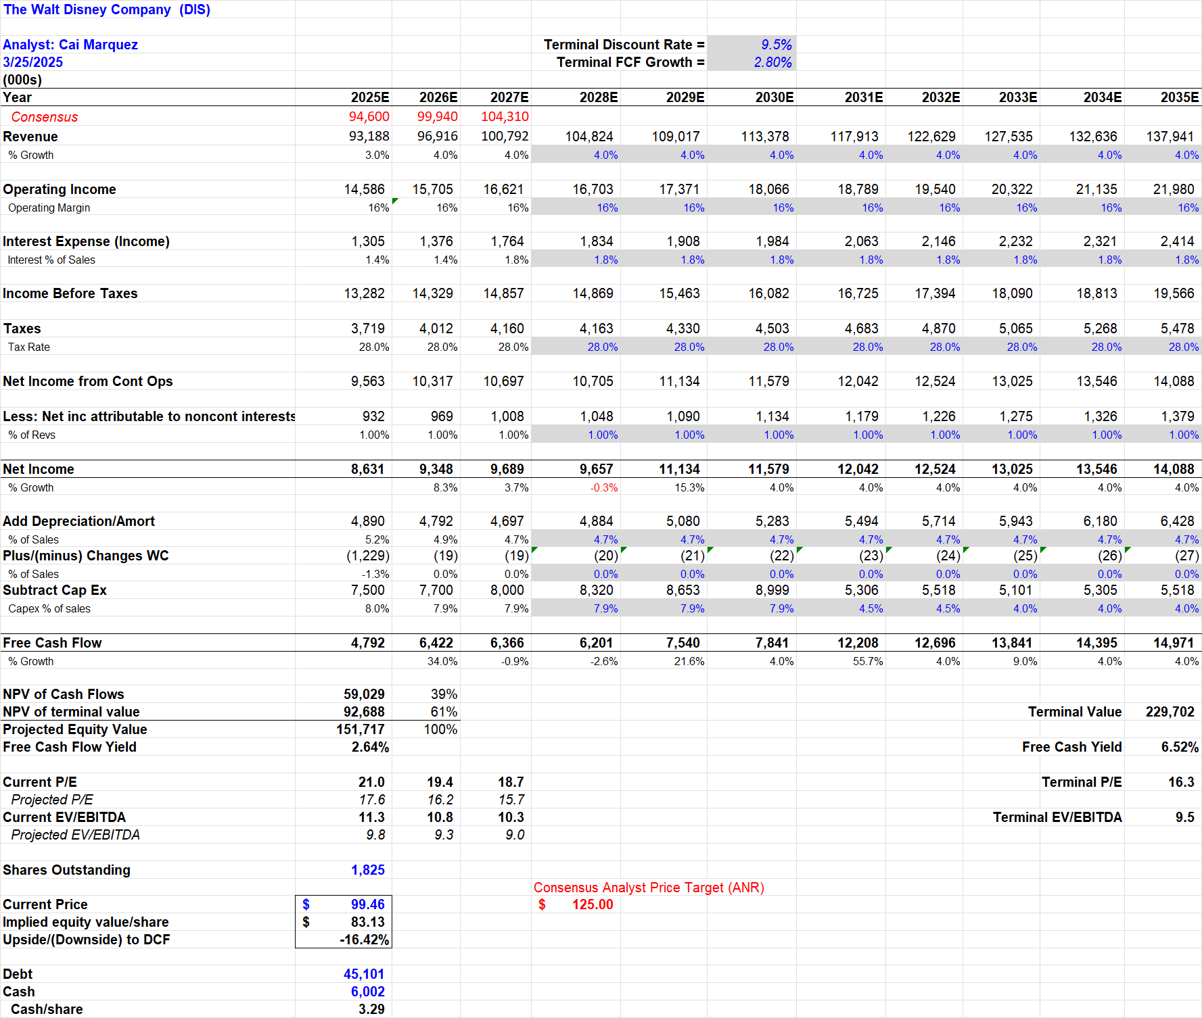
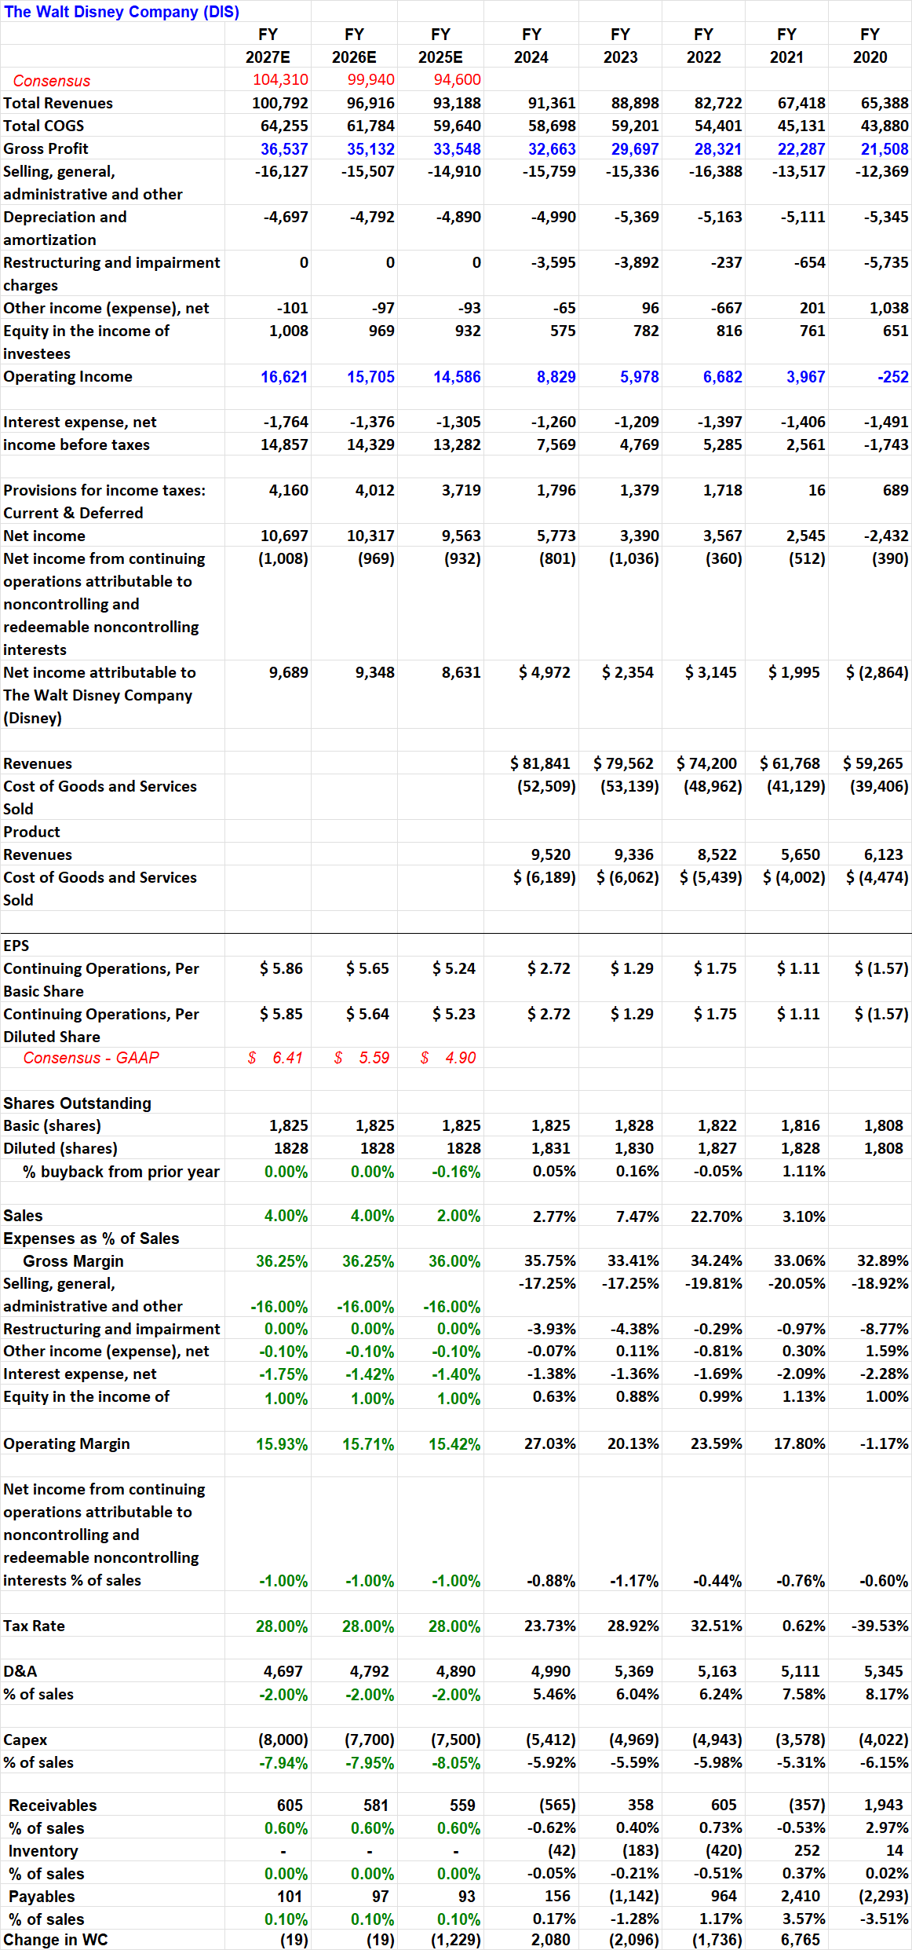
Appendix

Slide 22
Appendix

Slide 23
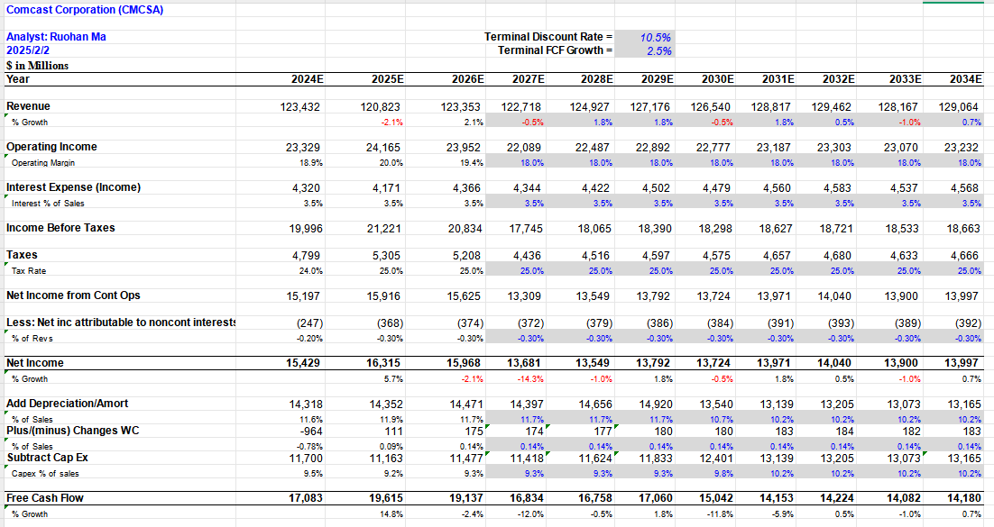
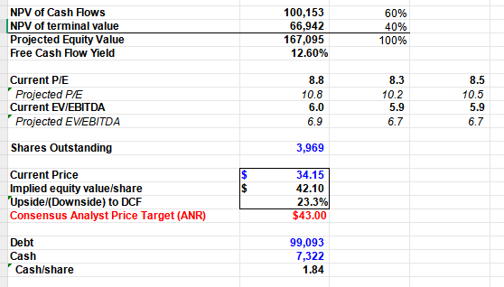
Appendix

Slide 24
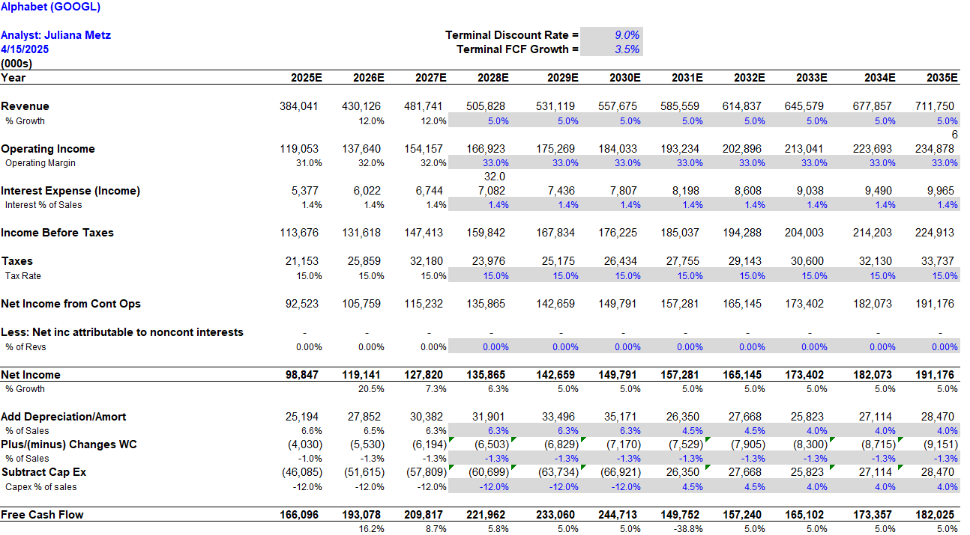
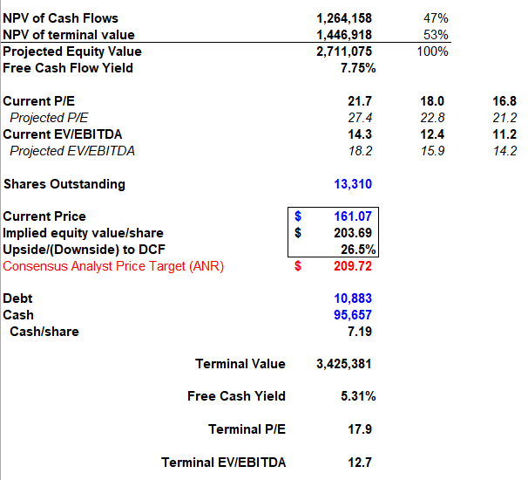
Appendix

