Slide 1
Communication Services
Juliana Metz, Cai Marquez, Ruohan Ma, and Jonny Musial

Slide 2
Agenda
Overview
Business Analysis
Economic Analysis
Financial Analysis
Valuation Analysis
Recommendation

Slide 3
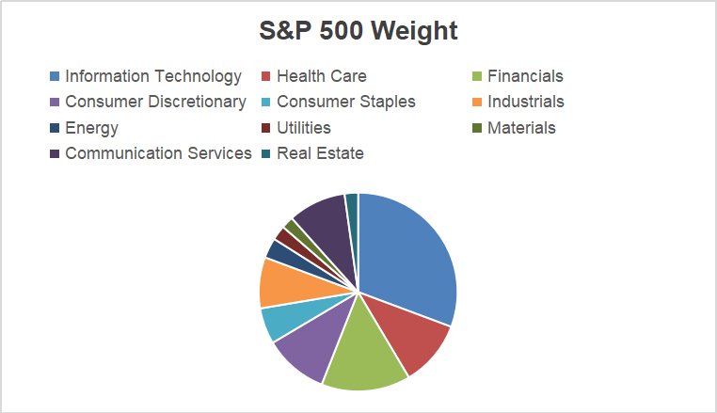
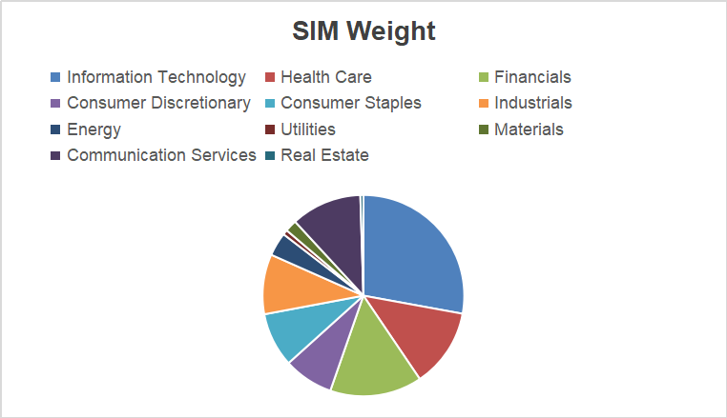
Overview
Communication Service Sector Market Cap $5.85T; 9.45% S&P and 11.36% in SIM Portfolio
Source: SIM Report February 2025

Slide 4
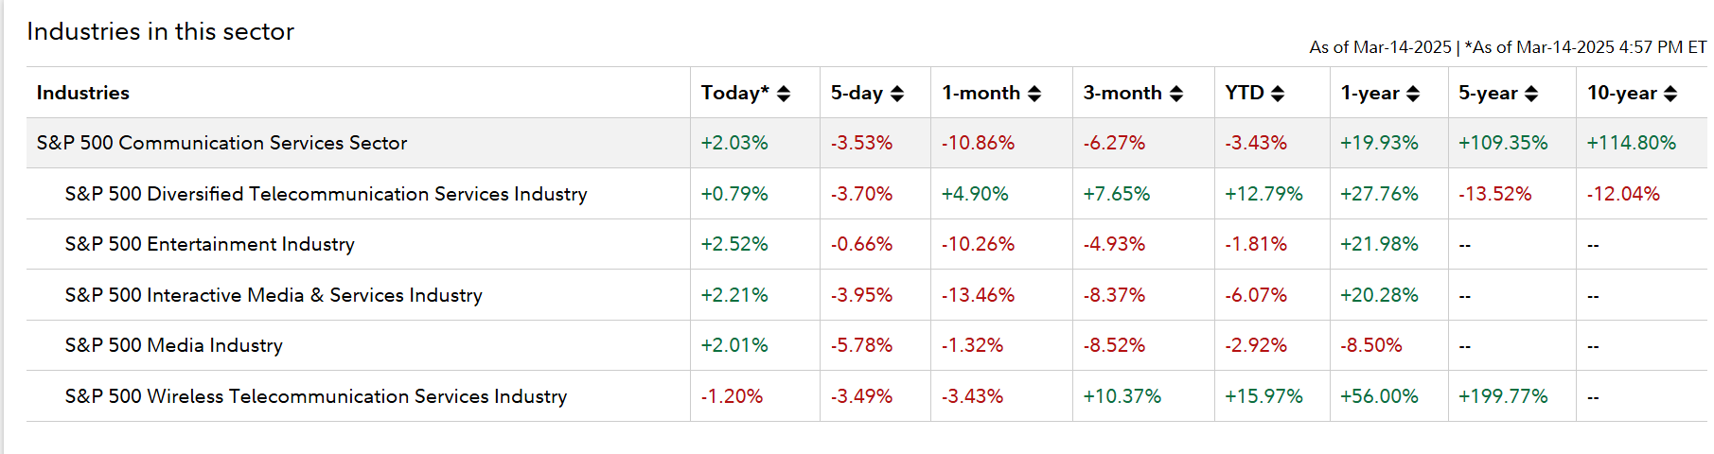
Overview
Industries in Communication Service Sector compared to S&P 500
Source: Fidelity

Slide 5
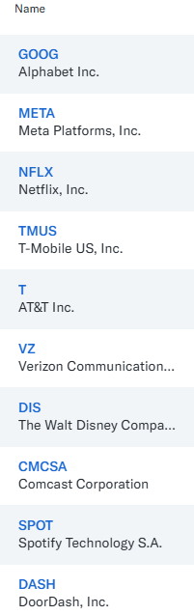
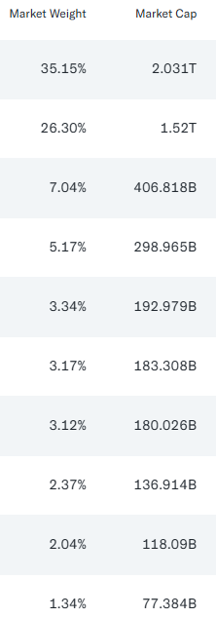
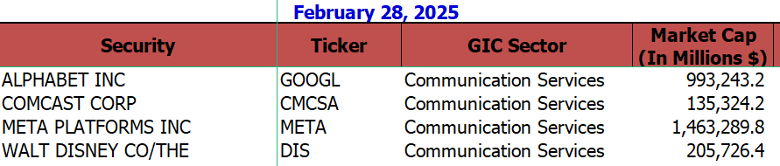



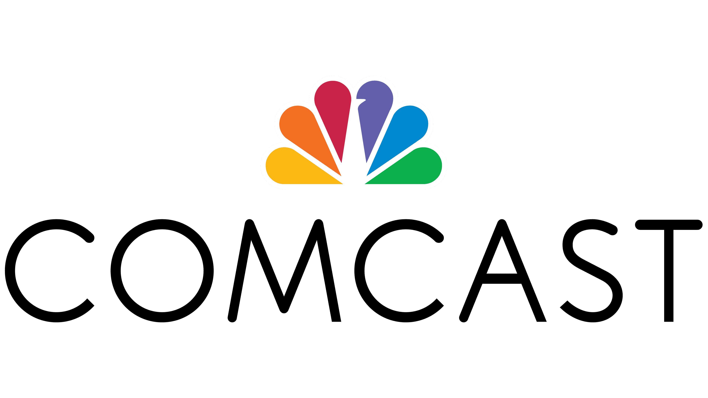

Overview
Top 10 Companies by Market Cap

Slide 6
Business Analysis

Slide 7
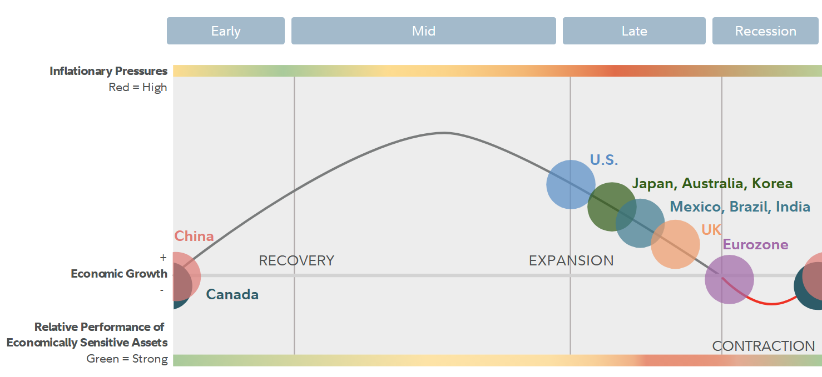
Business Analysis
Current Business Cycle Phase
Source: Fidelity
Notes:
Juliana

Slide 8
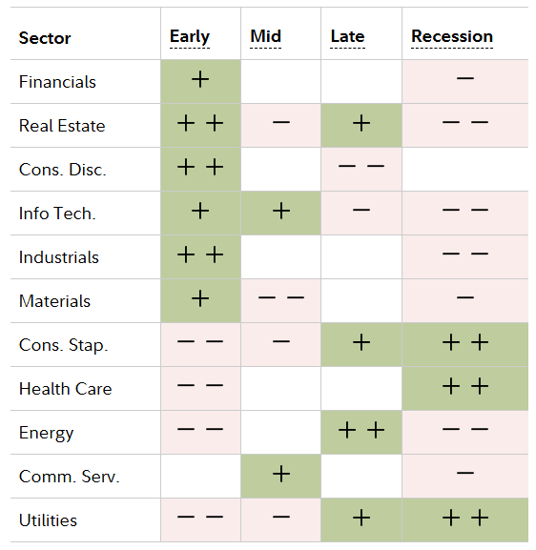

Business Analysis
Sector Life Cycle Performance by Business Cycle Phase
Comm. Service Sector (Offensive)
Not Recession-Proof: Communication services are cyclical and heavily reliant on consumer discretionary spending, which tends to decline during economic downturns.
High Competition: The sector faces intense competition from streaming platforms, telecom providers, and emerging technologies like satellite-based internet.
Volatility: The sector experiences higher volatility due to shifts in consumer preferences, technological disruptions, and regulatory pressures.
Elastic Demand: Demand for communication services is more elastic, as consumers may cut back on premium subscriptions or discretionary services during recessions.
Notes:
Juliana-While communication services thrive during early and mid-economic cycles due to innovation and growth drivers like 5G and AI, they lack the defensive qualities of sectors like healthcare or utilities during recessions.

Slide 9
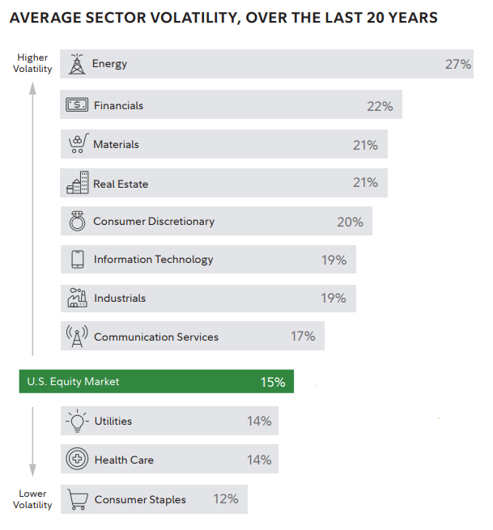

Slide 10
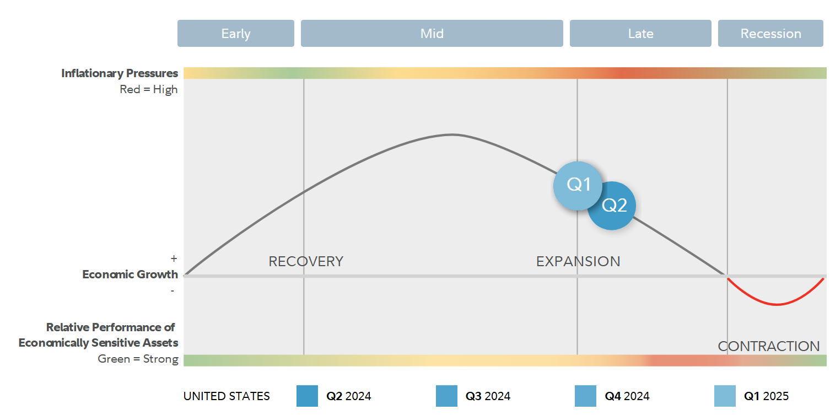
Business Analysis
Communication Service
The market appears to be in the expansion phase where the communication sector tends to perform well.
Increased demand for communication services as businesses and consumers spend more.
Notes:
Juliana

Slide 11
Business Analysis
Porter's 5 Forces
Bargaining Power of Buyers (Low to Medium):
- Inelastic demand: Consumers prioritize network reliability and speed, reducing price sensitivity. Businesses, however, have more leverage due to bulk purchasing and customization needs.
- Government influence: Subsidies and regulations (e.g., BEAD program) limit buyer power by standardizing pricing and service quality.
-Switching costs: High for residential customers due to contracts and bundled services, but lower for businesses with more flexible options.
Bargaining Power of Suppliers (Moderate):
- Specialized infrastructure dependence: While telecom giants like Verizon can choose from numerous general suppliers, they face concentrated bargaining power from key providers of 5G radios, fiber-optic components, and cloud infrastructure partnerships (Ericsson, Nokia, hyperscalers).
- Vertical integration risks: Major suppliers like chip manufacturers (Qualcomm) and tower companies (American Tower) control upstream technologies, with 30% of telecom sites globally relying on mid-band spectrum suppliers as of 2024.
Switching costs paradox: While Verizon can easily switch basic equipment suppliers, replacing specialized network components requires 6-12 months for compatibility testing and service reconfiguration.
Threat of New Entrants (Low):
- High capital requirements: Significant investments in infrastructure (e.g., fiber, 5G) deter new players.
- Industry consolidation: Dominant companies like Verizon and AT&T often acquire smaller competitors, further reducing opportunities for new entrants.
Threat of Substitutes (Medium):
- Niche alternatives: Fixed wireless access (FWA) and satellite internet (e.g., Starlink) offer alternatives but lack the reliability and speed of fiber and 5G.
- Consumer behavior: Price-sensitive customers may switch to cheaper options, but quality and reliability remain key decision factors.
Rivalry Among Competitors (High):
- Market concentration: A few dominant players (Verizon, AT&T, T-Mobile) compete intensely for market share, driving innovation and price wars.
- Switching costs: High for consumers due to contracts and bundled services, but businesses have more flexibility, increasing competitive pressure.
- Patent advantage: Premium products and services (e.g., private 5G networks) provide temporary competitive edges, but rivals quickly replicate innovations.
Notes:
This analysis highlights the communications sector’s competitive dynamics, with suppliers and buyers exerting moderate influence, high barriers to entry, and intense rivalry among established players.

Slide 12
Business Analysis
Catalyst Risk
Cybersecurity Concerns: Rising adoption of generative AI has heightened risks related to data privacy, governance, and trust, making cybersecurity the top risk for telcos in 2025.
Regulatory Challenges: Changing policies around user privacy, free speech, and antitrust issues may impact major players like Meta and Alphabet.
Skills Shortages: Talent gaps in AI expertise and culture management are inhibiting effective transformation within the sector.
Competitive Pressures: Emerging disruptors such as OpenAI are intensifying competition with innovative ad-supported business models.
Legacy System Complexity: Transitioning from outdated IT and network infrastructures poses operational challenges for telcos aiming to maximize value from new technologies.
AI Advancements: Generative AI is driving innovation in digital advertising, personalized content, and new product development, such as AI-powered tools and smart devices.
Remote Work Trends: The shift to hybrid work models has increased demand for Unified Communications as a Service (UCaaS), enabling seamless collaboration across distributed teams.
Digital Transformation: Organizations are adopting cloud-based communication solutions to replace legacy systems, enhancing scalability and operational efficiency.
5G Adoption: Wireless providers are leveraging 5G networks for improved connectivity and fixed wireless services, boosting market penetration.
Government Initiatives: Investments in digital infrastructure and policies promoting technology adoption are accelerating growth in communication services.
Notes:
Juliana put in but if anyone wants to talk on this

Slide 13
Economic Analysis

Slide 14
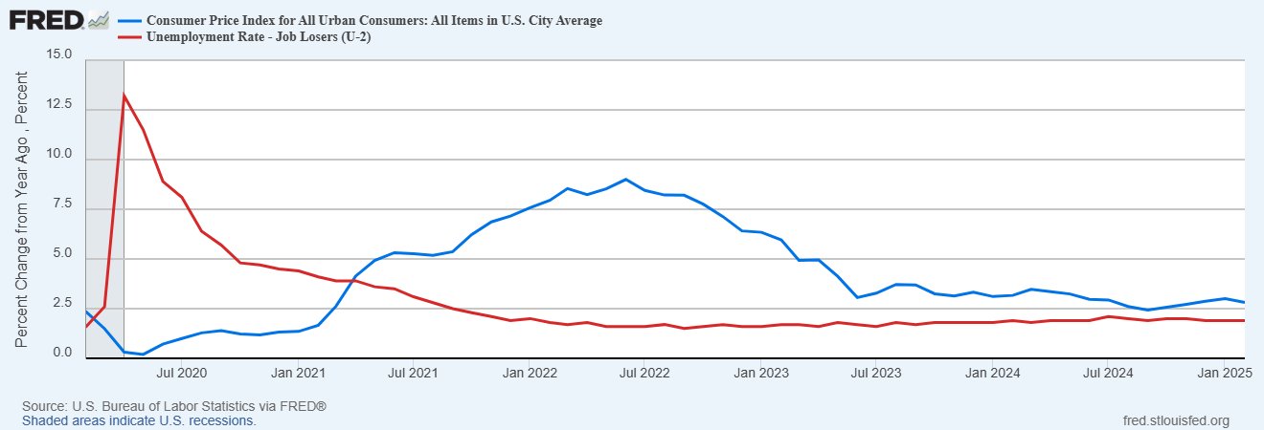
Economic Analysis

Slide 15
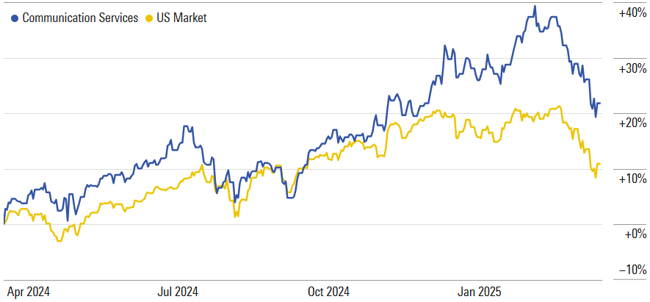
Economic Analysis
Source: yahoo!finance

Slide 16
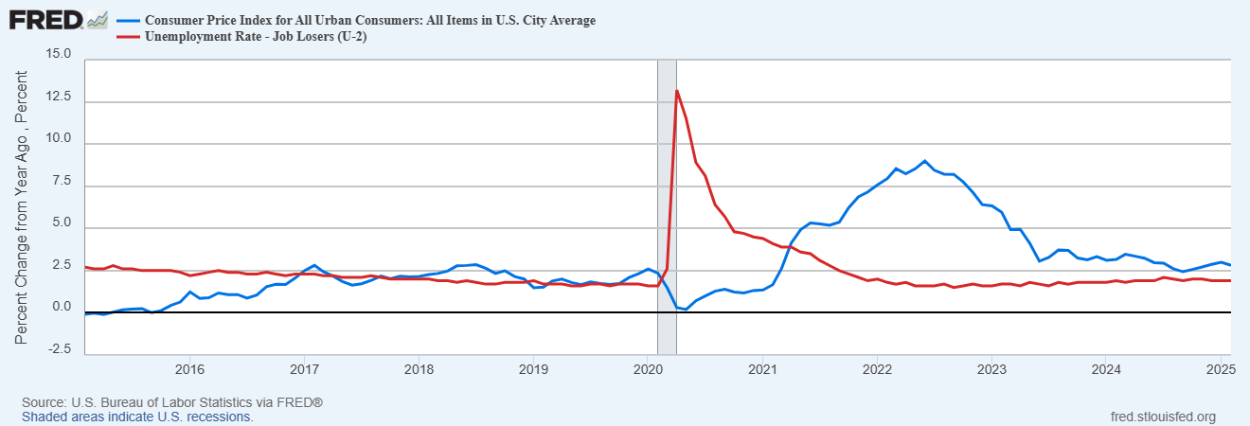
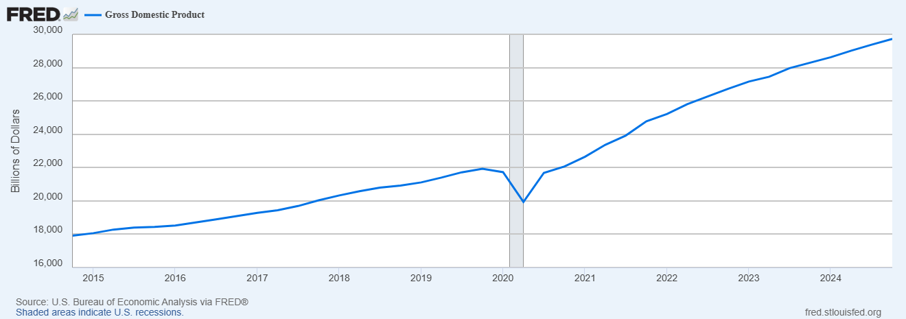
Economic Analysis

Slide 17
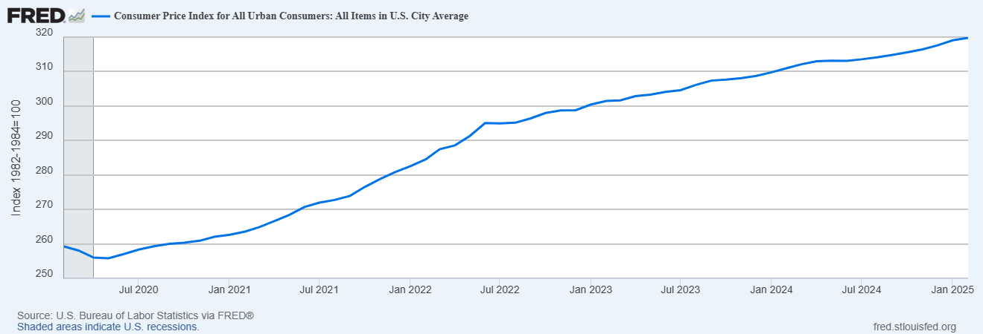
Economic Analysis

Slide 18
Financial Analysis

Slide 19
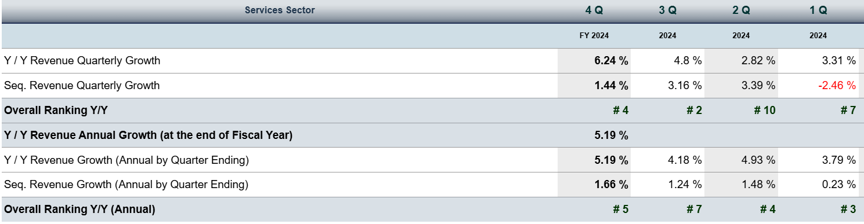
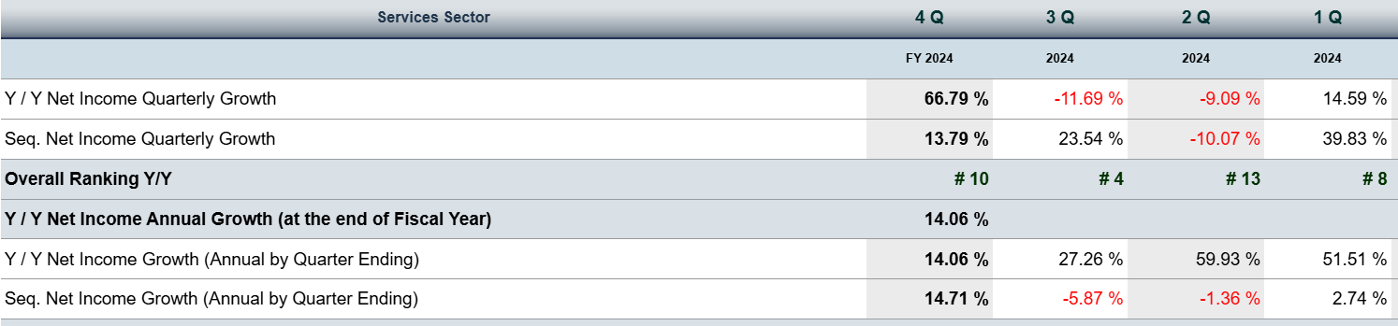
Growth Rates

Slide 20
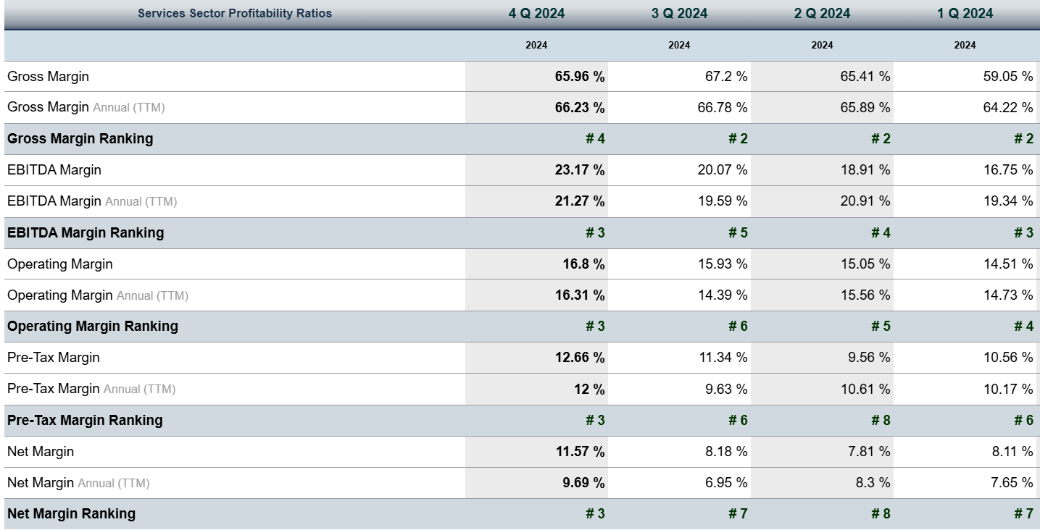
Margins

Slide 21
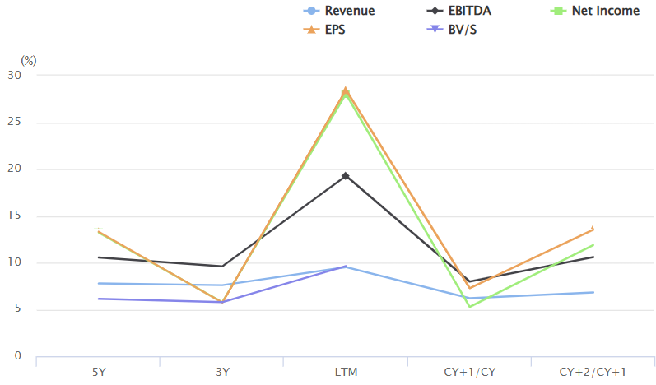
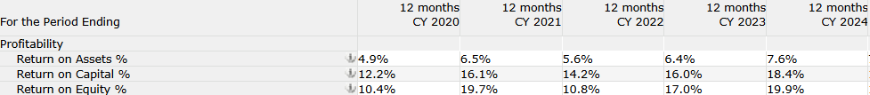
Source: NetAdvantage

Slide 22
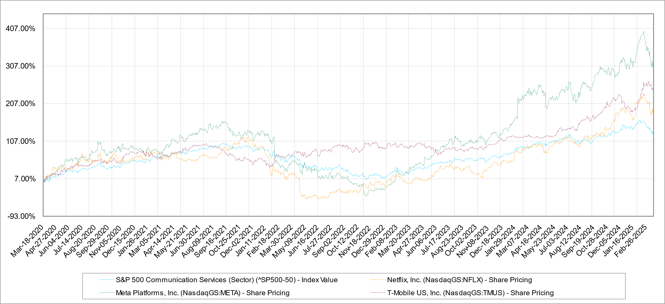

Slide 23
Valuation Analysis

Slide 24
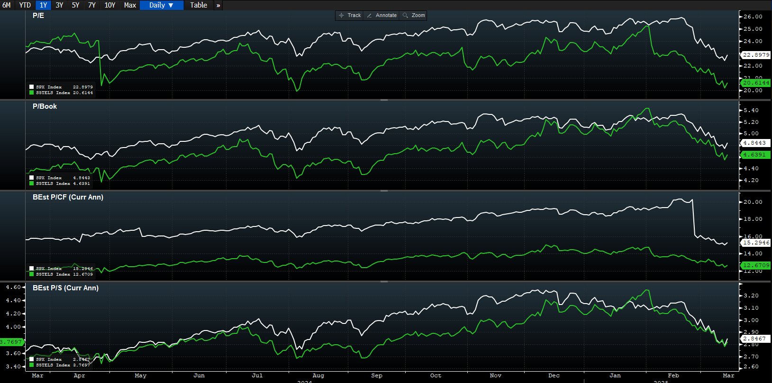
S&P 500 vs Comm.
Source: Bloomberg

Slide 25
Valuation Analysis
Company P/E ratios
Ticker | Market Cap | P/E | 10 of the largest Comm. Services P/E
GOOGL | 2.03T | 20.88 | 24.66
META | 1.54T | 25.17
NFLX | 392.68B | 46.81
TMUS | 292.26B | 25.85
T | 190.80B | 11.41
VZ | 183.42B | 9.81
DIS | 178.32B | 20.24
UBER | 149.47B | 49.74
BKNG | 146.54B | 27.32
CMCSA | 133.86B | 9.34
Source: Bloomberg

Slide 26
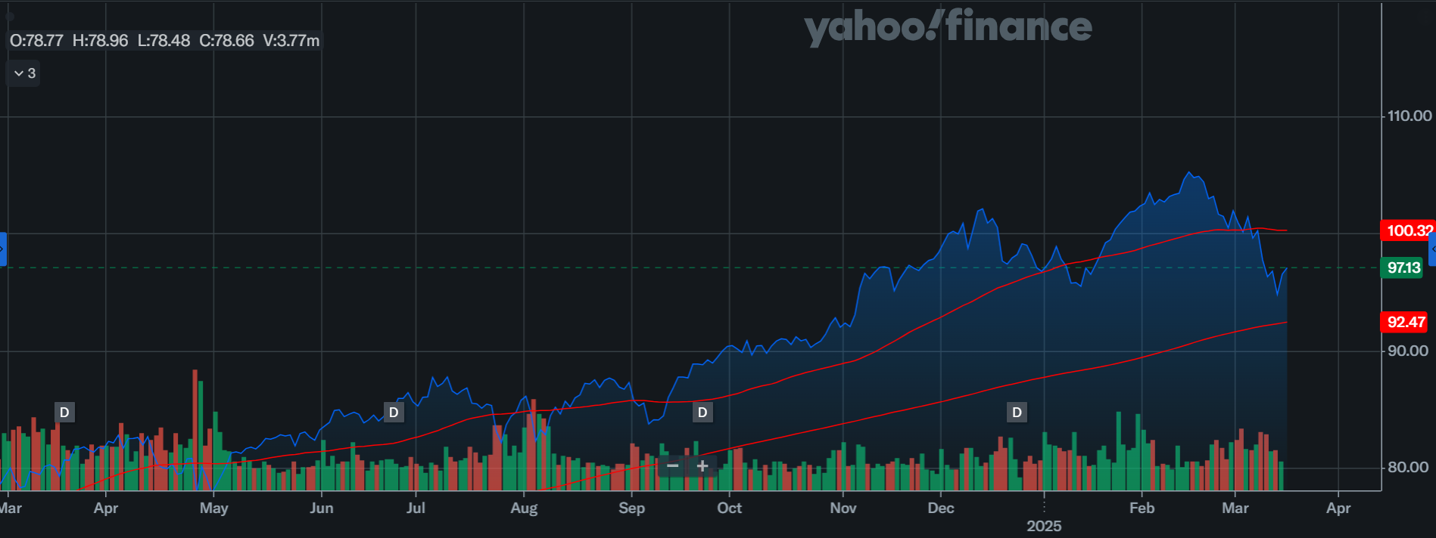
Technical Analysis: 50 Day MA vs 200 Day MA of XLC index
Source: Yahoo Finance

Slide 27
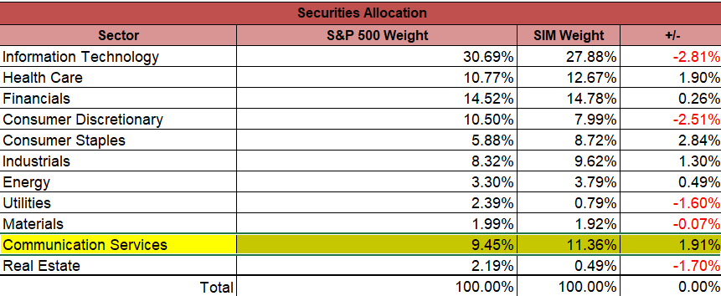
Sector Weightings

Slide 28
Holdings | Weightings
Alphabet Inc | 3.80%
Comcast Corporation | 1.72%
Meta Platforms | 2.93%
The Walt Disney Company | 2.90%
Sector Weighting: | 11.36%

Slide 29
Recommendation
Communication services sector is currently overweighted in the SIM portfolio by 191 basis points.
We recommend to maintain the holdings in this sector. We believe that the sector will perform well based off the growth prospects due to the development of technologies such as 5G, cloud computing and AI.
Risk: Decreases in consumer spending, competition, timing and regulatory issues.

