Slide 2
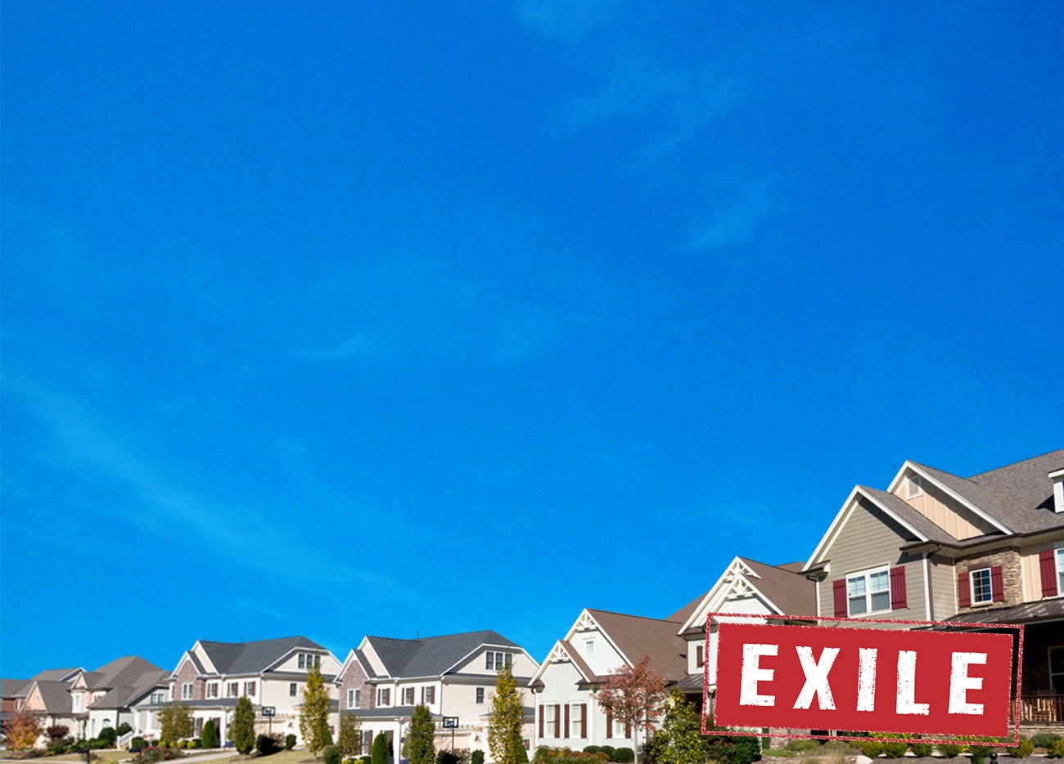
Old Testament
Genesis
Exodus
Leviticus
Numbers
Deuteronomy
LAW

Slide 3
Old Testament
PROPHETS
Joshua
Judges
Samuel
Kings
Isaiah
Jeremiah
Ezekiel
Hosea
Joel
Amos
Obadiah
Jonah
Micah
Nahum
Joel
Amos
Obadiah
Jonah
Micah
Nahum
Habakkuk
Zephaniah
Haggai
Zechariah
Malachi

Slide 4
Psalms
Proverbs
Job
Song of Songs
Ruth
Lamentations
Old Testament
WRITINGS
Ecclesiastes
Esther
Daniel
Ezra
Nehemiah
Chronicles

Slide 5
Old Testament
Law: This is how to live. God is just.
Prophets: You aren’t following the Law! Come back to God! Here are the consequences if you don’t…
Writings: People’s RESPONSE to God’s Law and God’s prophets.

Slide 7
Ecclesiastes 1:1-2
“The words of the teacher, son of David, king in
Jerusalem.”

Slide 8
Ecclesiastes 1:1-2
“The words of the teacher, son of David, king in
Jerusalem.”
“Meaningless, meaningless, Utterly meaningless. Everything is meaningless.”

Slide 9
Ecclesiastes 1:13
“I applied my mind to study and to explore by
wisdom all that is done under the heavens…

Slide 10
Ecclesiastes 2:10
“I denied myself nothing my eyes desired;
I refused my heart no pleasure.”

Slide 11
Ecclesiastes 2:17-20
“So I hated life, because the work that is done under the sun was grievous to me. All of it is meaningless, a chasing after the wind. I hated all the things I had toiled for under the sun,

Slide 12
Ecclesiastes 2:17-20
…because I must leave them to the one who comes after me. And who knows whether that person will be wise or foolish? Yet they will have control over all the fruit of my toil into which I have poured my effort and skill under the sun.
This too is meaningless. So my heart began to despair over all my toilsome labour
under the sun.

Slide 13
Ecclesiastes 2:23
“All their days their work is grief and pain; even at night their minds do not rest. This too is meaningless.”

Slide 14
Ecclesiastes 3:9-11
“What do workers gain from their toil? I have seen the burden God has laid on the human race.”

Slide 15
Ecclesiastes 3:9-11
“What do workers gain from their toil? I have seen the burden God has laid on the human race.”
“He has made everything beautiful in its time. He has also set eternity in the human heart; yet no one can fathom what God has done from beginning to end.”

Slide 16
Ecclesiastes 3:12-13
“I know that there is nothing better for them than to be happy and enjoy themselves as long as they live; moreover, it is God’s gift that all should eat and drink and take pleasure in all their toil.”

Slide 17
Ecclesiastes 12:9-13
Not only was the Teacher wise, but he also imparted knowledge to the people. He pondered and searched out and set in order many proverbs. The Teacher searched to find just the right words, and what he wrote was upright and true.

Slide 18
Ecclesiastes 12:9-13
The words of the wise are like goads, their collected sayings like firmly embedded nails—given by one shepherd.

Slide 19
Ecclesiastes 12:9-13
Be warned, my son, of anything in addition to them.
Of making many books there is no end, and much study wearies the body.

Slide 20
Ecclesiastes 12:9-13
Now all has been heard;
here is the conclusion of the matter:
Fear God and keep his commandments,
for this is the duty of all mankind.
For God will bring every deed into judgment,
including every hidden thing,
whether it is good or evil.

