Slide 1
Funding Retirement: A Global Challenge
Robert C. Merton
School of Management Distinguished Professor of Finance
MIT Sloan School of Management
August 2014

Slide 2
Challenges to Funding Retirement
Sources of potential non-sustainability of current retirement funding systems
  Shifting demographics: US, Europe, Asia populations aging rapidly
  Increasing longevity: population living longer
  Economy shift from rural agriculture toward city industrial
  Legacy of large unfunded liabilities of define-benefit and pay-as-you-go pension plans from inadequate contributions and overly optimistic return-earning assumption
  Contribution and balance sheet risks too great for plan sponsors
Only four ways to improve the chances for achieving a good retirement
  Save more for retirement and lower lifetime consumption level
  Work longer before retiring
  Take more risk and be prepared for the consequences if the risk is realized
  Improve the efficiency & effectiveness of the retirement funding system

Slide 3
Basic Implications of Increased Longevity
On average, each of us has to pay for our lifetime consumption from the years we work
Work for 40 years and live 10 years in retirement means pay for 50 years of consumption by saving 20% (neglect interest) and consuming 80%.
If life expectancy increases by 10 years and we keep the same retirement age, then we must pay for 60 years of consumption with 40 years of work by higher saving, 33% and lower consumption, 67%.
To maintain the same consumption of the prior generation, we will have to work longer. To sustain the same 80% consumption level, we would have to work 48 years (an addition 8 years) and retire for 12 instead of 20 years.
If one could earn a higher expected return on savings then expected consumption could be improved without saving more or working longer. However, if to obtain that higher expected return, one must take more risk. One must be prepared to live with the consequences if that risk is realized.
It is likely that we will work longer. Good news is that medical improvements have increased the age for which we can work. Simply raising the retirement age may have significant distributional effects on lower-income people that need to be considered.

Slide 4
Improvements to the Efficiency and Effectiveness of the System
Higher expected returns on investment for the same risk. There is no magic. We cannot dictate the risk/return tradeoff available in the market. We can however improve the chances of achieving a specific target of income by a willingness to give up the chance to have more than the target income in return for a greater chance of achieving that goal.
In conjunction with this goal-based investment strategy, we can manage better the important risks of interest rate and longevity risks as well as traditional wealth accumulation risk.
We can pay more attention to investment expenses and other friction costs.
We can try to get the most income benefits out of the assets we have.
We may need to consider making our bequest strategy to the next-generation better designed to produce the same utility with smaller bequests, or outright reduce what we leave to the next generation.
We turn now to the design criteria for a more efficient DC retirement system and possible means for improving the amount of retirement benefits from the assets we have.

Slide 5
A Good Retirement Goal is to Sustain the Standard of Living Enjoyed in the Later-Part of Work Life
Characterized by inflation-protected income for life
  Key Design Criteria:
  Set retirement replacement income goal ….and not wealth accumulation
  Offer robust, scalable low-cost investment strategies that make efficient use of all dedicated retirement assets to maximize the chances of achieving the retirement income
  Manage the shortfall risk of not achieving this goal.
  Be effective for participants who are and remain completely unengaged.
  5. Goals individually customized for each participant based on salary, age, gender, plan accumulation and other retirement-dedicated assets
  6. Integrate all sources of retirement savings into an individually tailored dynamic portfolio strategy informed by changes in market and personal conditions
  7.Provide only meaningful information and choices with easy implementation to participants who do engage
  8.Offer seamless transition at retirement from accumulation phase to post-retirement payout phase with flexible options to combine annuities, long-maturity government bond portfolio, risk asset portfolio for goal-based future real income growth, and deferred annuities which start at age 85 as “tail insurance” for longevity, according to individual retiree profile.

Slide 6
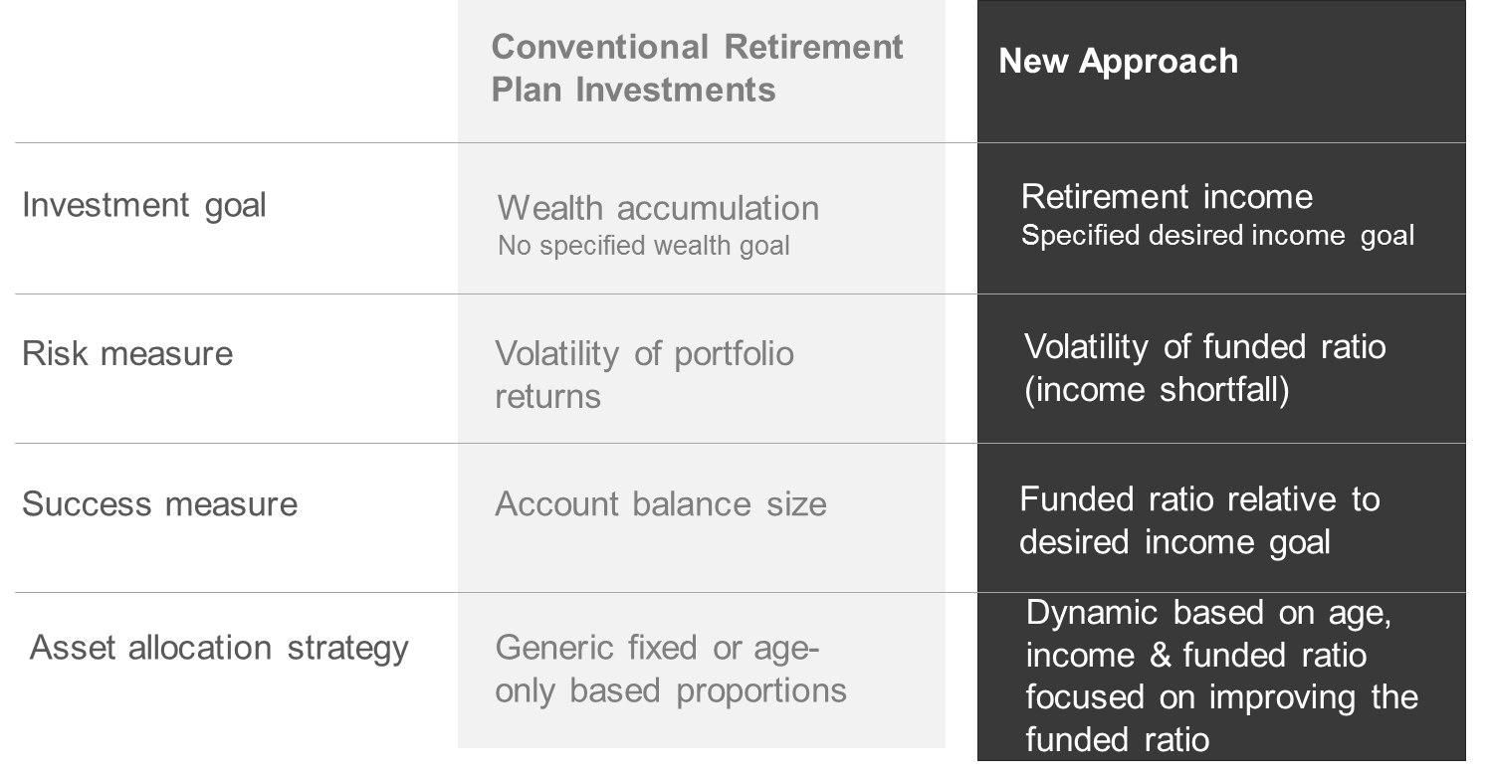
What Makes This Approach Different Than Current Practice?
Goal-based investing and focusing on what matters most: income

Slide 7
Focus on Retirement Income versus Wealth Accumulation
Interest rate changes can cause a large difference in the amount of retirement income available from a given amount of wealth. The longer the life expectancy the greater is the impact of interest rate change on cost.
In the last 4 years, long-maturity interest rates in Chile have varied between 2.37% and 3.88%. The same annuity income benefit in retirement will cost 11% more at 2.37% than at 3.88%.
Funded ratio is equal to the amount of retirement income the current accumulation could buy/ target retirement income goal. So if the target replacement income goal is 1,000 CLF and the current accumulation could buy replacement income of 700 CLF, the funded ratio =0.70. If funded ratio = 1.00, then the current accumulation can buy replacement income of 1,000 CLF and the member has reached his goal and is fully funded.

Slide 8
Effect of Interest Rate Level on Retirement Funding
Price of $100,000 per year Inflation-Protected Life Annuity Beginning at Age 65

Slide 9
Effect of Interest Rate Level on Retirement Funding
Price of $100,000 per year Inflation-Protected Life Annuity Beginning at Age 65
 | Present Value of Annuity ($ millions)
 | Real Interest Rate
Current Age | 4.13% | 1.50% | Difference in Cost (%) | 0.50% | Difference in Cost (%)
65 | $1.30 | $1.64 | 26% | $1.81 | 10%
60 | $1.06 | $1.52 | 44% | $1.76 | 16%
55 | $0.87 | $1.42 | 63% | $1.72 | 22%
50 | $0.71 | $1.31 | 86% | $1.68 | 28%
45 | $0.58 | $1.22 | 111% | $1.64 | 34%

Slide 10
Effect of Interest Rate Level on Retirement Funding
Price of $100,000 per year Inflation-Protected Life Annuity Beginning at Age 65
 | 4.1% | 0.62 | 0.69 | 0.72 | 0.79 | 0.87 | 1.00
 | 2.5% | 0.71 | 0.79 | 0.83 | 0.91 | 1.00 | 1.15
Interest Rate R | 1.5% | 0.78 | 0.86 | 0.91 | 1.00 | 1.10 | 1.26
 | 0.5% | 0.86 | 0.95 | 1.00 | 1.10 | 1.21 | 1.39
 | 0.0% | 0.90 | 1.00 | 1.05 | 1.16 | 1.27 | 1.46
 | -1.0% | 1.00 | 1.11 | 1.16 | 1.28 | 1.40 | 1.62
 |  | -1.0% | 0.0% | 0.5% | 1.5% | 2.5% | 4.1%
 |  | Interest Rate r

Slide 11
30-year UST TIPS Interest Rates 2007-2014

Slide 12
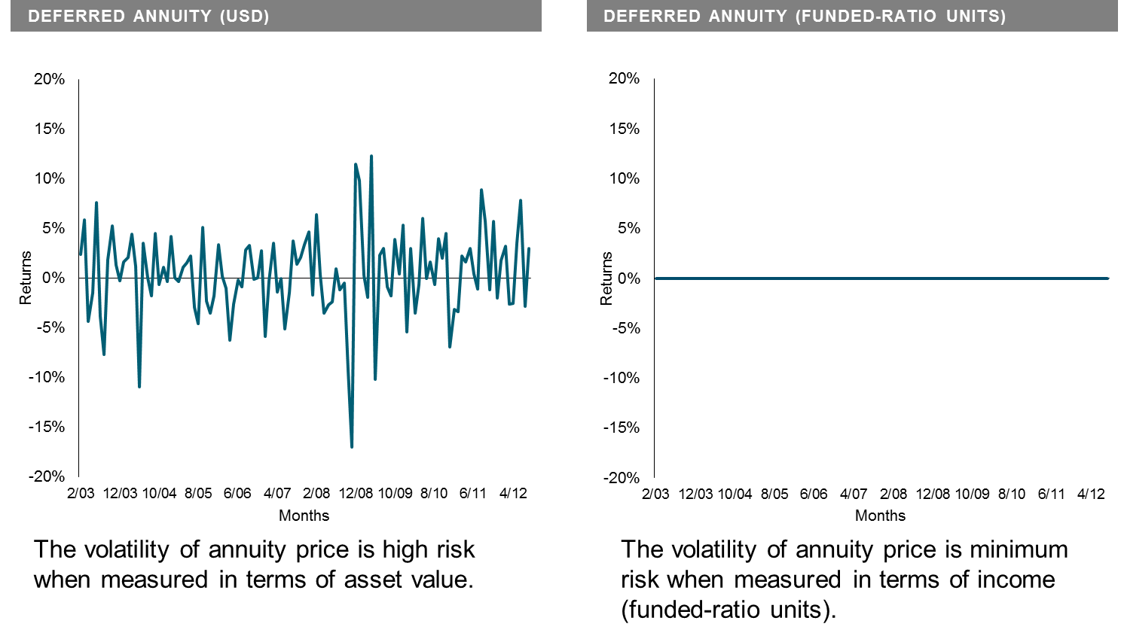
Wrong Risk Measure: Retirement Funding has an Income Goal
But DC Investing Focuses on Wealth Accumulation
Inflation-protected deferred annuity with payouts equal to targeted income for retirement
( Funded ratio = 1.00) monthly returns, if marked to market
High risk in wealth terms, minimum risk in income terms
Annuity returns based on yield from US Treasury Inflation Protected Securities (TIPS). Data provided by Bloomberg.

Slide 13
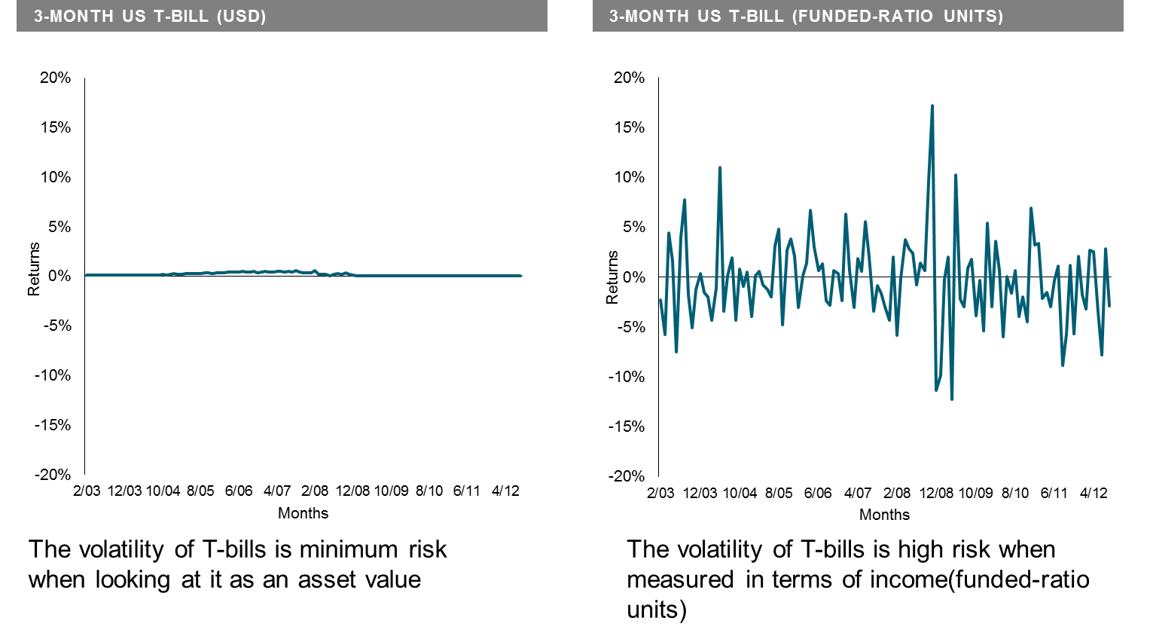
Wrong Risk Measure: Retirement Funding has an Income Goal
But DC Investing Focuses on Wealth Accumulation
90-Day US T-bill monthly returns
Wealth preservation does not mean income preservation.
Based on T-bill data provided by Bloomberg.

Slide 14
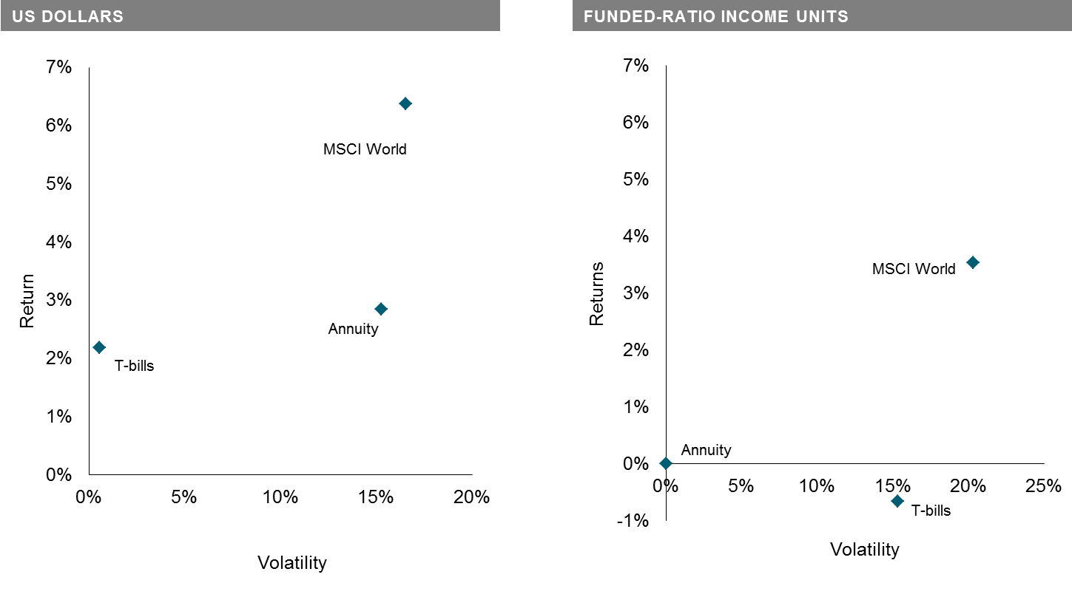
Risk & Return Wealth vs. Income Goal
Measuring the risk/return tradeoff correctly
Copyright © 2014 by Robert C. Merton

Slide 15
Interest Rate Risk to Retirees During Accumulation Phase
In the last 4 years, long-maturity interest rates in Chile have varied between 2.37% and 3.88% . If rates were 3.88%, the same annuity retirement income benefit with payments beginning at age 65 will be lower by the following, if rates were to fall to 2.37%
Age now Decline in Retirement Income (Funded Ratio)
65 - 10 %
60 - 17%
55 - 23%
50 - 29%
The average maturity of fixed income investments in Chile’s retirement funds is 5 years which is considerable lower than average maturity needed to hedge an immediate life annuity, which is around 15 years. This would suggest that managers place more emphasis on wealth [aka price] volatility than on retirement income volatility
To correct this, rules should change to report the funded ratio and its change.

Slide 16
Getting the Most from the Assets Retirees Have:
Annuities and Reverse Mortgage
Annuities including “tail-insurance” on longevity deferred to > 85 life annuity allow a larger payout for the same assets as long as one lives in return for giving up any assets at death when they are no longer needed.
Reverse mortgage integrate the house into funding as both a pre-paid specialized housing-consumption annuity and a general retirement funding asset. The house is the principal source of personal saving for middle class people and typically the largest asset at retirement.
The reverse mortgage requires no payment of either principal amount or
cumulative interest until retiree leaves the house (usually at death). It is non-
recourse and so does not jeopardize any other assets in the estate.
It is an obvious choice for someone with no bequest motive and it can be
used to create an improved bequest function over just leaving the house.
82% of senior citizens in Chile own their home.
Chile has a large annuity and mortgage market. There may however be a need to improve the reverse mortgage design to make it more effective.

Slide 17
APPENDIX
Post-retirement flexible spend-down strategies
Innovations for next-generation retirement solution
Goal-based investing can improve the chances of achieving the target income

Slide 18
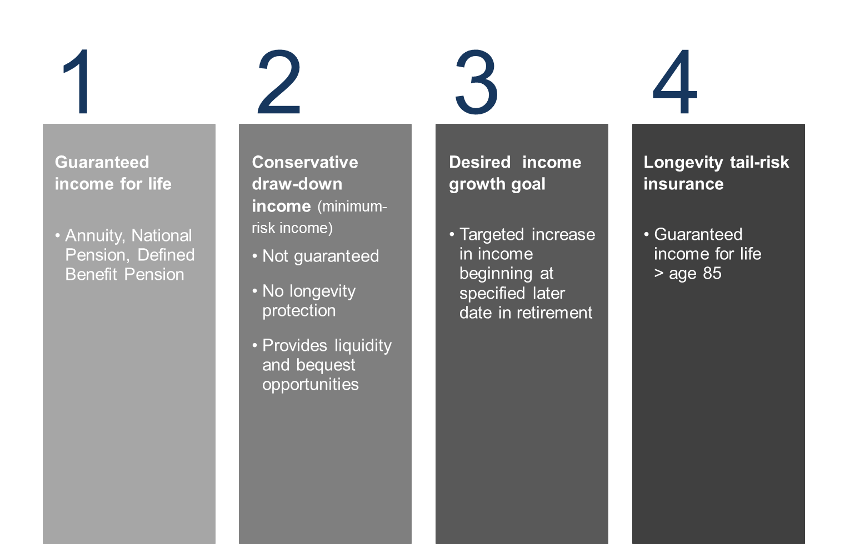
Post-Retirement Flexible Spend-Down Strategies
4 components of income provision in retirement

Slide 19
Innovations for Next-Generation Retirement Solution
House: both a pre-paid consumption and retirement-funding asset
Reverse mortgage: improved asset-use efficiency and bequest design
Interest-rate and age-dependent contribution rates to reduce member
interest rate duration mismatch risk during accumulation phase
Integration to include other retirement-dedicated assets
Product efficiency: long-term care and life annuity
Tail-Insurance on longevity: > age 85 life annuity
Standard of living risk: consumption-linked income units
Insurance companies issue globally mortality bonds based on local mortality to improve longevity risk diversification

Slide 20
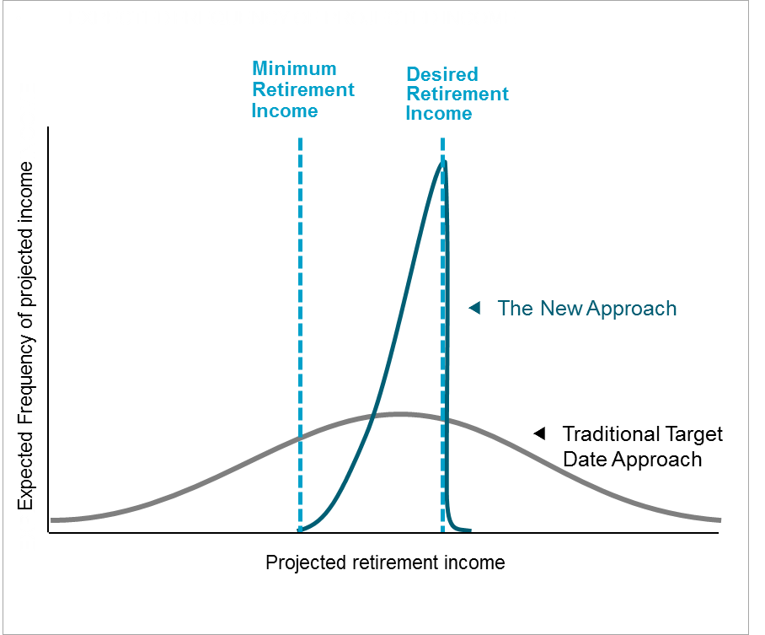
Dynamic Portfolio Strategy Focuses on the Goal
Narrows the range of targeted retirement income scenarios
  Dynamic portfolio strategy cuts off excess upside possibilities to improve chances of achieving desired income target.
  Risk-taking is greatly reduced if it is no longer deemed necessary to obtain the goal
  Seeks to maximize the chances of achieving the desired income goal, subject to a minimum funded income constraint
For illustrative purposes only. Actual probability of distributions will differ. The frequency of projected income illustrates how often an outcome occurs.

